Slide 1
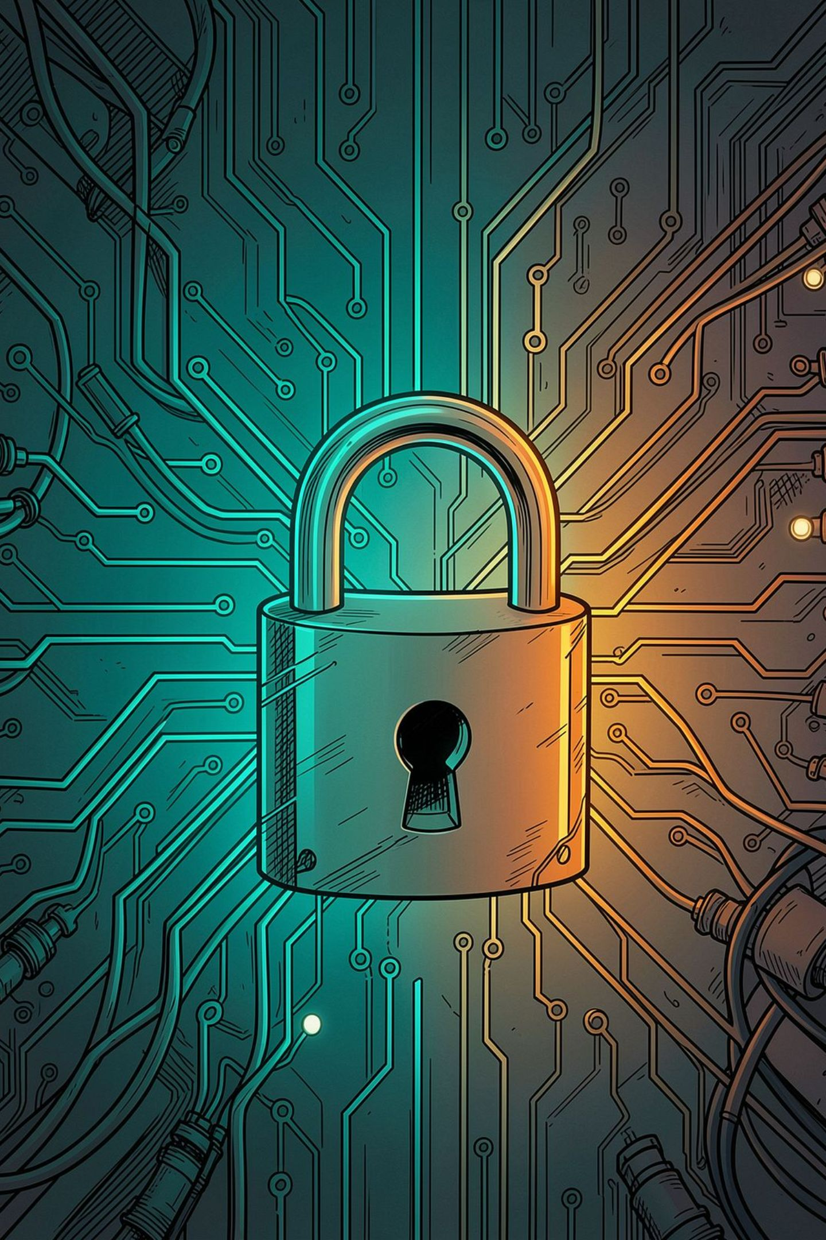
Cyber Security Essentials
Practical guidance to protect devices, networks, and sensitive data from unauthorized access, theft, and disruption.

Slide 2
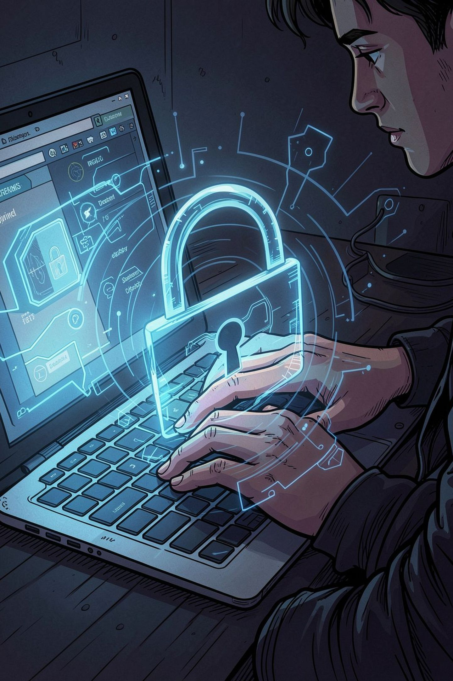
What Is Cyber Security?
Definition
Protecting devices, networks, and sensitive information from unauthorized access or attacks.
Why It Matters
Prevents data theft, financial loss, and operational disruption.

Slide 3



Common Cyber Threats
Phishing
Ransomware
Malware
Fraudulent emails or fake sites that steal credentials and payment data.
Malware that encrypts data and demands payment to restore access.
Software designed to damage, disrupt, or gain unauthorized access to systems.

Slide 4
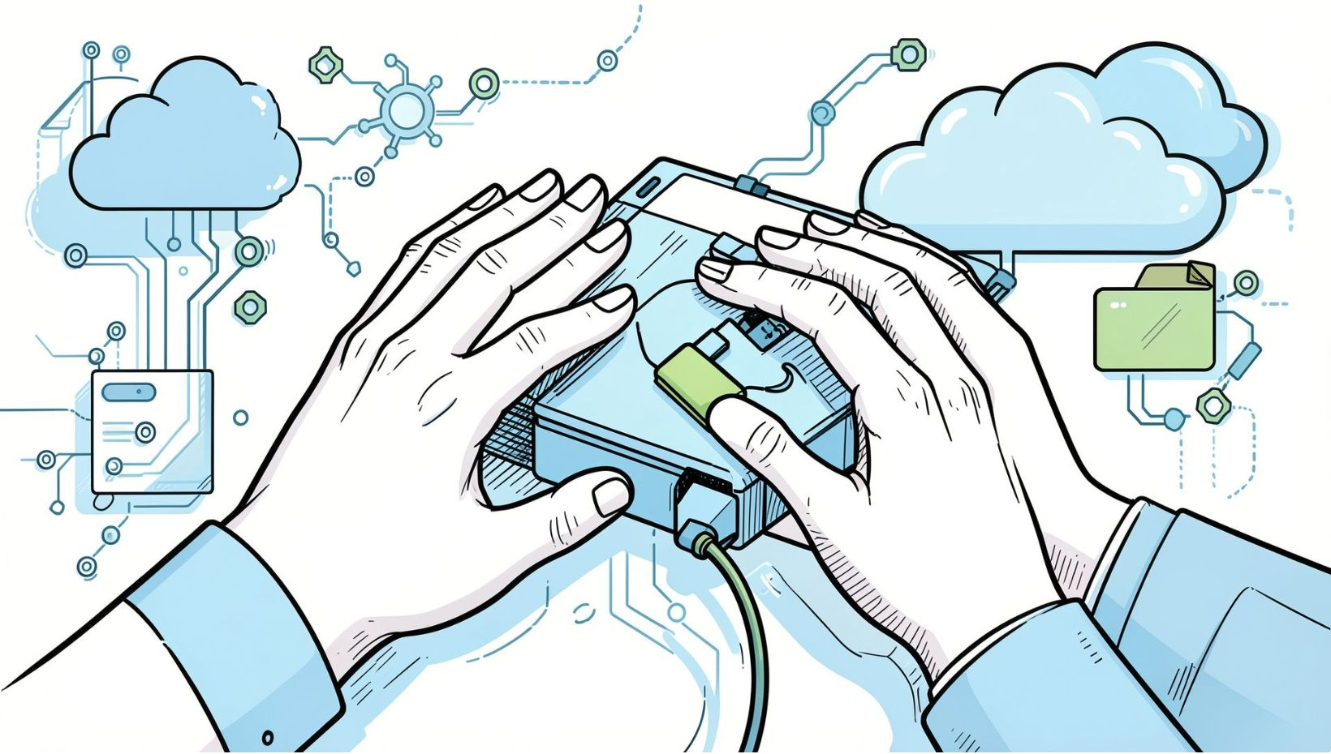
Best Practices — Core Habits
01
Keep Software Updated
Apply OS and app patches to close known vulnerabilities.
02
Use Strong Passwords
12+ characters with mixed case, numbers, and symbols; avoid reuse.
03
Limit Access
Grant sensitive-file access only to those who need it.
04
Backup Regularly
Back up to external drives or cloud (examples: iDrive, Datto).

Slide 5
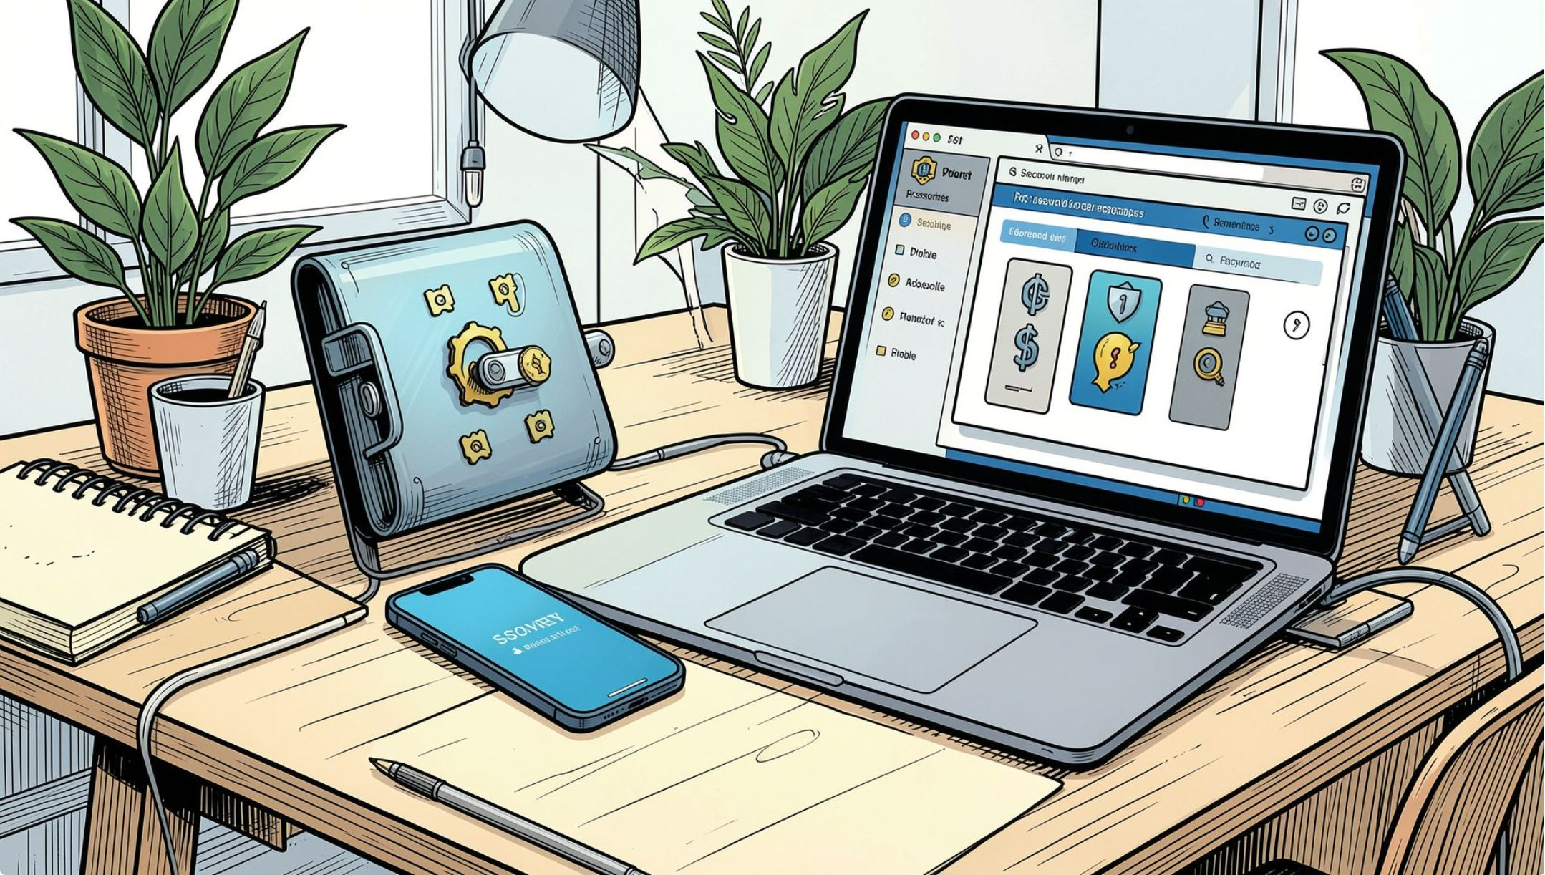
Passwords & Managers
What Makes a Strong Password
At least 12 characters, mixed case, numbers, symbols, and unique per account.
Password Managers
Generate and store complex passwords securely to avoid reuse and simplify access.
Risks of Weak Passwords
Can cause breaches, unauthorized access, and financial loss.

Slide 6

Two-Factor Authentication (2FA)
Password
Something you know
Stronger account protection
One-time code
Something you have
2FA requires two forms of ID (password + one-time code). Methods include SMS, authenticator apps, and security keys. Benefits: prevents many attacks and alerts to suspicious activity.

Slide 7
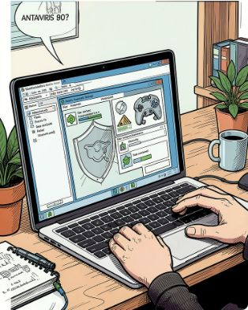
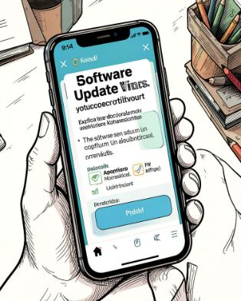
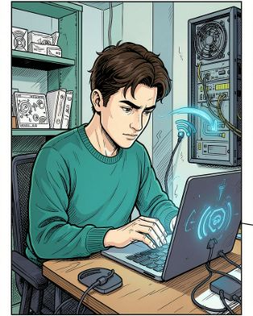
Securing Personal Devices
Use Antivirus
Keep Devices Updated
Be Wary of Public Wi‑Fi
Keep antivirus up to date and run regular scans to detect threats.
Install OS and app updates to receive critical security fixes.
Avoid sensitive transactions on public networks; use a VPN when necessary.

Slide 8
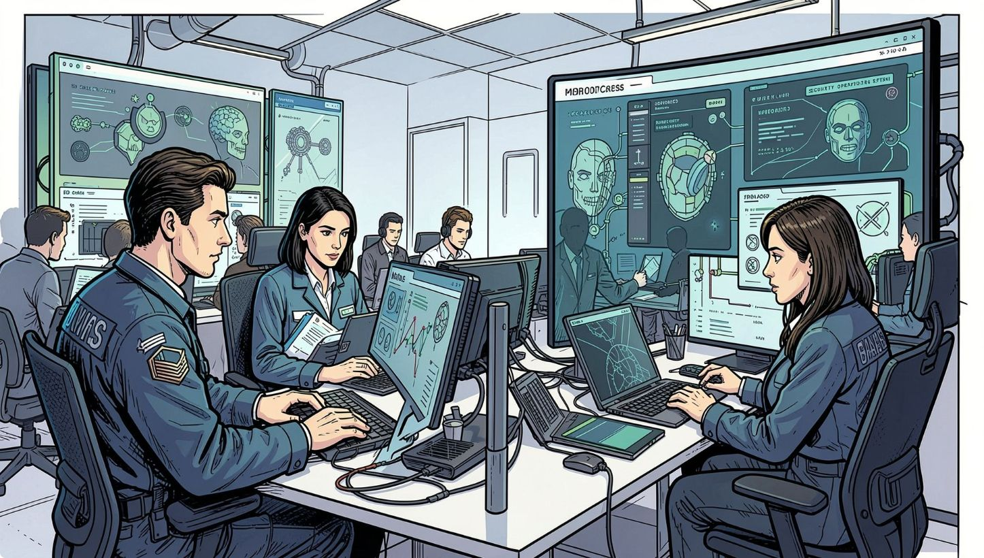
Managed Services & EDR
Technical solutions can be hard to evaluate. For small and medium businesses, use a checklist comparing EDR to traditional antivirus:
Real-time monitoring — EDR can, AV can't.
AI threat detection — EDR can, AV can't.
Process monitoring (before/during/after) — EDR can, AV can't.
Low performance impact during continuous monitoring — EDR can maintain performance; AV can slow systems.
Ransomware rollback — EDR can, AV can't.
EDR improves IT security and business continuity for growing businesses.

Slide 9


Our Offering — 2nd Chance PC
Managed Services
Why Choose Us
Domain/network admin, EDR, vendor support, help desk to keep businesses running.
35 five‑star reviews. Partnerships: Dell, Cisco, Mint, iDrive, Constant Contact, DriveSavers.

Slide 10


Takeaways & Next Steps
Stay Informed
Act Now
Get Help
Threats evolve — follow trusted sources and update policies regularly.
Use strong passwords, enable 2FA, keep systems updated, and back up data.
Consider managed EDR and professional support to improve security and continuity.
When tech fails, business stalls — invest in prevention and reliable support.

