Slide 1
PulseCheck Instant, Explainable Credit Risk Scoring
Team Members:
Lina El-Husseini
Meghna Ganesh Kumar
Murughanandam Sivasubramanian
Pravin Kumar Rajak
Sarfraz Nawaz
Course: MSDS 422: Practical Machine Learning
Northwestern University
GitHub: https://github.com/Pravin971/PulseCheck-Credit-Risk-Scoring#
Date: 22 August 2025

Slide 2
Agenda
Problem Definition
Literature survey
Data
EDA
Model architectures
Model training and testing
Result analysis
Model optimization
Results analysis and conclusions
Q&A

Slide 3



Problem Statement
The Problem:
Traditional credit scoring is slow and outdated (rely on fixed rules)
Fails to capture the dynamic nature of credit behavior.
Leads to missed lending opportunities and increased default risks.
A need for fast, reliable, and explainable real-time decisions.
The solution must enhance user experience and ensure regulatory compliance
Our Solution:
Develop a machine-learning powered, real time credit risk scoring system
Key Features:
Instant predictions
Interactive, user-friendly web interface using Streamlit.
Interpretable explanations for each decision to build trust and ensure accountability.

Slide 4
Literature Survey
The project is grounded in established research in 3 main areas:
Credit Scoring: statistical classification methods for consumer credit scoring, highlighting the challenges of traditional approaches in a digital age. (Hand and Henley 1997; Lessmann et al. 2015)
Earlier models such as Logistic Regression provided clear probabilistic output that was easy to interpret but struggled with complexity
Later research introduced more powerful but less interpretable models like Random Forest and Gradient Boosting - higher accuracy
Model Interpretability: A growing demand for transparent AI. The importance of understanding model predictions has led to the development of techniques that move beyond "black box" models which is crucial for helping stakeholders understand the rationale behind each decision, thereby improving trust, user adoption and ensures accountability. (Lundberg and Lee 2017)
Real time deployment: Today’s digital economy needs instant decisions. Streamlit used as a proxy - a lightweight and efficient framework

Slide 5
Data - The foundation
Dataset: Credit Risk Dataset (~32.5K records)
Source: Kaggle https://www.kaggle.com/datasets/laotse/credit-risk-dataset?resource=download
Features (12 features):
Demographics such as age & home ownership status
Borrower Income
Loan attributes - (debt to income ratio, interest rate, loan amount)
Credit default history & length
Employment status
Borrowing purpose
Target Variable: loan_status, a binary classification (0 = non-default, 1 = default)

Slide 6
Understanding the Dataset Structure
Borrower Information - the applicant
Loan Characteristics - the loan itself
Credit History - past behavior
Loan percent of income (0%-83%)
Age (20-144 years)
Loan intent (medical, education, etc.)
Previous defaults (Y/N)
Income ($4K-$6M)
Loan grade (A through G)
Credit history length (2-30 years)
Home ownership status
Loan amount ($500-$35,000)
Loan status (target: default or not)
Employment length (0-123 months)
Interest rate (5.42%-23.22%)
crucial for understanding their financial profile
helps us understand the specifics of the lending request
vital for assessing past behavior

Slide 7
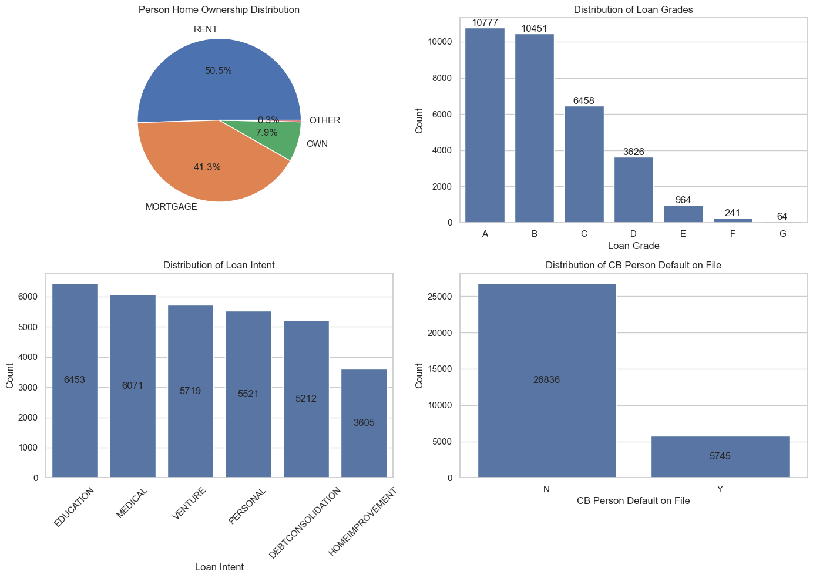

Slide 8
Exploratory Data Analysis (EDA)

Slide 9

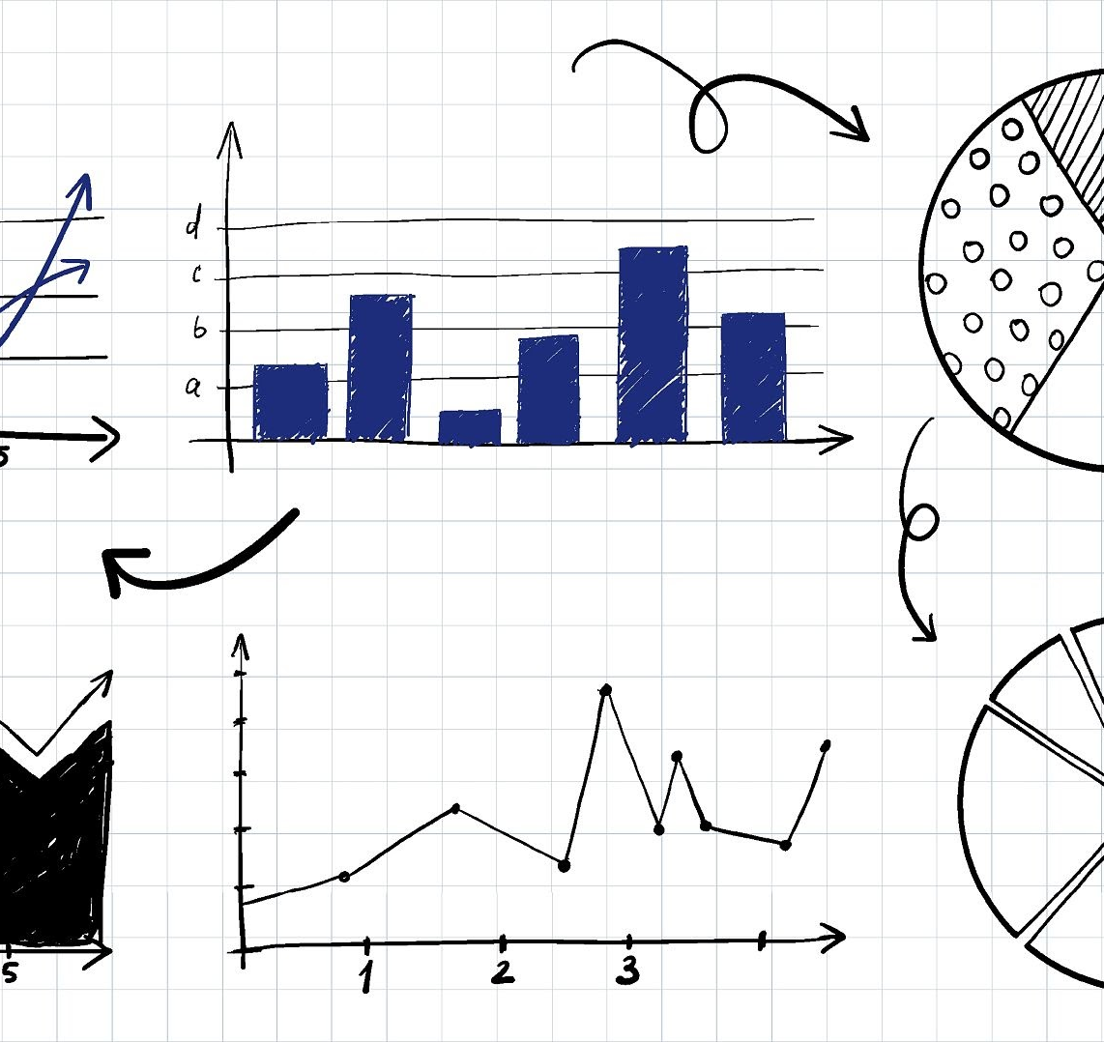

EDA Framework & Class Imbalance
Dataset Characteristics
EDA Framework
32,581 total loan applications
12 features (mix of numeric and categorical)
Handling Outliers and Missing Values
Class Imbalance: 21.8% default vs. 78.2% repaid
Identify and handle missing data points
Handling Imbalance
Exploratory Analysis
Focus on F1-score and ROC-AUC metrics
Analysis and Insights
Feature Engineering
Create new predictive variables
Notes:
Recognizing the Imbalance
Dataset has 21.8% defaults vs. 78.2% repaid → this is a significant imbalance, and you’ve highlighted it upfront.
Strategic Sampling Techniques
Using oversampling (SMOTE, ADASYN) or undersampling to balance classes is a good practice.
These prevent the model from being biased toward the majority class (repaid loans).
Class Weight Adjustments During Training
Assigning higher weight to the minority class (defaults) during training makes the model pay more attention to predicting defaults.
This is often better than only resampling since it preserves data distribution.
Evaluation Metrics (F1 & ROC-AUC)
Accuracy is misleading in imbalanced datasets (e.g., predicting all “repaid” gives ~78% accuracy but zero value).
Focusing on F1-score (balance of precision & recall) and ROC-AUC ensures fair evaluation.

Slide 10
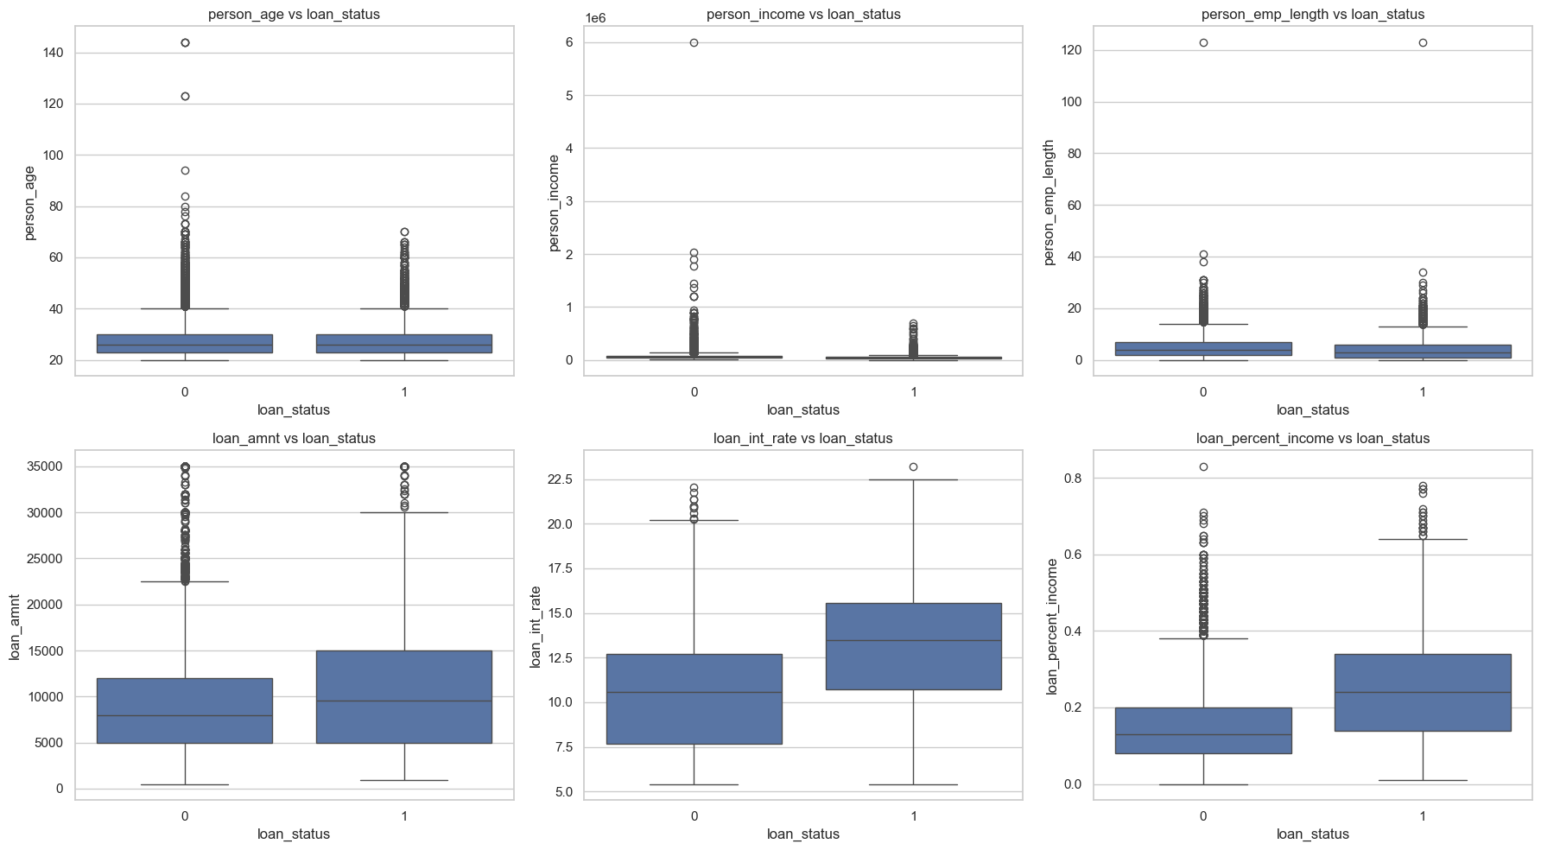
Outliers
Data-entry errors likely in age and employment length. => Cleaned and Capped (Age)
True but extreme outliers exist in loan_int_rate and loan_percent_income. => Kept, as they capture risky behavior.
Scale distortion in income and loan amount. => Applied log transform or capping.
Outlier treatment is not about blindly removing data, it’s about balancing data quality vs preserving signal for credit risk.
Notes:
Data Quality Issues: Extreme outliers in age, income, and employment length suggest errors or skew that must be cleaned or transformed.
Income & Employment: Higher income and longer employment history are associated with better loan approval chances.
Loan Characteristics: Approved loans often have slightly higher amounts and interest rates, showing lenders balance risk with pricing.
Debt-to-Income Ratio: A critical risk factor; higher ratios are linked to approvals, but extreme cases (>0.8) are concerning.
Overall Pattern: Loan approval is multifactorial—no single feature dominates; lenders weigh combinations of income, loan amount, and risk ratios.
Data Quality Issues: Extreme outliers in age, income, and employment length suggest errors or skew that must be cleaned or transformed.
Income & Employment: Higher income and longer employment history are associated with better loan approval chances.
Loan Characteristics: Approved loans often have slightly higher amounts and interest rates, showing lenders balance risk with pricing.
Debt-to-Income Ratio: A critical risk factor; higher ratios are linked to approvals, but extreme cases (>0.8) are concerning.
Overall Pattern: Loan approval is multifactorial—no single feature dominates; lenders weigh combinations of income, loan amount, and risk ratios.
1. Person Age vs Loan Status
Distribution of age looks similar between approved and not approved groups.
Most applicants are between 20–50 years.
Some extreme outliers above 100 years may be data quality issues (unrealistic ages).
Insight: Age does not appear to be a strong differentiator of loan approval, but unrealistic outliers should be cleaned.
2. Person Income vs Loan Status
Majority of incomes are clustered at the lower end, with a few extreme high-income outliers (up to tens of millions).
Median income is slightly higher for approved loans.
Insight: Higher income improves approval chances, but presence of extreme outliers indicates skewed distribution that should be normalized/log-transformed for modeling.
3. Employment Length vs Loan Status
Most applicants have shorter employment histories (close to 0–10 years).
Median employment length is slightly higher for approved loans.
Outliers above 100 years are unrealistic and need correction.
Insight: Employment stability improves approval likelihood, but again data cleaning is needed.
4. Loan Amount vs Loan Status
Loan amounts are right-skewed; most are below 20,000, with outliers reaching 35,000+.
Approved loans have slightly higher median amounts than rejected ones.
Insight: Larger loan requests can still be approved if other conditions (income, credit) are favorable.
5. Loan Interest Rate vs Loan Status
Interest rates range between ~5%–25%.
Approved loans tend to have slightly higher interest rates.
Insight: Lenders may approve riskier loans by compensating with higher interest, balancing their exposure.
6. Loan Percent Income vs Loan Status
This feature (loan amount ÷ income) is a critical risk measure.
Median debt-to-income ratio is noticeably higher in approved loans.
Extreme outliers exist (>0.8, meaning loan exceeds 80% of income).
Insight: Despite higher ratios being riskier, lenders are approving some loans with high debt-to-income ratios—possibly offset by other strong factors (like collateral or credit score).
Overall Insights
Data Quality Issues: Outliers in age, income, and employment length suggest errors or extreme skew that must be cleaned or winsorized before analysis.
Key Predictors:
Income and employment length → positive effect on approvals.
Debt-to-income ratio → critical risk indicator.
Loan amount and interest rate → approved loans skew slightly higher.
Approval Pattern: Approvals are not strictly conservative (e.g., approving higher debt-to-income cases), suggesting a multifactor decision process beyond just one feature.
Data Quality Issues: Extreme outliers in age, income, and employment length suggest errors or skew that must be cleaned or transformed.
Income & Employment: Higher income and longer employment history are associated with better loan approval chances.
Loan Characteristics: Approved loans often have slightly higher amounts and interest rates, showing lenders balance risk with pricing.
Debt-to-Income Ratio: A critical risk factor; higher ratios are linked to approvals, but extreme cases (>0.8) are concerning.
Overall Pattern: Loan approval is multifactorial—no single feature dominates; lenders weigh combinations of income, loan amount, and risk ratios.

Slide 11
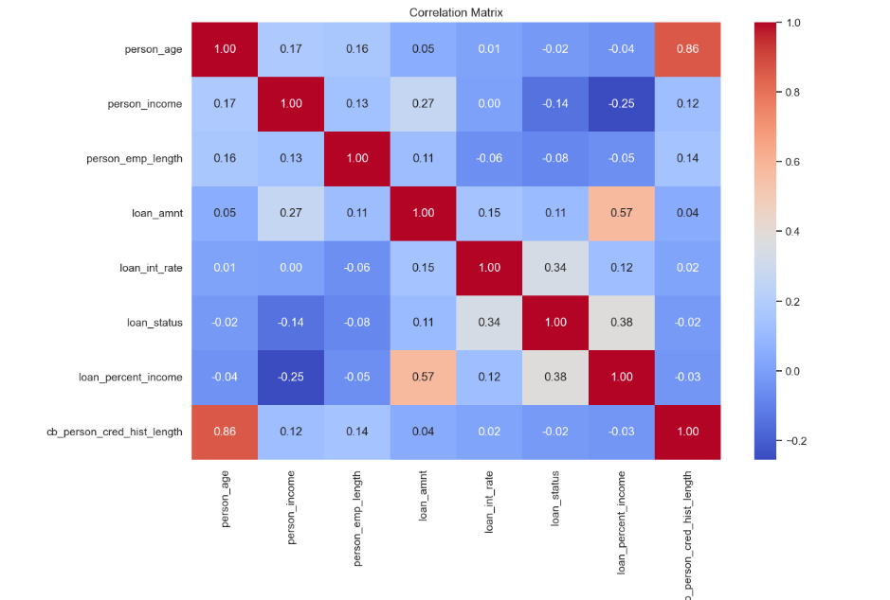
Correlation Analysis
Loan approval decisions are driven primarily by repayment capacity (loan-to-income ratio) and interest rate, with income playing a secondary role. Age, employment length, and credit history length have minimal impact, indicating lenders prioritize financial capacity over personal background factors.
Notes:
Key Observations from Correlation Analysis
Strong Correlations
person_age ↔ cb_person_cred_hist_length (0.86)
As expected, older applicants tend to have longer credit histories.
This is almost redundant information — one of these variables may be dropped to avoid multicollinearity.
loan_amnt ↔ loan_percent_income (0.57)
Larger loan amounts naturally increase debt-to-income ratio.
Shows strong dependency, but loan_percent_income is the more normalized, risk-relevant feature.
Moderate Correlations with Loan Status
loan_status ↔ loan_int_rate (0.34)
Higher interest rates correlate with higher chance of default.
Lenders may charge higher rates to riskier applicants, but this also leads to repayment stress.
loan_status ↔ loan_percent_income (0.38)
Higher debt-to-income ratio → higher probability of default.
This confirms it is a critical predictive variable.
loan_status ↔ loan_amnt (0.13)
Weak correlation, but still suggests that higher loan amounts slightly increase default risk.
Weak/Negligible Correlations
person_income vs loan_status (-0.16)
Slightly negative relationship: higher income borrowers are less likely to default, but the effect is weak.
person_emp_length vs loan_status (0.11)
Very weak correlation — employment length alone is not a strong predictor.
🔹 Insights
Top Risk Indicators:
Debt-to-income ratio (loan_percent_income) and interest rate (loan_int_rate) are most strongly linked to defaults.
These features should be prioritized in modeling and feature engineering.
Multicollinearity Risk:
person_age and cb_person_cred_hist_length are highly correlated → consider dropping or combining into a stability index.
Weak Predictors:
Employment length and income, while important contextually, show weak correlation individually with loan default.
They may still add value in nonlinear models (e.g., decision trees, ensembles) when interacting with other variables.
Strategic Use:
Instead of raw loan amount, loan_percent_income should be used — it provides a relative affordability measure.
Higher interest rates combined with higher debt ratios could signal high-risk profiles.

Slide 12
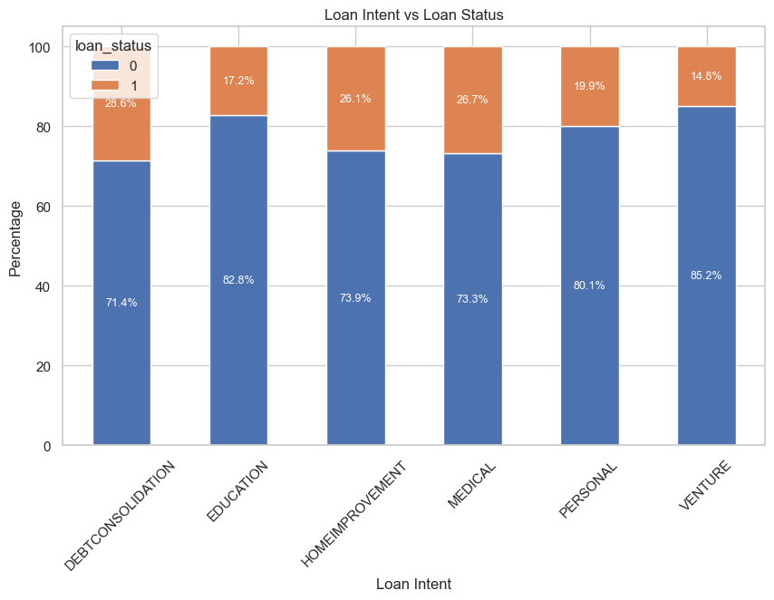

Slide 13
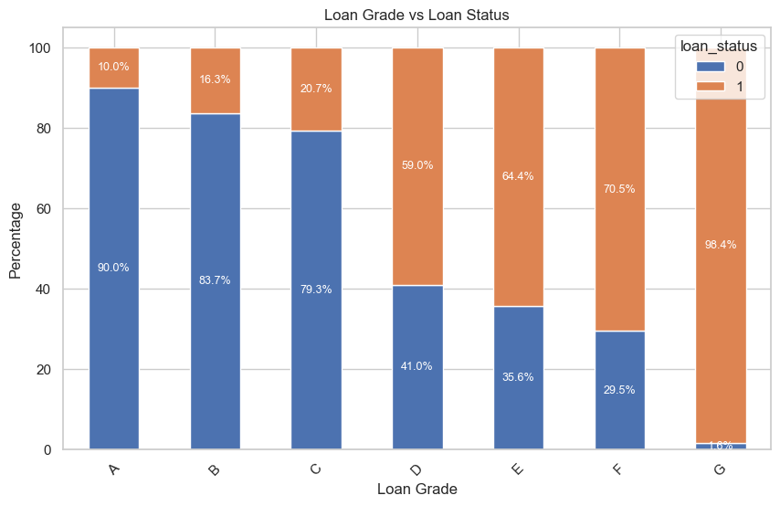

Slide 14
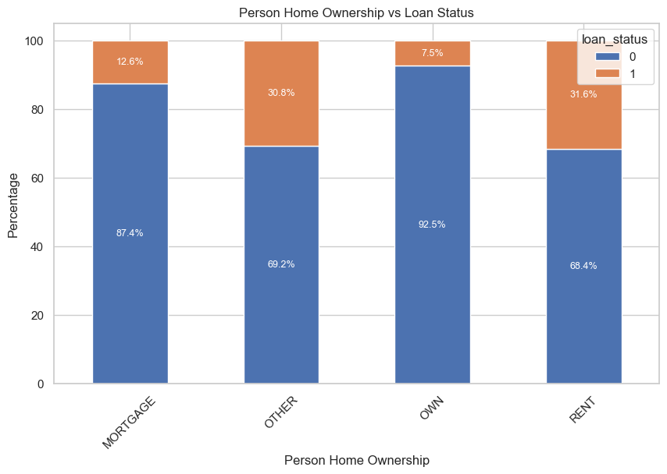

Slide 15
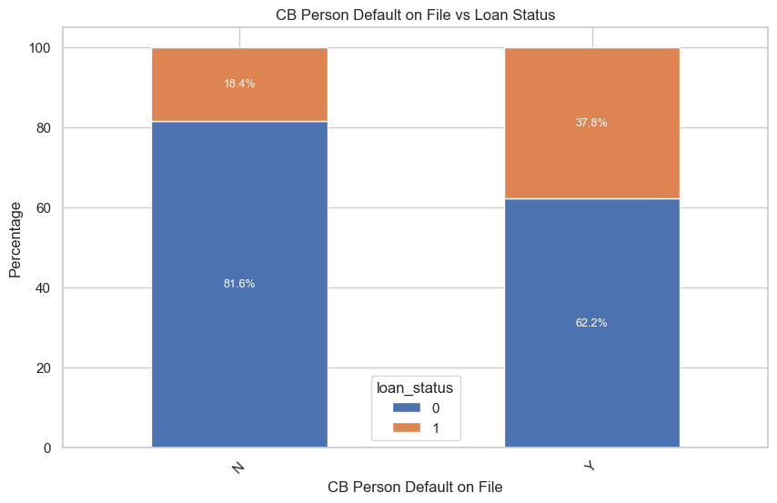

Slide 16
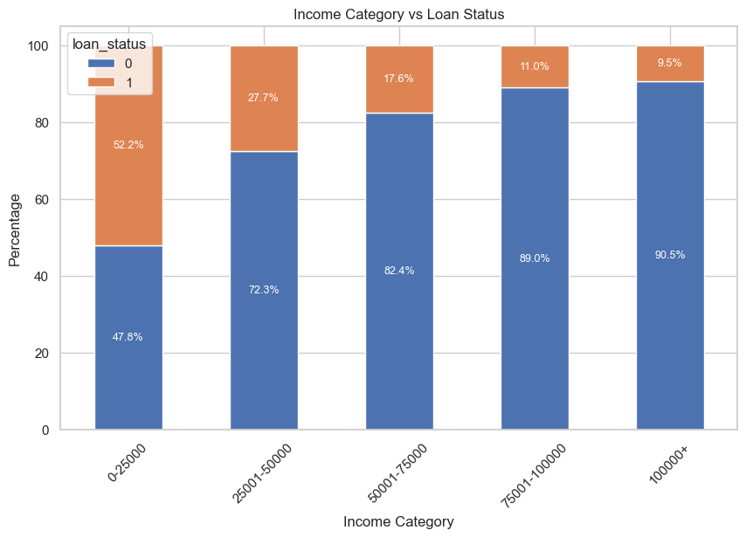

Slide 17
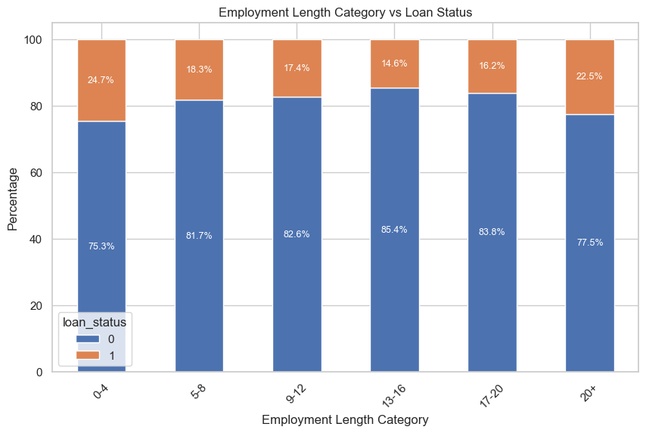

Slide 18
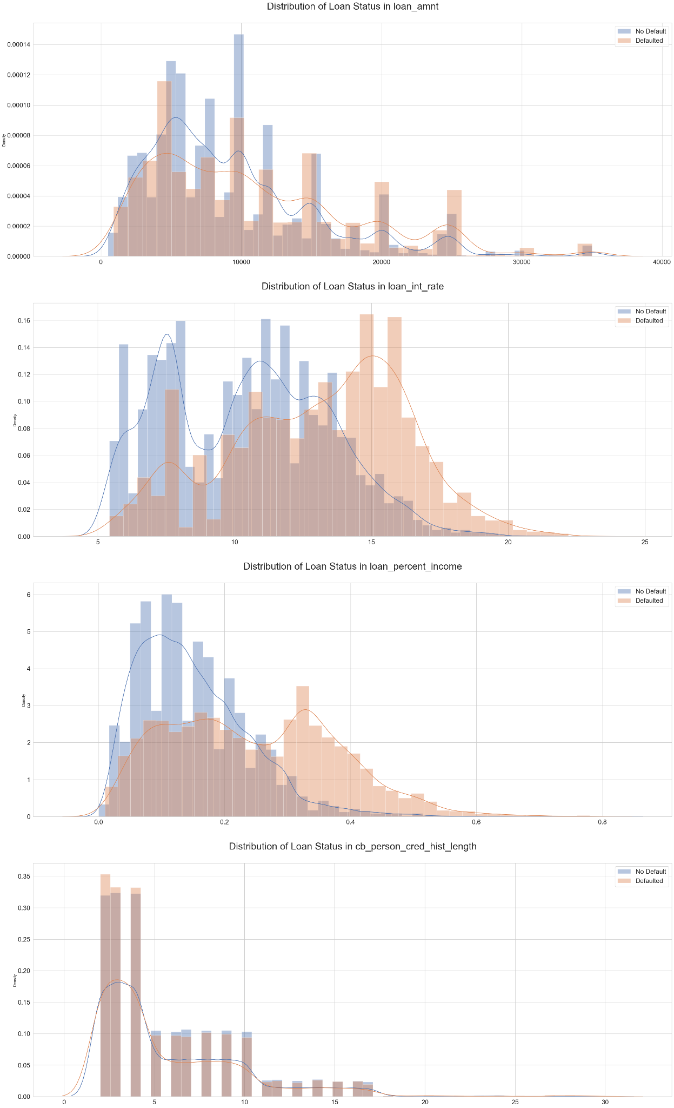

Slide 19
Feature Engineering
1
2
3
Derived Numerical Features
Employment Stability Transformation
Missing Value Treatment & Categorical Encoding
Created income_to_loan_ratio (person_income / (loan_amnt + 1)) to better capture:
Converted raw person_emp_length into categorical bins:
Applied median imputation to critical numeric features (person_emp_length, loan_int_rate).
Borrower's ability to afford loan payments
0–2yrs (high risk/early career)
3–7yrs (mid-career stability)
Implemented one-hot encoding with drop_first=True on:
Risk tolerance relative to income
7–20yrs (established career)
Potential repayment capacity
20yrs+ (maximum stability)
loan_grade, loan_intent, person_home_ownership
This ratio helps identify high-risk cases where loan amount approaches or exceeds annual income.
Unknown (for missing values)
cb_person_default_on_file, emp_length_bin
Also imputed missing values in original numeric column with median for model feature diversity.
Dropping first category prevents multicollinearity while preserving information.

Slide 20



EDA Takeaways & Next Steps
Key Insights from EDA
Next Steps
Strongest predictors: income level, loan purpose, prior defaults
Model Ensemble
Combine strengths of multiple algorithms (LR, RF, XGBoost)
Engineered features captured non-linear relationships
Debt Restructuring, Medical loans carry highest risk,
Segment-Specific Models
Develop tailored scoring for each risk segment
Temporal Validation
Cross-validation and out-of-time testing

Slide 21
Models

Slide 22
Real-World Application & Model Selection
Many financial institutions use advanced machine learning models for improved accuracy such as:
Wells Fargo uses LightGBM & XGBoost for risk analysis & traditional models like Logistic Regression for credit decisioning
Citigroup (Citi) uses deep learning models for fraud detection and risk management
Based on publicly available data
Our Project Models (6):
Logistic Regression: Used as interpretable baseline for a clear comparison with more complex models
XGBoost & LightGBM: Used as our high performance models due to their speed and accuracy
SVM: Included to explore a non-linear approach
ANN & 1D CNN: Used as deep learning benchmark to evaluate a modern neural network approach to the problem

Slide 23
Model 1: Logistic Regression & Results
Model Summary & Architecture: Logistic Regression
Linear model, easy to understand feature importance and direction of influence.
Used the logistic (sigmoid) function to produce probabilities between 0 and 1.
Decision Rule: Default cutoff at 0.5 for classification.
Role in Analysis: Selected as the baseline model due to high interpretability and transparency.
Data split 80% training and 20% validation
Hyperparameter Tuning:
GridSearchCV with 5-cross-fold validation was used
to find optimal combination of:
C: [0.01, 0.1, 1, 10, 100]
Penalty: [L1 and L2]
Best Parameters: {C: 0.1, Penalty: l1}
ROC – AUC Score: 0.8617
Time taken: 7.12 seconds
Classification Report - pre-tuning
 | Precision | Recall | F1-Score
0 | 0.88 | 0.95 | 0.91
1 | 0.75 | 0.53 | 0.62
Accuracy | 0.86
Classification Report - post-tuning
 | Precision | Recall | F1-Score
0 | 0.88 | 0.95 | 0.91
1 | 0.75 | 0.53 | 0.62
Accuracy | 0.86

Slide 24
Model 2: Support Vector Machine (SVM)
Model Summary:
It was included to demonstrate the project's capability to handle a variety of algorithms, including those that are not tree-based. It is known for its effectiveness in high-dimensional spaces and for its ability to model complex decision boundaries.
Data split 80% training and 20% validation
Hyperparameter Tuning:
GridSearchCV with 3 fold cross validation used to optimize for the best C, gamma, and kernel combination
Key Parameters Used:
C: regularization parameter [0.1, 1]
Gamma: [scale, auto]
Kernel: rbf
Best Parameters:
C: 1
Gamma: scale
Kernel: rbf
TIme Taken: 387.32 seconds
Classification Report pre-tuning
 | Precision | Recall | F1-Score
0 | 0.90 | 0.99 | 0.94
1 | 0.93 | 0.62 | 0.74
Accuracy | 0.91
Classification Report post-tuning
 | Precision | Recall | F1-Score
0 | 0.90 | 0.99 | 0.94
1 | 0.93 | 0.62 | 0.74
Accuracy | 0.91

Slide 25
Model 3: 1D CNN & Results
Model Summary & Architecture:
A 1D CNN was included to explore a deep learning approach to the problem by processing sequences of data (in this case, the numerical features).
Uses a Conv1D layer to learn patterns across adjacent features
A Flatten layer used to transforms the 2D output of the convolution to a 1D vector
Input Layer: Conv1D(filters=32, kernel_size=2, activation='relu')
Hidden Layers: Dense(128, activation='relu'), Dense(64, activation='relu'), Dense(32, activation='relu')
Output Layer: Dense(1, activation='sigmoid') for binary classification.
Training Details:
Optimizer: Adam
Epochs: 10
Time taken: 32.44 seconds
Classification Report
 | Precision | Recall | F1-Score
0 | 0.90 | 0.99 | 0.94
1 | 0.93 | 0.61 | 0.74
Accuracy | 0.91

Slide 26
Model 4: Artificial Neural Networks & Results
Model Summary & Architecture: Artificial Neural Network (ANN)
A Sequential model built with Dense layers and Dropout for regularization. Data split 80% training and 20% validation.
Input Layer: Dense(128, activation: ‘relu’)
Hidden Layers: Dense (64, activation: ‘relu’), Dense(32, activation: ‘relu’)
Output Later: Dense(1, activation: ‘sigmoid’) for binary classification
Training details & Key Parameters:
Optimizer: Adam
Epochs: 50
Threshold: 0.4 (trial and error)
Drop out: (0.2, 0.2)
ROC – AUC Score: 0.8952
Classification Report
 | Precision | Recall | F1-Score
0 | 0.93 | 0.9364 | 0.9332
1 | 0.7664 | 0.7475 | 0.7569
Accuracy | 0.8952

Slide 27
Model 5: LightGBM & Results
Model Summary & Architecture:
Gradient boosting framework with leaf-wise tree growth
Highly efficient and fast compared to alternatives
Scales well to large datasets with high performance
Leaf-wise strategy makes it strong for real-time applications
Data split 80% training and 20% validation
Hyperparameter Tuning
We used GridSearchCV with 3 cross fold validation on
unscaled data to optimize the model:
Key Parameters Used:
N_estimators: [50, 100, 200]
Max_depth: [5, 10, 15]
Learning_rate: [0.01, 0.1, 0.2]
Num_leaves: [31, 50]
Best Parameters:
Learning rate: 0.1
Max depth: 10
n_estimators: 200
Num of leaves: 50
Time Taken: 113.72 seconds
Classification Report pre-tuning
 | Precision | Recall | F1-Score
0 | 0.92 | 0.99 | 0.96
1 | 0.97 | 0.71 | 0.82
Accuracy | 0.93
Classification Report
 | Precision | Recall | F1-Score
0 | 0.93 | 0.99 | 0.96
1 | 0.95 | 0.72 | 0.82
Accuracy | 0.93

Slide 28
Model 6: XGBoost & Results
Model Summary & Architecture: XGBoost (eXtreme Gradient Boosting) 🚀
Advanced ML algorithm known for speed & performance
Builds models sequentially, correcting prior errors
Highly effective for complex, structured datasets
Delivers strong predictive accuracy
Data split 80% training and 20% validation
Hyperparameter Tuning
GridSearchCV with 5-cross-fold validation was used to tune key parameters for optimal performance
Key Parameters
N_estimators: [50, 100, 200]
Max_depth: [3, 5, 7]
Learning Rate: [0.01, 0.1, 0.2]
Best Parameters:
Learning rate: 0.1,
Max depth: 7
n_estimators: 200
ROC – AUC Score: 0.9429
Time taken: 14.91 seconds
Classification Report pre-tuning
 | Precision | Recall | F1-Score
0 | 0.93 | 0.99 | 0.96
1 | 0.95 | 0.72 | 0.82
Accuracy | 0.93
Classification Report post-tuning
 | Precision | Recall | F1-Score
0 | 0.93 | 0.99 | 0.96
1 | 0.97 | 0.72 | 0.82
Accuracy | 0.9429

Slide 29
Model 6.5: Stacking Ensemble (LightGBM & XGBoost)
A stacking ensemble combines the predictions of multiple base models.
We used XGBoost and LightGBM as our base models.
The predictions from these two models are then used as input for a meta-model, which makes the final prediction. In this case, we used a simple Logistic Regression model as the meta-model.
Key Advantages:
Faster Inference Time: While the ensemble did not provide a significant increase in accuracy over the best single model, its lightweight meta-model allows for very fast, real-time predictions, which is a critical feature for our web application.
Robustness: This method leads to a more robust model that generalizes well to unseen data by combining the strengths of diverse models.
ROC – AUC Score: 0.9451
Time taken: 4.75 seconds
Classification Report
 | Precision | Recall | F1-Score
0 | 0.93 | 0.99 | 0.96
1 | 0.94 | 0.73 | 0.83
Accuracy | 0.93

Slide 30
Model Comparison & Summary
Model | Type | ROC–AUC | Precision (1) | Recall (1) | F1-Score (1) | Notes
XGBoost | Gradient Boosting | 0.9429 | 0.97 | 0.72 | 0.82 | GridSearch tuned; strong benchmark
LightGBM | Gradient Boosting | 0.9434 | 0.95 | 0.72 | 0.82 | Tuned with GridSearch; scalable
ANN | Deep NN (3 hidden layers: 256–128–64) | 0.8952 | 0.77 | 0.75 | 0.76 | Threshold tuned to 0.40 → better recall
1D CNN | Deep Learning (Conv1D) | 0.9113 | 0.94 | 0.62 | 0.74 | Early exploration, not fully tuned
SVM | Kernel-based | 0.8893 | 0.93 | 0.62 | 0.74 | Best with RBF kernel; optimized C, gamma
Logistic Regression | Linear, interpretable | 0.8617 | 0.75 | 0.53 | 0.62 | GridSearch → C=0.1, Penalty=L1
Key Findings
Tree-based models excel
ANN shows promise for recall
Interpretability vs. performance
XGBoost and LightGBM demonstrated superior performance across all metrics, making them ideal for financial applications requiring high precision and good overall performance.
The neural network achieved the best recall for class 1, suggesting its value when false negatives are particularly costly (e.g., fraud detection).
Logistic Regression offers full interpretability but with ~8% lower accuracy than the top performers. This tradeoff should be evaluated based on regulatory and explanation requirements.

Slide 31
Q&A

