Slide 1



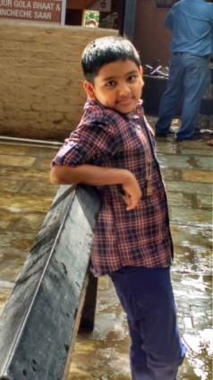
MON
TUE
WED
THU
FRI

Slide 2


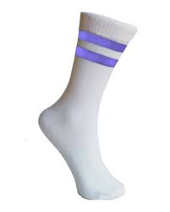
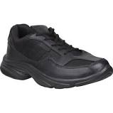
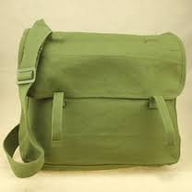

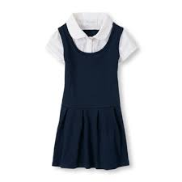
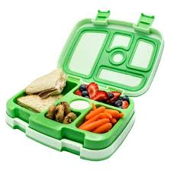
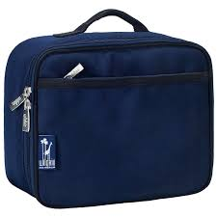

 | M | T | W | T | F
 | M | T | W | T | F
Notes:
Shoes, Socks, Lunch Box, Lunch Bag, Water Bottle, Uniform, School Bag

Slide 3
Day | Date | Assignment | Points | Earned
Notes:
Shoes, Socks, Lunch Box, Lunch Bag, Water Bottle, Uniform, School Bag

Slide 4

 | 16 | 17 | 18 | 19 | 20 | 21 | 22 | 23 | 24 | 25
ENG. LANG.
ENG. LIT | L – 1 L – 2 |  |  |  | L – 4 L – 5 |  |  |  |  | L – 6
SCIENCE |  | L – 1 L – 2 |  |  |  | L – 3 L – 5
MARATHI |  |  |  |  |  |  |  |  | HALF
MATHS |  |  | MISSIN NAME |  |  |  | SIGN, ASC, DESC, ODD, EVEN

Slide 5
 | 26 | 27 | 28 | 29 | 30 | 01 | 02 | 03
ENG. LANG.
ENG. LIT |  |  |  |  | REVISE
SCIENCE |  | L – 6 |  |  |  |  | REVISE
MARATHI | HALF |  |  |  |  |  |  | REVISE
MATHS |  |  | PLACE, EXPAND, SKIP |  |  | REVISE

Slide 6
AMOGH CHAVAN

Slide 7

 | 17 | 18 | 19 | 20 | 21 | 22 | 23
ENG. LANG. |  |  |  | EL - 1
EVS 1 |  |  |  | L - 3
HINDI |  | L -1 |  | L – 2,3 |  | L – 6
MARATHI |  |  | L – 10, 11 G - 1 |  |  |  | L – 13,15 G -2
MATHS | L-1 L-2(1/2) |  |  |  | L-2(1/2) L-3
EVS 2 |  |  | L – 1, 2 |  |  |  | L – 3
ENG. LIT | L-1 L-2 |  |  |  | L-3 P-1
SCIENCE |  | L-1 L-2 |  |  |  | L-3 L-4
CIVCS |  |  |  |  |  |  | C - 1

Slide 8
 | 24 | 25 | 26 | 27 | 28 | 29 | 30
ENG. LANG. | EL - 2 |  |  |  | EL - 3
EVS 1 | L - 9 |  |  |  | L - 11
HINDI | L -8,9 |  | L – 10, G - I |  | L - 11 |  | L – 14 G - II
MARATHI |  |  |  | L-16,17 G - 3
MATHS |  | L-4 L-7(1/2) |  |  |  | L-10 L-7(1/2)
EVS 2 |  |  |  | L - 4
ENG. LIT |  | L-4 P-2 |  |  |  | L-5 P-3
SCIENCE |  |  | L-5 L-7 |  |  |  | L-13
CIVCS |  |  |  | C - 2

Slide 9
 | 01 | 02 | 03
ENG. LANG. |  | EL - 4
EVS 1 |  | L -18
HINDI
MARATHI | L -19 G – 4
MATHS
EVS 2 | L – 5
ENG. LIT
SCIENCE
CIVCS | C - 3

Slide 10

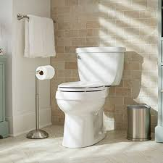



 | M | T | W | T | F
Notes:
Exercise, Kitchen, Bathroom, Hall, Sweeping

