Slide 1

SOC Threat Detection & Monitoring using Splunk

Slide 2
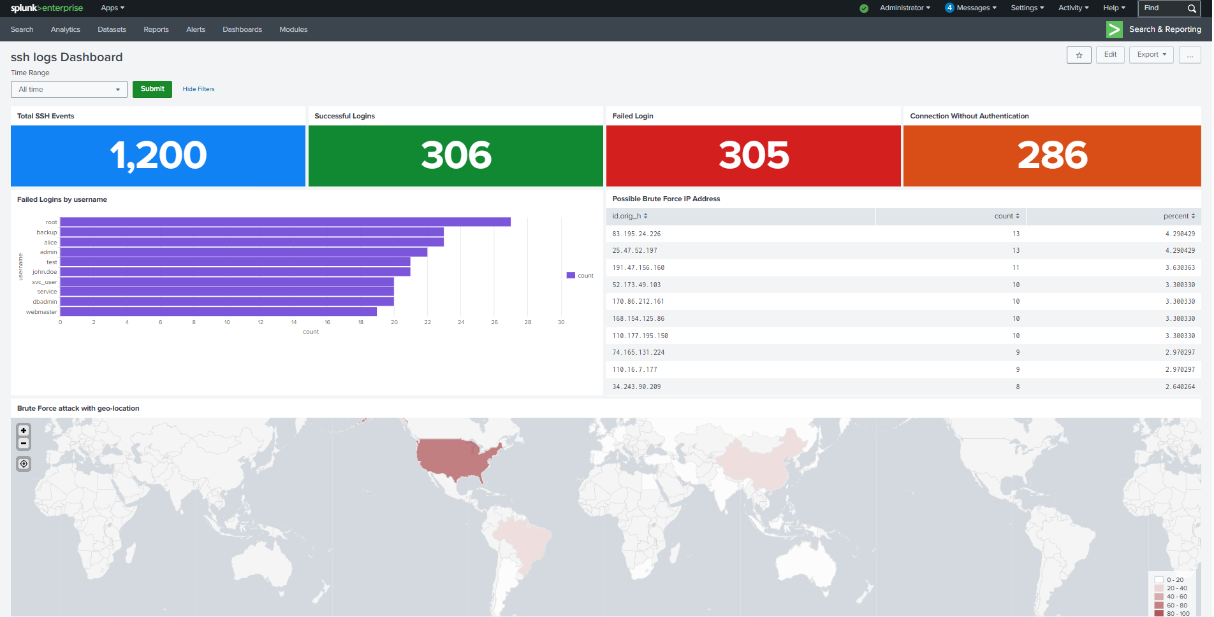
SSH Threat Monitoring Dashboard
Detects failed logins, brute-force attempts, and attacker locations

Slide 3
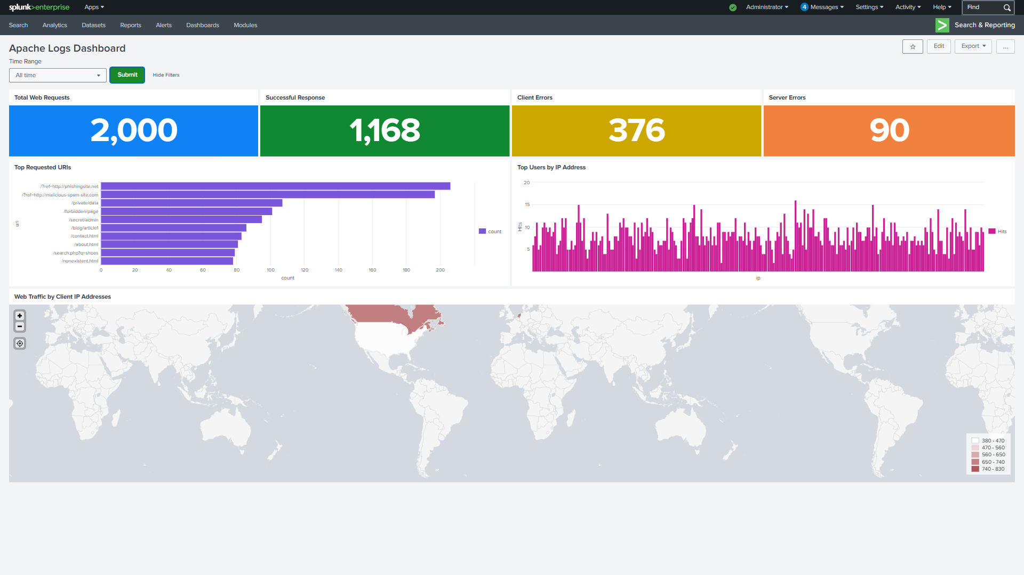
Web Traffic Monitoring Dashboard
Monitors web traffic, errors, and most accessed resources

Slide 4
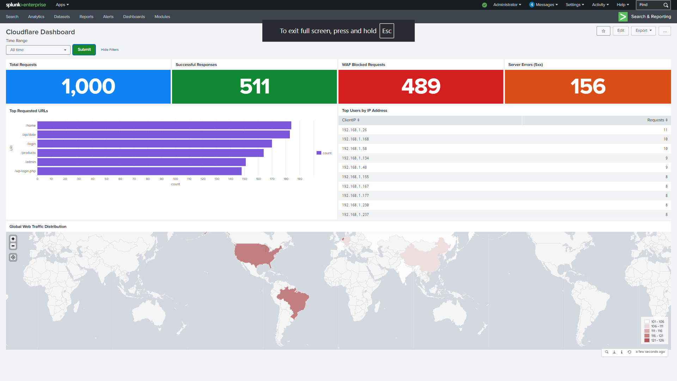
Cloudflare Dashboard
Tracks WAF blocks, traffic patterns, and suspicious client activity

