Slide 1


React JS
Pravinkumar R .D.

Slide 2
What are we going to learn?
What is React JS?
Features of React JS
How to get React JS?
Introduction to React JS Component
Creating first React application
React application bootstrapping process
Introduction to JSX
Introduction to Virtual DOM

Slide 3
What are we going to learn?
Working with CSS
Configuring Bootstrap CSS Framework in React Application
Different ways to integrate CSS in React Components
Introduction to React PoC – Proof-Of-Concept
PoC architecture
Project structure
Integrating axios library in React application
Formatting data using Intl object/namespace of JavaScript
Introduction to React Hooks
Converting PoC into SPA – Single Page Application

Slide 4
What are we going to learn?
Introduction to React Router library
Configuring Routes
Authentication and Authorization
Login and Registration
Security Trimming
Protecting routes
Lazy Loading components
Introduction to Context API
Working with Forms

Slide 5
What are we going to learn?
Introduction to Redux
Why? What? How?
Working with Redux library
Converting PoC to use Redux storage
Redux and Class components
Redux and Function Component [Hooks]
Introduction to React Testing

Slide 6
What is React JS?
It is a JavaScript library for building User Interfaces
It is developed by Facebook
The most popular JavaScript library with large community support
Can be used as V from MVC
Can be used on client as well as server

Slide 7
Features of React JS
It follows web standards like Component based development using React way
It supports ES5 and ECMA2015 during React development
JSX is a preferred way writing React Components
Virtual DOM – Representation of DOM is kept in memory
It offers declarative way to program user interfaces
React can also render on Server using node and power mobile apps using React Native
Communication between components is made easy using PROPs

Slide 8
Features of React JS
React components maintains its own state
Unidirectional Data Flow – One way data flow
It offers number of Lifecycle methods which you can use to run your application logic
React has its own unique way of handling events on DOM elements
You can do conditional rendering of components depending on the state of the application
React follows “controlled component” when working with Forms

Slide 9
Features of React JS
React Component can be loaded -
Eager Loading
Lazy Loading [16.3 and onwards]
Starting with React 16.8, now we have React Hooks
Most appreciated feature by React Developers

Slide 10
Introduction to React Component
Different ways to create components in React –
ES5
createClass function
Stateless function
ES6/ECMA2015
Class
Stateless function

Slide 11
ES5 Class Component
var CompanyMessage = React.createClass({
render: function () {
return (<h1>Welcome To Hello World!</h1>);
}
});

Slide 12
ES6 Class Component
class CompanyMessage extends React.Component {
constructor(props) {
super(props);
}
render() {
return (<h1>h1>Welcome To Hello World!</h1>);
} }

Slide 13
ES5 Stateless Component
var CompanyName = function(props) {
return (<h1>Welcome To Hello World!</h1>);
});

Slide 14
ES6 Stateless Component
const HelloWorld = (props) => {
return (<h1>Welcome To Hello World</h1>);
});

Slide 15
Advantages of Stateless Components
Class is not required
Enforces best practices
Don’t use “this” keyword
Understanding becomes easy
Maintenance becomes easy
Testing becomes easy
Performance is higher

Slide 16
Class Components
Use class components –
To maintain the state of the component
To use refs
To use lifecycle methods

Slide 17
What are Container Components?
The container components –
Has few or no markup
Who pass the data and actions down
Knows about the store [Redux]
Are stateful components

Slide 18
What are Presentation Component?
The presentation components – [16.7]
Contains all markup
They receive the data and actions from props
Don’t know about the store [Redux]
Are functional components

Slide 19
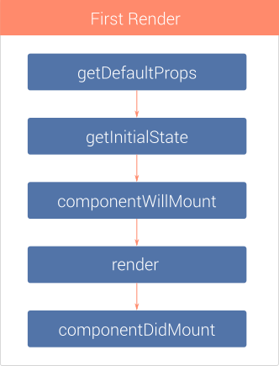
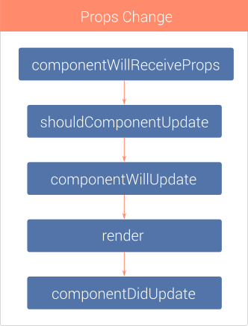
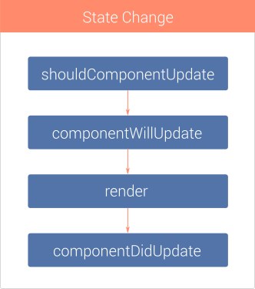
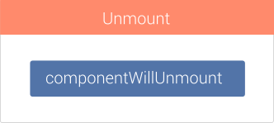
Component Lifecycle Methods

Slide 20
Props & State in React
Similar to function arguments
Props are used to pass the data to child components
Props are immutable
State is declared in container components
State can be modified by –
Actions, network calls or others
Set initial state in a constructor

Slide 21
Creating First React App
Install Node JS LTS Version
https://nodejs.org/en
Install Visual Studio Code
https://code.visualstudio.com/download
Creating First React application using NPX –
npx create-react-app my-app
NPX - Node Package eXecute

Slide 22
Introduction to Vite
Vite is next generation frontend tooling
Instant server start –
On demand file serving over native ESM, no bundling required
Hot Module Replacement irrespective of application size
Out-of-the-box support for Typescript, JSX, CSS and others
Optimized build using pre-configured Rollup build

Slide 23
Why Vite?
We are using bundling systems like Webpack and parcel
It bundles all the JS modules, CSS and other assets
Does this every time you make a change which can get really slow as our app grows with hundreds of modules
Slow server start –
Cold-starting the dev server needs to build the entire application and then serve
Slow updates –
Even though the HMR is supported by some bundling system, as app grows, it will become slower

Slide 24
Aim of Vite
Solve the issues by leveraging the power of native ESM support in browser
Vite pre-bundles the dependencies using esbuild
esbuild is written in GO and pre-bundles 10-100x faster than JavaScript based bundlers
Vite serves the source code over native ESM
Vite only needs to transform and serve source code on demand, as the browser requests it

Slide 25
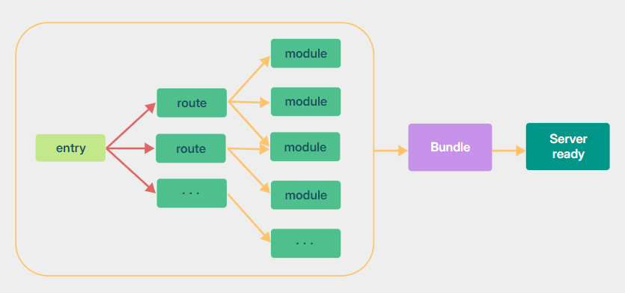
Bundle Based Dev Server

Slide 26
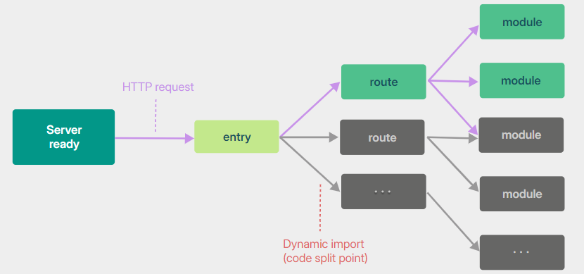
Native ESM Based Dev Server

Slide 27
Creating First React App using Vite
Run below command to create Vite Application
npm create vite@latest vite-react
The above command will as you to choose the application template
For Example – React [with JavaScript or Typescript]
npm install to install all the required dependencies
CD to the project – vite-react
npm run dev –
Starts the dev server and serves the application

Slide 28
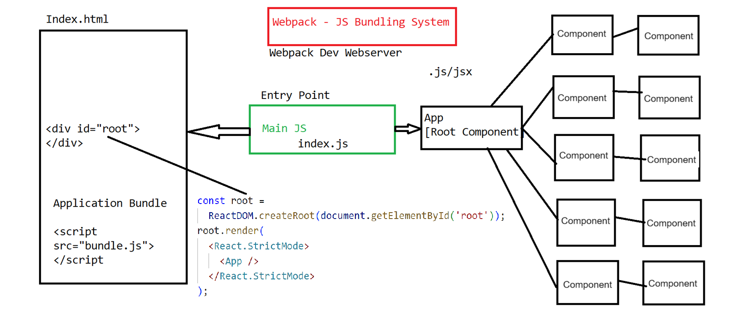
React Application Bootstrapping Process

Slide 29
What is <React.StrictMode>?
Helps to identify components which uses unsafe lifecycle methods
Warns about the usage of the legacy string ref API
Warns about the usage of the deprecated findDOMNode
Helps in finding unexpected side effects
Strict Mode is a developer tool and it runs only in development mode. No effect for production build
In order to identify and detect any problems and to show errors and warnings, StrictMode renders every component inside the application twice

Slide 30
What is JSX?
Syntax extension for JavaScript
Let you write HTML-like markup inside a JavaScript file
Most React developers prefer the conciseness of JSX
Rules –
Return single root element
you can use Fragment [<>…</>] in case you don’t want container element
Close all the tags
Follow camel casing

Slide 31
JSX and Curly Braces
Single Curly Brace – {JavaScript Expression/Variables}
JSX attributes inside quotes are passed as strings
Curly braces let you bring JavaScript logic and variables into your markup
They work inside the JSX tag content or immediately after = in attributes
Double Curly Braces – {{CSS/Object}}
It is not special syntax. It’s a JavaScript object tucked inside JSX curly braces

Slide 32
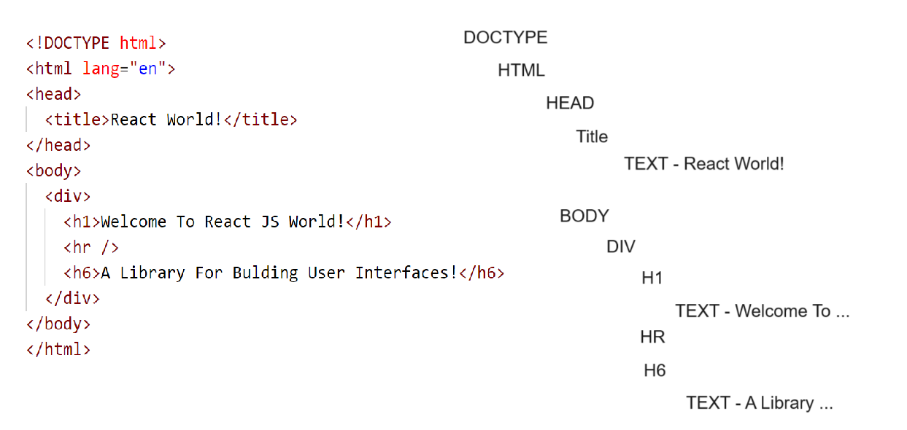
Introduction to Virtual DOM
Actual DOM Representation

Slide 33
Virtual DOM
DOM
Virtual DOM

Slide 34
Diffing Algorithm
Diff
Update
DOM
Virtual DOM
Virtual DOM

Slide 35
What is Reconciliation and Batch Update?
React keeps the in-memory Virtual representation of actual DOM and keep it sync with batch update.
This above process is called Reconciliation
Batch Update –
ReactJS using the diff algorithm to find the minimum number of steps to update the Real DOM
Once it has these steps, it executes all the steps in one event loop without involving multiple steps to repaint the Real DOM
If there are more elements which get updated ReactJS will wait for the event loop to finish
Then, in bulk will update the real DOM with all the updated elements

Slide 36
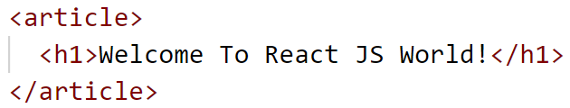
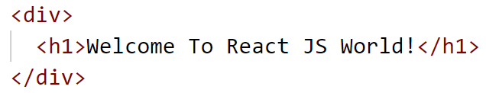
Different Diffing Algorithms
First example –
Let’s assume that we want change article to div tag
Here we are changing the root element article to div and h1 is intact
In this case, the diffing algorithm will replace and re-render the above hierarchy

Slide 37
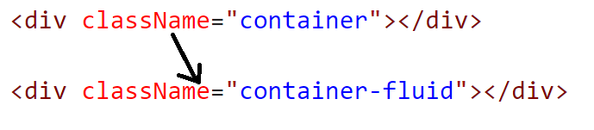
Different Diffing Algorithms
Example – 2
Let’s assume that we want to change class from container to container-fluid
In this case, there is no teardown happening and hence only update will be the attribute change as part of the batch update

Slide 38
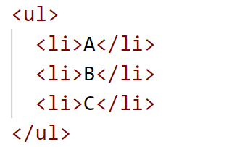
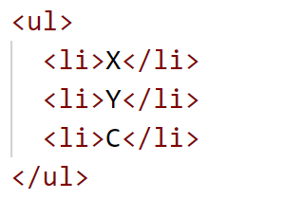
Different Diffing Algorithms
Example – 3
In the above example, React will do the comparison of each item line-by-line
It will check the existence of the items. If it is there, it will do nothing or else it will update the item accordingly
This diffing is expensive

Slide 39
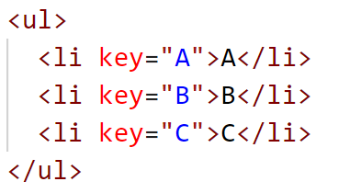
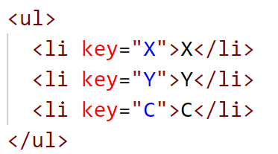
Different Diffing Algorithms
Example – 3
That’s why React complaint about not having key in list of items
With key comparison, the algorithm work much faster rather than comparing the items one by one

Slide 40
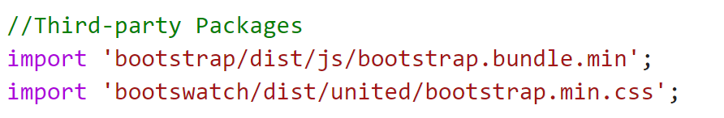
Configuring Bootstrap CSS Framework
First we will install Bootstrap package [Officials]
Second we will install Bootswatch package
It is third-party themes package which offers number of free themes
Command –
npm install bootstrap bootswatch
Next – in our index.js file, we will import the packages –

Slide 41
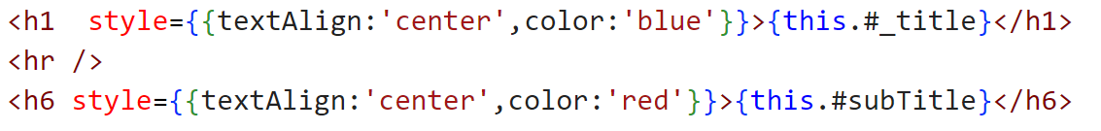
Working with CSS
Inline CSS –

Slide 42
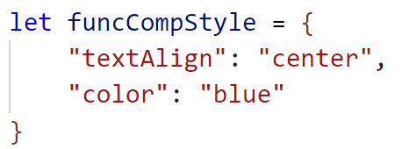
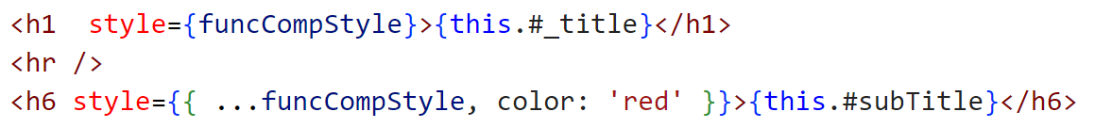
Working with CSS
Component Level CSS –

Slide 43
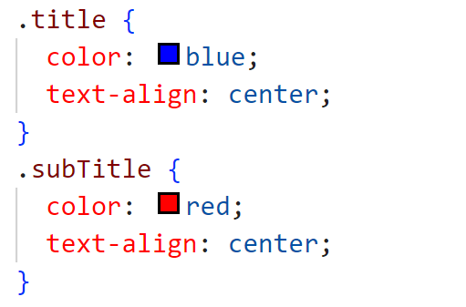
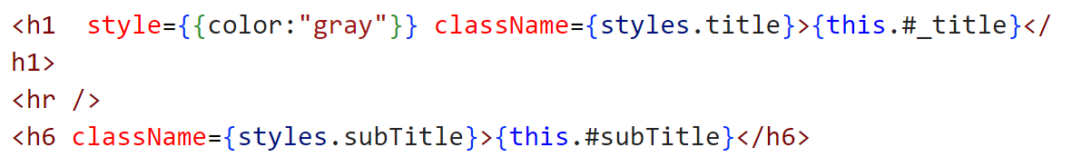
Working with CSS
CSS As-A Module – Component Styles
ComponentName.module.css
Import the above CSS module into a
component

Slide 44
Introduction to PoC
Events Management Portal
Roles – Employee and Hr
Employee Responsibilities –
Employee can register himself/herself
Employee can see other employee details
Employee can see the list of events and event details. Also can register for an event and give the feedback for an attended event
Hr Responsibilities –
All the responsibilities of Employee
Can schedule, postpone and cancel events
Can take feedback and generate reports for the same

Slide 45
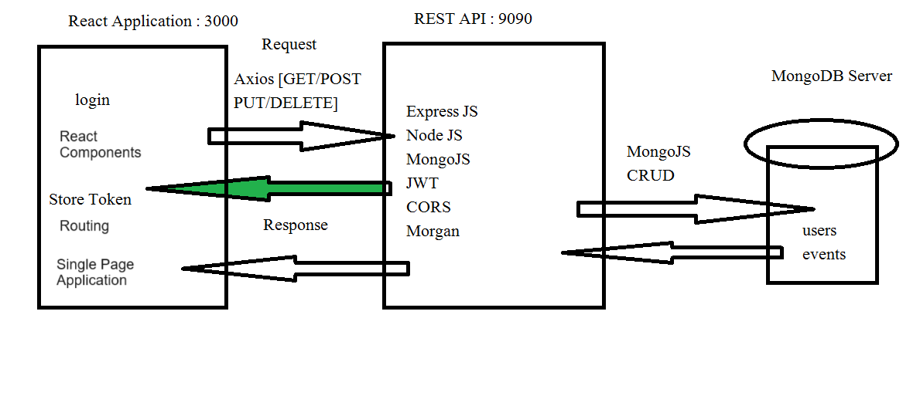
Introduction to PoC

Slide 46
What’s new in React 19?
use() Hook –
you can read a promise with use()
Simplifies asynchronous operations and context management
It replaces useEffect(), useContext() and other hooks
Enables more declarative handling of asynchronous operations
Currently only works with Libraries and Frameworks that support caching for promises

Slide 47
What’s new in React 19?
useActionState() –
Streamlines state management within "Actions“
Automatically tracks pending states during actions
Provides a clear indication of action status (pending, success, error)
It accepts a function (the “Action”), and returns a wrapped Action to call
Previously it was called useFormState()

Slide 48
What’s new in React 19?
useFormStatus() –
Allows nested child components to access information about the parent form
Don’t need to do prop drilling to pass form state down the component tree
Simplifies form handling in complex components
This hook reads the status of the parent <form> as if the form was a Context provider

Slide 49
What’s new in React 19?
useOptimistic() –
Enables optimistic updates while background operations (e.g., network requests) are in progress
Provides a more responsive user experience by updating the UI immediately
Can be used to implement undo/redo functionality

Slide 50
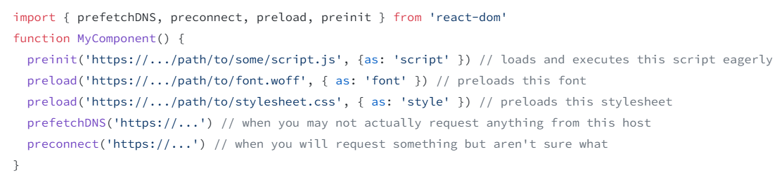
What’s new in React 19?
Assets Loading –
Preloading resource in background
Scripts, stylesheets and fonts
It will improve the page load performance
React 19 includes a number of new APIs for loading and preloading Browser resources

Slide 51
What’s new in React 19?
React Compiler –
It is a new compiler currently in Beta
It is a build-time only tool that automatically optimizes your React app
Automatically memoizes your code
useMemo(), useCallback() hooks are implicitly implemented in React Compiler
It will use its knowledge of JavaScript and React’s rules to automatically memoize values or groups of values within your components and hooks

Slide 52
What’s new in React 19?
Custom Elements –
React 19 adds full support [100%] for custom elements
Ref as a Prop
You can now access ref as prop for functional component
No need to use forwardRef
Support for cleanup function from ref callbacks
<Context> as provider –
You can render <Context> as provider instead of <Context.Provider>

Slide 53
What’s new in React 19?
Support for document Metadata –
Earlier document metadata tags like <title>, <link> and <meta> were inserted manually or with the help of libraries react-helmet
In React 19, added support for rendering document metadata tags in components natively
When react renders the component, it will see the metadata tags and automatically hoist them to the <head> section of document

Slide 54
Let’s Get Started!!!

