Slide 1
INDUSTRY DOCCUMENT MANAGMENT SYSTEM
Group Members – Pravin Nikam(220343120065)
Rujuta Jagtap (220343120090)
Pratik Sawale (220343120097)
Dhanashree Thube (220343120109)
Project Guide – Mrs. Harshita Maheshwari

Slide 2
Contents
Introduction
Choice of topic
Proposed System
Methodology
Proposed System Model
Proposed Approach
Screenshot
System Requirements
Applications
Advantages & Limitations
Conclusion
Future Scopes
References

Slide 3
Introduction
Almost all mid-scale and small scale industries or organization are doing the all the documentation work and audit reports only in offline mode or by using email for managing all data regarding one particular project .
To overcome such problem:
Industry document Management System can be useful for maintaining data records of all departments regarding the one particular project and simultaneously keeping the record of project progress becomes very easy at a time
. On single Common platform nos. Of departments can give their progress reports of that particular project

Slide 4
Choice of topic
To make documentation (Industrial)Fully online mode.
•Flow of project maintain in a queue.
•Make the project progress/Status Monitor easily.
•To provide number of project parallel working and monitoring their progress.
•Monitoring progress of each department and overall for project
•It will help to understand particular problem easily and action can be taken at earlier stages only.

Slide 5
Proposed System
AIM:
1. It will help to make project progress/Status Monitor easily.
2.Monitoring progress of each department and overall for project
3.It will help to understand particular problem easily and action can be taken at earlier stages only.

Slide 6
Methodology
The objective is to create a web site that can perform the following:-
1.designing ER diagram and implementing those relation into database in form of tables
2. By using React JS we will be designing front end of our project ,here we will be having Login form which will take input from users and whatever response from server will be displayed to user
3. In this level there will be the actual connectivity with the server the pre processing of request and generating the response will be the main task in this level.

Slide 7
Proposed System Model
There are three main modules:
Authentication Department Audit
1. login 1 Add attendance 1 breakdown analysis
2.registeration 2 View attendance 2 preventive Maintenance sheet
3 add employee 3 Machine details 3 Electricity Consumption
4 log out

Slide 8
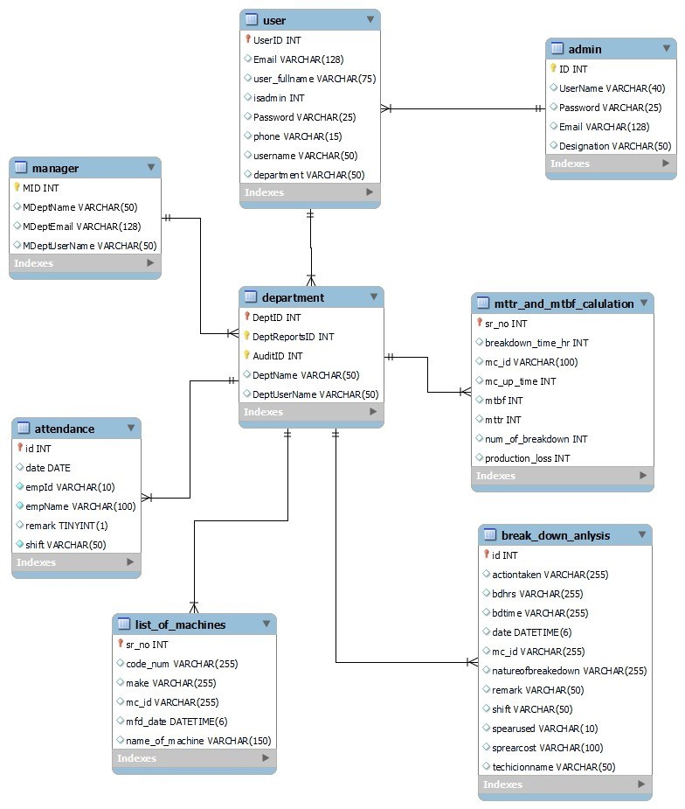
Proposed Approach

Slide 9
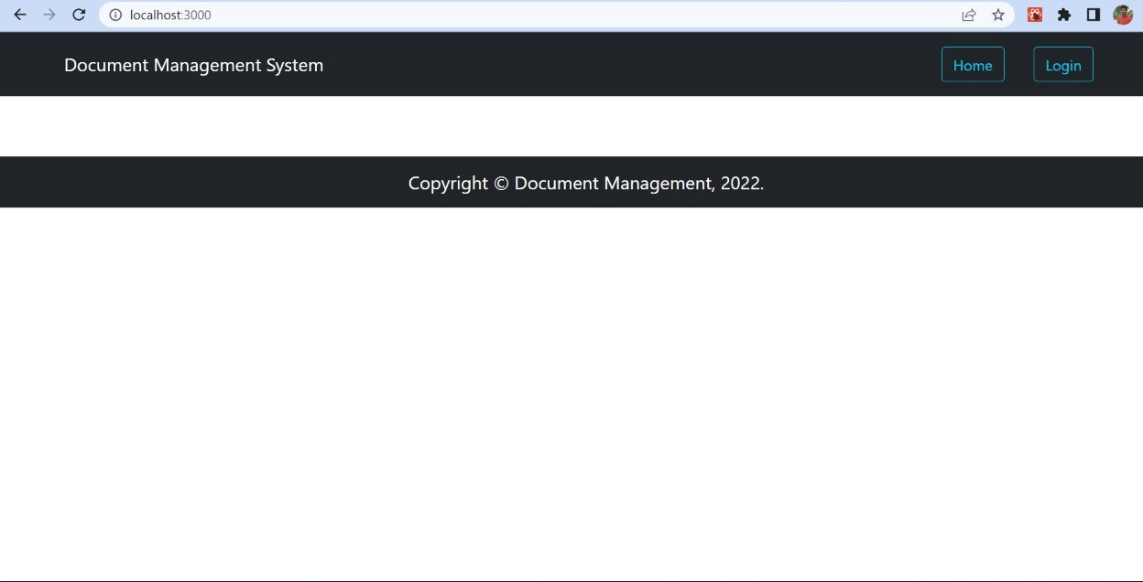
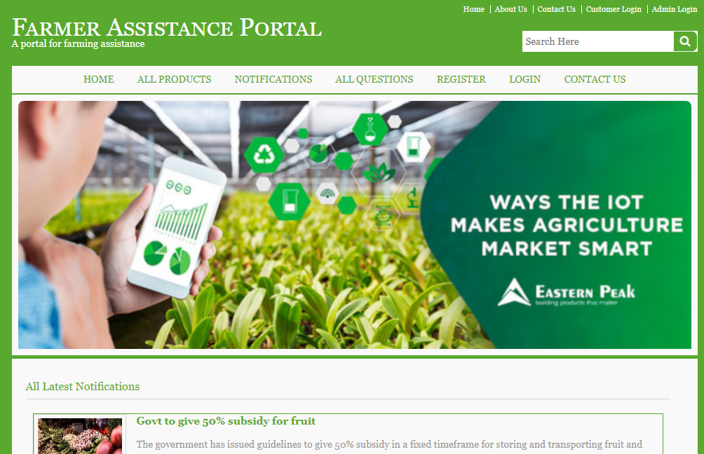
Screenshots

Slide 10
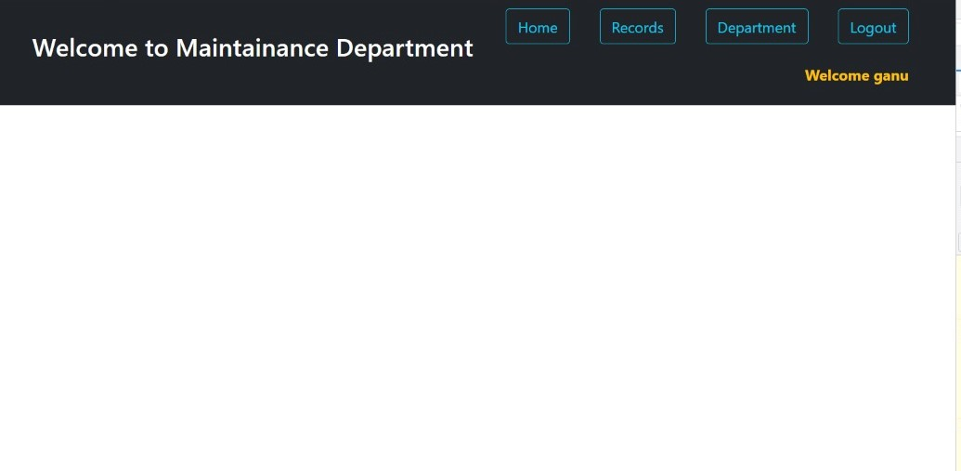

Slide 11
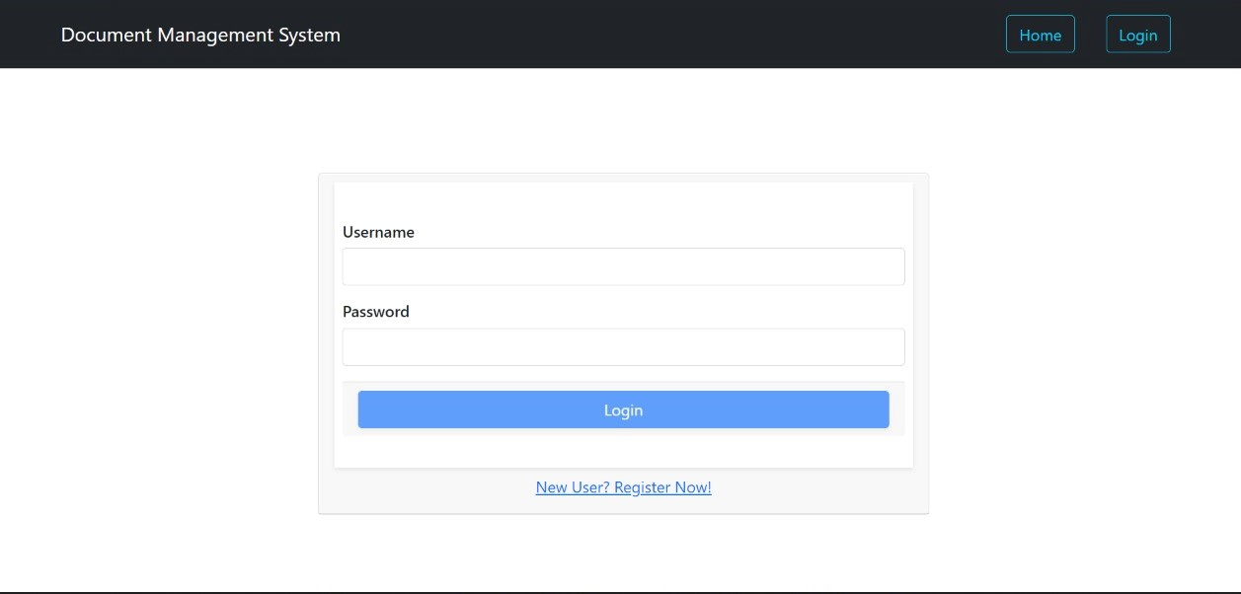

Slide 12
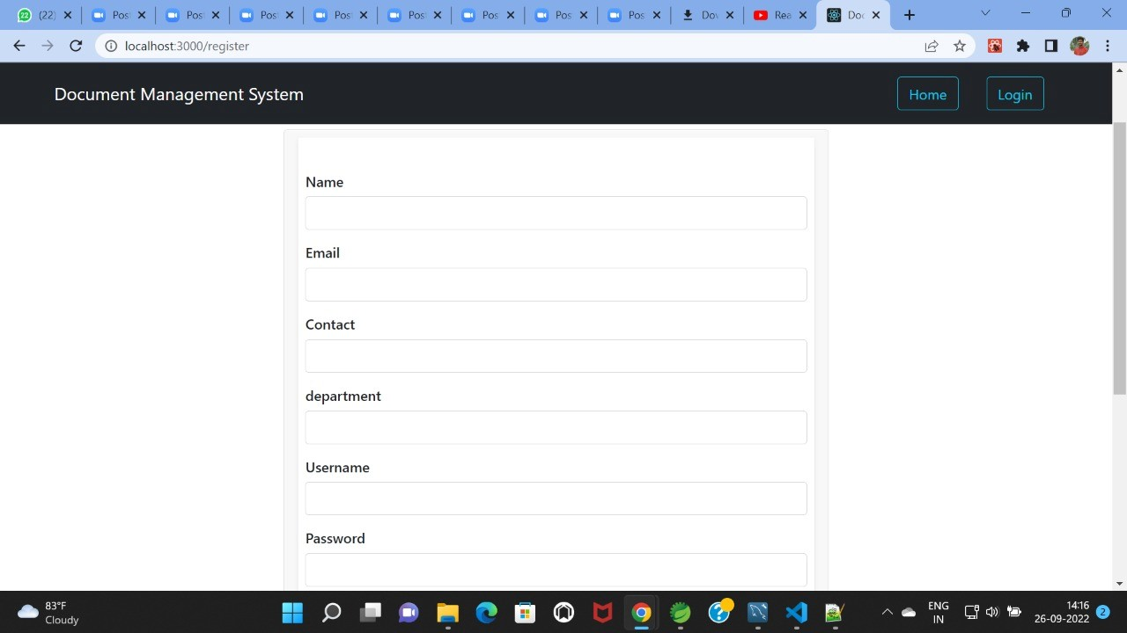

Slide 13
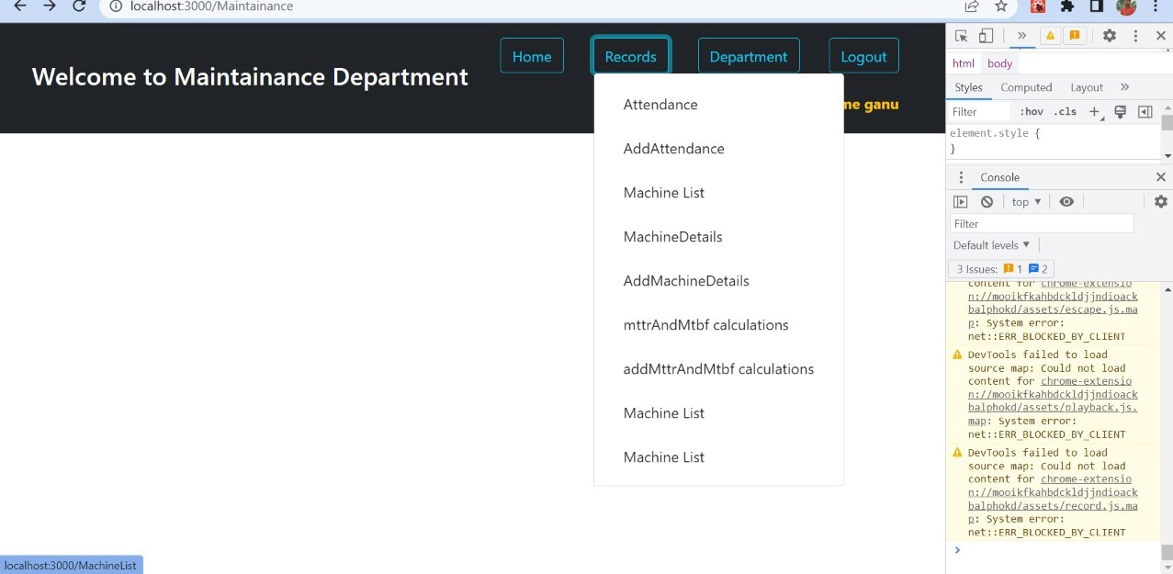

Slide 14
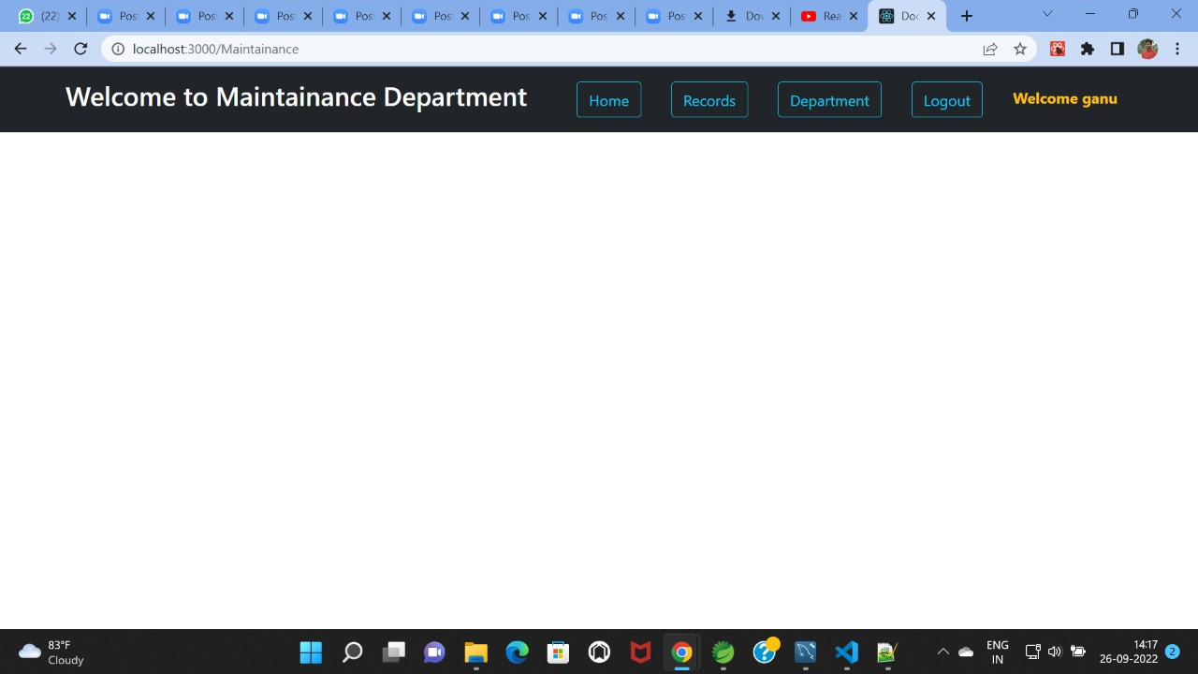

Slide 15
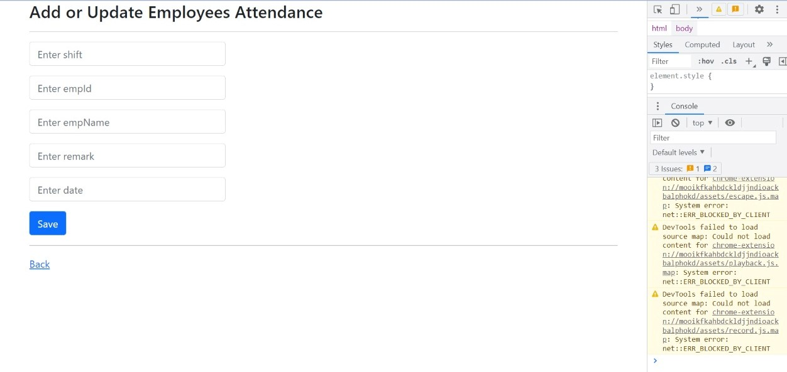

Slide 16
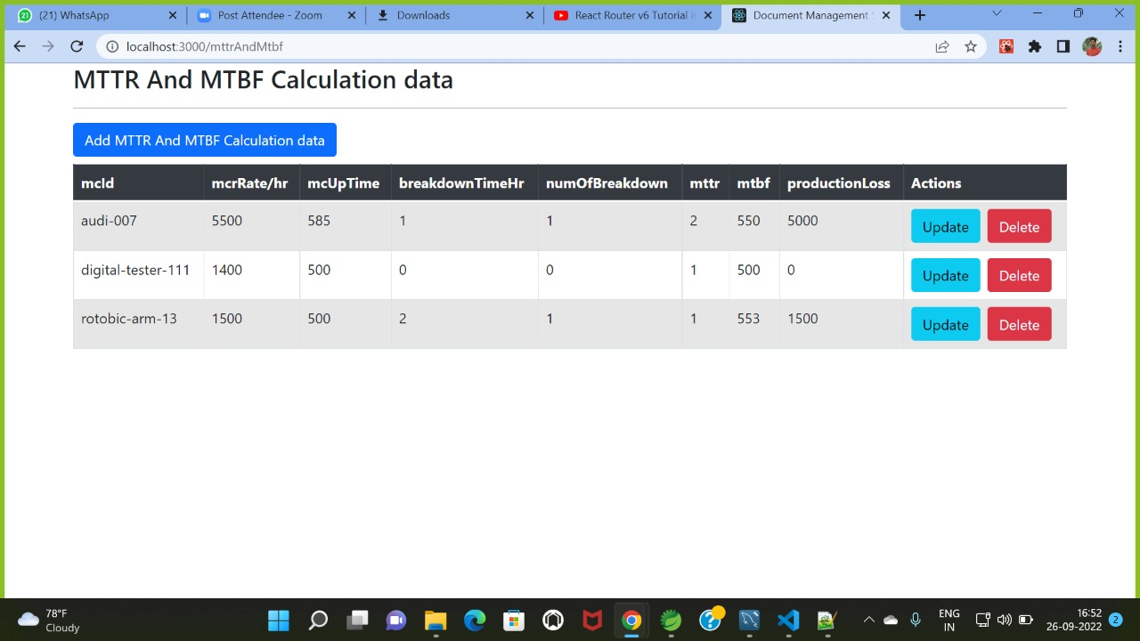

Slide 17
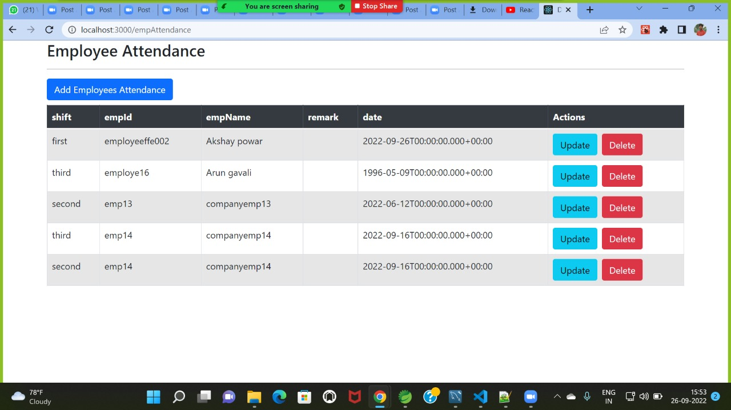

Slide 18
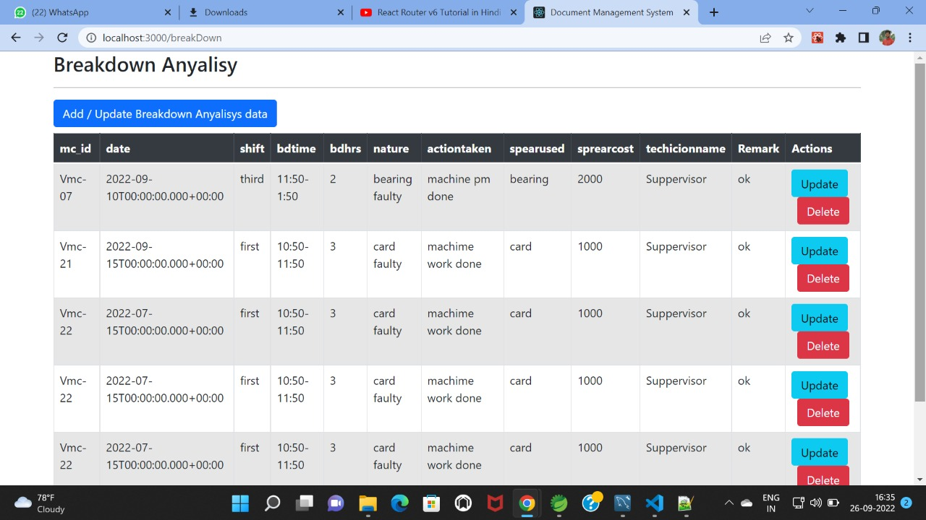

Slide 19
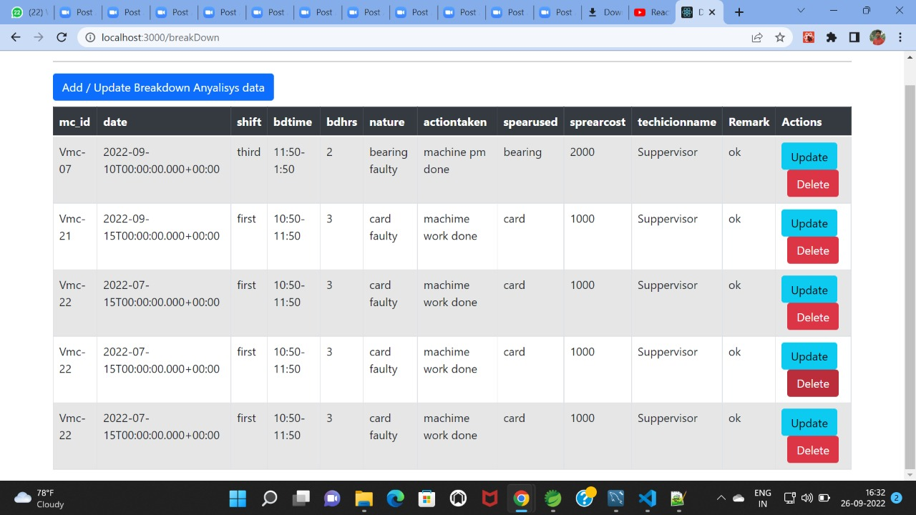

Slide 20
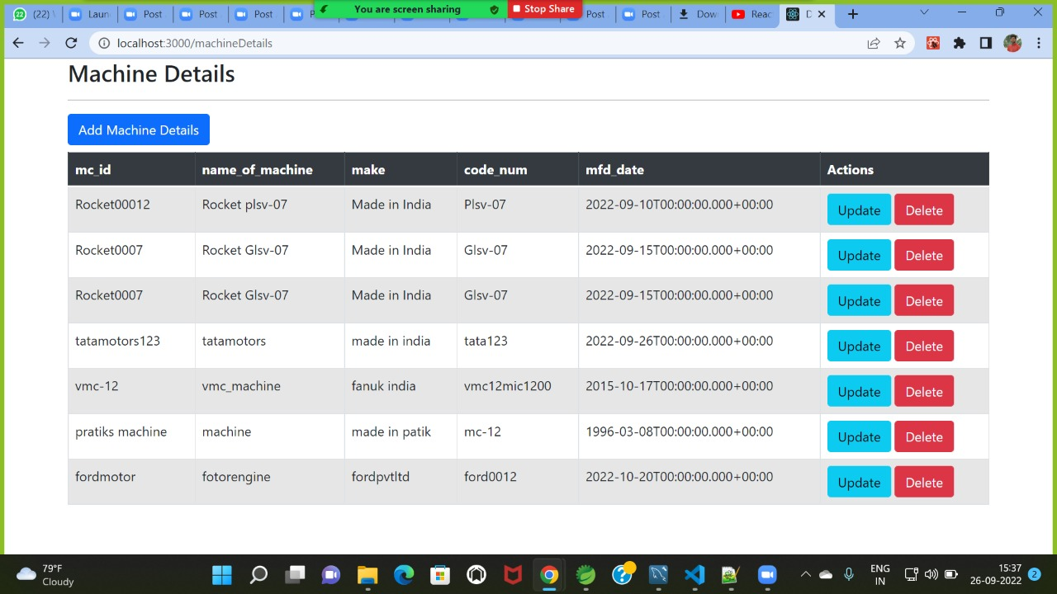

Slide 21
System Requirements
Software Requirements:
• Windows (All Versions)
• Spring Tool Suite, MySQL, Visual Studio

Slide 22
Technologies Used
HTML : Page Layout has been designed in HTML.
CSS : Used for all designing part.
JavaScript : All Validation task and animations has been developed by JS.
Spring Tool Suite is used to develop spring application
JAVA : All the business logic has been written in JAVA.
MySQL : MySQL database has been used as database

Slide 23
Applications
Daily Production monitoring system
•Automatic project_shorts

Slide 24
Advantages
Transparency in the system.
Saves Time, cost and energy.
3.Industry documentation done whole through online (Paperless)
4.Project flow can be maintain and monitor easily

Slide 25
Limitations
Accurate verification of the users is required.
It requires an extensive database and memory.

Slide 26
Conclusion
Industry document Management System can be useful for maintaining data records of all departments regarding the one particular project and simultaneously keeping the record of project progress becomes very easy at a time.
On single Common platform nos. Of departments can give their progress reports of that particular project and work done by all department can be monitored easily and raising issue and solving that is possible at earlier stages only .
For this we have to use strong backend and front end technology to provide a such large amount of data to MR and also to the Company owner.

Slide 27
Future Scope
Project flow can be maintain and monitor easily
Audit Report can be done in online mode
Finding difficulties and taking actions for that particular problem can be taken at earlier stages only.
Project growth n loss monitoring possible easily

Slide 28
References
Mr. Saleel Bagde for Database.
Mrs. Harshita Maheshwari for HTML JS & CSS also she was our project guide.
Mrs.Mayuri Fakirpure for Spring Boot in Java.
https://www.slideshare.net
https://www.projectideas.co.in
A special thanks to Infoway Management who arranged extra lab time for us.

Slide 29
THANK YOU

