Slide 1
AP software development CI environment Integration Verification Preparation Manual

Slide 2
Revision history
Ver | Revisions | Revised content | Date of revision | Reviser | Authorizer
1.0 | Create New |  | 2024/03/26 | RS | PTC Mogi ACE

Slide 3
table of contents
【table of contents】
Introduction
Purpose of this book
Scope of this document
Manual List
Integration verification concept
Integration verification concepts: Purpose/Step-by-step verification/Regression testing
The concept of an integrated verification environment
Framework used for integration verification
Differences from mass production verification environment: Observation and control
How to select test items
Image of evaluation of observation logs
Image of the tester
Procedure
Create a remote stub
Create a control code (RPC)
Create a tester
Operation check

Slide 4
Introduction
【table of contents】
Purpose of this book
Scope of this document
Manual List

Slide 5
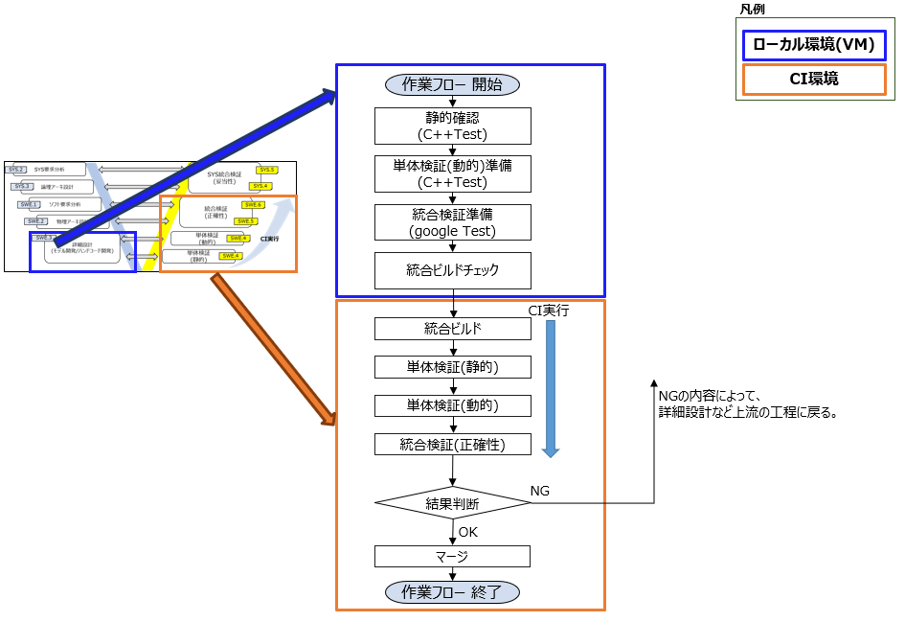
Purpose of this book
[Purpose of this book]
・You will be able to understand the concept of integrated verification in AP software.
・You will be able to create test files and stubs to be used in CI integration verification.
[Scope of this document]
The workflow for "Integrated Verification Preparation" is explained in the "Work Procedures" section of this document.
Workflow (AP software development_CI environment_Overall usage manual.pptx excerpt)
Scope of application
*The concept of "integration verification" carried out by CI
It is described in this book.
(For specific CI procedures, see the "CI Execution Manual.")

Slide 6
Manual List
【overview】
A list of manuals for the AP software CI environment is provided.
Manual Title | the purpose
AP software development_CI environment_Overall usage manual | ・You will be able to understand the workflow from detailed design(※) to integrated verification. ・Understand the CI environment. (*Detailed design will explain the work flow after static confirmation)
AP software development_CI environment_Static verification manual | ・You will be able to understand the concept of static verification in AP software. ・Static analysis (verification/verification) can be performed. ・You will learn how to interpret static analysis (verification/verification) results.
AP software development_CI environment_unit verification (dynamic) preparation manual | ・You will be able to understand the concept of unit verification in AP software. ・You will be able to create test cases and stubs to be used in CI unit verification (dynamic).
AP software development_CI environment_integrated verification preparation manual | ・You will be able to understand the concept of integrated verification in AP software. ・You will be able to create test cases and stubs to be used in CI integration verification.
AP software development_CI environment_Evaluation board confirmation manual | ・Being able to perform testing using evaluation boards. ・You will be able to check the communication packets and logs of the evaluation board.
AP software development_CI environment_CI execution manual | - Be able to execute CI and check and harvest verification results. ・Be able to issue pull requests on GitHub and merge (reflect) work content.
This book
[List of supplementary materials]
Although implementation work is outside the scope of application, materials related to CI environments are listed below.
Supplementary Material Name | the purpose
AP software development_CI environment_build | The ability to create executable binaries for AP software.

Slide 7
Integration verification concept
【table of contents】
Integration verification concepts: Purpose/Step-by-step verification/Regression testing
The concept of an integrated verification environment
Framework used for integration verification
Differences from mass production verification environment: Observation and control
How to select test items
Image of evaluation of observation logs
Image of the tester

Slide 8
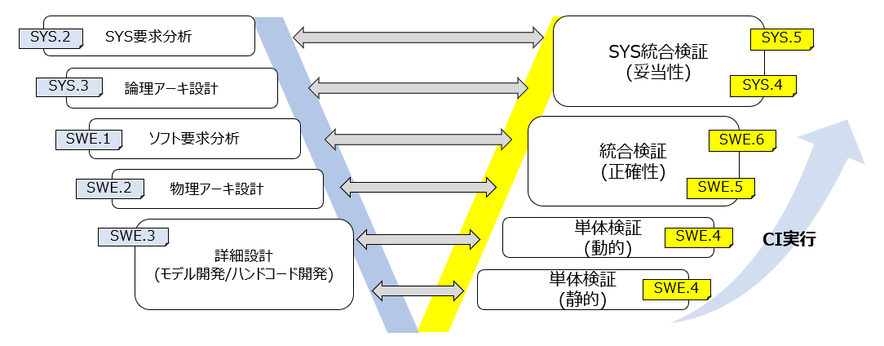
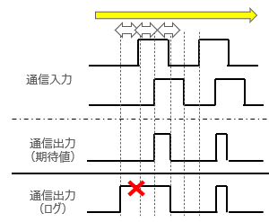
Purpose of integration verification
[What is integrated verification?]
This refers to SWE.5 integration testing and SWE.6 eligibility testing.
The behavior of software and communication between software
whether it is consistent with the architectural design (SWE.5);
Also, verify the validity with the software requirements (SWE.6).
Verification is carried out step by step for each functional unit of the architecture,
This also includes verification to confirm that no "unintended changes" have occurred in processing where the changes are not expected to affect operation.
■ About phased verification (details on the next slide)
By checking in stages, starting with small areas and working your way up to larger areas, defects can be found and corrected early.
Integration testing with library functions will also be carried out as part of the phased verification process.
① Within a subcomponent (e.g. IF behavior)
② Between subcomponents (e.g. IF behavior, message communication behavior)
③ Between each software (component)
Checking the timeline, etc.
*Subcomponent = functional unit of architecture
Counterpart software (component)
Target software (component)
③
Communication Input
Communication Input
In-Car
(EC8, etc.)
Subcomponent A
Checking the timeline, etc.
Communication Output
①
Communication Output
Function A
Function B
Function C
③
Subcomponent B
②
③
Communication Input
Function X
Function Y
Out-Car
Library
Communication Output

Slide 9
Integration Verification Concept: Step-by-step Verification
[About phased verification]
An image of step-by-step verification is illustrated below.
① Within a subcomponent (e.g. IF behavior)
⇒When subcomponent A is created, integration testing is performed within the area enclosed in the red frame.
② Between subcomponents (e.g. IF behavior, message communication behavior)
⇒When subcomponent B related to subcomponent A is created, expand the test scope and perform integration testing within the green frame.
③ Between each software (component)
⇒Once all the subcomponents of the Target software are completed, expand the testing scope and conduct integration testing within the blue frame.
Target software movement
Software for verification
Target software (component)
Test pattern ①
Subcomponent A
Counterpart software (component)
Stub
Scope of verification
Function A
Function B
Function C
Test pattern ②
In-Car
A stub that simulates communication with
Test pattern ③
Subcomponent B
Scope of verification
Out-Car
A stub that simulates communication with
Function X
Function Y
*Stub: Software for testing
(To make the Target software behave as intended)
Scope of verification for ③

Slide 10
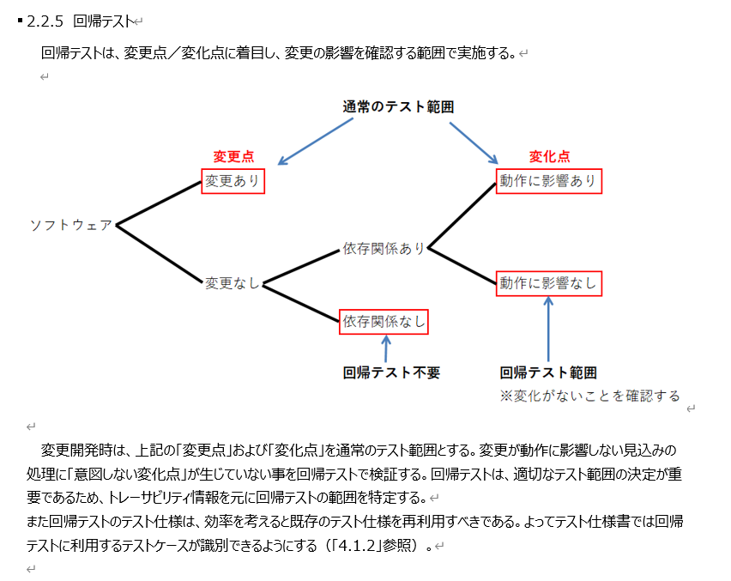
Integration Verification Concept: Regression Testing
[Necessity of regression testing]
In addition to step-by-step verification, there is regression testing that focuses on changes/variations.
"There are no unintended changes in the processing that are expected not to affect the operation of the changes."
confirm.
In other words, the tests conducted before the specification change should be conducted after the specification change,
Tests for specifications that do not change behavior verify that the previous results are obtained. (Full test)
↓Software Integration and Integration Testing Guidelines.docx
Software Integration and Integration Testing Guidelines.docx

Slide 11

The concept of an integrated verification environment
[Integrated Verification Environment Concept]
The AP area of ​​CoreECU contains Guest and Host clusters.
Communication is performed within the same cluster and with other clusters.
As an integrated verification environment in a local environment (VM),
Integration verification is carried out using a virtual environment called a container that simulates an actual ECU.
Character | role
tester | ・Communication instructions (control) to the stub - Observe the logs and compare the observed logs with the expected logs
stub | - Communication with target software according to test pattern ・Return values ​​and result logs from the target software
Target Software | ・Software to be verified
CoreECU
Local environment (VM)
GUEST cluster
(AP region)
HOST cluster
(AP region)
Tester Container
GUEST container
HOST container
communication
(SOME/IP)
control
communication
(SOME/IP)
Counterpart software
Target Software
tester
Counterpart software
(stub)
Target Software
This configuration is based on the AUTOSAR system test working
(One of the AP activities of the AUTOSAR Consortium)
Image of integration verification
Tester Container
GUEST container
HOST container
①Target software
Behavior verification
control
Counterpart software
(stub)
Communication (SOME/IP)
tester
Target Software
DLT Log
②Target software
Communication behavior verification
※Target software
Logs can also be observed
Observe and evaluate logs

Slide 12
The concept of an integrated verification environment
[About the configuration of integrated verification]
The configuration of integrated verification will change depending on the software layout.
Cooperation within the same cluster and cooperation with CP regions are possible, and will be verified using the configuration shown below.
*Specific verification procedures for collaboration within the same cluster or collaboration with CP regions as shown in the figure below have not been confirmed. Future maintenance is planned.
・Examples of software that only works within a HOST cluster
Tester
GUEST
HOST
App on the other device
Stub
Communication (SOME/IP)
Target Software
※Target software
Logs can also be observed
tester
control
DLT Log
Collaborative Software
(stub)
Observe and evaluate logs
DLT Log
・Examples of software that works with the CP area
*A stab just before CP is required before S2S.
control
Tester
GUEST
HOST
(CP region)
App on the other device
Stub
Communication (SOME/IP)
S2S
tester
Target Software
Just before CP
stub
DLT Log
※Target software
Logs can also be observed
DLT Log
Observe and evaluate logs
※S2S:
Signal to Service

Slide 13
Framework used for integration verification
[Framework used for integration verification]
Integration verification does not use special tools, but uses multiple frameworks.
■ Frameworks used
・Google Test Framework: Used to evaluate observed logs and expected logs.
・DLT Framework: Used to observe DLT logs output by AP software.
・RPC (Remote Procedure Call): For the target software,
It is used to instruct the software communication method of the test pattern given from the stub.
Tester
RPC
GUEST
HOST
tester
control
(Communication Instructions)
Counterpart software
(stub)
communication
(Communication execution)
Target Software
evaluation
DLT Log
Google Test Framework
Observe the log
DLT Framework

Slide 14
Differences from mass production verification environment: Observation and control
[Differences in verification environment from mass production]
"Observation" and "control" are used as mechanisms to achieve integrated verification.
"Observation" is also carried out in mass production, but the process is different in AP software development. "Control" is a method that first appears in AP software development.
【control】
The need for control
Since the ECU and tester parts are separated in the integrated verification environment, it is necessary to control communication between the tester and ECU.
Control Role
"Control" allows for intended communication (test patterns) and makes it possible to generate behavior that occurs infrequently.
In this CI environment, RPC (Remote Procedure Call) is used to control the opposing software (stub) and to allow communication between the stub and target software.
【observation】
The AP software can use the log output function to output DLT logs.
By setting up logs when values ​​are updated or at conditional branches, and then "observing" those logs with a tester, you can check the behavior of the AP software.
In this CI environment, logs are "observed" using DLT Framework.
In mass production, the values ​​of global RAM are monitored and observed directly.
In AP software development, since it is not possible to directly observe variables like mass-produced global RAM, the values ​​of variables are output as logs and then these logs are observed.
Tester Container
GUEST
HOST
tester
In RPC
"Control" communications
Counterpart software
(stub)
Target Software
Controlled Communications
rpc
DLT Log
"Observing" the log
Mass production software
AP Software
2100
DLT Log
13:30:50:50 :[XX_APL]output NE = 2000
13:30:50:61 :[XX_APL]output NE = 2000
13:30:50:73 :[XX_APL]output NE = 2100
13:30:50:82 :[XX_APL]output NE = 2100
NE
2000

Slide 15


Image of the tester
【tester】
An executable binary that includes the test suite.
[Test Suite]
Multiple test patterns with similar test objectives and conditions
The whole set is called a test suite.
In this CI environment, we create it_tester.cpp as one test suite.
Store it under test/IT_Test/tester in the application directory.
[Test Pattern]
A test unit that counts as one integration test.
Implement it as the TEST_F function in it_tester.cpp.
Example: Test Pattern 1
period
10ms
10ms
10ms
10ms
30
40
input
10
20
output
Expected value
20
30
30
10
tester
Build
server_it_tester2.cpp
class ServerTest2 : …
{
TEST_F common variables
}
TEST_F(test21, check_aaa)
{
Enter XX in the □□ communication
}
TEST_F(test22, check_bbb)
{
Enter △△ in □□ communication
}
…
■Image
server_it_tester1.cpp
class ServerTest1 : …
{
TEST_F common variables
}
TEST_F(test1, check_xxx)
{
Instruct the stub to communicate test pattern 1
Collect and evaluate output logs
}
TEST_F(test2, check_yyy)
{
Instruct the stub to communicate test pattern 2
Collect and evaluate output logs
}
…
Repository Configuration
nextpf-xxx
Common variables and function definitions
(Test fixture)
apps
↓Software to be verified
SampleServer_autosar_adaptive
src
Test pattern 1
test/IT_Test/tester
↓Two test suites
server_it_tester1.cpp
server_it_tester2.cpp
Test pattern 2
SampleClient_autosar_adaptive_STUB
src
↑TEST_F Each one is a test pattern

Slide 16
How to select test items
[Regression testing]
Conducting full testing can ensure quality, but it takes time and reduces work efficiency.
In this CI environment, we provide a way to exclude certain tests so that regression testing can be performed only on tests that require it.
←Not a full test,
Narrow it down to this range
test/IT_Test/tester: Test suite storage location
server_it_tester_A1.cpp
server_it_tester_Bsan.cpp
Evacuate
Not applicable
Software Integration and Integration Testing Guidelines.docx
server_it_tester_Asan2.cpp
Excluding certain tests
You can exclude specific tests from the accumulated integration tests using the following method. (Including purposes such as saving execution time)
- Test suite level exclusion
It is possible to exclude the test suite file (it_tester.cpp) by moving it to a different directory other than test/IT_Test/tester. (Top right)
- Not applicable at test pattern level
Use a mechanism to exclude the test from verification by editing the test suite file. (Explained on Slide 34)

Slide 17
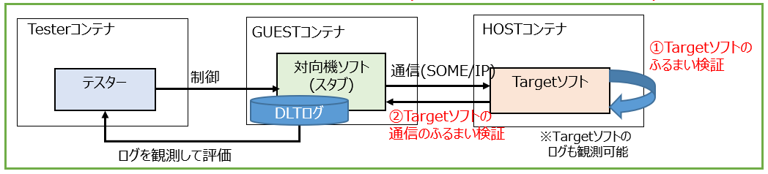
Image of evaluation of observation logs
[Image of evaluation of observation logs]
There are several ways to observe DLT logs. In this manual,
Rather than observing and evaluating the output for each input, we use a method in which we observe and evaluate them all at once at the end, on a test pattern basis.
For each test pattern, observe the logs together and verify that all related logs are as expected.
Example: Test Pattern 1
period
10ms
10ms
10ms
10ms
30
40
input
10
20
20
30
30
output
Expected value
10
Tester
DLT
Opposing machine stub
Target Software
control
Test pattern 1
Test Instructions
input 10
output 10
DLT Log
"output = 10"
input 20
output 20
"output = 20"
input 30
output 30
"output = 30"
input 40
output 30
DLT log observation
observation
"output = 30"
Observation Log Evaluation
Instead of observing and evaluating every single time every 10 ms,
After executing one test pattern in its entirety, the logs are collectively observed and evaluated.
⇒Example: The output log is 10→20→30→30
"output = 10"
"output = 20"
"output = 30"
"output = 30"
"output = 10"
"output = 20"
"output = 30"
"output = 30"
Expectation Log
VS

Slide 18
Procedure
【table of contents】
1. Create a peer stub
2. Create a test pattern
3. Create a tester
4. Check the operation

Slide 19

Work procedure Overview
VSCode
1. Creating a stub for the other device
Communicate with the Target software
Create software that empties the contents of the opposing machine.
Opposing machine stub
input
Target Software
output
2. Test pattern creation
According to the test pattern
Create communication processing with the Target software.
Opposing machine stub
input
Target Software
rpc
output
Test pattern execution instructions (control)
Create a tester to evaluate communication results.
3. Tester Creation
tester
Test PTN
control
Opposing machine stub
input
Target Software
rpc
output
Log observation & evaluation
Can the created test be executed correctly?
Check the operation.
4. Operation check
tester
Test PTN
control
Opposing machine stub
input
Target Software
Test Run
rpc
output
result.xml
Log observation & evaluation

Slide 20
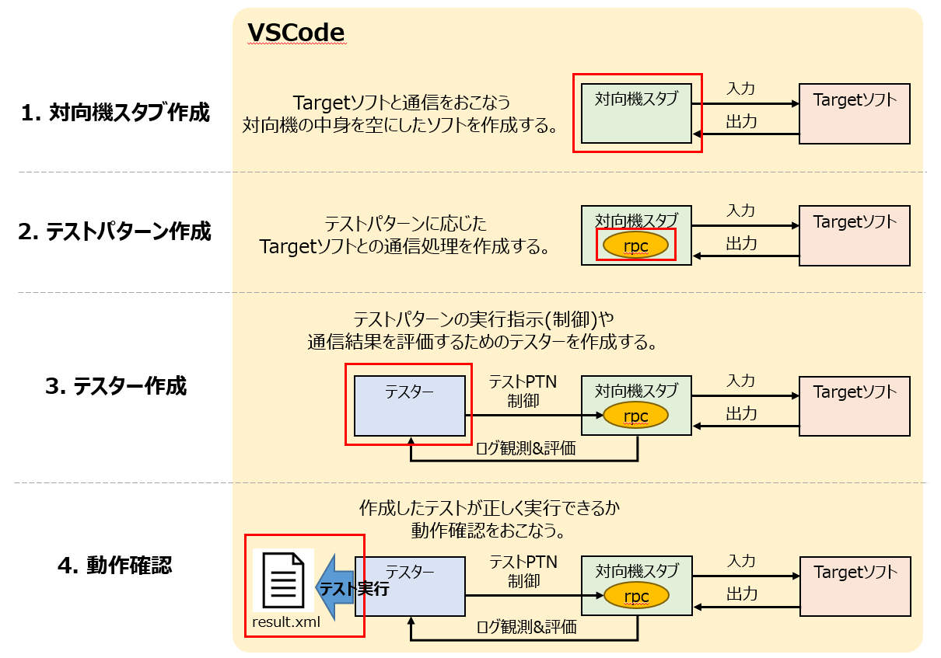
Create a remote stub

Slide 21
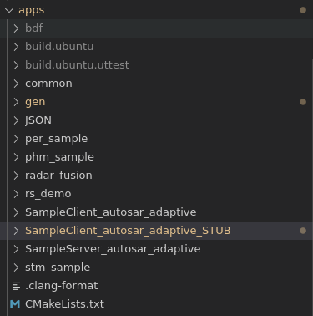
Step 1: Create a stub for the other device
[What is a remote device stub?]
A communication partner for evaluating Target software. In step 2, to implement communication processing with the target software according to the test pattern,
In this procedure 1, it is sufficient to create a stub for the other machine that has the minimum startup/shutdown functions and communication processing with the target software.
【How to make】
There are several ways to create it, as shown below, but this manual explains method ②.
1) Create a counterpart device (equivalent to a stub) from ARXML that can start/shut down the software and perform minimum communication processing. (Pattern created from scratch)
②If the opposing device software already exists, create a stub based on that software. (Pattern of using what exists)
[Procedure: Preparing for stub creation]
Duplicate the software of an already existing counterpart device.
Here, we will create a stub based on the already existing opposing device software "SampleClient_autosar_adaptive".
Duplicate (copy) it as "SampleClient_autosar_adaptive_STUB".
Counterpart software
(SampleClient_
autosar_adaptive)
input
Target Software
(SampleServer_
autosar_adaptive)
output
Duplicate
(The contents are still the same)
Duplicate
Opposing machine stub
(SampleClient_
autosar_adaptive_STUB)
Under apps in the repository

Slide 22
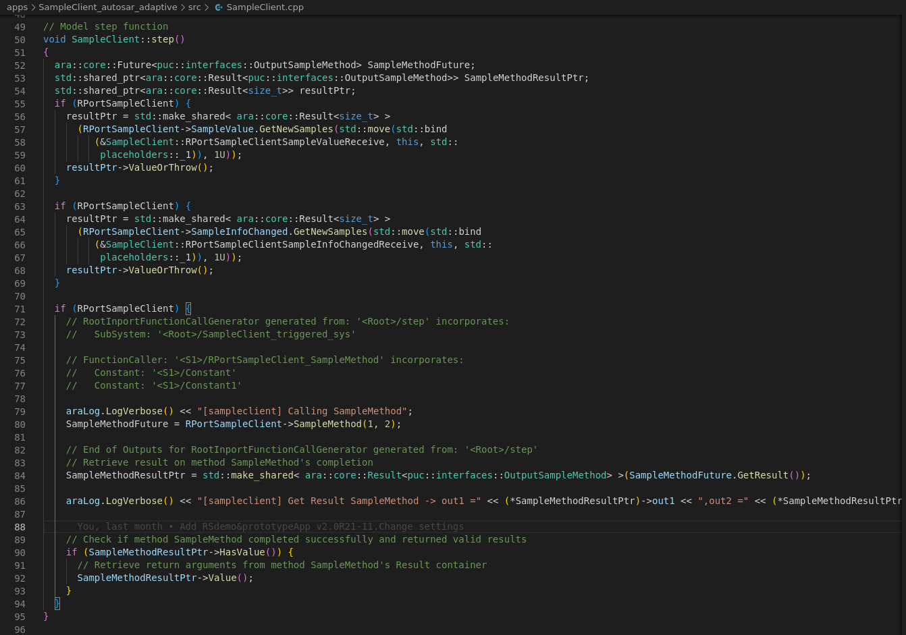
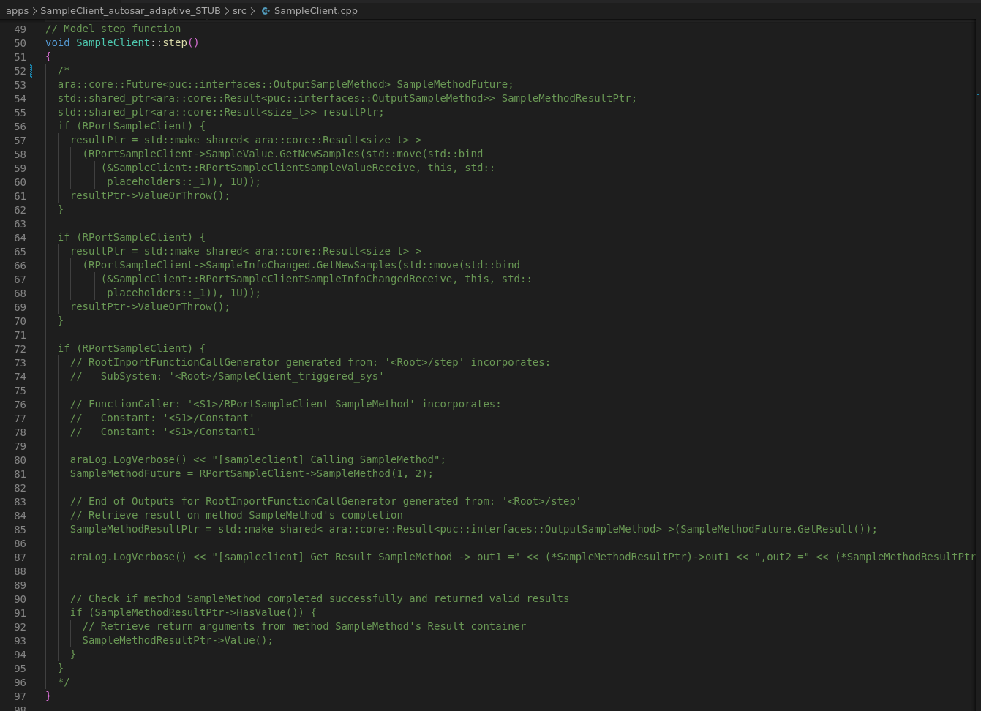
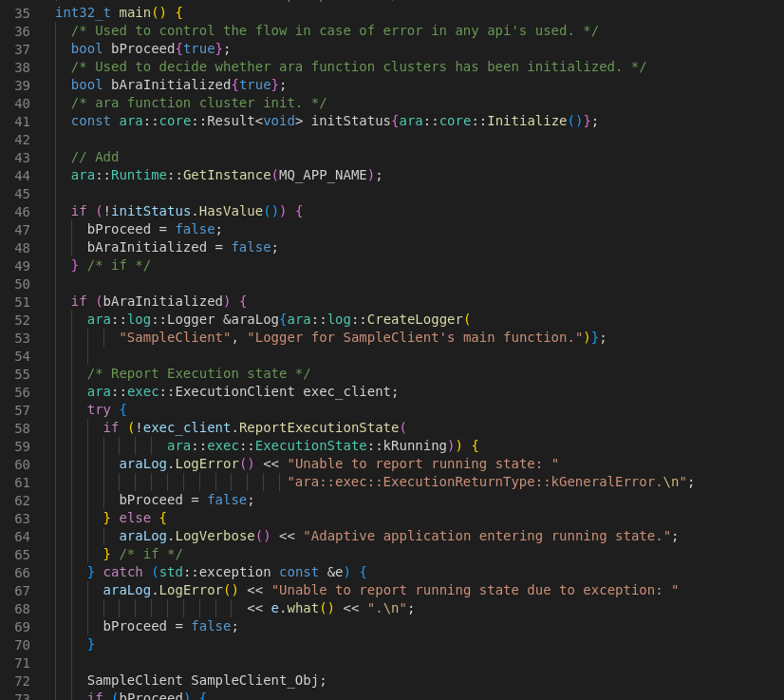
Step 1: Create a stub for the other device
[Procedure - Stub-]
As mentioned in the previous slide, in step 2, communication processing with the target software according to the test pattern is implemented.
Therefore, in preparation for replacing the original processing of the opposing device with a test pattern, the original processing is commented out (disabled).
*Do not comment out the processes required for starting and shutting down the other device's software, as they must be executed.
Supplement: Why comment out the actual processing?
Example: SampleClient_autosar_adaptive_STUB
Incorporating RPC into the other machine
It controls communication and log output for integration verification,
If the original process (communication or log output) exists
The processes are also executed simultaneously.
Depending on the timing of RPC control,
By the original processing
This may change the test results,
It must not affect the testing.
■The contents of the function that communicates with the target software (the actual processing) are commented out.
Commenting
Counterpart software
boot
SampleClient.cpp
Loop Start----------------
Comment out communication processing and log output.
RPC Control
■The process of starting and ending the software on the other device remains the same.
Communication A (Input X)
Communication A (Input Y)
⇒Possibility of affecting the test
RPC Control
Result log output for communication A
Starting and closing the software
It does nothing to the process.
Result log output for communication A
Communication B
Loop End------------------
main.cpp
end

Slide 23
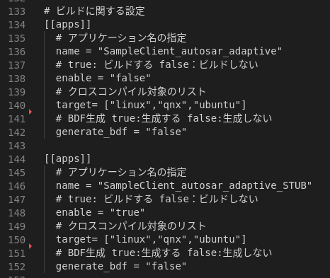
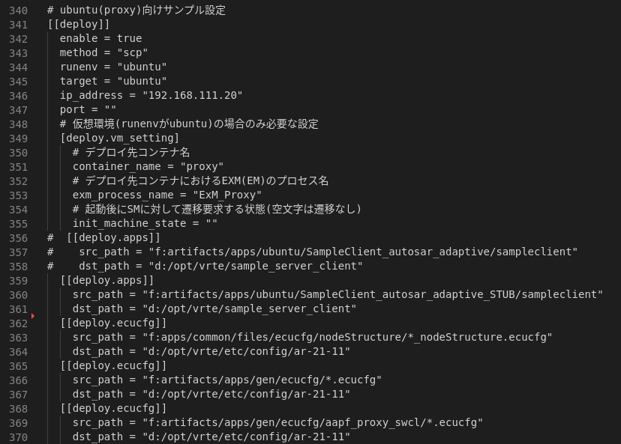
Step 1: Create a stub for the other device
[Procedure - Change build/deploy settings -]
Modify Setting.toml and build and deploy the created remote machine stub.
*Setting.toml is a configuration file for using a CI environment. Here you can set the build target and deployment settings.
*In this procedure, the stub is created based on an existing device, so the description is in an orange frame. If you are creating a stub from scratch, just fill in the contents in the red box.
■ Build settings
■ Deployment settings
(*Ubuntu is used as an example, but hardware A and hardware B are set up in the same way.)
*
③
①
②
①
③
③
②
Change procedure
1) Copy the build settings of the target machine software already described.
②Change the "name" of the copied build setting to stub.
③ Change the "enable" of the other device software already listed to "false",
Set "enable" on the stub side to "true".
Change procedure
①Copy the deployment settings of the opposing device software that have already been written.
②Change the "src_path" of the copied deployment settings to a stub.
③ Comment out (add # to the beginning) the deployment settings for the opposing machine software that have already been written.
*name: Application directory name
enable: Whether to build or not
*src_path: The path where the executable binary generated by the build exists
dst_path: The path to deploy the executable binary from src_path

Slide 24
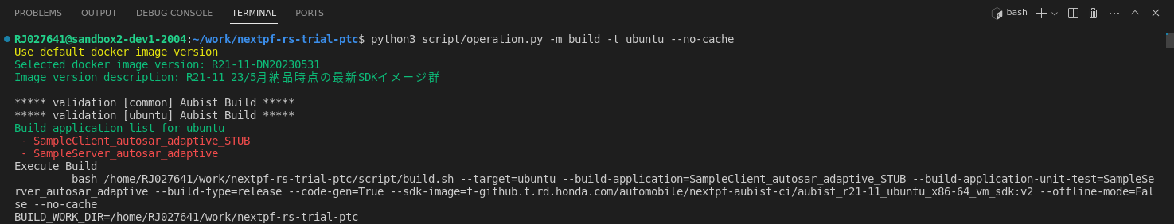
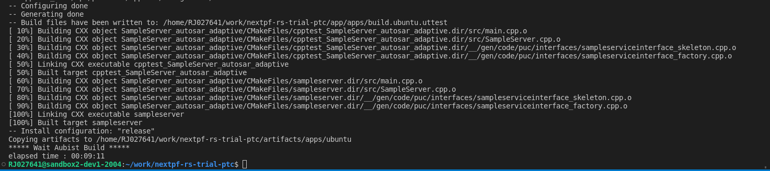
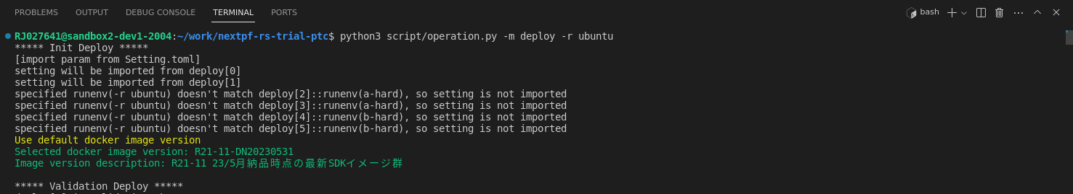
Step 1: Create a stub for the other device
[Procedure - Build/Deployment Check -]
Run the build and deploy commands and ensure there are no errors.
For copy and paste (ubuntu target)
■ Execute build command
python3 script/operation.py -m build -t ubuntu --no-cache
Yes:
For copy and paste (ubuntu target)
■ Execute the deploy command
python3 script/operation.py -m deploy -r ubuntu
Yes:

Slide 25
Creating a Test Pattern

Slide 26
Step 2: Create a test pattern
[What is RPC?]
RPC stands for Remote Procedure Call.
Generally speaking, it is a set of rules for one piece of software to request processing from another piece of software via communication or other means and for returning the results.
By using RPC, it is possible to handle abnormal or infrequent communications at the intended timing.
In this CI environment, the tester issues communication instructions (at the intended timing) to the stub of the other machine,
Used to communicate with the target software (intended communication).
[Procedure - RPC implementation -]
To incorporate RPC into the remote machine stub, create the following four files.
The template file is available at the link below, so please modify the template file by referring to the contents of the link.
①. rpc_invoke.h
②. rpc_invoke.cpp
③. rpc_invoke_impl.h
④. rpc_invoke_impl.cpp
tester
Opposing machine stub
Target Software
Communication Instructions
rpc
Communication for failure
Behavior
Is it as intended?
Request feature ID3
Return value (response)
RPC implementation example
・Function ID1 Communication A (ex. Method) is executed four times with different input values
・Function ID2 Communication B (ex. Event) is performed once
・Function ID3: Implement communication for malfunction
Follow the steps below.

Slide 27
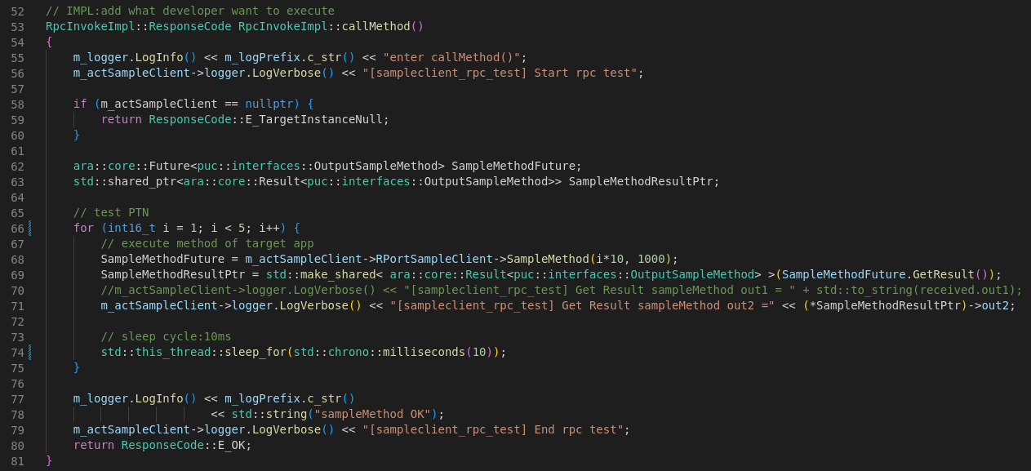
Step 2: Create a test pattern
[Supplementary note - RPC implementation example]
A specific implementation example of the part corresponding to the RPC test pattern is described below.
Opposing machine stub
Example: Test Pattern 1
RPC
period
10ms
10ms
10ms
10ms
Implementing the process for test pattern 1
(Method communication at 10 ms intervals
(Execute 4 times with different input)
30
40
input
10
20
30
30
output
10
20
rpc_invoke_impl.cpp
Test pattern 1 from the tester
Instruction-driven functions
Test pattern implementation
Test pattern communication
(i*10 corresponds to the input in the upper right figure)
Log Output
(out2 corresponds to the output in the upper right figure)
10ms sleep

Slide 28
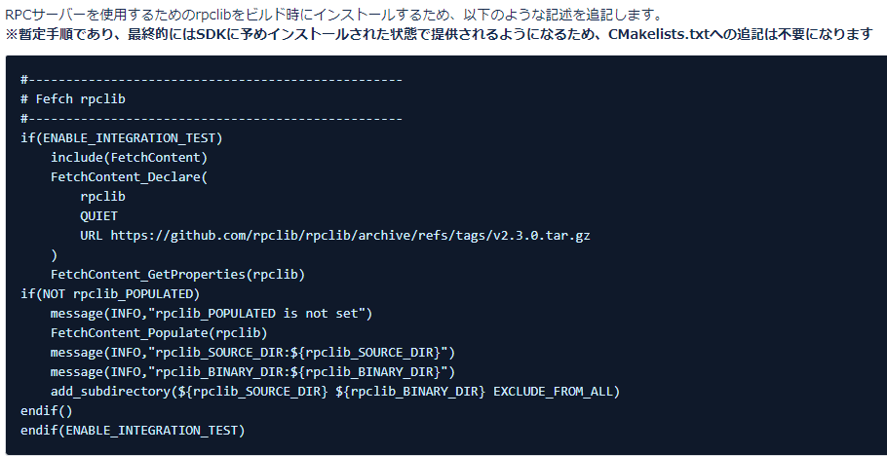
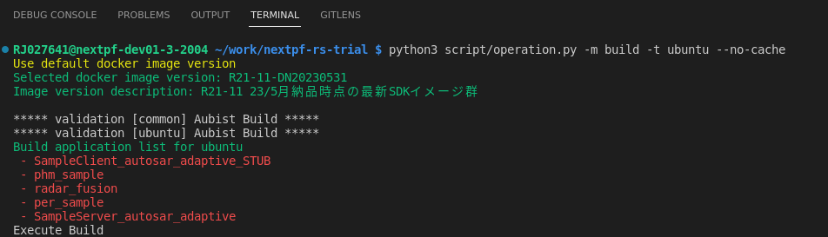
Step 2: Create a test pattern
[Procedure - Incorporate RPC into the remote machine stub]
Incorporate RPC into the opposing machine stub and check the build.
Follow the steps below.
[Additional information about rpclib]
Regarding "Modifying CMakelists.txt," in order to use RPC, you need to build including rpclib.
As of April 8, 2024, the provided SDK does not include rpclib,
As a temporary solution, if you have an application that uses RPC, you will need to install rpclib in CMakeLists.txt.
Please note that if you are incorporating RPC into multiple apps, you only need to write it in one CMakeLists.txt.
This must be included in the CMakeList.txt of the first app that is built among apps that incorporate RPC.
Link excerpt
Example: When executing a build command
Build Order
(You won't know until you build it)

Slide 29
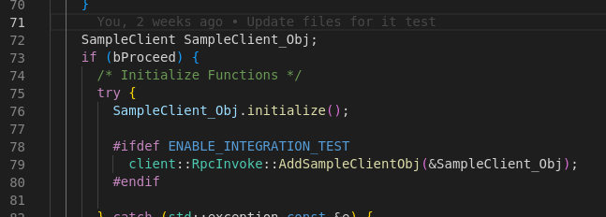
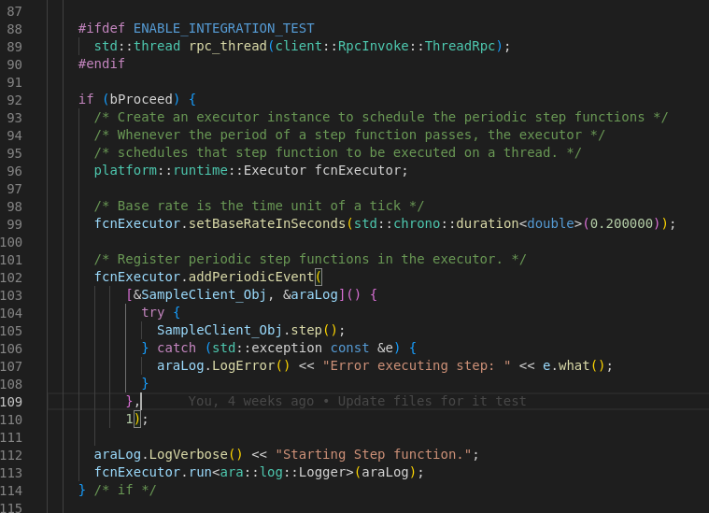
Step 2: Create a test pattern
[Additional information - Regarding RPC integration -]
Regarding "Modifying source files"
The implementation details vary depending on the software, and the additional sections may also differ. As an example, an example of adding SampleClient is described in this document.
Example: SampleClient’s main.cpp
Instance creation process
Initialize process
postscript
After the Initialize process
The instance setting function was called.
*Pass the created instance.
Example: SampleClient’s main.cpp
postscript
In the image above
After the initialization process and before the soft start process
Implemented RPC thread generation process.
Soft start process

Slide 30
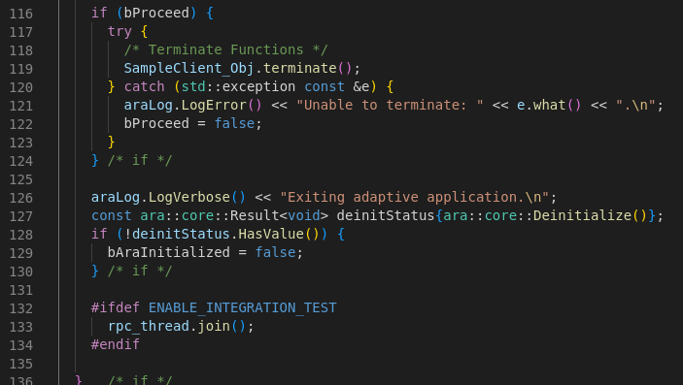
Step 2: Create a test pattern
[Additional information - Regarding RPC integration -]
Regarding "Modifying source files"
The implementation details vary depending on the software, and the additional sections may also differ. As an example, an example of adding SampleClient is described in this document.
Example: SampleClient’s main.cpp
End processing
postscript
After termination
The function to wait for thread termination was called.

Slide 31
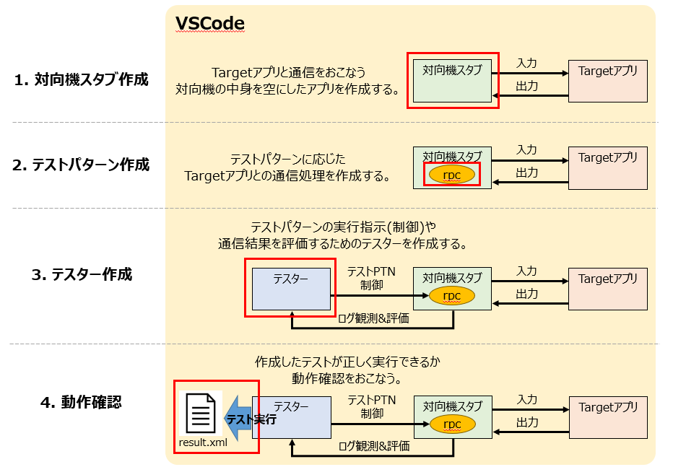
Create a tester

Slide 32
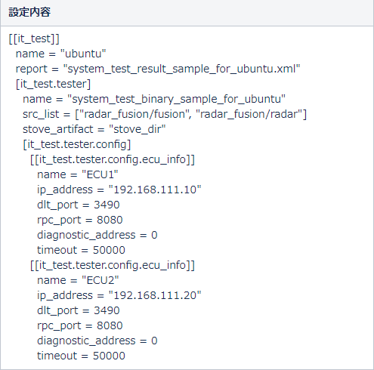
Step 3: Create a tester
[Procedure - Tester implementation -]
A tester file template is provided at the link, so please implement the following content by referring to the link.
・Change from template to software-specific information
・Implementation of TEST_F (main body of each test pattern) (communication request part of test pattern, evaluation part of expected log observation log, etc.)
Once the implementation is complete, carry out the "Build Tester" step described at the very end of the link, and if no errors occur, the creation is complete.
Follow the steps below.
[Additional information - About modifying Setting.toml]
Regarding "Settings in Setting.toml", "src_list" is a software-specific setting.
In "src_list", write the application directory in which the created it_tester.cpp exists.
src_list: Contains it_tester.cpp
The application directory must be specified.

Slide 33

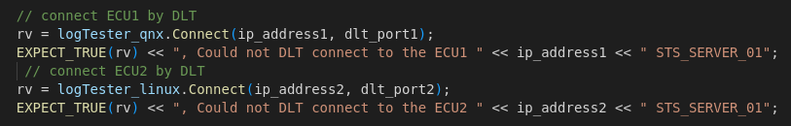
Step 3: Create a tester
[Additional information - Recommended implementation for testers]
In order to improve the accuracy of tester log acquisition, the following two points are recommended:
①Implement sleep processing.
To prevent DLT connection and log acquisition from becoming unstable,
Implement a sleep process of 10 to 30 seconds before the connect process and before the GetMessageList function.
example.
②If there are multiple ECUs that will obtain DLT logs, prepare a variable to store the DLT logs for each ECU.
If you want to get DLT logs for both the QNX and Linux software,
Instead of reusing one variable, prepare and use two variables.
example.
Here
timeToWaitForLogMessages is set to 20 seconds
Definition process
One variable called logTester in QNX/Linux
If you reuse it, an error will occur.
DLT connection processing

Slide 34
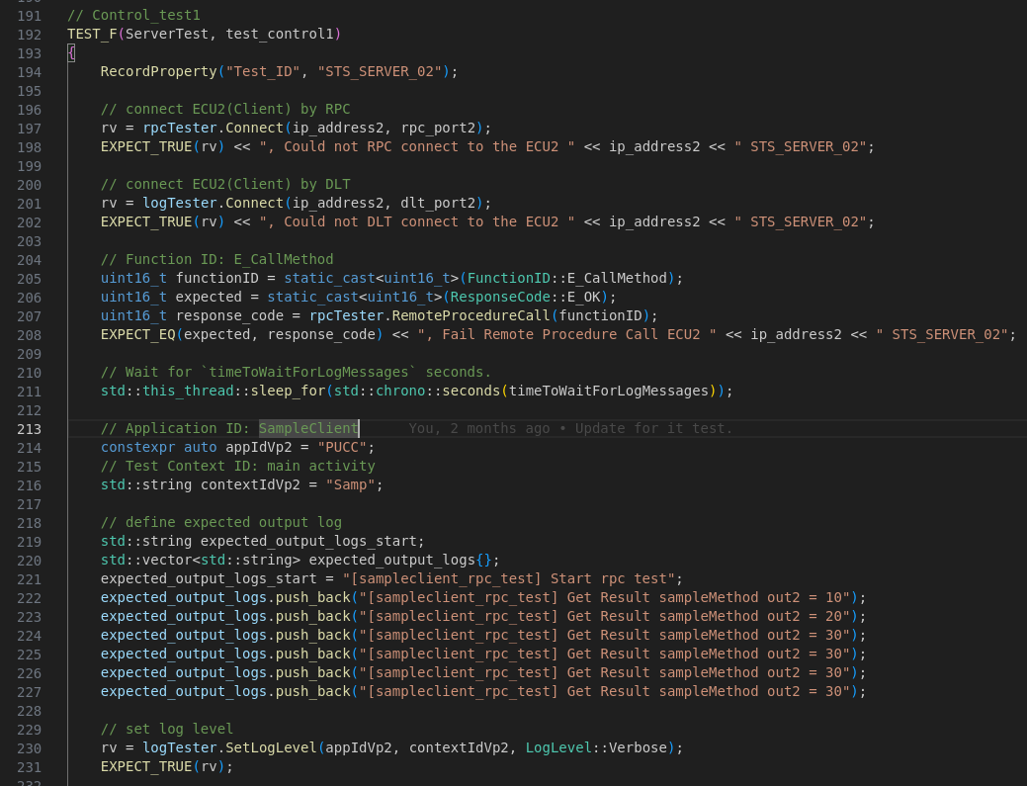
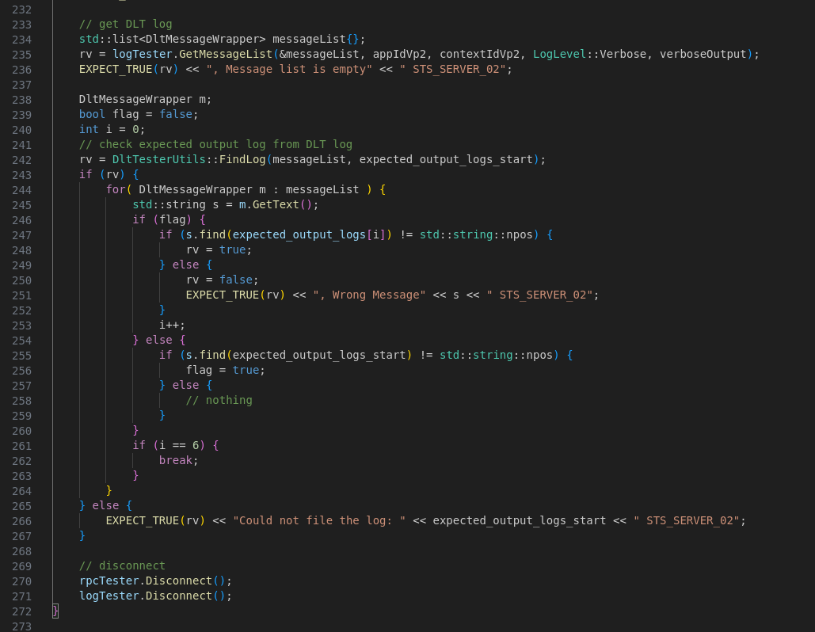
Step 3: Create a tester
[Supplementary note - Tester implementation example]
A specific implementation example of a tester is described below.
Supplementary Note: If you use TEST_F(ServerTest, DISABLED_test_control1)
Can be set as a test not to be performed.
⇒ Test patterns can be excluded
server_it_tester_cotrol.cpp
tester
Test pattern 1 implementation
① Calling function ID1
2) Definition of expected value
③ DLT log observation
④Evaluation of observation logs and expected values
①
②
Instead of evaluating the output value itself,
Evaluating whether the expected log exists in the DLT log. (Log string comparison)
Instead of evaluating the output value itself,
Evaluate whether the expected log exists in the DLT log.
③
④
Due to ①, the RPC side will
Test pattern 1 communication is performed
Example: Test Pattern 1
period
10ms
10ms
10ms
10ms
30
40
input
10
20
20
30
30
output
10

Slide 35
Operation check

Slide 36
Operation check
[Procedure - Execute integration test -]
Verify in a local environment that integration tests run as intended.
Builds the software to be used for integration testing and then runs the integration test commands.
Follow the steps below.
[Procedure - Checking results -]
Check the output report results and DLT logs to verify that the integration test was performed as intended.
Follow the steps below.
[Additional information - About how to harvest]
For detailed information on how to prune, please refer to the document "Integration Test Pruning Instructions.pptx".

Slide 37
that's all

