Slide 1
PMR TERMINAL
Daily Market Intelligence · by Praveen
Friday, 02 Oct 2026 10:02 SGT
Market tone: RISK-OFF
RAG 17R / 13A / 16G | 41.3% above 200DMA | Portfolio Rs 1,945,824 (+12.2%)
Educational analytics - not investment advice.

Slide 2










MTD Gainers & Losers
Top 5 each · 3-month sparkline
GAINERS
LOSERS
Infosys
+4.1%
Natural Gas
-3.0%
INFY.NS · RED
NG=F · RED
Crude Oil WTI
+2.8%
Hang Seng
-2.6%
CL=F · RED
^HSI · RED
NIFTY IT
+2.2%
ITC
-2.6%
^CNXIT · RED
ITC.NS · RED
Nikkei 225
+2.1%
Alphabet
-1.7%
^N225 · AMBER
GOOGL · AMBER
US Energy
+2.0%
FTSE 100
-1.7%
XLE · GREEN
^FTSE · GREEN

Slide 3
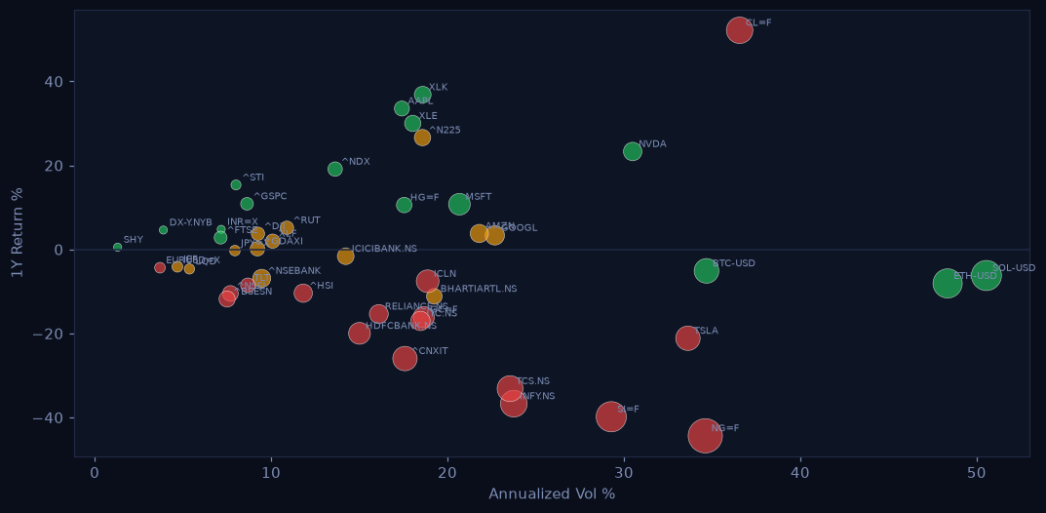
Risk Map
1Y return vs annualized volatility · color = RAG · size = |max drawdown|

Slide 4
AI Signal Desk
Buy/Sell engine - top conviction calls
US Technology
STRONG BUY
95%
above 200DMA · golden cross (50>200) · MACD bullish
Nvidia
STRONG BUY
95%
above 200DMA · golden cross (50>200) · MACD bullish
Microsoft
STRONG BUY
95%
above 200DMA · golden cross (50>200) · MACD bullish
Solana
STRONG BUY
86%
above 200DMA · golden cross (50>200) · MACD bearish
Bitcoin
STRONG BUY
86%
above 200DMA · golden cross (50>200) · MACD bearish
Nasdaq 100
STRONG BUY
95%
above 200DMA · golden cross (50>200) · MACD bullish
Ethereum
STRONG BUY
85%
above 200DMA · golden cross (50>200) · MACD bearish
Apple
STRONG BUY
83%
above 200DMA · golden cross (50>200) · MACD bearish
US Energy
STRONG BUY
81%
above 200DMA · golden cross (50>200) · MACD bearish
Dollar Index
BUY
78%
above 200DMA · golden cross (50>200) · MACD bullish
Nikkei 225
BUY
76%
above 200DMA · golden cross (50>200) · MACD bullish
S&P 500
BUY
68%
above 200DMA · golden cross (50>200) · MACD bearish

Slide 5
Portfolio P&L
Base currency INR · USD/INR 95.93
Symbol
Qty
Avg
Last
Value
P&L
P&L %
Day %
BTC-USD
0.1
60,000
84,926
Rs 814,667
Rs 239,104
+41.5%
+1.6%
GC=F
1
2,300
4,178
Rs 400,793
Rs 180,161
+81.7%
+0.0%
AAPL
10
185
330
Rs 316,866
Rs 139,401
+78.5%
+0.0%
NVDA
8
450
231
Rs 177,166
Rs -168,172
-48.7%
+0.0%
INFY.NS
80
1,400
1,035
Rs 82,800
Rs -29,200
-26.1%
+0.0%
RELIANCE.NS
50
2,450
1,168
Rs 58,385
Rs -64,115
-52.3%
+0.0%
TCS.NS
25
3,600
2,075
Rs 51,875
Rs -38,125
-42.4%
+0.0%
HDFCBANK.NS
60
1,520
721
Rs 43,272
Rs -47,928
-52.5%
+0.0%
Total Rs 1,945,824 | P&L Rs 211,126 (+12.2%) | Sharpe 0.09 | Vol 20.39% | VaR95 -1.9%/day

