Slide 1
PMR TERMINAL
Daily Market Intelligence · by Praveen
Friday, 04 Sep 2026 08:49 SGT
Market tone: MIXED
RAG 10R / 21A / 15G | 60.9% above 200DMA | Portfolio Rs 1,926,452 (+12.3%)
Educational analytics - not investment advice.

Slide 2










MTD Gainers & Losers
Top 5 each · 3-month sparkline
GAINERS
LOSERS
Crude Oil WTI
+6.7%
TCS
-3.3%
CL=F · RED
TCS.NS · RED
Bitcoin
+3.3%
Tesla
-3.0%
BTC-USD · AMBER
TSLA · RED
Bharti Airtel
+3.2%
Nikkei 225
-2.4%
BHARTIARTL.NS · AMBER
^N225 · AMBER
ITC
+2.9%
Microsoft
-2.1%
ITC.NS · RED
MSFT · GREEN
Apple
+2.6%
Amazon
-1.8%
AAPL · GREEN
AMZN · AMBER

Slide 3
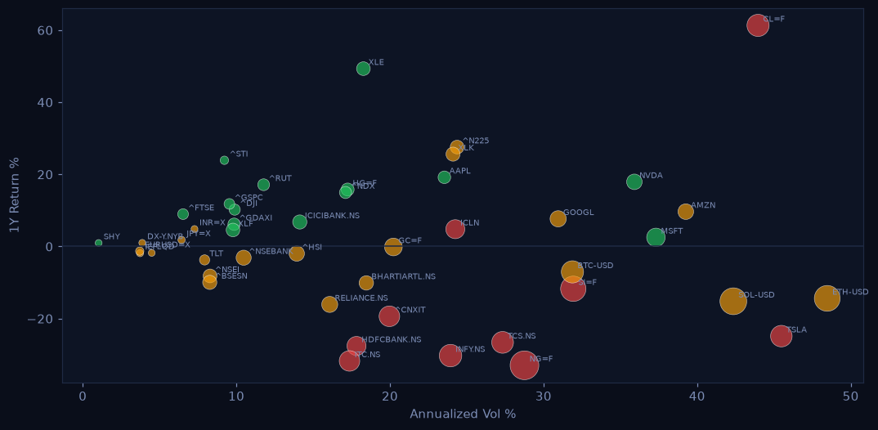
Risk Map
1Y return vs annualized volatility · color = RAG · size = |max drawdown|

Slide 4
AI Signal Desk
Buy/Sell engine - top conviction calls
Copper
STRONG BUY
95%
above 200DMA · golden cross (50>200) · MACD bullish
Microsoft
STRONG BUY
83%
above 200DMA · golden cross (50>200) · MACD bearish
Nvidia
STRONG BUY
95%
above 200DMA · golden cross (50>200) · MACD bullish
NIFTY IT
STRONG BUY
82%
above 200DMA · golden cross (50>200) · MACD bullish
ICICI Bank
STRONG BUY
93%
above 200DMA · golden cross (50>200) · MACD bullish
Apple
STRONG BUY
92%
above 200DMA · golden cross (50>200) · MACD bullish
US Financials
STRONG BUY
80%
above 200DMA · golden cross (50>200) · MACD bearish
US Energy
BUY
93%
above 200DMA · golden cross (50>200) · MACD bullish
Ethereum
BUY
78%
above 200DMA · golden cross (50>200) · MACD bearish
Straits Times
BUY
71%
above 200DMA · golden cross (50>200) · MACD bearish
Solana
BUY
75%
above 200DMA · golden cross (50>200) · MACD bearish
S&P 500
BUY
68%
above 200DMA · golden cross (50>200) · MACD bearish

Slide 5
Portfolio P&L
Base currency INR · USD/INR 94.47
Symbol
Qty
Avg
Last
Value
P&L
P&L %
Day %
BTC-USD
0.1
60,000
81,145
Rs 766,614
Rs 199,764
+35.2%
+5.0%
GC=F
1
2,300
4,523
Rs 427,273
Rs 209,980
+96.6%
+0.0%
AAPL
10
185
325
Rs 307,006
Rs 132,227
+75.7%
+0.0%
NVDA
8
450
224
Rs 169,609
Rs -170,501
-50.1%
+0.0%
INFY.NS
80
1,400
1,130
Rs 90,424
Rs -21,576
-19.3%
+0.0%
RELIANCE.NS
50
2,450
1,302
Rs 65,125
Rs -57,375
-46.8%
+0.0%
TCS.NS
25
3,600
2,320
Rs 58,003
Rs -31,997
-35.5%
+0.0%
HDFCBANK.NS
60
1,520
707
Rs 42,399
Rs -48,801
-53.5%
+0.0%
Total Rs 1,926,452 | P&L Rs 211,721 (+12.3%) | Sharpe 0.12 | Vol 19.57% | VaR95 -1.91%/day

