Slide 1
GROUP PROJECT PROPOSAL

Slide 2
Title
ConnectHub: Prepaid Network Services Database

Slide 3
Team Members
- Pravalli
- Sukanya
- Sruthi
- Swati
- Pooja

Slide 4
Introduction
This database is designed to manage the operations of a mobile network provider that offers prepaid plans to its customers.

Slide 5
Business Requirement Overview
The database will manage user information, plan details, user plan subscriptions, usage data, and payment records.

Slide 6
User Management
Stores detailed information about users, including names, contact details, and addresses.

Slide 7
Plan Management
Supports various prepaid plans with specific data caps, call minutes, text message allowances, and validity periods.

Slide 8
Subscription Tracking
Tracks each user's plan subscription details, including activation and expiration dates, and plan status.

Slide 9
Usage Tracking
Records usage details against each active plan, ensuring usage does not exceed plan limits.

Slide 10
Payment Processing
Records all payments for plan activations, including amount, payment date, and method.

Slide 11
Specific Assumptions
- Designed for prepaid plans only.
- Limited predefined payment methods.
- Does not handle customer support queries or ticketing.

Slide 12
Database Structure
- Users Table
- User Plans Table
- Plans Table
- Payments Table
- Usage Table

Slide 13
Entities and Attributes
Conceptual Design
Users:
Contains basic user information
User ID
Full Name
Email
Phone Number
Address

Slide 14
Entities and Attributes
Plans:
Lists the different prepaid plans that the provider offers.
Plan ID
Plan Name
Data Cap (GB)
Call Minutes Cap (Minutes)
Text Messages Cap
Validity Period (days)
Cost

Slide 15
Entities and Attributes
UserPlans:
Links users to their prepaid plans and tracks the status of each plan
User Plan ID
User ID
Plan ID
Activation Date
Expiration Date
Plan Status (Active/Expired)

Slide 16
Entities and Attributes
Payments:
Records the payments made by users to purchase or recharge their plans.
Payment ID
User ID
Amount
Payment Date
Payment Method

Slide 17
Entities and Attributes
Usage:
Tracks the usage of each user.
Usage ID
User Plan ID
Data Used (GB)
Call Minutes Used
Text Messages Sent
Usage Date

Slide 18
Relationships
User-UserPlans Relationship (One-to-Many)
Plan-UserPlans Relationship (One-to-Many)
User-Payments Relationship (One-to-Many)
UserPlans-Usage Relationship (One-to-Many)

Slide 19
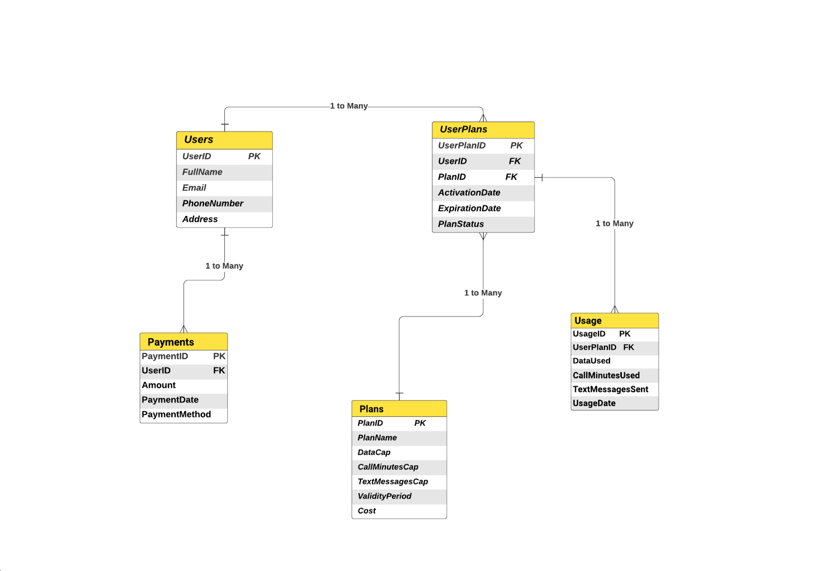
ER Diagram

Slide 20
Logical Design
Logical design of database tables including Primary keys and Foreign keys

Slide 21
Logical Design
Entity: Users | Attributes: User ID (Primary Key), Full Name, Email, Phone Number, Address
Entity: Userplans | Attributes: User Plan ID (Primary Key), User ID (Foreign Key), Plan ID (Foreign Key), Activation Date, Expiration Date, Plan Status (Active/Expired)
Entity: Plans | Attributes: Plan ID (Primary Key), Plan Name, Data Cap (MB or GB), Call Minutes Cap (Minutes), Text Messages Cap (Messages), Validity Period (days), Cost
Entity: Payments | Attributes: Payment ID (Primary Key), User ID (Foreign Key), Amount, Payment Date, Payment Method
Entity: Usage | Attributes: Usage ID (Primary Key), User Plan ID (Foreign Key), Data Used (MB or GB), Call Minutes Used, Text Messages Sent, Usage Date

Slide 22
Physical Design
Physical design of database tables including data types and keys and storage allocation

Slide 23
Physical Design
Users:
User ID INT PRIMARY KEY
Full Name VARCHAR (50)
Email VARCHAR (50)
Phone Number BIGINT
Address VARCHAR (100)
UserPlans:
User Plan ID INT PRIMARY KEY
User ID INT FOREIGN KEY
Plan ID INT FOREIGN KEY
Activation Date DATE
Expiration Date DATE
Plan Status (Active/Expired) VARCHAR (10)

Slide 24
Physical Design
Usage:
Usage ID INT PRIMARY KEY
User Plan ID INT FOREIGN KEY
Data Used (MB or GB) VARCHAR (10)
Call Minutes Used TIME
Text Messages Sent INT
Usage Date DATE
Plans:
Plan ID INT PRIMARY KEY
Plan Name VARCHAR (20)
Data Cap (MB or GB) VARCHAR (10)
Call Minutes Cap (Minutes) TIME
Text Messages Cap (Messages) INT
Validity Period (days) INT
Cost FLOAT

Slide 25
Physical Design
Payments:
Payment ID INT PRIMARY KEY
User ID INT FOREIGN KEY
Amount FLOAT
Payment Date DATE
Payment Method VARCHAR (10)

Slide 26
Normalization
The tables considered are already confirming to all the 3 normalization forms i.e, 1NF, 2NF and 3NF since there are no repeating groups, no partial dependency and no transitive dependency.

Slide 27
Tables with sample data

Slide 28
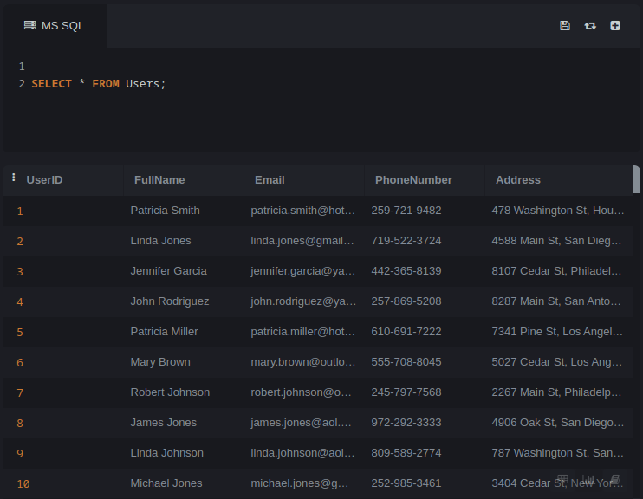
Users

Slide 29
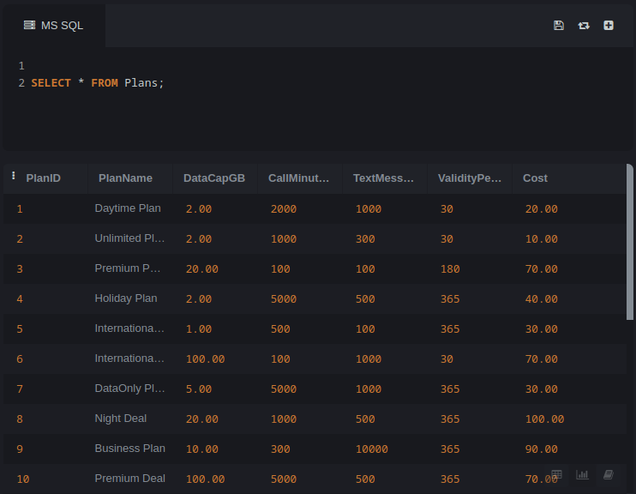
Plans

Slide 30
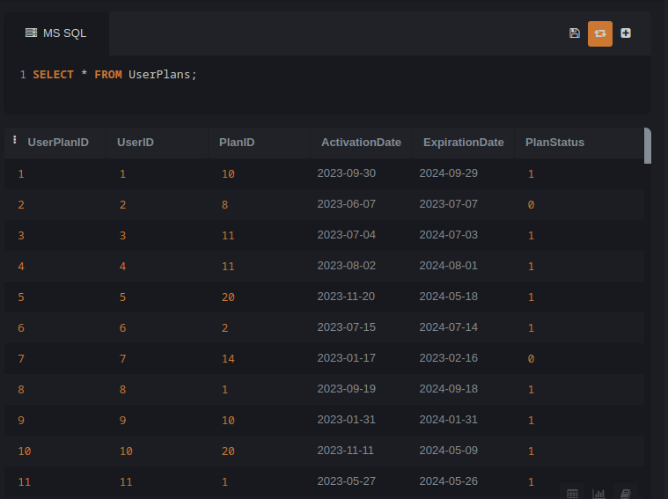
User Plans

Slide 31
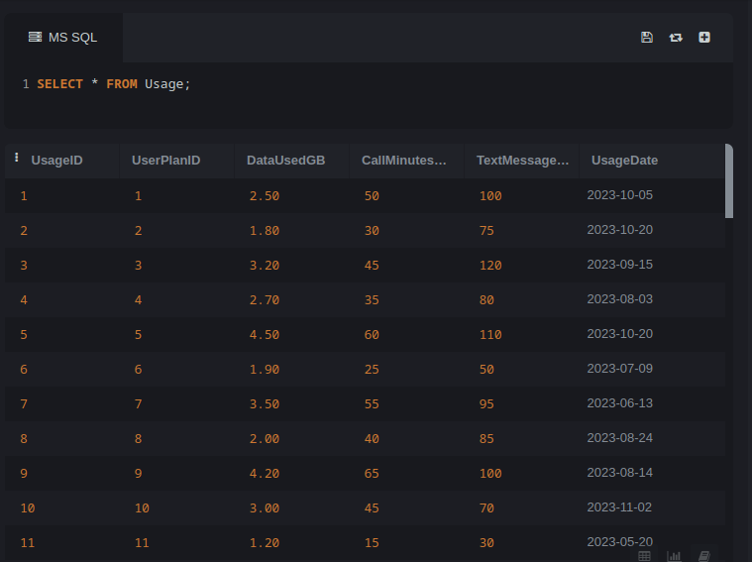
Usage

Slide 32
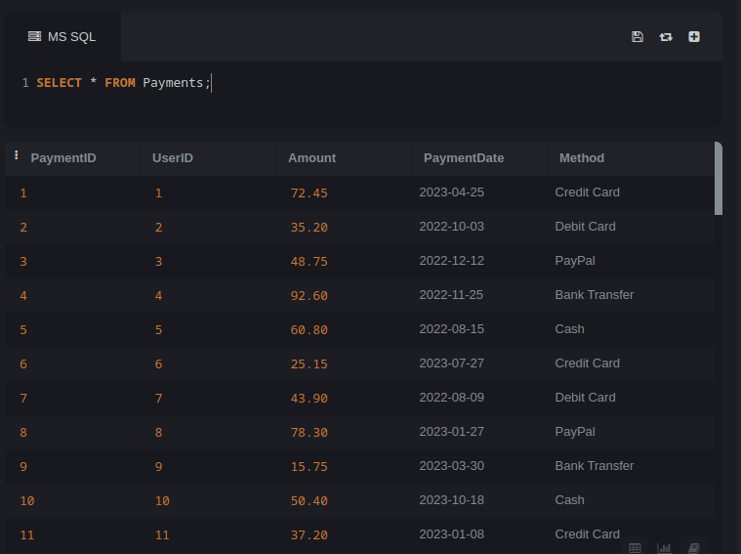
Payments

Slide 33
Sample Business Queries

Slide 34
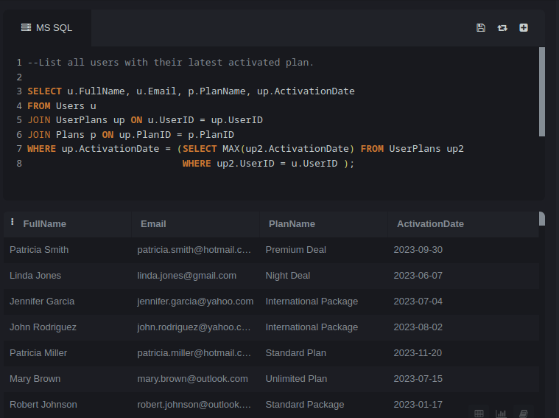

Slide 35
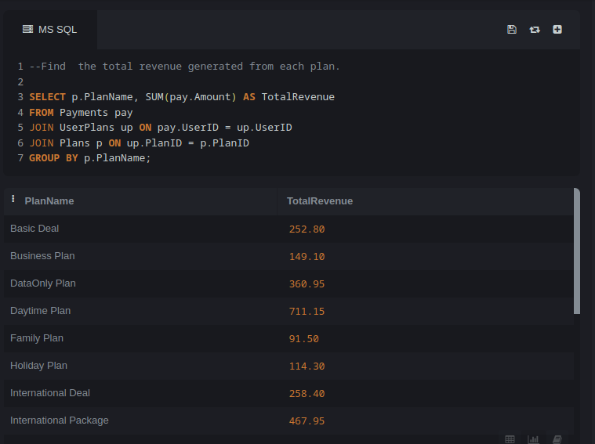

Slide 36
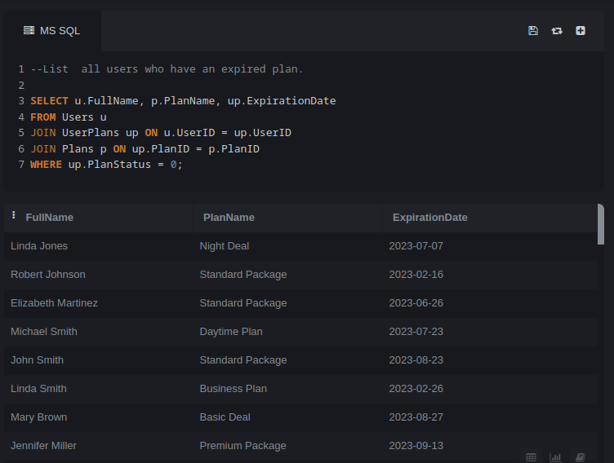

Slide 37
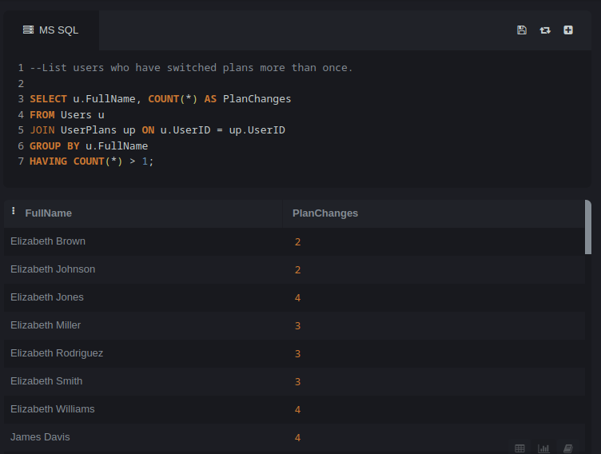

Slide 38
Thank you

