Slide 1


KNS Institution Of Technology​
Department of Electronics and Communication
Engineering
PROJECT PRESENTATION ON
WIRELESS CHARGING SYSTEM FOR ELECTRIC VEHICLES
Under The Guidance Of
Asst .Prof MRS . Jabeena banu
Department of ECE
Presented by:
LUBNA ANJUM(1KN19EC010)
PAVANI.AC(1KN19EC014)
PRAVEEN.S(1KN19EC016)
VINAY KUMAR.S(1KN19EC023)

Slide 2
TABLE OF CONTENTS
CONTENTS
INTRODUCTION
ABSTRACT
COMPONENTS LIST
IR SENSOR CIRCUIT
WORKING OF TOUCHLESS DOORBELL
APPLICATION OF TOUCHLESS DOORBELL SYSTEM
IMPLEMENTATION PROGRESS SO FAR
REFERENCES
RESULTS

Slide 3
INTRODUCTION
Doorbell is one of the most common devices being used in our daily life. The bell needs physical contact for its operation. Such physical devices have high probability to transmit viruses. Given the current COVID situation, there’s an increased focus to build electronic products that avoid human contact in day-to-day-life. Door Bell is one of such devices which requires human contact for every visitor needing entry to our home. There is a high priority need to look at a solution that can avoid contact to the bell, yet serve the purpose of alerting the home members of visitor at door.
Touchless Doorbell is an application of photo device along with electronic components to activate a bell on proximity to the circuit.

Slide 4
ABSTRACT
The project is based on the object detecting using the IR sensor. An IR sensor consists of an IR LED and photodiode. Together they are called as Photo - Coupler or Opt-Coupler. Touch less doorbell consists of IR LED, photo diode, resistors, potentiometer, general LED with a buzzer, etc. The sensor operates in such a way that whenever any object comes close to the IR sensor, the buzzer starts beeping and the LED glows. This concept of touch less door bell is very useful in Railroad crossings, School bells and Alarms in industrial plants etc. This system is also suitable for securing homes from intruder/ burglar.

Slide 5
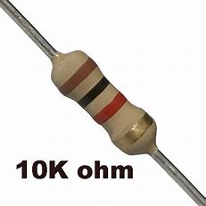
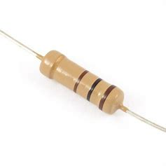
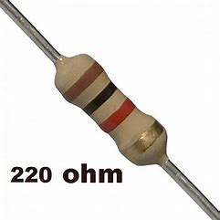
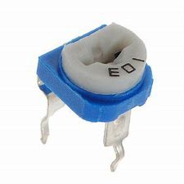
COMPONENTS LIST
100 ohm
Variable resistor
RESISTORS
A resistor is a two-terminal component . It is an electrical component that limits the flow of electrical current in an electronic circuit

Slide 6
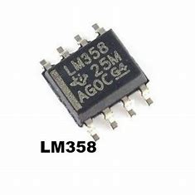
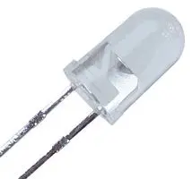
COMPONENTS LIST
The LM358 is one type of dual-channel operational amplifier (Op-Amp) called comparator. it is used to test a light dependent resistor ,a photodiode.
LM358 IC
A light-emitting diode (LED) is a device that emits light when current flows through it.
LED

Slide 7
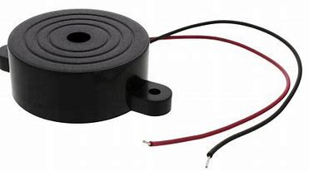
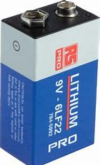
COMPONENTS LIST
A buzzer is an electrical device that is used to make buzzing sound. for example to attract someone attention.
BUZZER
There batteries are consumer replaceable, displaceable batteries.
BATTERY

Slide 8
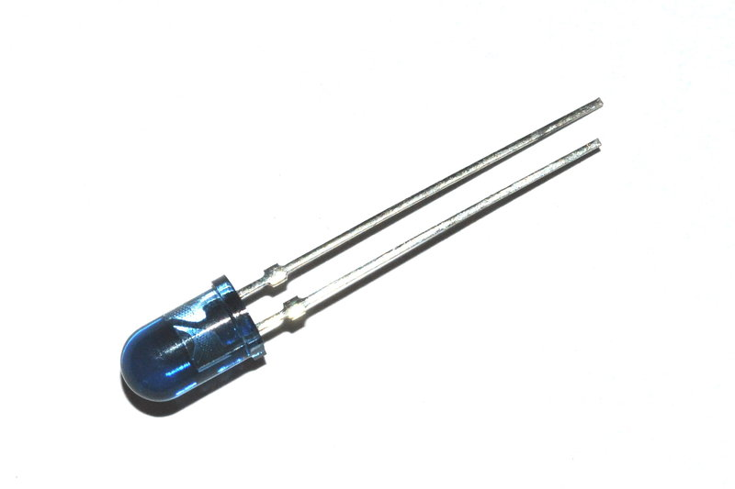
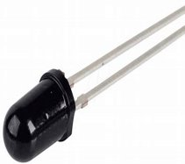
COMPONENTS LIST
IR LED (Infrared Transmitter) IR LED is a special type of LED that emits Infrared rays of the Electromagnetic Spectrum. When an object comes close to sensor the infrared light from led reflects from the object and detected by the receiver
IR TRANSMITTER
A photodiode is a p-n junction device that consumes light energy to generate electric current. Photodiodes are specially designed to operate in reverse bias condition.
PHOTODIODE (IR RECEIVER)

Slide 9
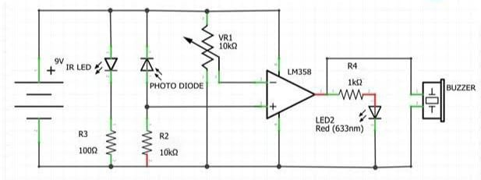
IR SENSOR CIRCUIT
2
1
220
3
CIRCUIT DIAGRAM OF TOUCHLESS DOORBELL

Slide 10
WORKING OF
TOUCHLESS DOORBELL
It consists of an IR sensor, LED, a photodiode, a potentiometer, an IC Operational amplifier and an LED. IR LED emits infrared light.
The Photodiode detects the infrared light. An IC Op-Amp is used as a voltage comparator. The potentiometer is used to calibrate the output of the sensor according to the requirement.
When the light emitted by the IR LED is incident on the photodiode after hitting an object, the resistance of the photodiode falls down from a huge value.
One of the input of the op-amp is at threshold value set by the potentiometer. The other input to the op amp is from the photodiode's series resistor.

Slide 11
WORKING OF
TOUCHLESS DOORBELL
When the incident radiation is more on the photodiode, the voltage drop across the series resistor will be high. In the IC, both the threshold voltage and the voltage across the series resistor are compared.
If the voltage across the resistor series to photodiode is greater than that of the threshold voltage, the output of the IC Op-Amp is high. As the output of the IC is connected to an LED, it lightens up.
The threshold voltage can be adjusted by adjusting the potentiometer depending on the environmental conditions. The positioning of the IR LED and the IR Receiver is an important factor. When the IR LED is held directly in front of the IR receiver, this setup is called Direct Incidence.
ln this case, almost the entire radiation from the IR LED will fall on the IR receiver. Hence there is a line of sight communication between the infrared transmitter and the receiver. If an object falls in this.​

Slide 12
APPLICATION OF TOUCHLESS DOORBELL SYSTEM
Some general applications of touchless doorbell are.
Fire engines,
In telephones,
In railroad crossing,
School bells ,
Alarms in industrial plants.

Slide 13
REFERENCES
Central Institute of Technology, Kokrajhar(A Centrally Funded Institute under Ministry of HRD, Govt of India)
www.electronicshub.com
www.robotshapers.com
www.electronicsforu.com
www.elonics.in
www.components101.co

Slide 14
RESULT
The automatic doorbell circuit, which we assembled, generates Beeping sound at working and as we know that the human hearing frequency is 20Hz to 20KHz. Thus, there would be no problem related to this frequency to humans. The buzzer produces the sound in the frequency range of 20Hz to 20K Hz which is hear-able to any human when an object comes closer to the sensors. This project is ecofriendly and as seen from the appendix which is a very low-cost and is affordable by any average consumer.

Slide 15
IMPLEMENTATION PROGRESS SO FAR
APRIL | Study of projects , purchase of components. | Done.
MAY | Implementation of part of project . review. | Done. Done.
JUNE | Completion and preparation of report | Done.

Slide 16

THANK YOU !

