Slide 1
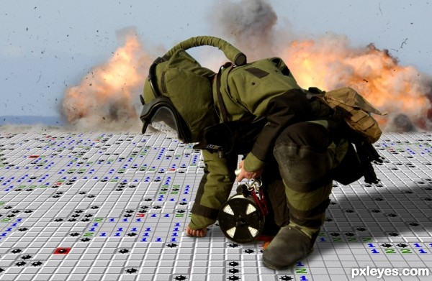
Minesweeper
DEVELOPED BY
Sujan Bhattarai(068/BEX/443)
Prateik Pokharel(068/BEX/431)
Rupak Khatiwada(068/BEX/437)
Notes:
DEVELOPED BY
Rajendra Adhikari
Rojan Bhattarai
Sandesh Kunwar

Slide 2
INTRODUCTION TO THE GAME
Designed by extensive use of OOP.
Strategic Single Player Arcade Game.
The objective of the game is to clear an abstract minefield without detonating a mine.
Contains Three game play themes and levels within the game.
Suitable for players of all ages.

Slide 3
RULES
The player must clear all mines safely to win a game.
The objective of the game is clear all mines.
The game ends as soon as a mine explodes.
The game is completed when the player extracts the boxes without exploding a mine.

Slide 4
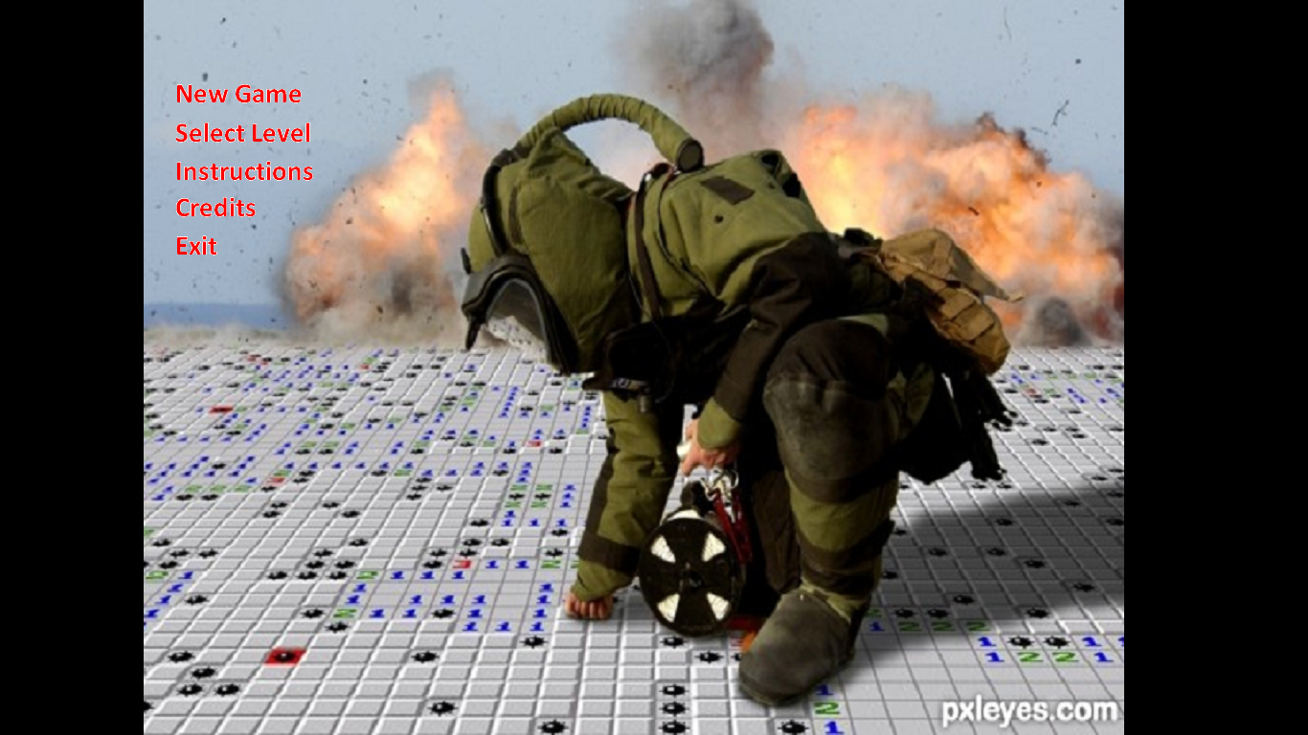
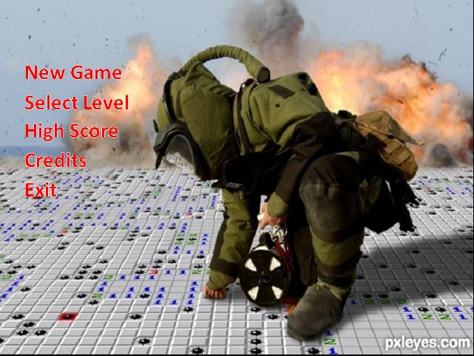
Menu structure

Slide 5
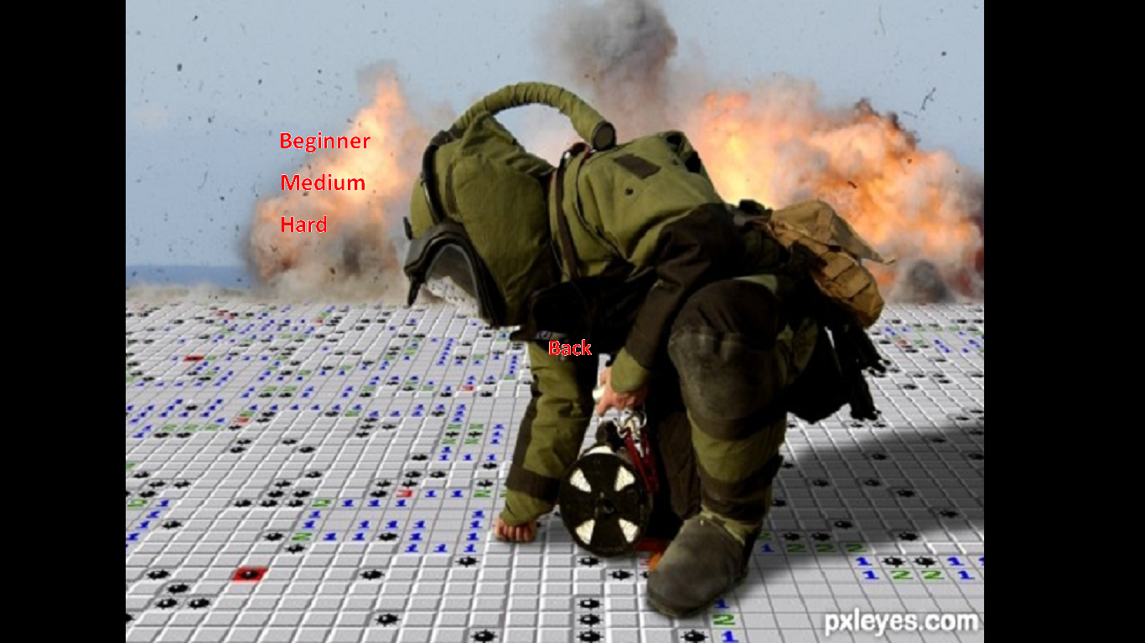
LeveL SELECTION

Slide 6
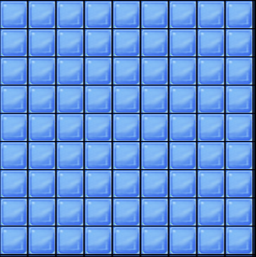
NEW GAME

Slide 7
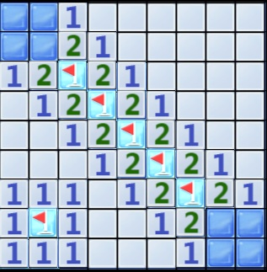
Game PLAY

Slide 8

WIN CONDITION

Slide 9

LOST CONDITION

Slide 10
Existing System
Earliest forms of the game were available in Mainframes of 60s and 70s.
Versions of Minesweeper are frequently bundled with operating systems and GUIs.
Variants of the basic game generally have differently shaped mine fields in two and three dimensions, or various two-dimensional layouts, such as triangular or hexagonal grids, or possibly more than one mine per cell.
After the development of Java programming and other Animation software's many Minesweeper Games are now available in the market and Internets.

Slide 11
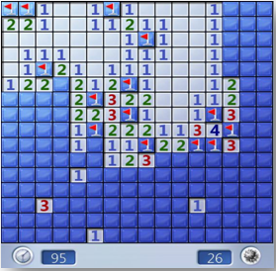
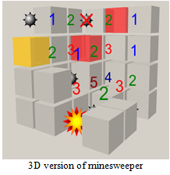

Slide 12
Working methodology
Transforming the concept one has in mind to reality, is a difficult task. To create a game with this level of complexity, required step by step processing. So, instead of trying to do everything at once, we started simple. Our working steps can be reduced into the following.
Firstly Decided which graphics library to use, and chose SDL
Started Learning basic Library routines, such as image blitting.
Decided classes and objects to be created.
Studied about the various inheritance and friendship relations among classes and functions
Started displaying those objects in graphical form in the screen.
Started to work on designing AI for distributing mines on the grid. *Tested for any bugs within the program and debugged them.
Developed project documentations.

Slide 13
Limitations and FUTURE Enhancements
Unable to attract the modern day gamers for long run.
One can easily pass through levels after playing the game for 5-6 times.
Game may still contain some bugs.
For future enhancements, we welcome all sorts of feedbacks from our gamers and well-wishers. If demanded by the gamers we promise to come out with much more improvised version as soon as possible.

Slide 14
THANK YOU All

