Slide 1




Proctoring
methods

Slide 2
Facial Recognition: Identifying, Verifying, and Counting Persons in Images and Videos using Stored Faces. Eye Tracking: Analyzing how many times a person looks away from a camera in a recorded video.
Problem statement

Slide 3




Resources Used
.
HAAR CASCADE CLASSIFIERS

Slide 4
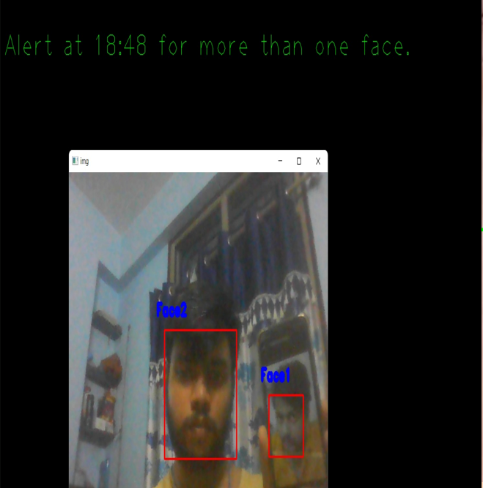
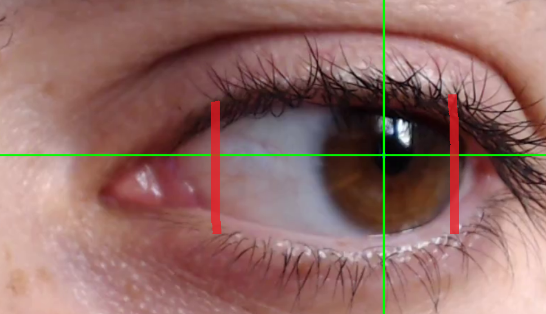

Slide 5
WORKFLOW
STEP 02
STEP 03
TRAINING
DETECTION/
RECOGNITION
STEP 01
STEP 04
PREPROCESSING
ADDING ALERTS
/COUNTING

Slide 6
WORKFLOW
PROJECT1 |  | PROJECT2
WEBCAM SETUP
WEBCAM SETUP
DATA COLLEC.
DATA COLLEC.
MODEL IMPORT
EYE CROPPING
MODEL IMPORT
ENCODING GENERAT.
ENCODING GENERAT.
MULTIPLE FACE DET.
FACE RECOGN.
BOUNDARY CREATION
EYE TRACKING
ALERT CREATION
ADDING DELAY
ALERT CREATION
COUNT LINE CROSSES

Slide 7
My Work Progress and Future Work
My work Progress:
Learnt how to work with pretrained models
Created a basic model to find number of people in camera
Created a basic eye tracking model
Explored a lot of OpenCV projects
Will learn how to train models using dlib
Include the face identification from a set of faces
Complete the eye tracking model by counting the line triggers
Develop API endpoints and refine the final model
My future Work:

Slide 8
Thank you!
Challenge and adversity are meant to help you know who you are. Storms hit your weakness, but unlock your true strength.

