Slide 1


Proctoring
methods

Slide 2

Proctoring methods
Things to be taken care of:
Face Recognition
Signature and ID matching
Candidate’s motion during evaluation process
Noise Detection
Create a model to recognize the face of person appearing for interview using opencv
python
Create a model that matches signature of the person to the signature in application form and also ID like aadhar etc.
Detect background noises if any mark the candidate
Eye tracker and hand tracker so that it does go off the screen too much.

Slide 3
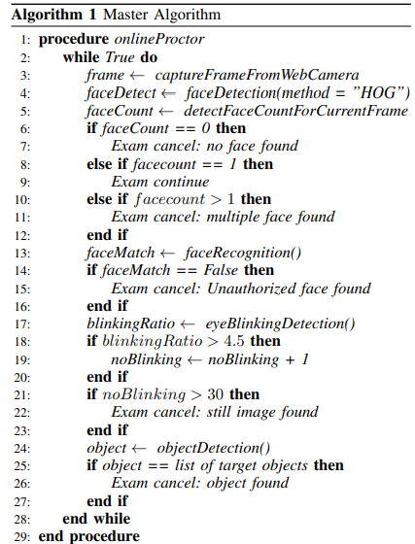
A raw code for Face recognition
We can make similar models for other purposes.

