Slide 1
Git
A tool for version control

Slide 2
What is Git?
Git is a version control system which helps in tracking changes in code and manage development history.
It offers branching, merging and history tracking of a file locally in a system.

Slide 3
Why Git?
Git is used in various team projects and collaborations to improve efficiency of the work flow. Git helps in the following different ways:
Enables team collaboration.
Simplifies the teamwork.
Tracks history of changes to help in debugging and improving.
Ensures code integrity and prevents conflicts among the peers.

Slide 4
How to use Git?
After installation, Git provides various commands which are essential for the collaborative work:
git init
git add
git commit
git branch
git push
git pull

Slide 5
Git Commands
Initializing:
git init – to initialize a Git repository in the current directory.
Tracking changes:
git add – stage files for next commit.
git status – check status of files in the repository.
Saving changes:
git commit – used to save the changes made in a file.

Slide 6
Git Commands
Branching:
git branch – create a new branch for feature development.
git checkout – switch to a specified branch.
Pushing changes:
git remote add origin – to link the local repository to a remote one.
git push –u origin main – push changes to the main branch of the remote repository.
Pulling updates:
git pull origin main – fetch and merge updates from the remote repository.

Slide 7
Example usage of Git
Install and setup Git in the system.
First create the necessary files that need to be uploaded or collaborated inside a folder.
Open the Git terminal and navigate to the folder to create a local repository using git init command.

Slide 8
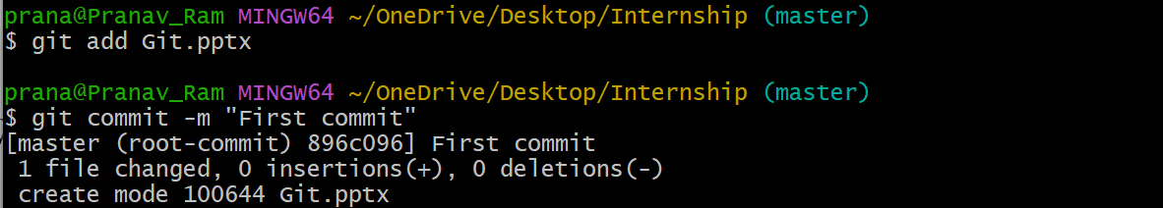
Example usage of Git
Now using git add <filename> command, add all the files that needs to be staged.
Then the staged files will be recorded after using the git commit –m “” command.
Give the appropriate commit message for better understanding.

Slide 9
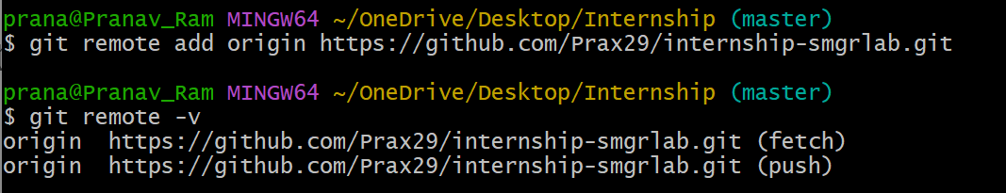
Example usage of Git
Now link the local repository to the remote repository on GitHub using git remote add origin <repo-url> command.
Copy the URL of the repository that was created in GitHub and run the command.

Slide 10
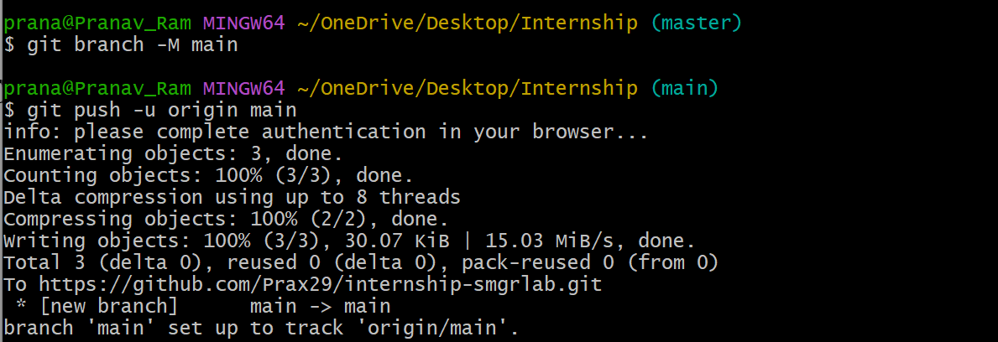
Example usage of Git
Since GitHub uses main branch as default branch, rename the local branch as main with the help of git branch –m main command.
Then push the new or modified files from the local repository to the remote repository using the git push –u origin main command.

Slide 11
Example usage of Git
Now the files will be made available on the remote repository.
If new files are to be added or existing files are to be modified, follow the same procedure as adding, committing and pushing the files.
To create a new branch, change the name of the branch from main to new_branch_name.
To jump to a new branch or merge a branch, use the command git checkout <branch_name> and git merge <branch_name> respectively.
To clone an existing repository git clone <repo-url> command is used.

Slide 12
Thank You!

