Slide 1


Analyzing Facebook Live Sellers in the Thai Fashion and Cosmetics Industries

Slide 2
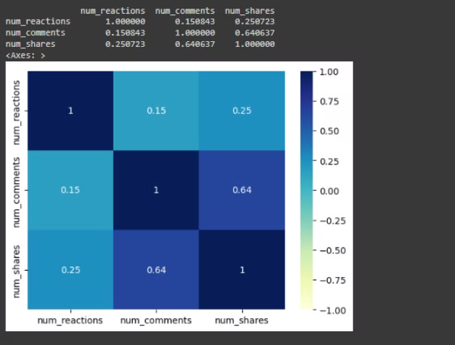
Analyzing Engagement Metrics
The analysis reveals the following correlations between key engagement metrics on Facebook Live posts:
Reactions vs. Comments: The correlation coefficient is 0.151, indicating a weak positive relationship between the number of reactions and comments.
Reactions vs. Shares: The correlation coefficient is 0.251, suggesting a weak positive correlation between the number of reactions and shares.
Comments vs. Shares: The correlation coefficient is 0.641, showing a moderate positive relationship between the number of comments and shares.

Slide 3
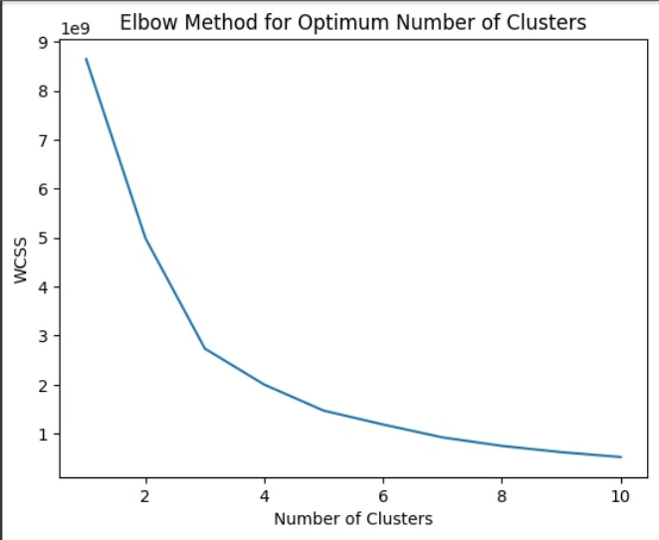
Clustering Facebook Live Sellers with K-Means
In this analysis, we will utilize the powerful K-Means clustering algorithm to gain deeper insights into the Facebook Live selling strategies of leading fashion and cosmetics retailers in Thailand. By grouping similar sellers into discrete clusters, we can uncover patterns in the types of content they post and the engagement metrics that drive their success on this dynamic platform.

Slide 4
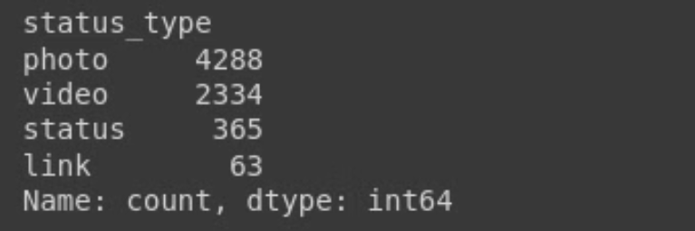
Analyzing the Variety of Post Types
Our analysis reveals a diverse range of post types used by fashion and cosmetics retailers on Facebook Live. From product demonstrations and tutorials to behind-the-scenes looks and influencer collaborations, these sellers are leveraging a variety of content formats to engage their audiences and drive sales. By understanding the distribution and performance of these different post types, we can uncover valuable insights to guide the social media strategies of businesses in these industries.

Slide 5
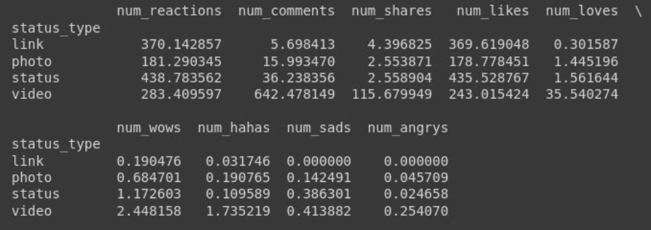
Engagement Trends by Post Type
Our analysis reveals some fascinating insights into how different types of Facebook Live content are performing in terms of engagement metrics. From popular product demos and tutorials to behind-the-scenes glimpses and influencer collaborations, we'll dive into the viewership, comments, and shares that are driving success for fashion and beauty brands on this dynamic platform.

Slide 6
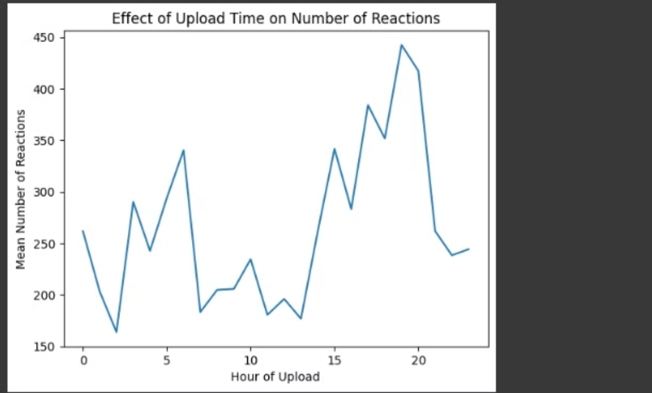
Effect of time of upload on reactions

