Slide 1
A GitHub Journey
GitHub Example Customer Statement

Slide 2
Customer Statement
Our security team is asking for help ensuring proper reviews are being done to code being added into our repositories. We have hundreds of repositories in our organization. What is the best way we can achieve at scale? We are new to some of the out-of-the-box settings and the GitHub API. Can you please help us create a solution that will accomplish this for our security team?

Slide 3
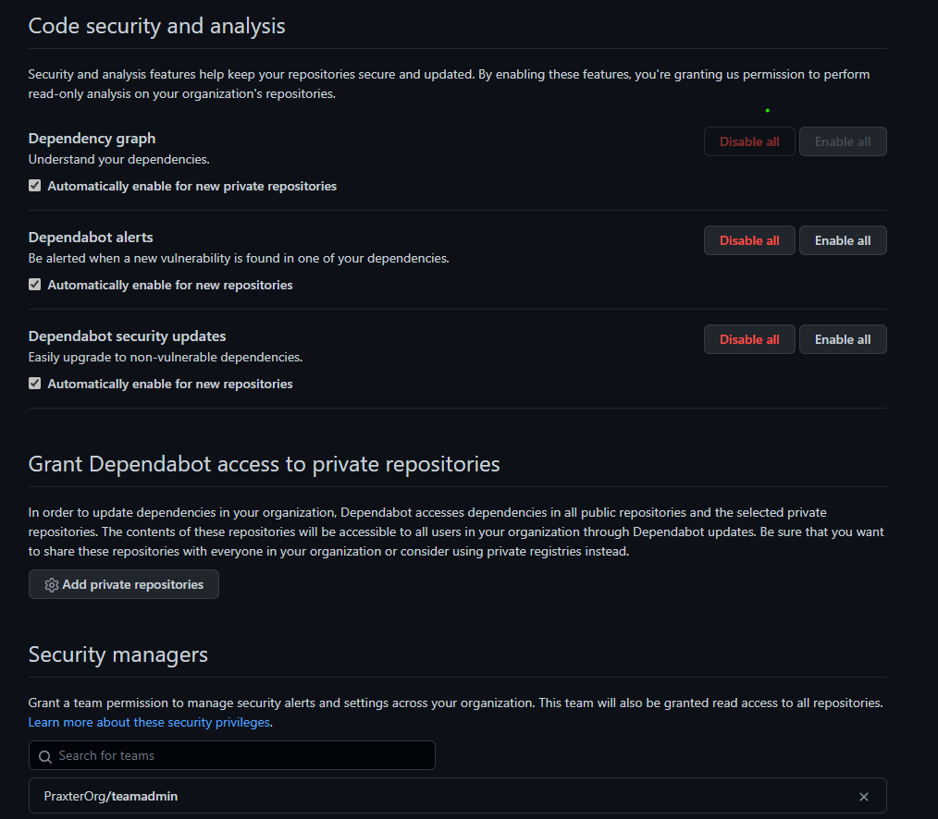
Organization Policy
Roles
I didn’t setup any of these roles but It certainly is a good practice to setup roles on the organization level to limit scope to least privilege model
Link - Roles in an organization - GitHub Docs
Organizational – Policy – My example
Several options available and the important thing is that the check box for the “automatically enable for new repositories”
Dependabot alerts – Automatically scans for vulnerabilities (public enabled by default private has restrictions)
Dependency Graph – shows the dependency vulnerabilities (public enabled by default private has restrictions)
Secret Scanning – scans for secrets that are in the repositories this is a advanced feature or enterprise feature
Link - Securing your organization - GitHub Docs

Slide 4
Team Setup
Setting up teams and then assigning them roles to repositories is a way to at scale members and organize.
For my example I used 4 Teams that I created using the PowerShell for GitHub.
Link PowerShell For GitHub (Hosted On GitHub)

Slide 5
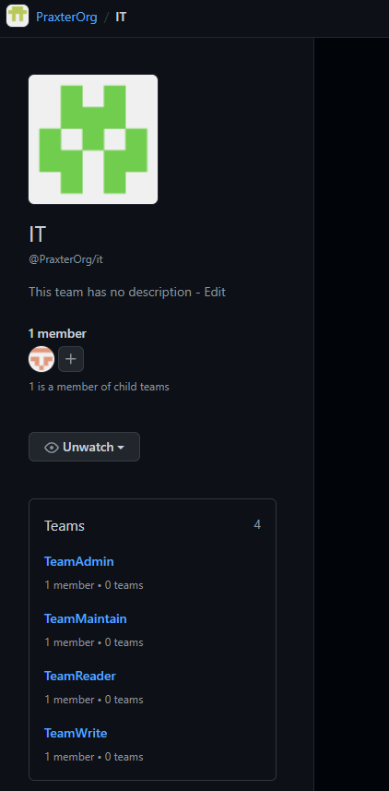
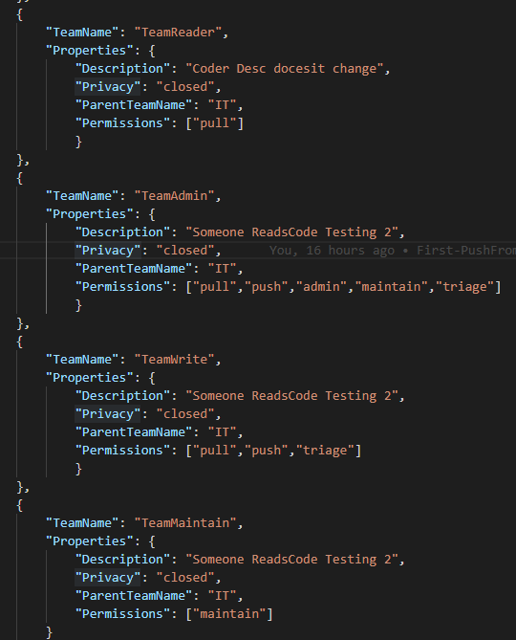


Team Setup
Here is my example of teams that I created under a IT Parent Team
I used a json file for the definitions

Slide 6
Repository Settings
Created “WidgetProduct1” Repository.
Elements in my example repository.
Teams Assignment
Security Policies
Workflow – Automation for the ScanQ - Don’t have code in the languages it supports
Visibility - changed to “Closed”
There is a lot of other features such as Codespaces and tags that are not explored in this demo
Creating and managing repositories - GitHub Docs

Slide 7
Repository Settings
Created “WidgetProduct1” Repository.
Again using the PowerShell GitHub, I created repository by code and then I flagged that as a template, which I will use to create other repositories.
This module leverages the GitHub’s powerful API – References here.
https://docs.github.com/en/res which was super easy to use

Slide 8
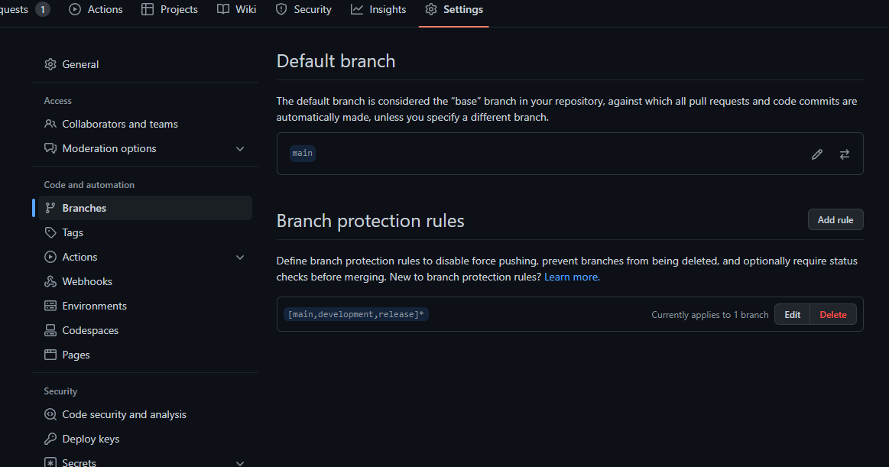
Branch Policies
Here is where you set the policy up that will allow you to protect your branches.
Here is a link “Managing a branch protection rule - GitHub Docs” to some documentation around Branch Policies

Slide 9
Branch Policies
Key Values
Require Pull Requests with 2+ approvers
Restrict who can dismiss pull requests
Require Conversation resolution before merging
Include administrators
Restrict who can push to matching branches

Slide 10
Making the Repository Template
Once I have completed the basic setup for the this repository then I can mark that as a template, so that new ones created would have an easy way to standardize settings

Slide 11
Code Protection
Added the Security Policy to the template repository
Adding a security policy to your repository - GitHub Docs
Here is my link to the documentation on “Code Scanning”
Finding security vulnerabilities and errors in your code with code scanning - GitHub Docs
Managing Dependency Review
This isn’t available for the free versions on private but enabled on all public versions as moved more towards that

Slide 12
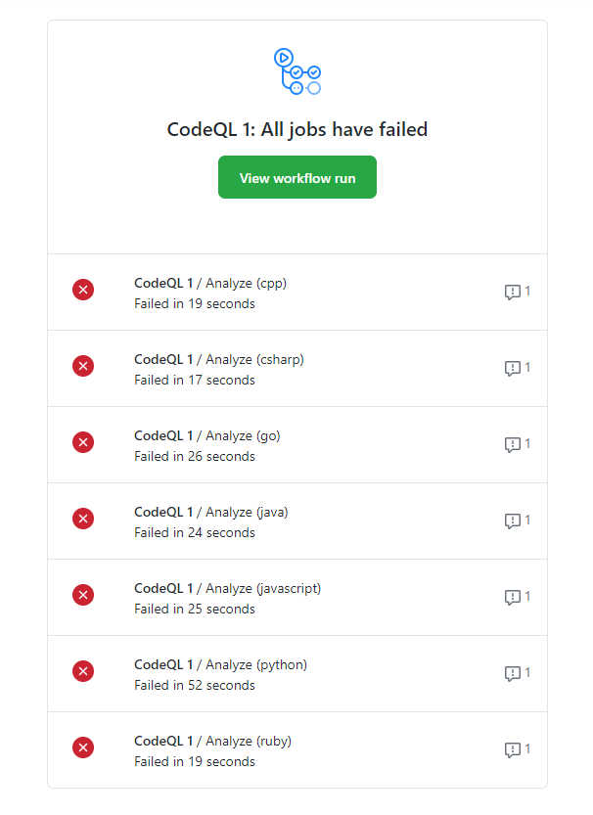
Webhook and Notification
I ran out of time to do this exercise the thought was to spin up a logic app in my MSDN subscription and use that to create a actions rules for events that are sent from GitHub webhooks
Of course base events are sent already like the example here

