Slide 1
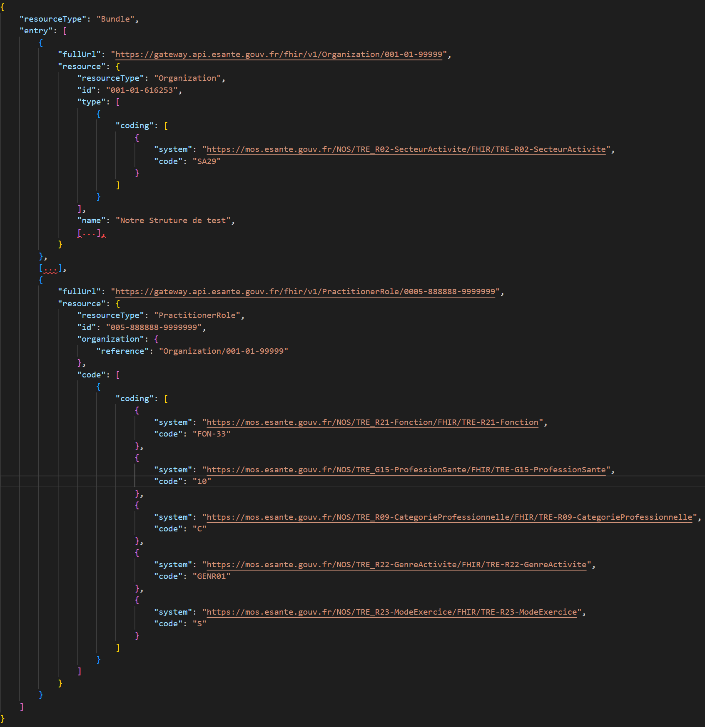
Couloir Ségur 3
1
2

