Slide 1
PRESENTATION ON “Fastest Finger First ”
Shah Pray

Slide 2
CONTENT
Abstract
Circuit diagram
Working
Components
Software Implementation
Software Simulation
Applications
Future scope
Conclusion
References

Slide 3
Abstract
A project on how to make a fastest finger first circuit which can track the first person to press the trigger or Buzzer.
This circuit consists of multiple replicas of a module, each of which can be assigned to a single quiz taker or a team.
Each module contains a trigger (We used momentary push button in the video) and an LED indicating whether the team corresponding to this module is the first one to press the trigger.

Slide 4
We can create numbers of same module for require number of teams/person attempting quiz .
For this project the number of module is 3.

Slide 5
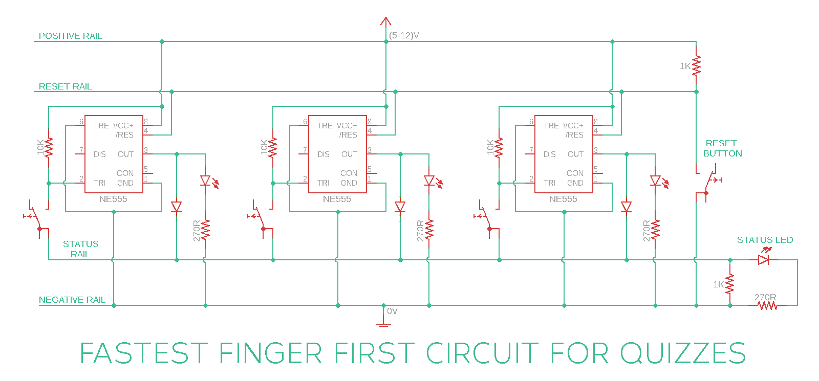
Circuit diagram

Slide 6
Components
555 Timer IC
Momentary Push Button Switch
1N4148 Diodes
LED
10K Resistor
1K Resistors
Breadboard
Battery

Slide 7
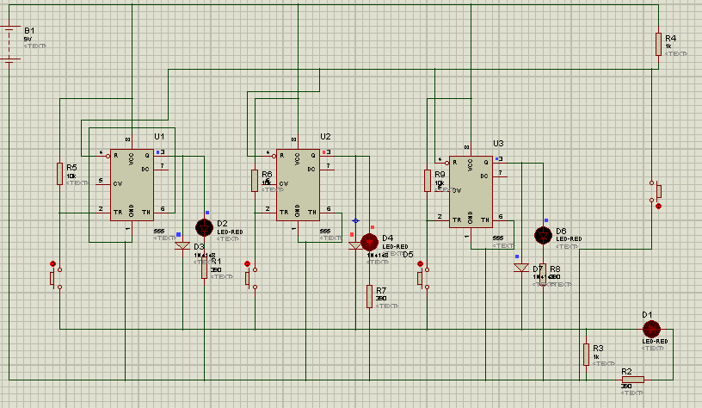
Software Implementation

Slide 8
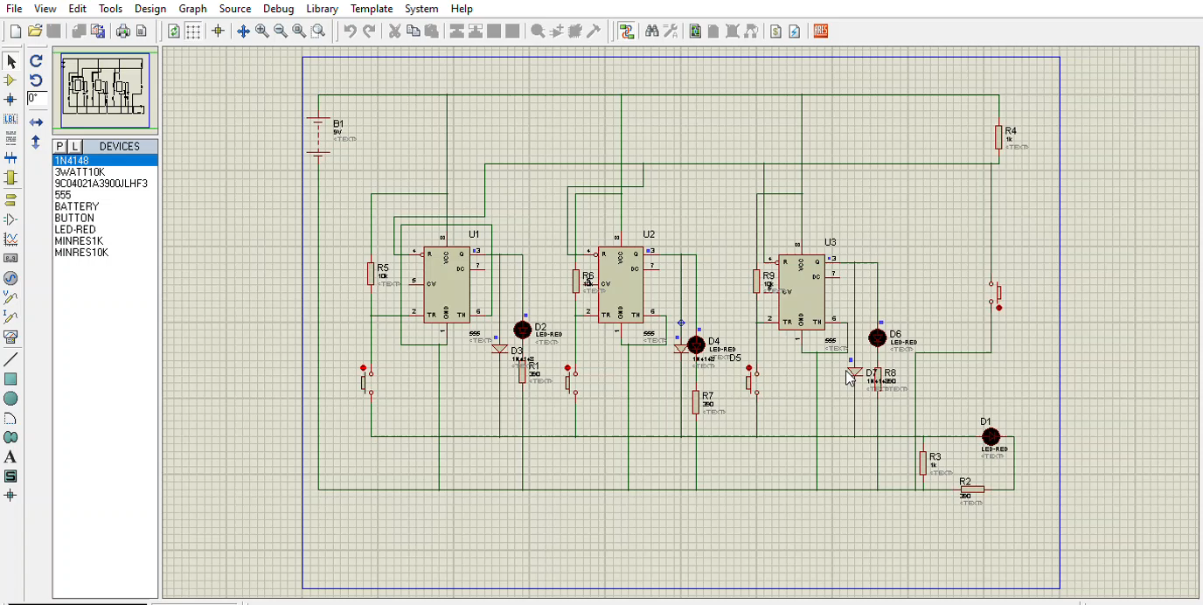
Software Simulation

Slide 9
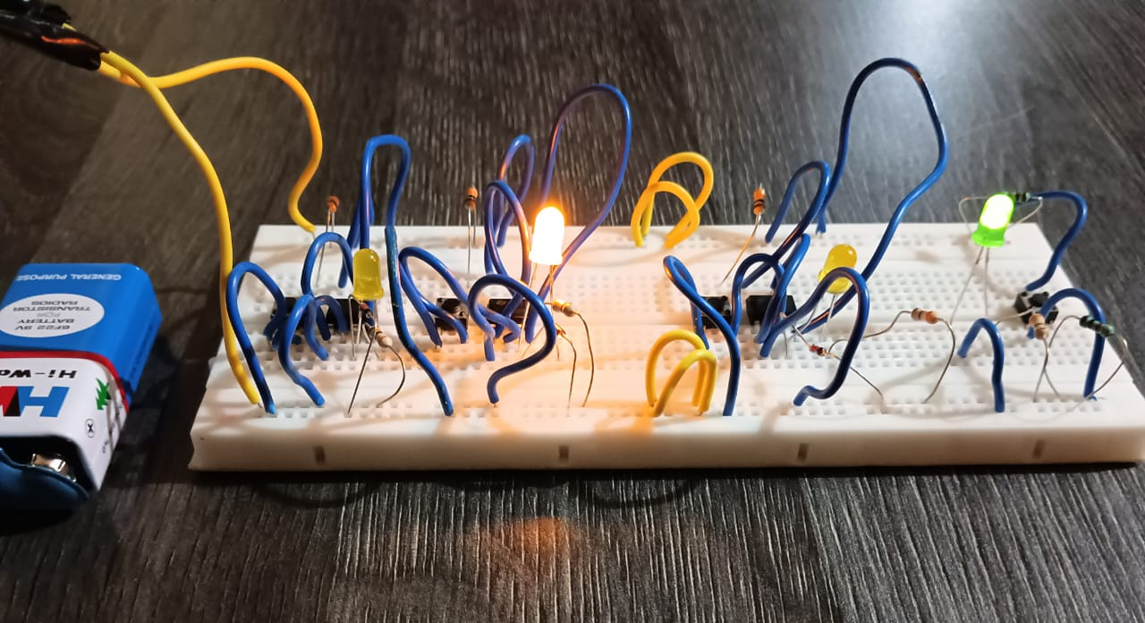
Breadboard Implementation

Slide 10
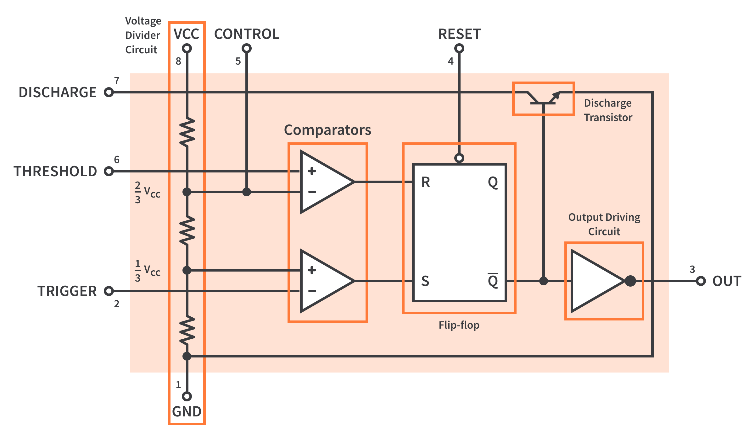
555 Timer IC

Slide 11
Working
When the output of all the modules are in OFF state, the voltage at status rail will be at 0V (default). When any team presses the button, this 0V from status rail is applied at Pin-2. Because 0V is less than 1/3rds of the supply voltage, the output of 555 IC corresponding to the team which pressed the trigger first turns ON.
Immediately after this happens, the voltage at status rail changes to positive voltage because of the feedback via PN diode. So even if other teams press the trigger now, the voltage at Pin-2 of the respective modules will be at positive voltage
Resetting of states of all the modules is done by applying 0V at the reset pin of all the 555 ICs using reset rail and a dedicated push button and the output doesn’t turn ON

Slide 12
Applications
We can conduct quizzes ,in which we can identify which team or person press buzzer first.
This make easy to identify the winner of round and quiz will fair for all participants.
Used in corporate training programs for team-building exercises and competitive tasks.

Slide 13
Future Work
I will try to include more modules so more number of team can participate.
I try to increase the accuracy of our project.
I include buzzer which sounds when someone press the trigger

Slide 14
Conclusion
The Fastest Finger First Circuit is an efficient and reliable system designed to identify the first responder in competitive events such as quizzes and game shows. By using a 555 Timer IC, diodes, and push buttons, this circuit ensures a fair and transparent selection process by preventing multiple activations once a response is recorded.

Slide 15
References
https://www.circuitbasics.com/wp-content/uploads/2015/01/555-Timer-Datasheet.pdf
https://www.circuitbread.com/tutorials/555-timer-1-introduction-to-555-timers

