Slide 1
1
0
0
5
B=2
Ans2=5
3
0
0
5
0
0
0
0
0
5

Slide 2
Heavy!
…

Slide 3
B=2

Slide 4
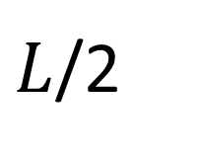
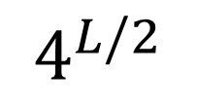
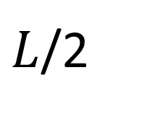
Set|
X
Set|
Y
P
T
$$4^{L/2}$$
S
$L$/2
$L$/2

Slide 5

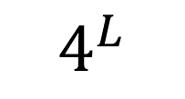
$$4^{L}$$
S
T
$$L$$

Slide 6
S
T

