Slide 1
Agenda
Introduction to BADAS Problem Statement Solution Overview Key Features of BADAS System Architecture Workflow Process User Roles and Responsibilities Symptom Analysis Logic User Interface Screenshots Technologies Used Benefits of BADAS Future Enhancements Conclusion Q&A Session

Slide 2
Problem Statement
Optimizing Hospital and User Management for Emergency Response Systems
Context:
In modern healthcare and emergency response environments, efficient management of hospital data, user accounts, and ambulance dispatch is critical for saving lives. However, existing systems often suffer from disorganized data, manual intervention, and lack of secure role-based access. These inefficiencies lead to delayed response times, mismanagement of resources, and compromised patient care.

Slide 3
Solution Overview
Overview
Symptom Analysis
Utilizes machine learning algorithms to evaluate patient symptoms. Determines the severity level of emergencies quickly and accurately. Reduces human error in assessing patient conditions.
Ambulance Type Recommendation
Suggests the most appropriate ambulance type based on symptom severity. Options include Basic Life Support (BLS), Advanced Life Support (ALS), or cab service. Ensures optimal resource allocation and response times.

Slide 4
Key Features of BADAS
Features
Symptom Analysis
Ambulance Recommendation
BADAS automatically analyzes symptoms entered by hospital staff or dispatchers, allowing for accurate assessment of the patient's condition.
The system suggests the most appropriate ambulance type (Basic Life Support, Advanced Life Support, or Cab Service) based on the severity of the symptoms.
Role-based Access Control
Data Management
BADAS includes role-based access for Admin, Dispatcher, Nurse, IT Support, and Doctor, ensuring secure and appropriate permissions for each user.
User and patient data is stored in CSV format, facilitating easy manipulation, retrieval, and management of critical information.

Slide 5
Workflow Process
Workflow
Login
Symptom Entry
Symptom Analysis
Dispatch Recommendation
Users log in to the system based on their assigned roles, ensuring access to information is restricted according to permissions.
Dispatchers or nurses enter patient details and symptoms into the system, capturing critical information for analysis and dispatch.
The system processes the symptoms using AI algorithms to determine severity, classifying cases as critical, moderate, or minor.
The system displays recommendations for the type of ambulance needed based on severity analysis, streamlining the dispatch process.
User authentication records Access logs
Patient symptom records Entry logs
Severity analysis report Recommendation parameters
Ambulance dispatch recommendations User alerts

Slide 6
User Roles and Responsibilities
Roles
Admin
Dispatcher
Nurse
Manage hospitals and resources, oversee user roles, and ensure system integrity.
Enter patient information and symptoms, dispatch ambulances based on recommendations.
Record patient details and symptoms, assist dispatchers with accurate information.

Slide 7
Symptom Analysis Logic
Analysis
Critical Symptoms
Moderate Symptoms
Minor Symptoms
Ambulance Type Recommendations
Symptoms such as chest pain, shortness of breath, and severe bleeding indicate life-threatening conditions, requiring an Advanced Life Support (ALS) ambulance.
Symptoms like fever, nausea, weakness, and dizziness suggest non-life-threatening situations, typically warranting a Basic Life Support (BLS) ambulance.
Symptoms including cough, mild fever, and sore throat are often considered less urgent, with recommendations for a cab service or no immediate ambulance action.
The system analyzes symptom severity and suggests the appropriate ambulance type, ensuring efficient resource allocation and timely responses.

Slide 8
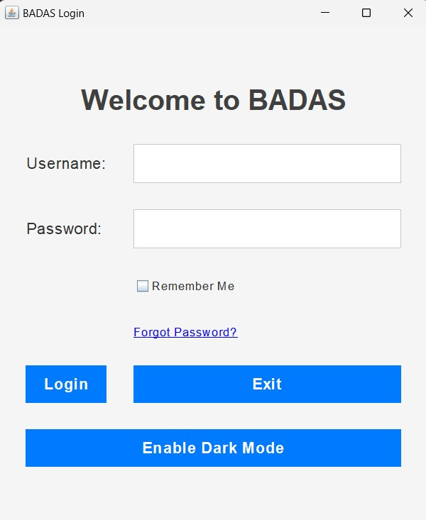
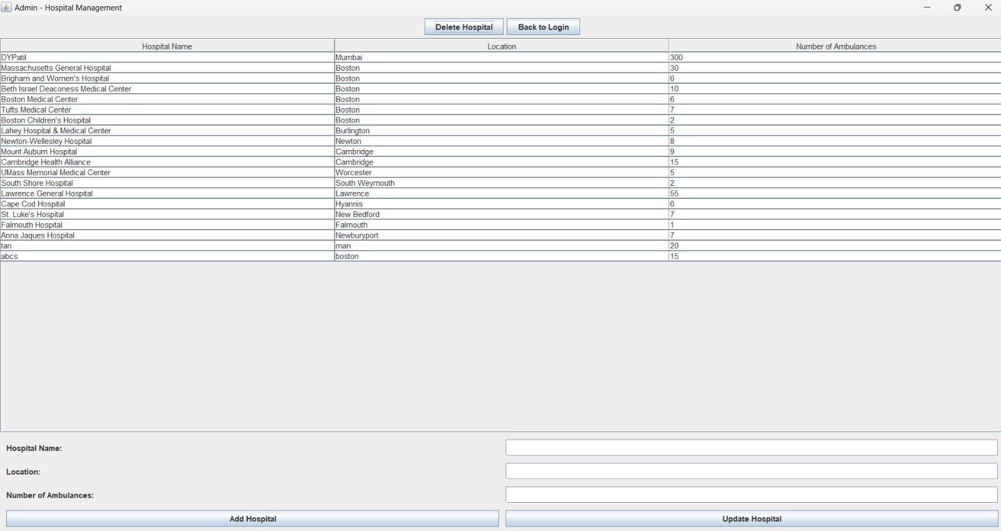
User Interface Screenshots
Interface
Login Page
The login page provides a secure entry point for users to access the BADAS system based on their roles.
Symptom Entry Page
This page allows dispatchers or nurses to enter patient details and symptoms easily and accurately.
Dispatch Recommendation Page
Displays the analysis of symptoms and recommends the appropriate ambulance type for the situation.

Slide 9
Benefits of BADAS
Benefits
Efficiency and Response Time
BADAS reduces ambulance dispatch times significantly. AI analysis ensures the right resources are deployed promptly. Streamlined processes enhance overall emergency response efficiency.
Cost-Effective Resource Allocation
Minimizes unnecessary deployment of advanced ambulances for minor cases. Reduces operational costs through optimized resource management. Leverages data to improve financial performance of emergency services.

Slide 10
Future Enhancements
Enhancements
Integration with Google Maps for location-based dispatch, improving response times by providing real-time traffic information. Real-time tracking of ambulances to monitor their locations and estimated arrival times, enhancing communication with hospitals and patients. Development of a mobile application for dispatchers and paramedics, allowing for on-the-go access to critical information and updates. Implementation of advanced analytics tools for data analysis, helping to identify trends, improve resource allocation, and enhance decision-making processes.

Slide 11
Summary
BADAS enhances ambulance dispatch efficiency through AI-driven analysis.
The BADAS system utilizes AI algorithms to analyze symptoms, ensuring ambulances are dispatched based on emergency severity. This reduces response times and optimizes resource allocation, preventing advanced ambulances from being sent for minor cases. Investing in BADAS will significantly improve emergency response capabilities, ultimately saving lives and resources.

Slide 12
Q&A Session
Conclusion
Please feel free to ask any questions related to the BADAS system and its functionalities. Your feedback is valuable and helps us improve our service. For further inquiries, contact us at: [Your Email or Team Contact Information]

Slide 13
Thank
you

