Slide 1
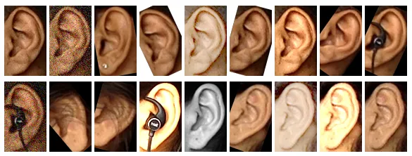
Basic Details of the Project
Student Innovation:
A machine learning based algorithm to detect the ear of different individuals and use it for authentication purposes
Project Title:
Ear Biometrics Detection

Slide 2
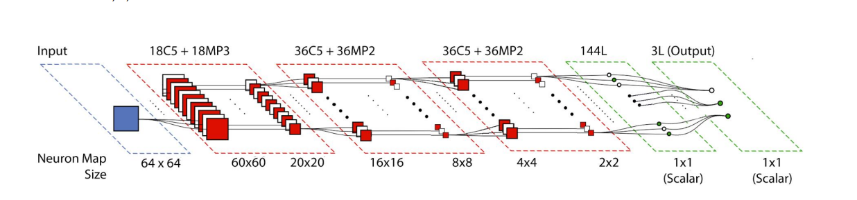
Idea/Approach Details
Image Acquisition
Preprocessing
Binary Image Conversion
Ear Detection
Feature Extraction Stage
Describe your idea/Solution/Prototype here:
Convolutional Neural Networks approach.
Describe your Technology stack here:
OpenCV
Python
Machine Learning
Convolutional Neural Network
Image Segmentation

Slide 3
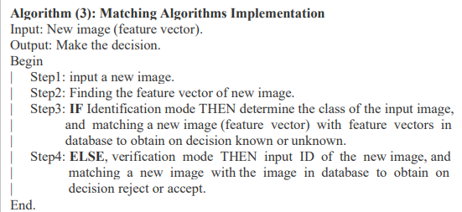
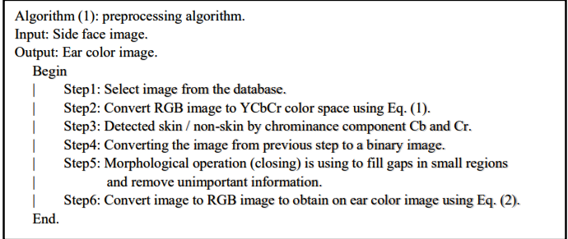
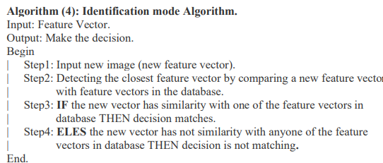
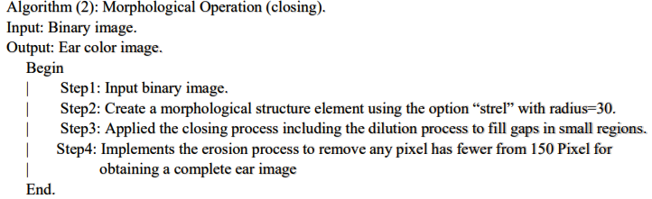
Idea/Approach Details
Algorithms

Slide 4
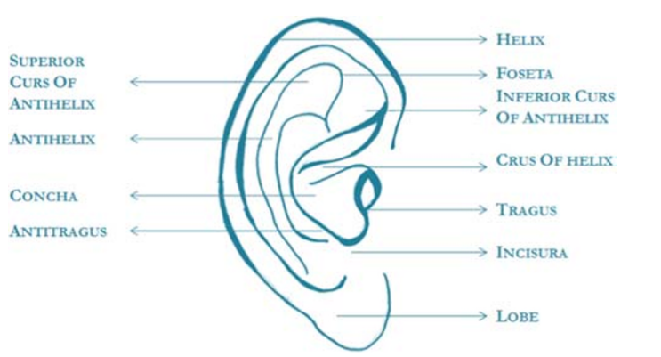
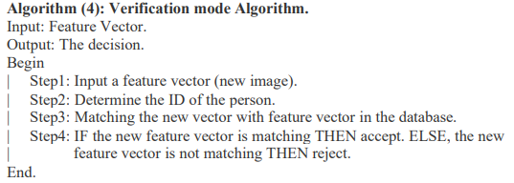
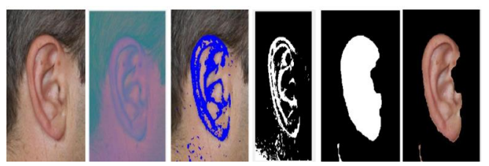
Idea/Approach Details

Slide 5
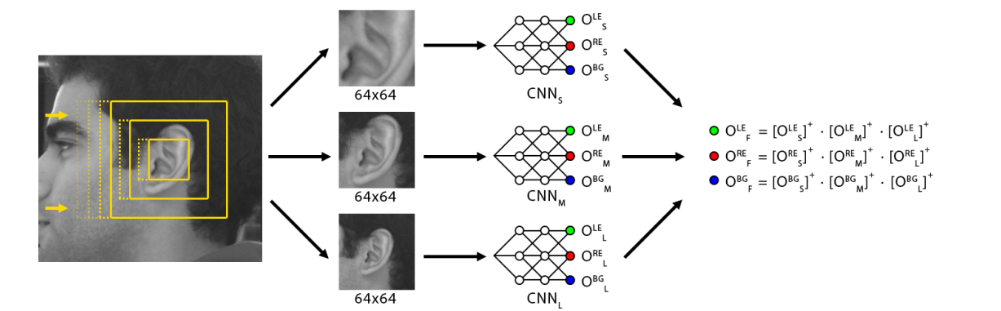
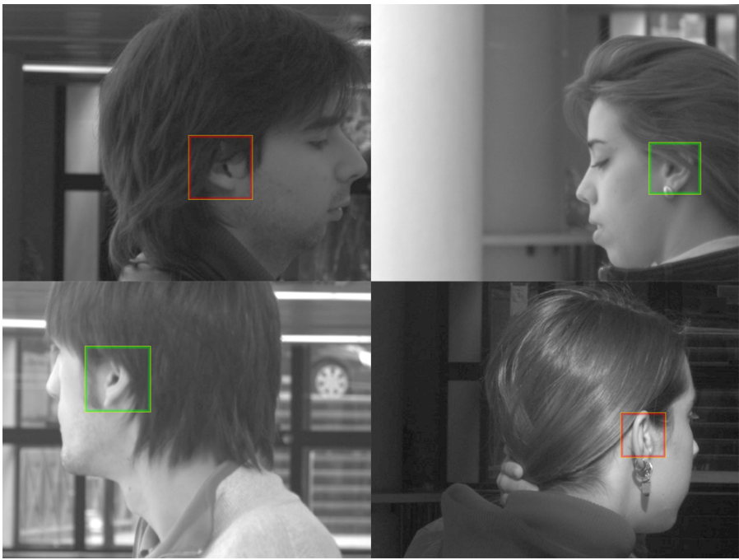
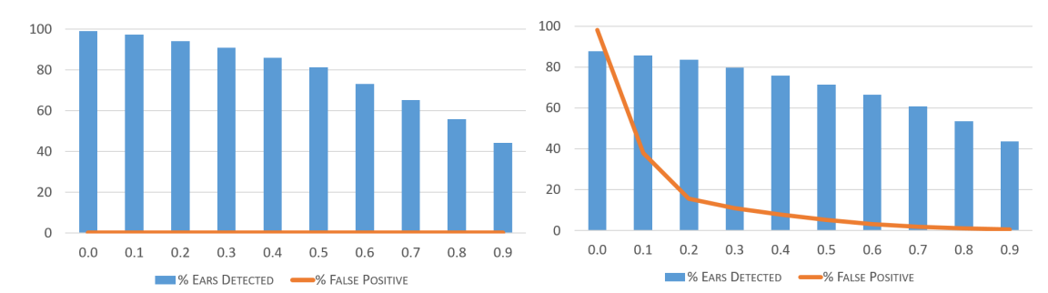
Expected Outcomes

