Slide 1
AutoAI Model Building Using IBM Watson Studio
This presentation explores an AI-powered predictive model for early diabetes detection, leveraging the advanced capabilities of IBM Watson Studio’s AutoAI. Our focus is on improving healthcare outcomes through intelligent automation.
Presented by: Prayas Tyagi
Date: 10-07-2025

Slide 2
Introduction
• What is AutoAI?
• Why automate machine learning pipelines?
• Role of IBM Watsonx Studio in AutoAI development

Slide 3
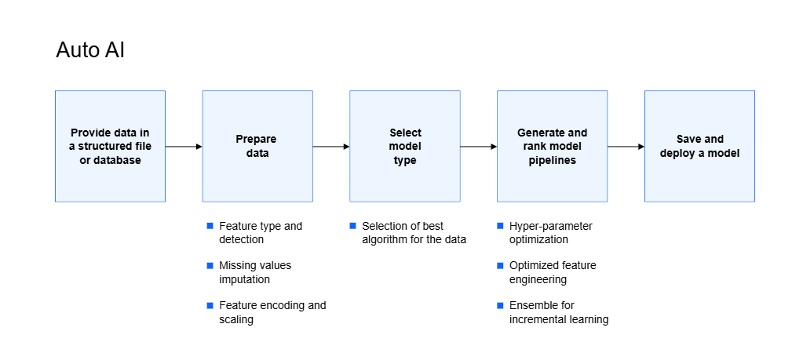

Slide 4
Problem Statement
• Manual machine learning model building is time-consuming
• Requires expert knowledge in model selection, feature engineering, and hyperparameter tuning
• Difficulties in deploying models quickly and efficiently

Slide 5
Proposed Solution
• Use IBM Watsonx Studio's AutoAI to automate ML model lifecycle
• Automatically handle preprocessing, model selection, and tuning
• Deploy models via Watson Machine Learning and integrate with a IBM Cloud.

Slide 6
Objective of the Project
• Automate end-to-end ML lifecycle
• Eliminate manual model selection, feature engineering, hyperparameter tuning
• Deploy easily using Watsonx capabilities

Slide 7
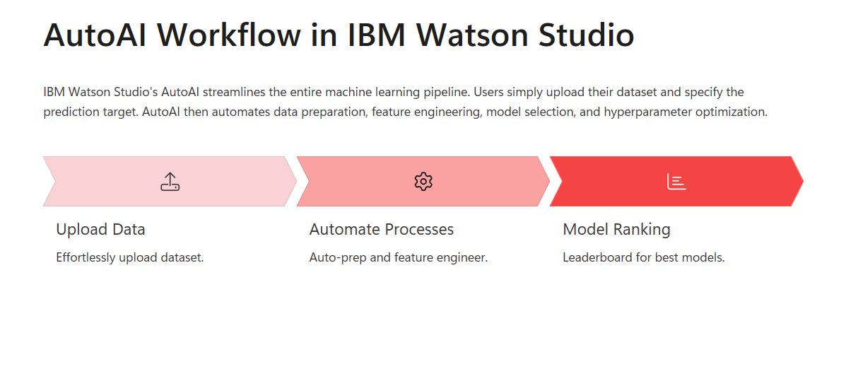
Project Workflow Overview

Slide 8
AutoAI Pipeline Details
• Automatic feature engineering: Handles rows which target values are missing(drop(default) or target imputation).
• Model selection: The second stage is an AutoAI experiment training is automated model selection.
• Model optimization: The following metrics are available for measuring the accuracy of pipelines during training and for scoring data.
• Hyperparameter optimization: Hyperparameter optimization refines the best performing models. AutoAI uses a novel hyperparameter optimization algorithm for certain function evaluations, such as model training and scoring, that are typical in machine learning.
• Explainability: All the explanation is explained on the next slide.

Slide 9
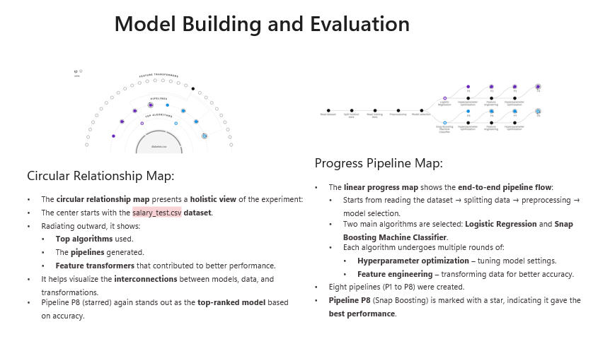

Slide 10
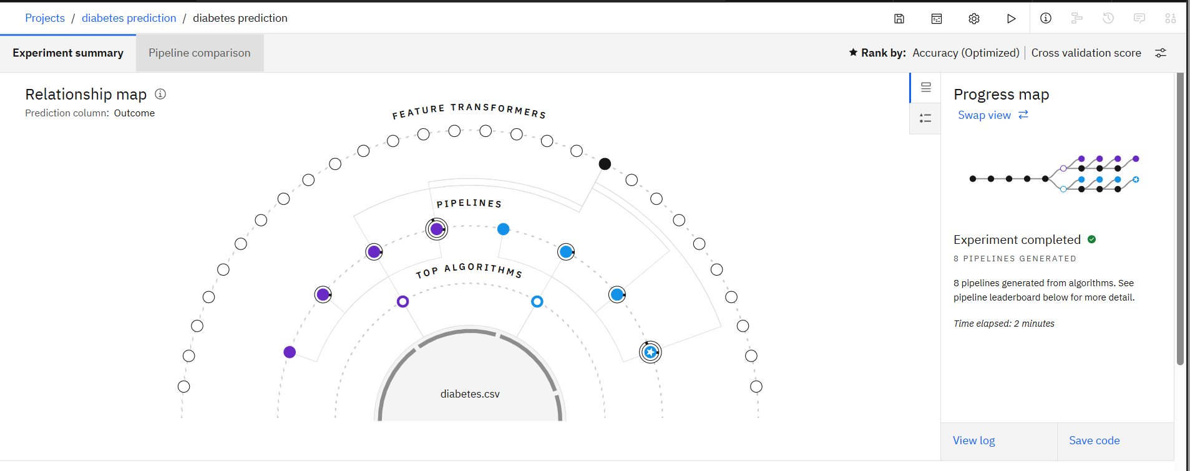
AutoAI Working 1. Show relationship map choosing the best path

Slide 11
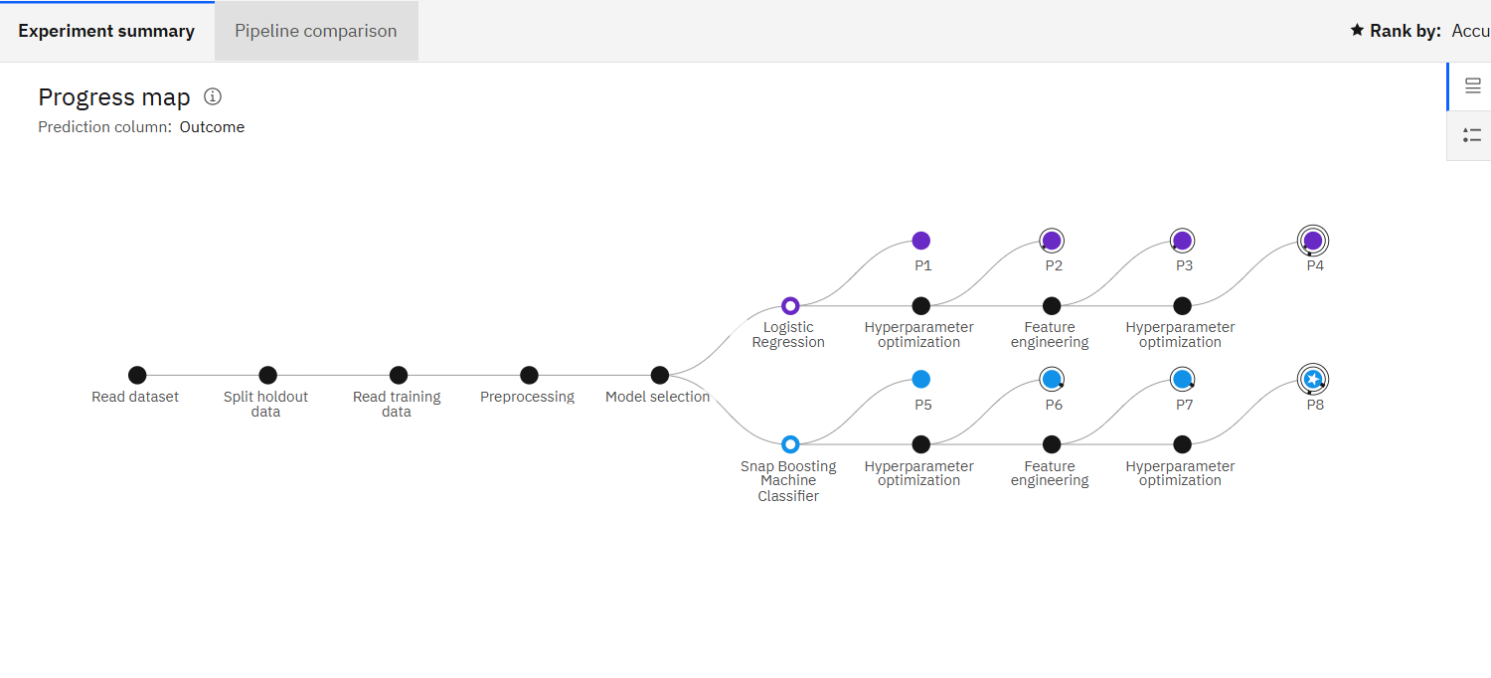
2. Progress of Pipeline Map

Slide 12
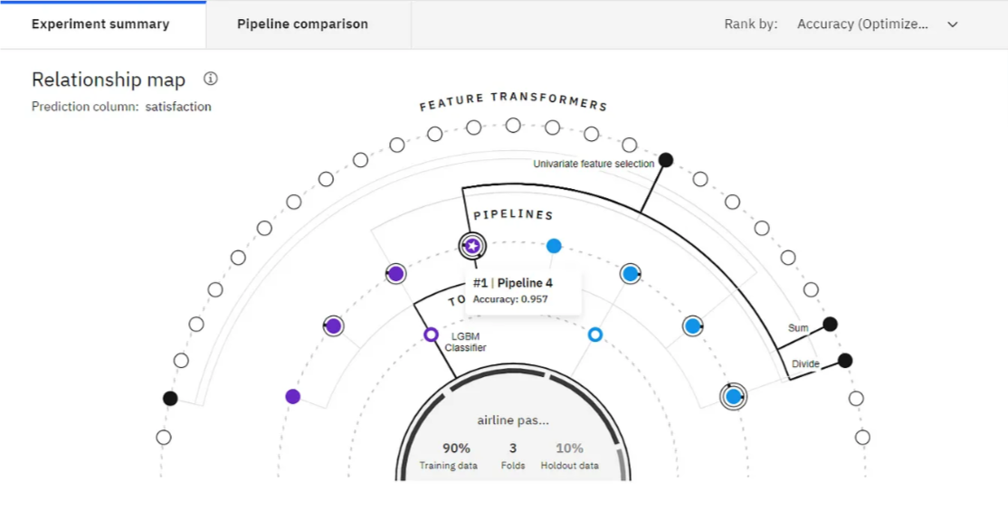
3. Relationship map choose the best path

Slide 13
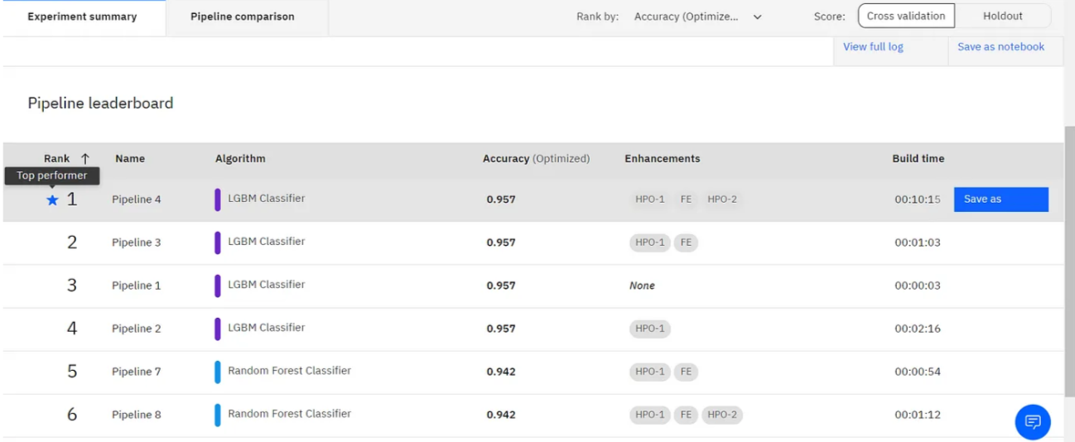
4. AutoAI’s top 2 selected algorithms (LGBM Classifier and Random Forest Classifier)

Slide 14
5. Final Choose of the pipeline
AutoAI Experiment: A completed experiment with P4 selected as the top performer pipeline (95.7% accuracy).

Slide 15
Tools & Technologies Used
• IBM Watsonx Studio
• AutoAI
• Watson Machine Learning
• Python
• IBM Cloud Storage

Slide 16
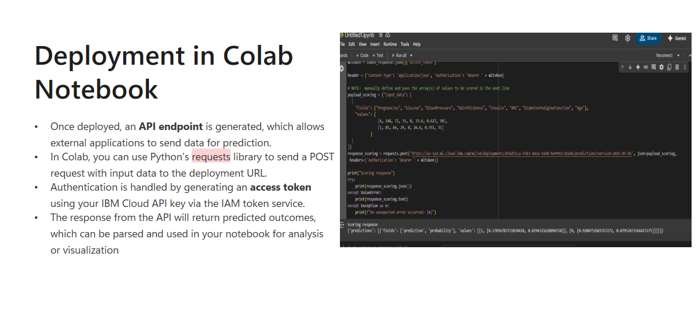

Slide 17
Future Scope
• Add more preprocessing options
• Improve UI with advanced visualization
• Integrate feedback loop for model updates

Slide 18
Conclusion
• End-to-end automation achieved
• Deployed scalable ML model
• Easy interface for users via web app

Slide 19
Q&A
Any Questions?
Thank you!

