Slide 1

LeafDoc: A Generative AI–Based Plant Identification and Disease Diagnosis System

Slide 2
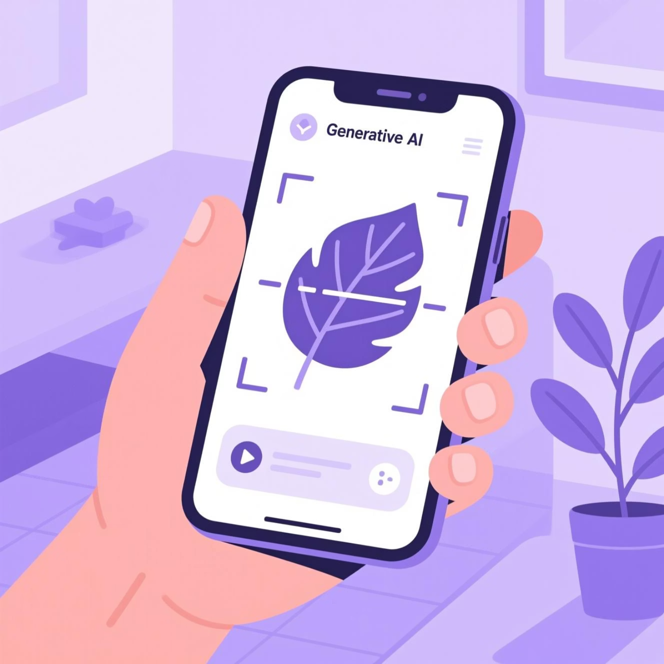
Introduction
LeafDoc, an AI-assisted system designed for plant identification and disease diagnosis using image-based analysis. Identifying plant species and detecting plant diseases at an early stage is often challenging for farmers and non-expert users due to dependence on expert knowledge and traditional manual methods.
LeafDoc addresses this challenge by providing a web-based solution that first identifies the plant from an uploaded image and then analyzes it for possible diseases. Based on the analysis, the system provides basic treatment suggestions and plant care guidance, aiming to support farmers, gardeners, and students through an accessible and easy-to-use plant health monitoring tool.

Slide 3
Literature Review
Our research journey began by exploring existing work in AI-driven plant identification and disease diagnosis. Existing studies highlight the following:
Image-Based Disease Detection
Plant Identification Systems
Several systems use image analysis for plant disease detection.
Image-based plant identification tools have been developed.
Such systems focus only on identifying plant species.
Most approaches rely on machine learning or deep learning techniques.
Disease diagnosis and treatment support are generally not included.
These systems usually assume the plant species is already known.
Agricultural Advisory Systems
Research Gap
Advisory systems assist users in crop and plant management.
Existing solutions work independently and lack integration.
Limited systems combine plant identification, disease diagnosis, and guidance.
Many depend on expert knowledge, rules, or sensor data.
Visual analysis of plant images is often missing.
This gap motivates the development of an integrated AI-based system like LeafDoc.

Slide 4
Objectives
The primary objectives of the LeafDoc project are as follows:
1
Plant Identification
2
Plant Disease Detection
To identify plant species from user-uploaded images using AI-assisted image analysis.
To analyze identified plants for possible diseases based on visual symptoms.
3
Recommendation and Guidance
4
User Assistance and Accessibility
To provide basic treatment suggestions and plant care recommendations for identified diseases.
To develop a user-friendly web-based system with chatbot support for assisting non-expert users.

Slide 5
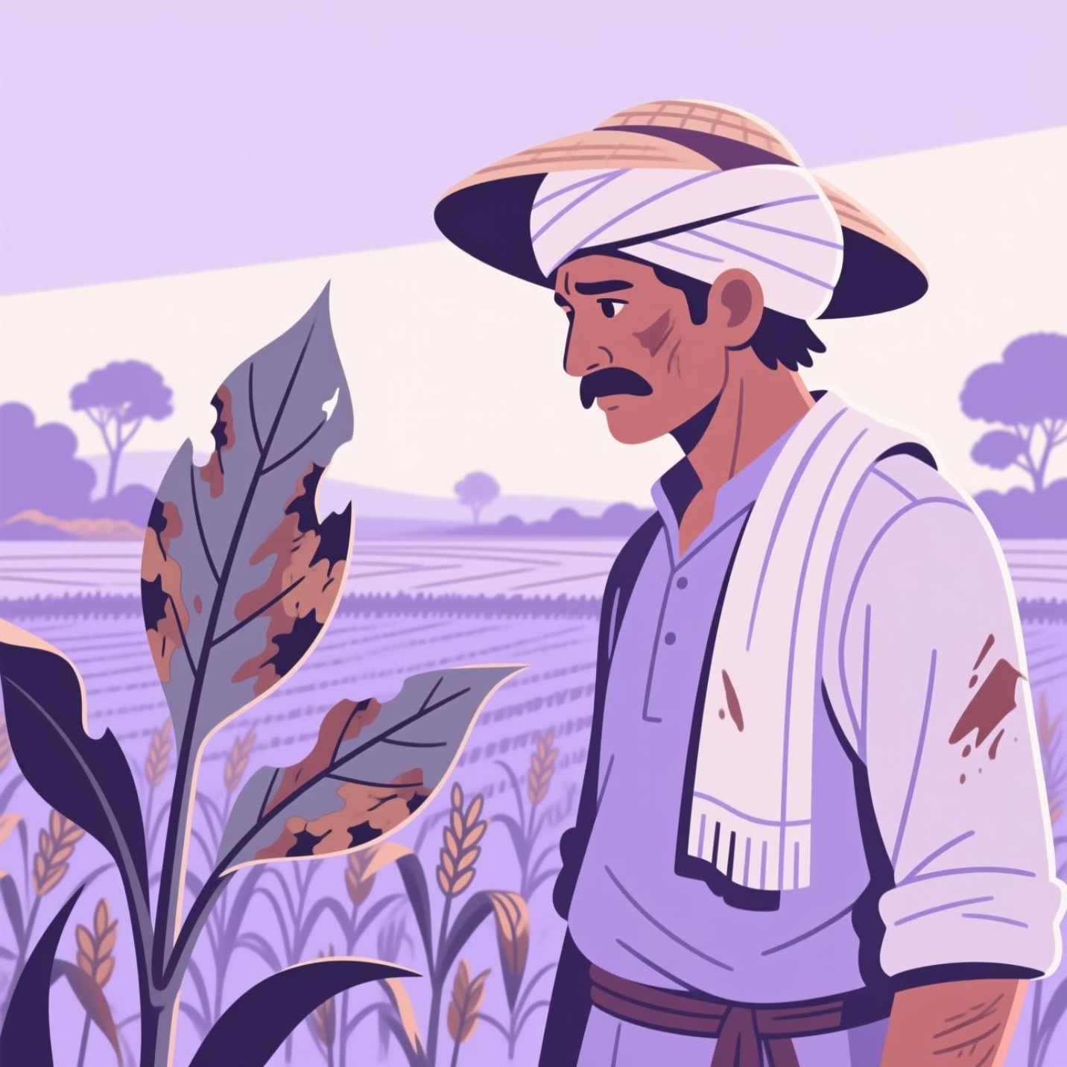

Problem Statement
Identifying plant species and diseases at an early stage is difficult for non-expert users.
Most existing solutions address plant identification or disease detection separately.
An integrated, easy-to-use system for plant analysis and guidance is needed.

Slide 6




Proposed System / Methodology
The LeafDoc system follows a structured workflow consisting of the following modules:
Image Input Module
Users upload an image of a plant or leaf through the web-based interface for analysis.
Plant Identification Module
The uploaded image is analyzed using a generative vision-language AI service to identify the plant species.
Disease Analysis Module
Based on the identified plant, the system analyzes visual symptoms to detect possible plant diseases.
Recommendation & User Interaction Module
The system provides basic treatment suggestions and plant care guidance, along with chatbot-based user assistance.

Slide 7
Plan for Future Work
Development of a Mobile Application
Real-Time Image Capture and Analysis
Multi-Language Support for Regional Users
Integration of Environmental Data
Extend the current web-based system into a mobile application for improved accessibility and convenience.
Enable real-time image capture through mobile devices for faster plant identification and disease analysis.
Provide support for multiple regional languages to make the system accessible to a wider user base.
Incorporate environmental factors such as climate and location to enhance plant care and recommendation accuracy.

Slide 8

References
S. P. Mohanty, D. P. Hughes, and M. Salathé, “Using deep learning for image-based plant disease detection,” Frontiers in Plant Science, 2016.
K. P. Ferentinos, “Deep learning models for plant disease detection and diagnosis,” Computers and Electronics in Agriculture, 2018.
A. Saleem, J. Potgieter, and K. M. Arif, “Plant disease detection and classification by deep learning: A review,” Plants, 2019.
R. Ramesh and R. S. K. M. Reddy, “Decision support systems in agriculture: A survey,” International Journal of Computer Applications, 2014.
Google AI, “Vision-Language Models and Generative AI Documentation,” Google Developers, 2024.

Slide 9
Thank You !

