Slide 1
Emotion detection by tweets and emoticons using machine learning
Rushikesh Kedari-35
Prayas More-48
Abhishek Kshatriya-42
Date of presentation: 22/06/2020
Under Guidance
Prof Pankaj Kunekar
Prof Priti Mishra
Atharva College of Engineering
Department of Information Technology
Notes:
1

Slide 2
Content
Introduction
Review of literature
Problem definition
Requirement Analysis
Discussion on Present Investigation
  Block diagram of System
  Algorithm/Flowchart
Results and Discussion
Conclusions
References
Future Scope
2
ACE- IT department Emotion detection by tweets and emoticons using ML
Notes:
2

Slide 3
Introduction
With the huge amount of increase in the web technologies, the no of people expressing their views and the opinion via web are increasing.
Twitter is becoming a major source of information.
Using social media, models are built for classifying “tweets” into positive , negative, and neutral classes.
This information is useful for everyone like businesses, governments and individuals .
3
ACE- IT department Emotion detection by tweets and emoticons using ML

Slide 4
Review of literature
Name of the paper | Authors | Description
Sentiment Analysis with Long Short-Term Memory networks | Prof. Fenna Miedema, Dr.sandjai Bhulai | Here RNN-LSTM are used for sentiment analysis. The goal of these research is to find out why these models works well for sentiment analysis.
Study of Twitter Sentiment Analysis using Machine Learning Algorithms on Python | Bhumika Gupta, Monika Negi, Kanika Vishwakarma, Goldi Rawat, Priyanka Badhani | In these paper we aim to review some papers regarding research in sentiment analysis
4
ACE IT department Emotion detection by tweets and emoticons using ML

Slide 5
Review of literature
Name of the paper | Authors | Description
Analyzing and predicting the US Midterm Elections on Twitter with Recurrent Neural Network | Antinio Lopardo, Marco Brambilla | This paper shows local support for two major US political parties. The method was able to predict the correct winner on 60%.
ACE IT department Emotion detection by tweets and emoticons using ML

Slide 6
Problem Definition
Despite the availability of software to extract data regarding a person’s sentiment on a specific product or service, organizations still face issue regarding the data extraction. With the rapid growth of www, people are using social media such as twitter which generate big volume of opinion texts in the form of tweets which is available for the sentiment analysis. Also prediction of long statements and slang’s are difficult to predict.
To overcome this problems we can develop a system using RNN-LSTM which can predict these tweets more accurately and can over perform the traditional models.
ACE- IT department Emotion detection by tweets and emoticons using ML

Slide 7
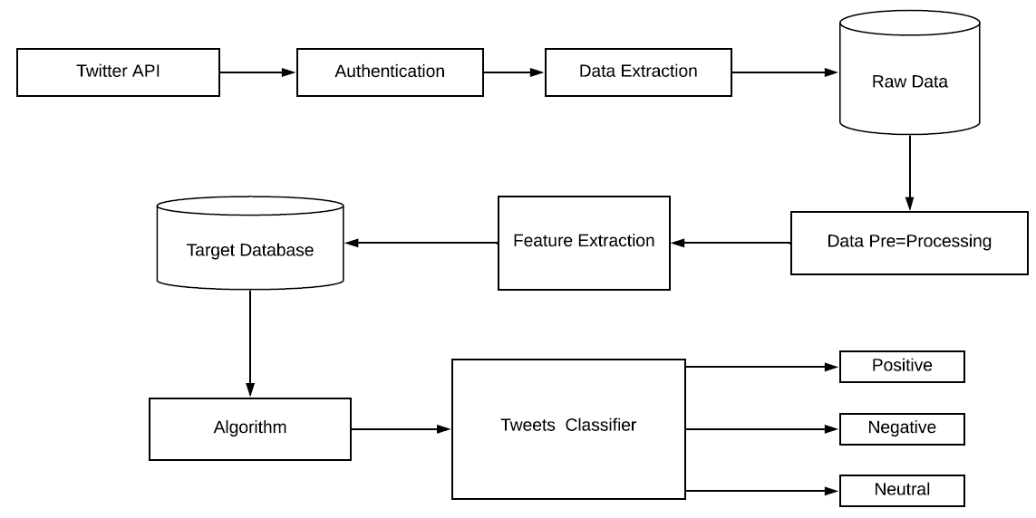
BLOCK DIAGRAM

Slide 8
Algorithm
Recurrent Neural Network (RNN)
Recurrent Neural Network is a generalization of feedforward neural network that has an internal memory. RNN is recurrent in nature as it performs the same function for every input of data while the output of the current input depends on the past one computation. After producing the output, it is copied and sent back into the recurrent network. For making a decision, it considers the current input and the output that it has learned from the previous input.
Long Short Term Memory (LSTM)
LSTM is an artificial recurrent neural network (RNN). LSTM has feedback connections. It can not only process single data points (such as images), but also entire sequences of data (such as speech or video).

Slide 9
Requirement Analysis
Software Details
Python and required libraries
Visual studio code
Public Data-set (Twitter)
ACE- IT department Emotion detection by tweets and emoticons using ML

Slide 10
Results and Discussion
When user enters search topic, based on that topic live tweets are extracted and system then predicts its polarity
Live tweets is saved in file along with its polarity
ACE- IT department Emotion detection by tweets and emoticons using ML

Slide 11
Conclusion
A emotion detection system can be developed using RNN-LSTM.
In these model an improved RNN language model is put forward using LSTM.
RNN with LSTM can lead to better accuracy rate and recall rate than the conventional RNN. Specifically, RNN with LSTM can identify many text instances with the structure like ‘although…but…’, ‘not only…but also…’, ‘however’ and so on. It identifies some long statements better than the conventional RNN
11
ACE- IT department Emotion detection by tweets and emoticons
Notes:
11

Slide 12
References
Analyzing and predicting the US Midterm Elections on Twitter with Recurrent Neural Network
- Antinio Lopardo, Marco Brambilla
Sentiment Analysis on Twitter : A Survey
-Rohita.V, D.Malathi
Sentiment Analysis with Long Short-Term Memory networks
-Prof. Fenna Miedema, Dr.sandjai Bhulai
Study of Twitter Sentiment Analysis using Machine Learning Algorithms on Python
-Bhumika Gupta, Monika Negi, Kanika Vishwakarma, Goldi Rawat
12
ACE- IT department Emotion detection by tweets and emoticons

Slide 13
Future Scope
We intend to build this project using Python programming language using Machine Learning concepts and Recurrent Neural Networks.
The scope of this project is to show how sentimental analysis can be used to recognize user’s mood or emotion using tweets which has been extracted in real time

Slide 14
Questions??
Thank You!
14
ACE- IT department Emotion detection by tweets and emoticons using ML

