Slide 1
Emotion detection by tweets and emoticons using machine learning
Rushikesh Kedari-35
Abhishek Kshatriya-42
Prayas More-48
Date of presentation:03/12/20
Under the guidance of: Prof. Renuka Nagpure
Atharva College of Engineering
Department of Information Technology

Slide 2
Content
Introduction
Review of literature
Problem definition
Feasibility Study and Scope of project
Proposed System
  Architecture or block diagram or Methodology (broader topic/algorithm)
Hardware & software requirements
. Software Requirement Specification
UML diagram(as per project requirements)
DFD Diagram
Sequence Diagram
E-R Diagram
Methodology
Conclusions
References
Future Scope
ACE- IT department Project Title

Slide 3
Introduction
With the huge amount of increase in the web technologies, the no of people expressing their views and the opinion via web are increasing.
Twitter is becoming a major source of information.
Using social media, models are built for classifying “tweets” into positive , negative, and neutral classes.
This information is useful for everyone like businesses, governments and individuals .
ACE- IT department Project Title

Slide 4
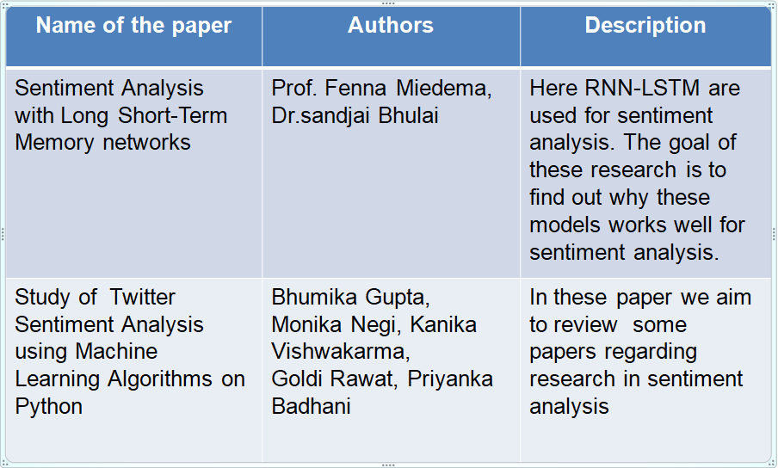
Review of literature
ACE IT department Project Title

Slide 5
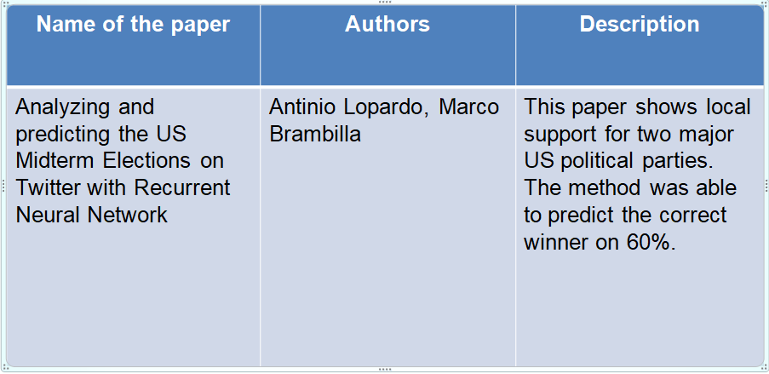
ACE- IT department Project Title

Slide 6
Problem definition & Proposed solution
Despite the availability of software to extract data regarding a person’s sentiment on a specific product or service, organizations still face issue regarding the data extraction. With the rapid growth of www, people are using social media such as twitter which generate big volume of opinion texts in the form of tweets which is available for the sentiment analysis. Also prediction of long statements and slang’s are difficult to predict.
To overcome this problems we can develop a system using RNN-LSTM which can predict these tweets more accurately and can over perform the traditional models.
ACE - IT department Project Title

Slide 7
Feasibility Study & Scope of project
We intend to build this project using Python programming language using Machine Learning concepts and Recurrent Neural Networks.
The scope of this project is to show how sentimental analysis can be used to recognize user’s mood or emotion using tweets which has been extracted in real time
ACE IT department Project Title

Slide 8
System description
Software Details
Python and required libraries
Visual studio code
Public Data-set (Twitter)
ACE IT department Project Title

Slide 9
Hardware & software requirements
Software Details
Python and required libraries
Visual studio code
Public Data-set (Twitter)
Hardware Details
Modem, WAN-LAN, Ethernet Cross-Cable
Screen Resolution: 800X600
RAM : 2GB and Hard Disk : 500GB
ACE - IT department Project Title

Slide 10
Software Requirements
Software Requirement Specification
  UML diagram (as per project requirements)
  DFD Diagram
  Sequence Diagram
  E-R Diagram
ACE- IT department Project Title

Slide 11
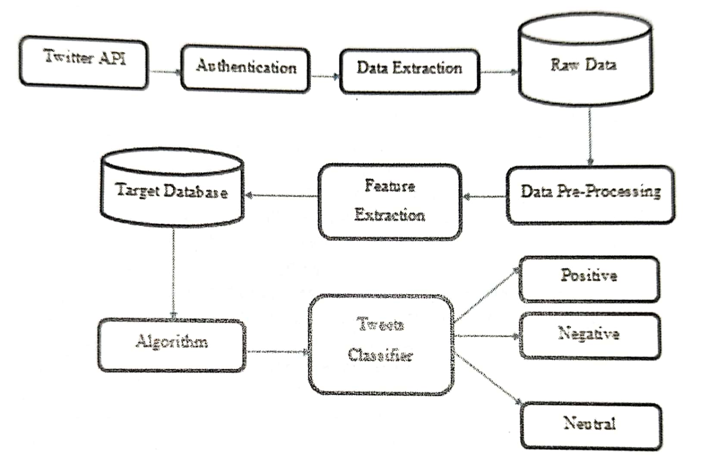
UML diagram
ACE- IT department Project Title

Slide 12
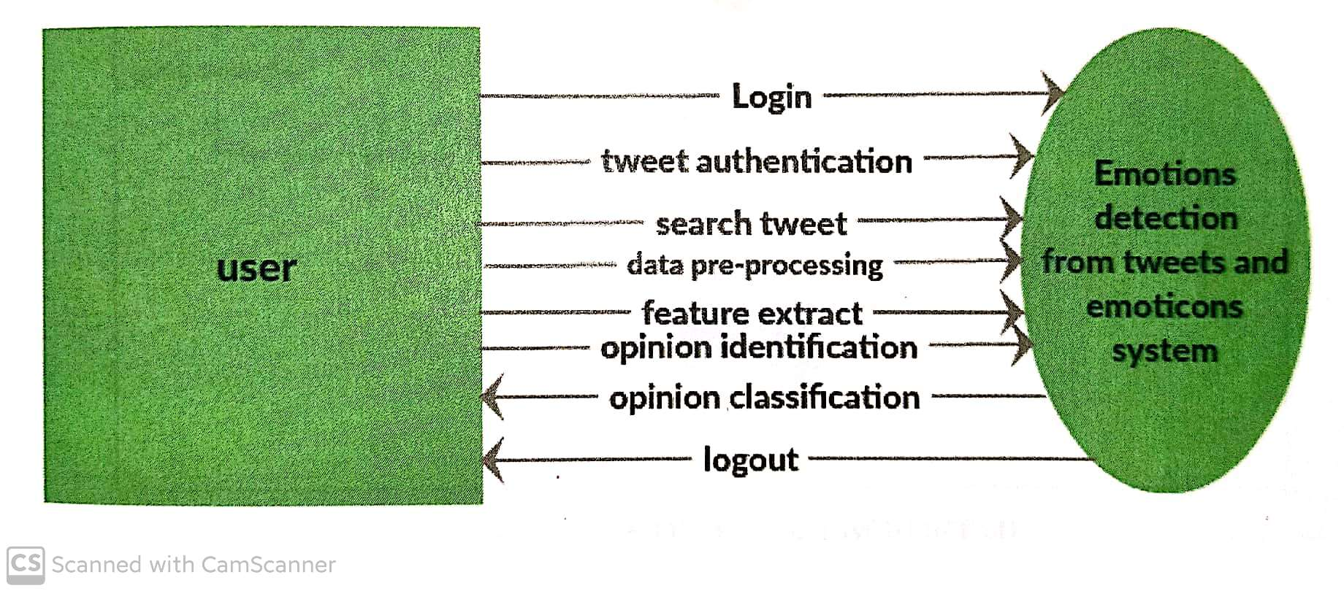
DFD Diagram
ACE- IT department Project Title

Slide 13
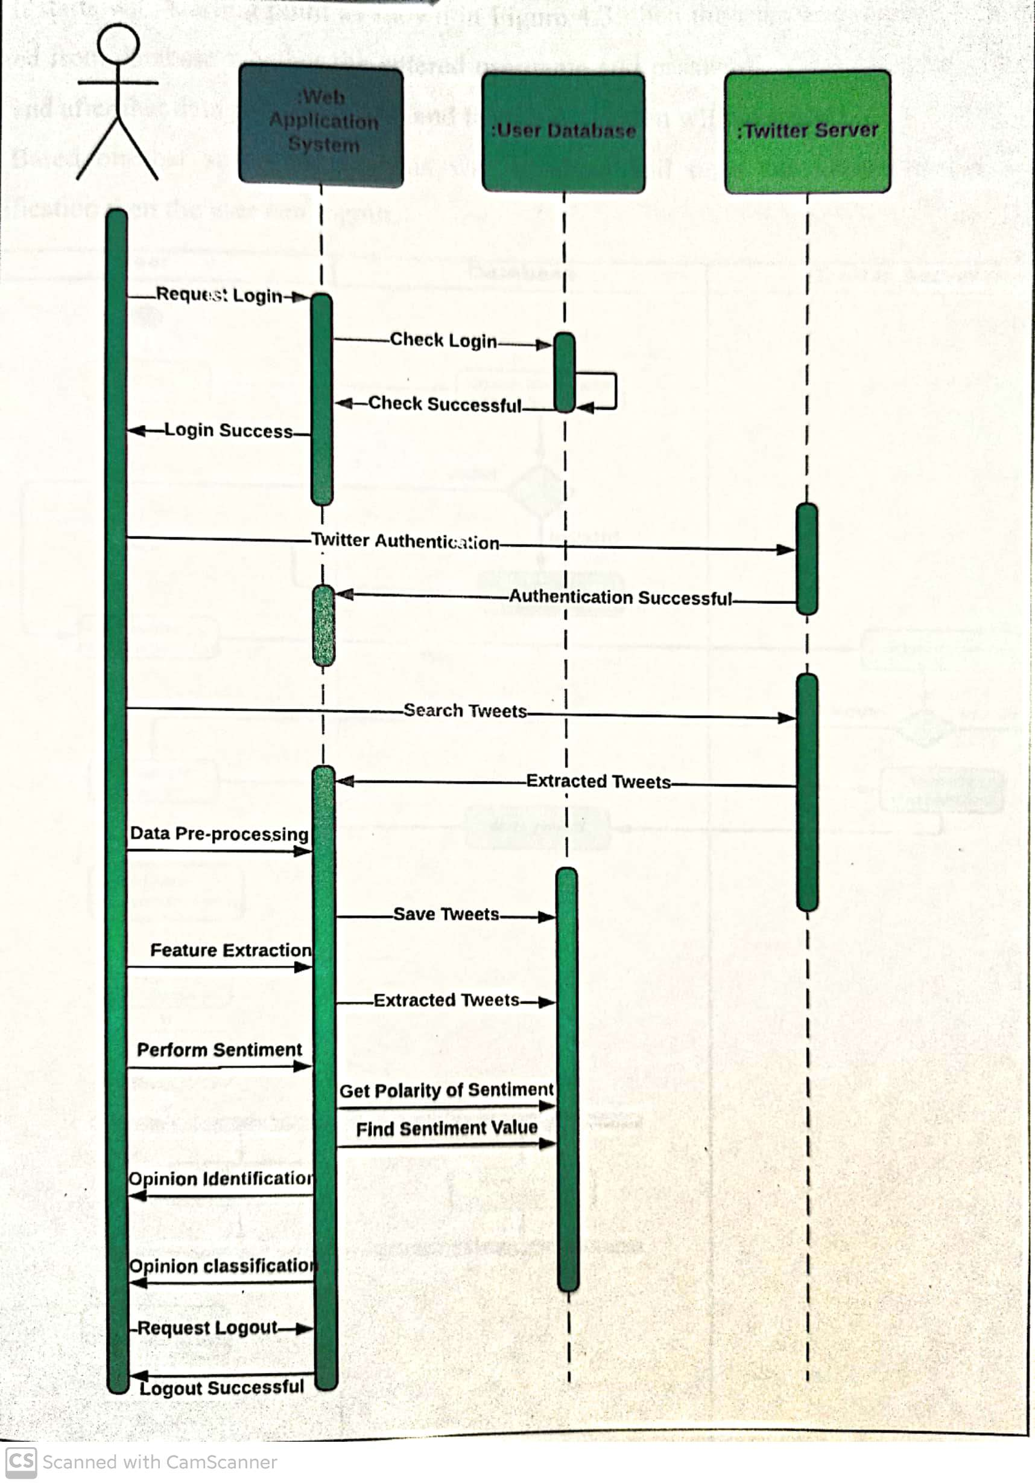
Sequence Diagram
ACE- IT department Project Title

Slide 14
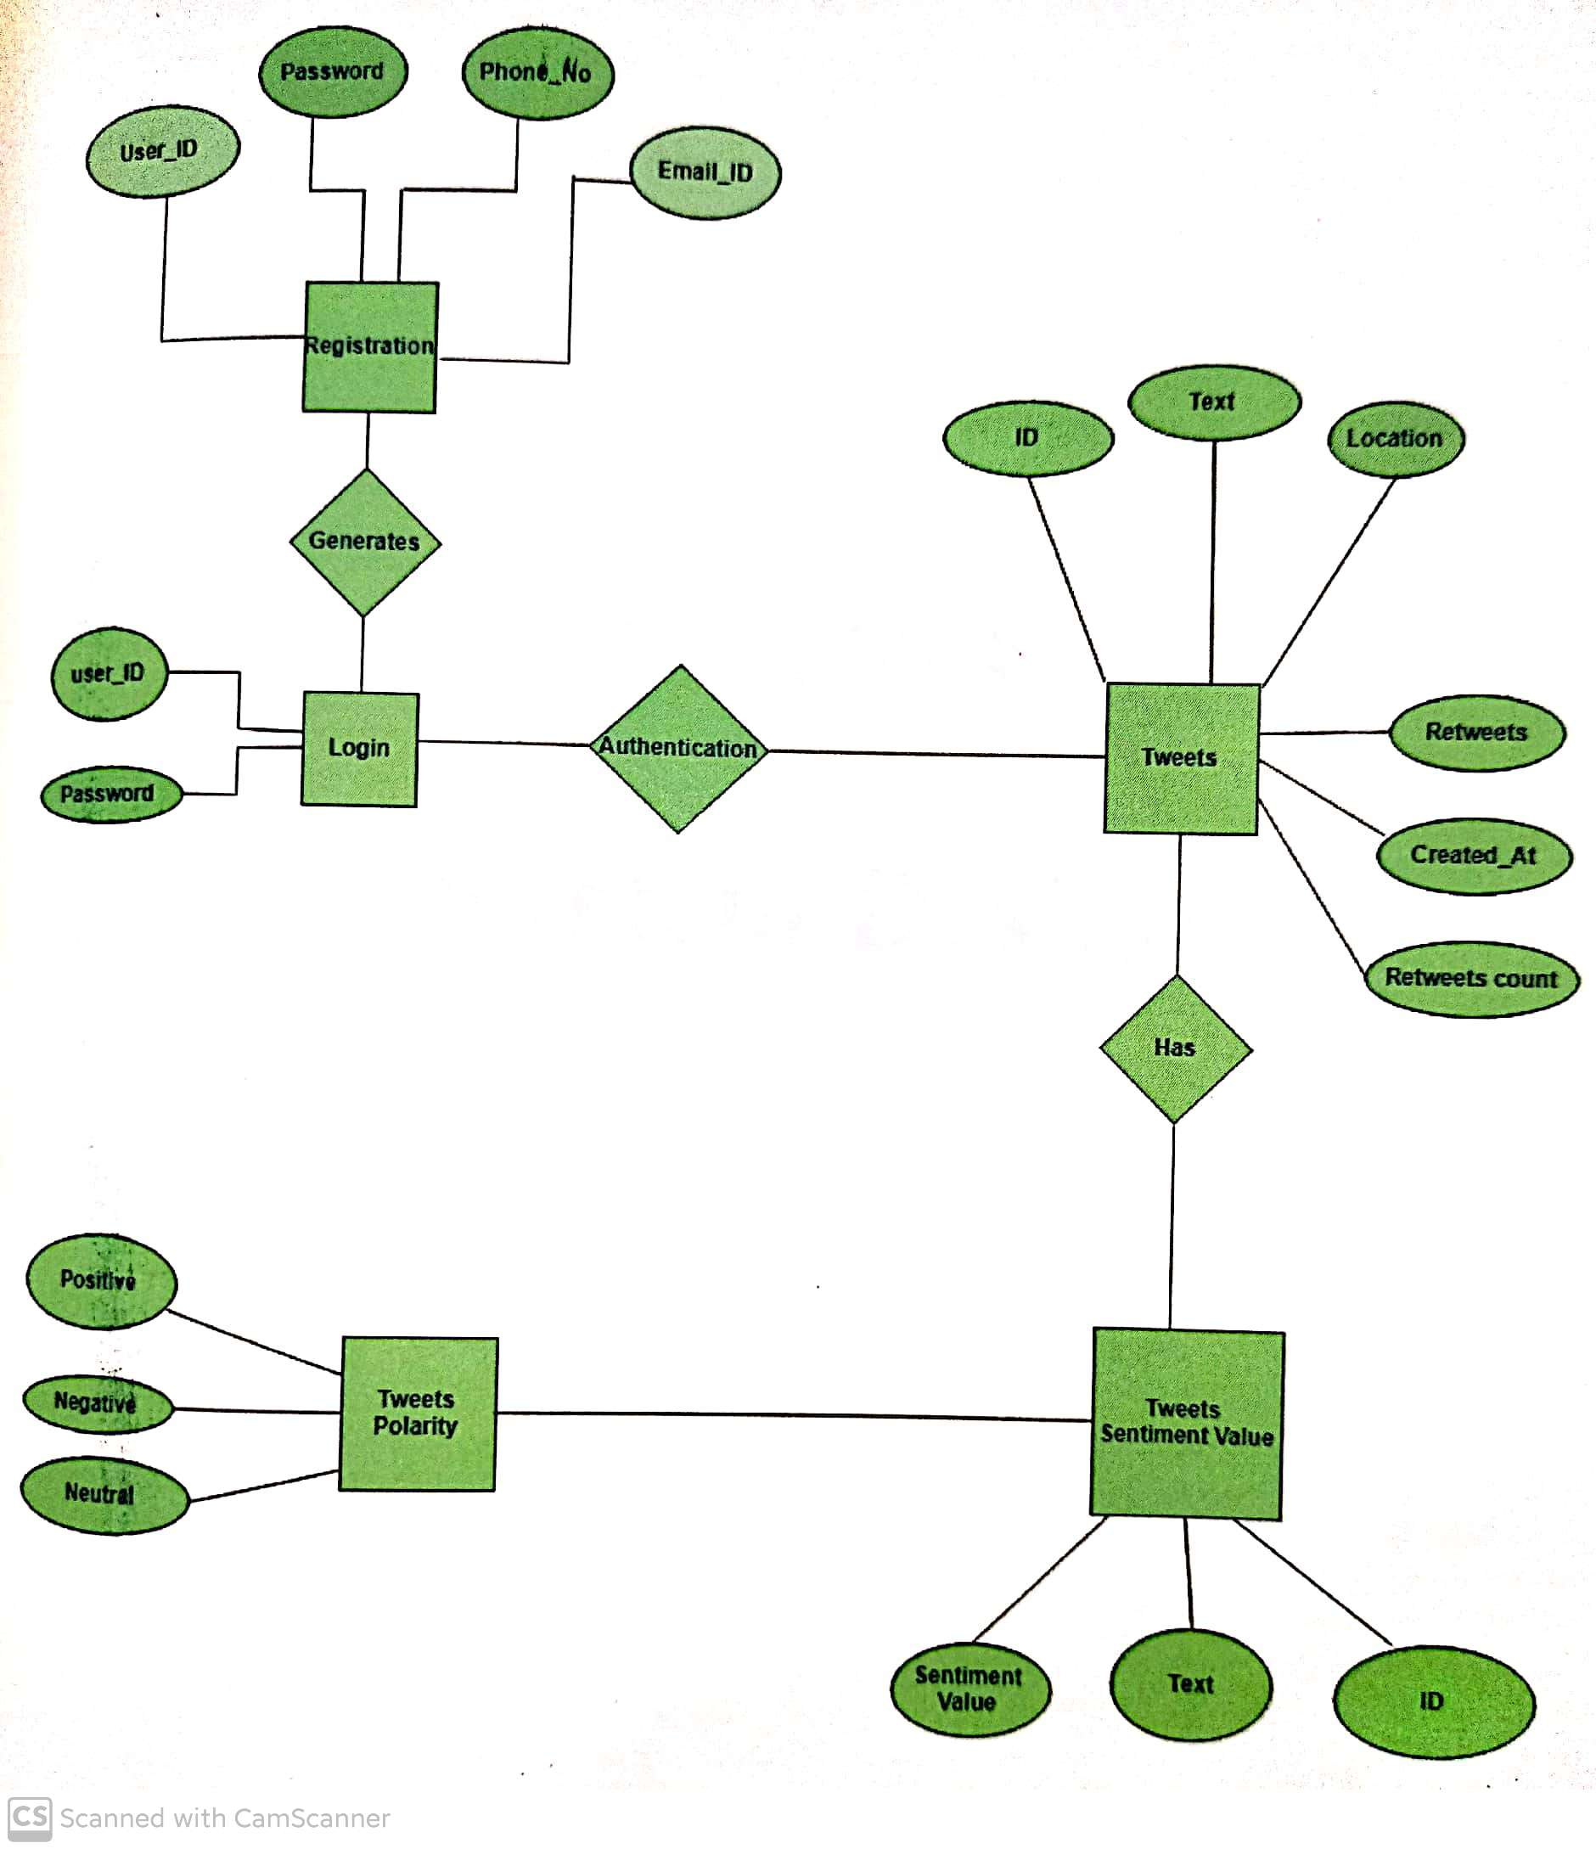
E-R Diagram
ACE- IT department Project Title

Slide 15
Methedology
ACE- IT department Project Title

Slide 16
Conclusions
A emotion detection system can be developed using RNN-LSTM.
In these model an improved RNN language model is put forward using LSTM.
RNN with LSTM can lead to better accuracy rate and recall rate than the conventional RNN. Specifically, RNN with LSTM can identify many text instances with the structure like ‘although…but…’, ‘not only…but also…’, ‘however’ and so on. It identifies some long statements better than the conventional RNN
ACE- IT department Project Title

Slide 17
Questions??
Thank You!
ACE- IT department Project Title

