Slide 1
Temperature and Humidity Monitoring Dashboard
323 | Prayatna Mishra
Progress Report of Project-I – CAPJ 256 – Class of 2024

Slide 2
Outline
Introduction
Problem Statement
Objective
Scope
Literature Review/Background Study
Methodology
Tools and Technology
Progress Till Now
Result
Conclusion
Reference

Slide 3
Introduction
Temperature and Humidity Tracking Dashboard
Combines Software and Hardware components to monitor the Temperature and Humidity level in real-time within an enclosed environment.

Slide 4
Problem Statement
Current methods for monitoring temperature and humidity lack accuracy, real-time capabilities, and proactive alerts.
Industries such as agriculture, food storage, pharmaceuticals, and manufacturing require a comprehensive software and hardware solution to continuously monitor and control temperature and humidity, enabling proactive decision-making and optimization while minimizing product spoilage and energy wastage.

Slide 5
Objective
To provide accurate and real-time monitoring of temperature and humidity levels in industries and environments.
To enable proactive decision-making and optimization based on the data.
To minimize product spoilage, energy wastage, and risks associated with suboptimal temperature and humidity conditions.
To enhance the overall overall quality, safety, and efficiency of the monitored environment.

Slide 6
Scope
What the System Does:
Real-time monitoring of temperature and humidity levels in enclosed environments.
Accurate data collection and visualization.
What the System Does Not Do:
Direct control of environment conditions (adjusting temperature and humidity).
Monitoring of other environmental factors beyond temperature and humidity.

Slide 7
Literature Review / Background Study
Existing research and studies on the Importance of temperature and humidity control in industries such as agriculture, food storage, pharmaceuticals, and manufacturing.[1]
Evaluation of the limitations and drawbacks of manual monitoring and control systems.[2]
Review of software and hardware solutions available in the market for real-time monitoring.

Slide 8
Methodology
Waterfall Model
As requirements were clear from the initial stages.
Well defined and structred.
Appropriate method for project that focuses on documentation.

Slide 9
Requirement Identification
Study of Existing Systems
There are currently no budget options that compete with the “Temperature and Humidity Monitoring Dashboard”
SensorPush has a competing solution, but it costs a total of $70 .

Slide 10
Requirement Identification
Requirement Collection
Functional Requirements:
The system must continuously track and monitor the temperature and humidity levels in real time.
The system must have the capability to send alerts or notifications to users when temperature or humidity levels exceeds specified thresholds.

Slide 11
Requirement Identification
Requirement Collection
Non-Functional Requirements:
The system shall be easy to install and configure.
The system shall have a low power consumption.
The system shall have a user-frie ndly interface.

Slide 12
Feasibility Study
Technical Feasibility
The ESP32 Microcontroller recurringly runs a program to retrieve temperature and humidity data and upload it to the Database.
The program uses a Serial Interfacing Package to import data from the DHT11.

Slide 13
Feasibility Study
Operational Feasibility
The Hardware component is install-once-use-forever solution.
It can be placed at one corner of the room.

Slide 14
Feasibility Study
Economic Feasibility
All the software components are all open-source.
The hardware components are available for a collective total of around Rs. 1,150 NPR.

Slide 15
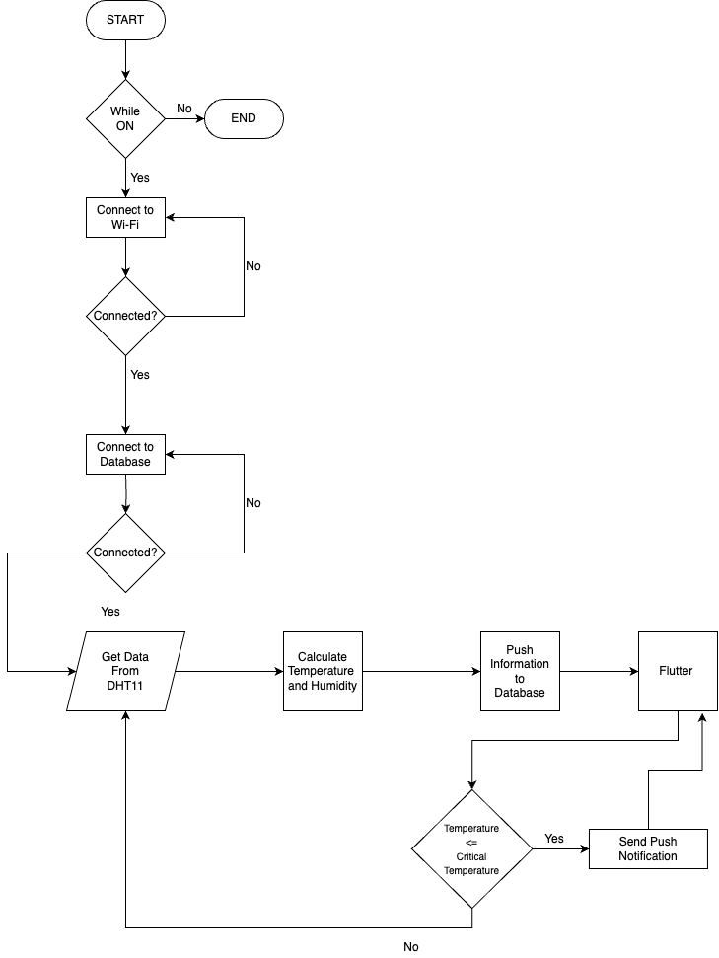
Flowchart
Figure II: Circuit Diagram for Temperature and Humidity Monitoring Dashboard

Slide 16
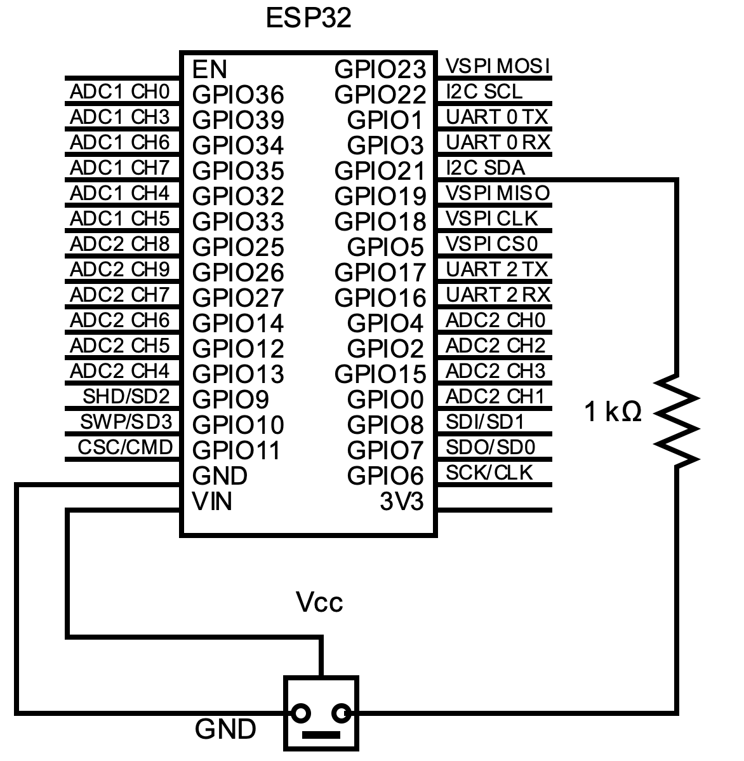
Circuit Design
Figure II: Circuit Diagram for Temperature and Humidity Monitoring Dashboard

Slide 17
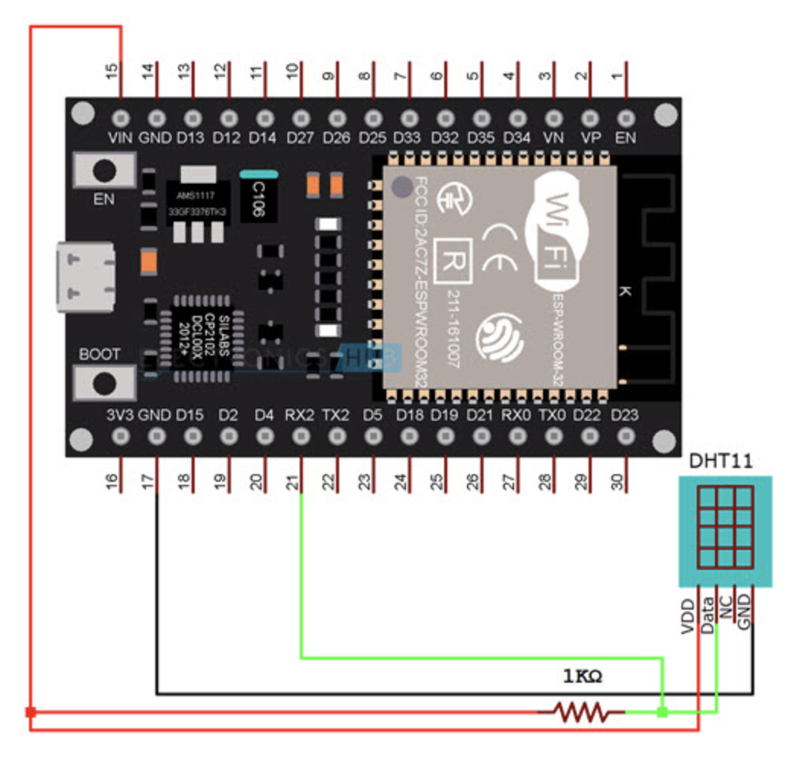
System Design
Figure III: Block Diagram for Temperature and Humidity Monitoring Dashboard

Slide 18
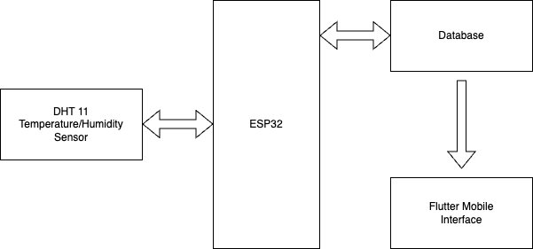
System Design
Figure I: Flowchart for Temperature and Humidity Monitoring Dashboard

Slide 19
Progress Till Now
Interfaced the Hardware Components together.
Established Connection between Hardware and Software.
DataBase Setup and Connection with Frontend.

Slide 20
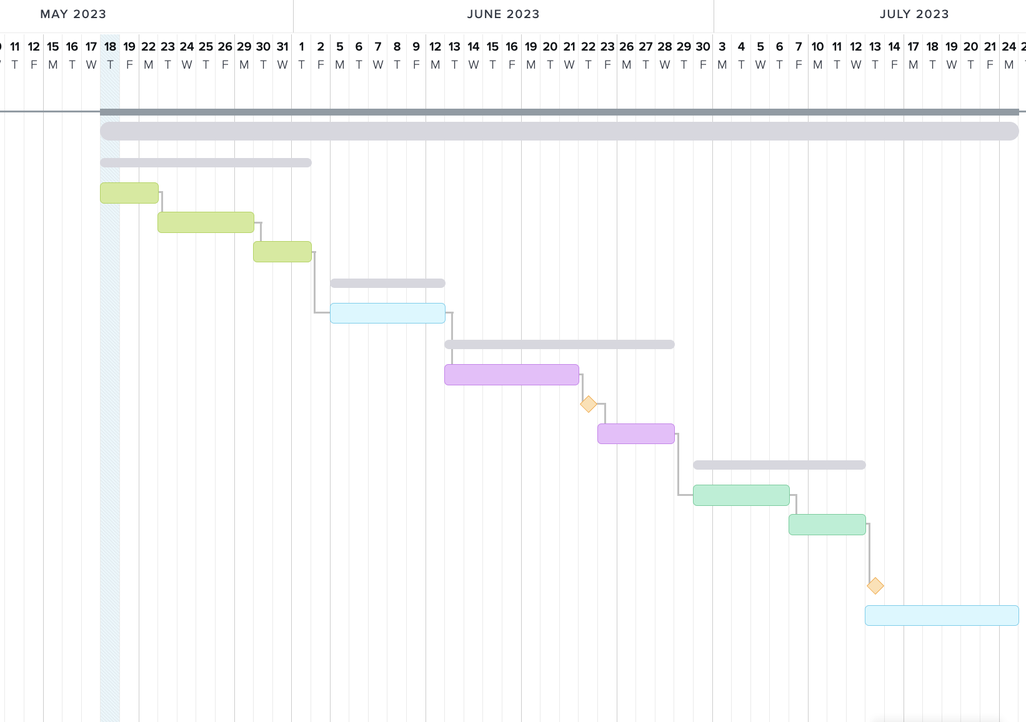
Gantt Chart
Figure IV: Gantt Chart for Temperature and Humidity Monitoring Dashboard

Slide 21
Tools and Technologies
Hardware Components: ESP32 Microcontroller, DHT11, Breadboard.
Backend Code: Arduino Programming Language (A Variation of C/C++).
Database Platform: Google Firebase Realtime Database.
Frontend Code: Flutter.
IDEs/Code Editors: Arduino IDE, Visual Studio Code.
Serial Monitor: Open Serial Port Monitor.
Diagrams and Charts: Draw.io, Monday.com, Circuit-Diagram.
Documentation: Microsoft Word and Microsoft PowerPoint.

Slide 22
Conclusion
Implementation of the system will enhance monitoring capabilities and decision-making.
Industries such as agriculture, food storage, pharmaceuticals, and manufacturing will benefit from the system’s real time monitoring of temperature and humidity levels.
The proposed system is technically feasible, economically viable and operationally compatible.

Slide 23
References
[1] "Microcontrollers Lab," [Online]. Available: https://microcontrollerslab.com/esp32-dht11-dht22-web-server/. [Accessed 03 05 2023].
[2] "TempGenius," [Online]. Available: https://www.tempgenius.com/. [Accessed 05 04 2023].

Slide 24
Demo

Slide 25
Thank You

