Slide 1


Fine-Tuning BERT on the AG News Dataset and Deploying a Real-Time Text Classification System
presented by:
  YOUNESS ATIF
  ABDELKEBIR BOUCHTI
  ANAS CHAFIK
Framed by:
soufiane hamida

Slide 2
Global Plan
Introduction & Context
Problem Statement & Motivation
Project Objectives & Contributions
BERT Architecture & NLP Background
Training Process & Dataset
Model Performance & Evaluation
System Architecture & Implementation
Deployment & Demo
Conclusion

Slide 3
Problem Statement & Motivation
Why Text Classification?
Challenges with Traditional Methods
Text classification is a core task in Natural Language Processing with applications such as:
  News categorization
  Sentiment analysis
  Spam detection
  Content moderation
  Recommendation systems
Bag-of-Words and TF-IDF ignore context
Classical ML models struggle with ambiguity
Same word can have different meanings depending on context
Why BERT?
Understands context in both directions
Pre-trained on massive corpora
Achieves state-of-the-art performance on NLP tasks

Slide 4
Project Objectives & Scope
Main Objectives
  Build a high-accuracy text classification model
  Fine-tune a pre-trained BERT model
  Deploy the model in a web application
  Make the system reproducible and scalable using Docker
Project Scope
  Classification of news text into 4 categories:
    World
    Sports
    Business
    Science & Technology
  Real-time inference through a web interface
TEXT
BERT Model
Science & Technology
World
Sports
Business

Slide 5
Model Architecture & Training

Slide 6
BERT & Architecture
BERT (Bidirectional Encoder Representations from Transformers)
BERT Architecture (High-Level)
Architecture Overview:
  Input text is split into tokens
  Tokens are converted into embeddings:
    Token embeddings
    Position embeddings
    Segment embeddings
  Passed through multiple Transformer encoder layers
  Output: contextualized word representations
Why Transformers?
  Parallel computation
  Long-range dependency modeling
  Attention mechanism replaces recurrence
Transformer-based language model introduced by Google
Pre-trained on very large text corpora:
  Wikipedia
  BooksCorpus
Uses self-attention to understand relationships between words

Slide 7
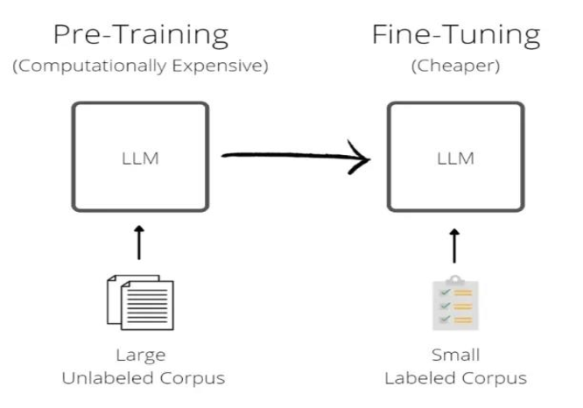
Pre-training vs Fine-Tuning
Pre-training (already done by Google):
  Masked Language Modeling (MLM)
  Next Sentence Prediction (NSP)
Fine-tuning (our project):
  Add a classification layer on top of BERT
  Train on labeled news data
  Update all model weights
Why Fine-Tuning?
  Requires less data
  Faster convergence
  High accuracy with minimal task-specific changes

Slide 8
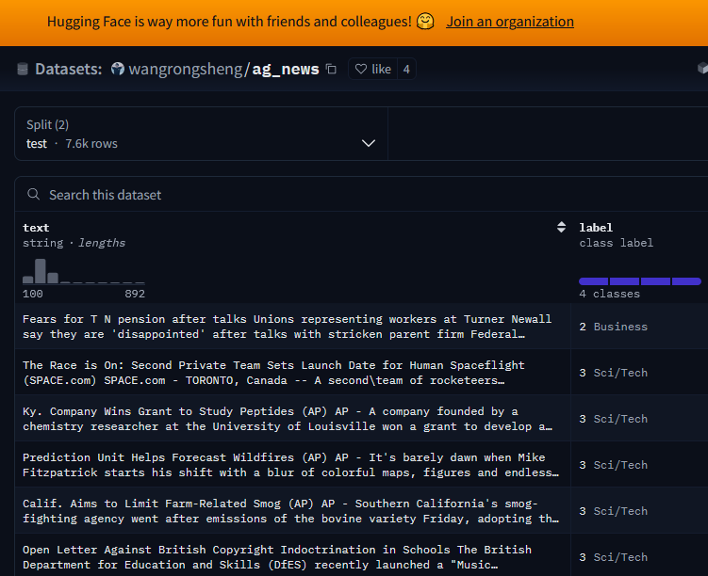
Dataset & Training Pipeline
Dataset: AG News
4 categories:
  World
  Sports
  Business
  Science & Technology
Balanced and widely used benchmark dataset
Training Pipeline
  Text cleaning
  Tokenization using BERT tokenizer
  Input formatting (attention masks, padding)
  Model fine-tuning
  Evaluation on validation set

Slide 9
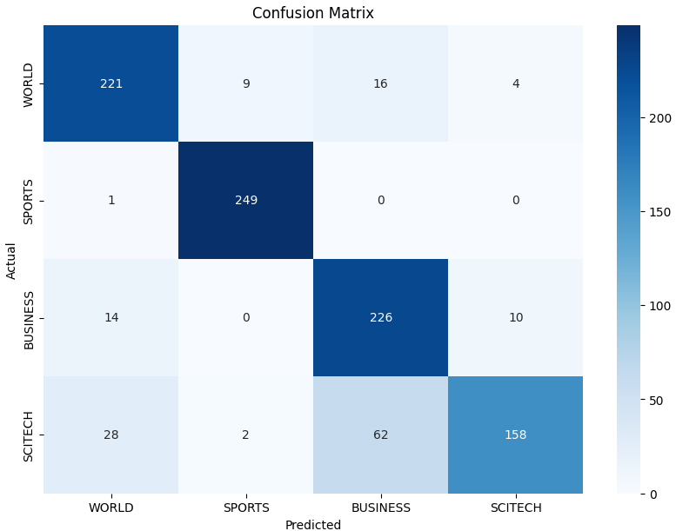
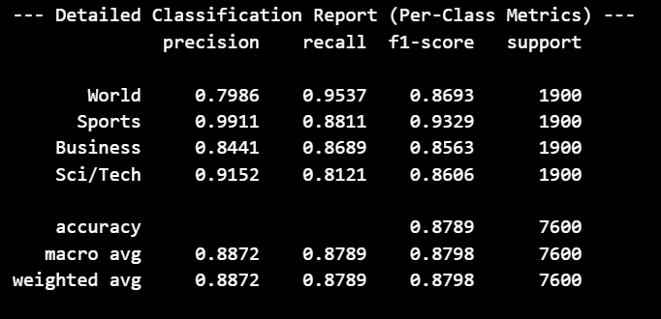
Model Performance & Evaluation
Evaluation Metrics
  Accuracy
  Loss (training & validation)
  Confusion matrix
Results
High classification accuracy
Strong generalization across categories
Minimal overfitting observed
Observations
BERT handles ambiguous text well
Contextual understanding improves classification quality

Slide 10
Implementation, Deployment & Demo

Slide 11
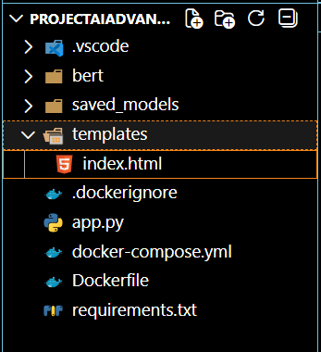
System Architecture
Overall System Architecture
Main Components:
  Frontend (HTML/CSS)
  User interface for text input
  Backend (Flask)
  Handles requests and model inference
  NLP Model (BERT)
  Loads fine-tuned model and tokenizer
  Deployment (Docker + Gunicorn)
  Ensures scalability and portability
Prediction Flow
  User enters text
  Flask receives request
  Text is tokenized
  BERT predicts class
  Result is returned to the user
Why This Structure?
  Clean separation of concerns
  Easy maintenance
  Production-ready layout

Slide 12
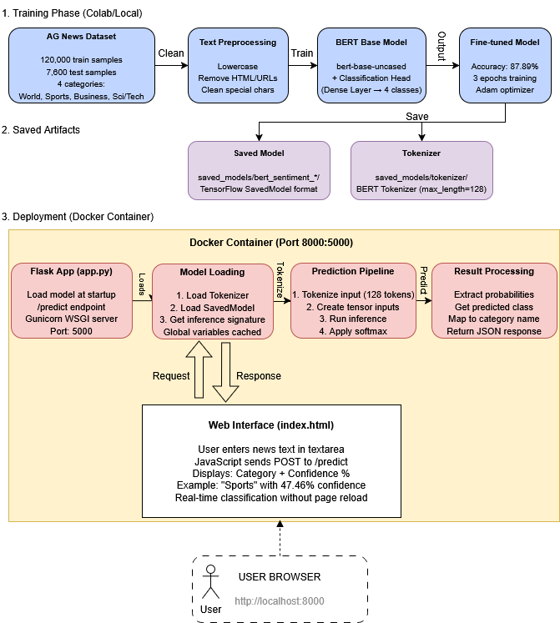
System Diagram & Data Flow
This diagram illustrates a complete BERT-based news classification pipeline, from training on the AG News dataset (120K samples, 4 categories) to deployment. The fine-tuned model achieves 87.89% accuracy and is containerized using Docker with a Flask web interface. Users can input news text through their browser and receive real-time predictions with confidence scores for categories: World, Sports, Business, and Sci/Tech.

Slide 13
Web Application Demo
Code + Demo

Slide 14
Conclusion
This project successfully demonstrates how a BERT-based NLP model can be fine-tuned for text classification and deployed as a real-time web application. It combines cutting-edge deep learning techniques with practical software engineering, making it both accurate and user-friendly.
Major Contributions
  High-quality text understanding with BERT
  Real-time classification through a Flask web app
  Scalable and reproducible deployment using Docker
  Practical applicability to news categorization, sentiment analysis, and more

