Slide 1
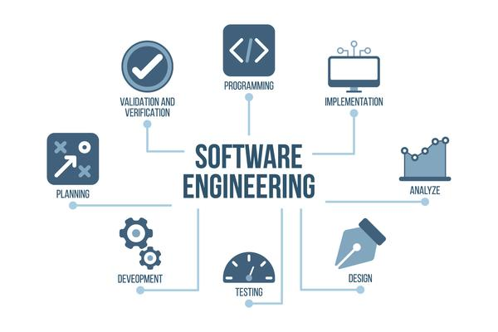
1
Introduction

Slide 2
Software Eng...
Software engineering is the branch of computer science that deals with:
the analysis,
design,
development,
testing,
deployment
and maintenance of software applications.
It involves the applications of engineering principles and knowledge of programming languages to build software solutions for end users.

Slide 3
SDLC…
The systems development life cycle (SDLC):
is the process of understanding how an information system (IS) can support business needs by designing a system, building it, and delivering it to users.
SDLC improves the probability of success of development by planning the overall process, cost and time of developing a software product.
Several researches has reported:
Most IS projects were either overtime, overbudget, or built with less functionalities…
SDLC basically focused on reducing the probability of occurrence of such mischiefs.

Slide 4
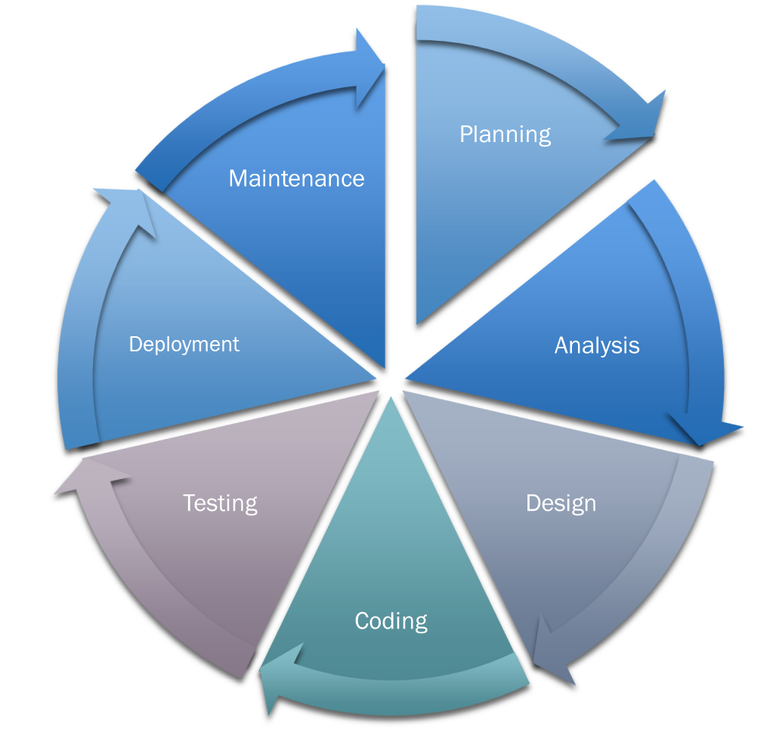
…
SDLC has four fundamental phases:- planning, analysis, design and implementation.
Each phase rely upon techniques that produce deliverables (specific documents and files that provide understanding about the project).

Slide 5
…
Understanding SDLC includes:
Understanding each and every phases of the cycle or (SDLC-phases)
and understanding the order in which the phases should be executed or (SDLC-Methodologies)
Analysis
Design
Coding
Planning
Planning is understanding
Why an IS should be built?
How the team will go built it?
What is required? Is the request possible to achieve?
If approved- a workplan also required
Analysis phase answers
Who will use the system?
What will the system do?
Where and when it will be used?
Analyze current system and ways to design a new system.
Requirement analysis
Design decides
How the system operates?
Architecture, UX, Network infrastructure, database design and program design.
Implementation includes
The overall steps of building the system involves
Coding
Testing
Installing
And preparing support plan for users.

Slide 6
SDLC-Methodologies
Understanding SDLC includes:
Understanding each and every phases of the cycle or (SDLC-phases)
and understanding the order in which the phases should be executed or (SDLC-Methodologies)
A methodology is a formalized approach to implementing the SDLC (i.e., it is a list of steps and deliverables).
SDLC-methodologies are different and unique, based on the order and focus it places on each SDLC phase.
SDLC-Methodologies can be categorized:
based on the focus where the development should give more emphasis for as:
Data-centered: focus is on defining and designing data storages as a core of the cycle.
Process-centered: focus is on defining and designing processes(business-rules) as a core of the cycle.
and Object-Oriented methodologies: gives equal emphasis by integrating both into objects.

Slide 7
Object oriented system development methodology
Object-oriented systems: - depicts a system as little modules, called objects, that encompass both data and process together.
Basic characteristics of object-oriented systems are:
Classes and Objects:
A class is the general template we use to defi ne and create specific instances, or objects.
An object is an instantiation of a class.
Every object has its own attributes and behaviors. Attributes are data about the object and behaviors are methods or functions an object can do.
Methods and Messages:
Methods implement an object’s behavior, so its an action that an object can perform.
Messages are information( function calls) sent to objects to trigger methods.

Slide 8
…
Encapsulation and Abstraction:
Encapsulation is simply the combination or binding of process and data into a single entity.
Abstraction is information hiding.
The principle of information hiding suggests that only the information required to use a software module be published to the user of the module.
Inheritance:
Enforces the arrangement of super classes, or general classes, at the top and the subclasses, or specific classes, at the bottom.
Subclasses inherit the appropriate attributes and methods from the super classes above them. That is, each subclass contains attributes and methods from its parent superclass.
Polymorphism:
Polymorphism means that the same message can be interpreted differently by different classes of objects

Slide 9
…
based on sequence in which SDLC-phases are executed as:
Structured Design: is a step-by-step development approach to the SDLC-phases.
Rapid Application Development(RAD): more focus on delivering some parts of the SDLC-phases.
E.g. design and implementation so users can suggest a revision based on that.
and Agile Development: an iterative application development that eliminates much of modeling and documentation.

Slide 10
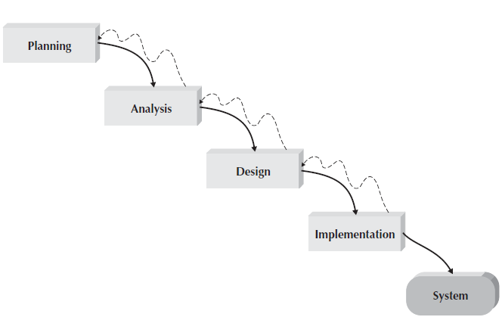
Structured…
Most data-centered and process-centered approaches follows the most commonly used structured development approaches:
Waterfall development approach:
Step by step development of SDLC-phases by delivering the expected key-deliverables from each phase and get approval from the project manager/ sponsor/.
Pros:
Identifies user and system requirements early.
Minimizes a need to change requirements later on progress.
Cons:
The design must be completed before implementation begins. [*time elapsing]
Adapting changes is difficult.

Slide 11
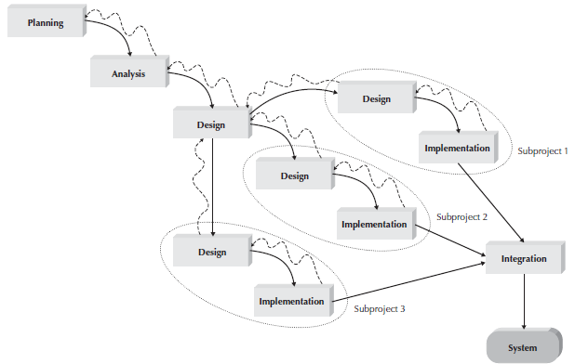
…
Parallel development approach:
is still a step by step implementation of the SDLC-phases, but it attempts to address a long delay in delivering the system:
by dividing the design and implementation phases of the whole project into series of distinct sub-projects,
then, deals with the subproject parallelly and integrated them into a deliverable system.
Pros:
reduce time delays
Cons:
requires significant dividing and integration effort.

Slide 12
RAD…
Rapid Application Development: - addresses both the weaknesses of the structured development methodologies by:
get some part of the system developed quickly into the hands of the users.
recommend using special techniques and computer tools to speed up the analysis, design, and implementation phases. Example:
computer-aided software engineering (CASE) tools,
joint application design (JAD) sessions,
fourth-generation or visual programming languages that simplify and speed up programming,
and code generators that automatically produce programs from design specifications.

Slide 13
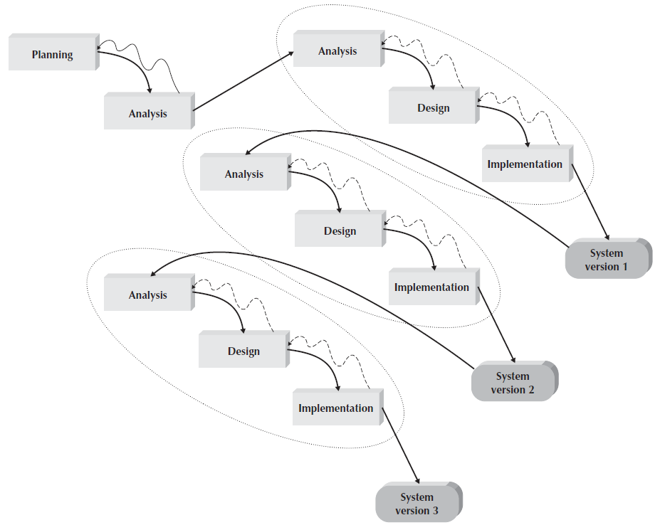
…
Phase-development methodology: - breaks an overall system into a series of versions that are developed sequentially.
Pros
Users quickly get a working system in to their hands.
Efficient in identifying unanticipated requirements.
Cons
Managing users expectations.

Slide 14
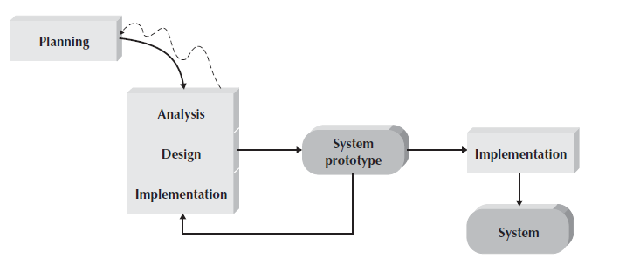
…
Prototype-development methodology: - performs the analysis, design, and implementation phases concurrently, and all three phases are performed repeatedly in a cycle until the system is completed.
A system prototypes are generated several times, until acceptable prototype is produced.
Pros
Focused more on functional requirements.
Cons
Managing users expectations.

Slide 15
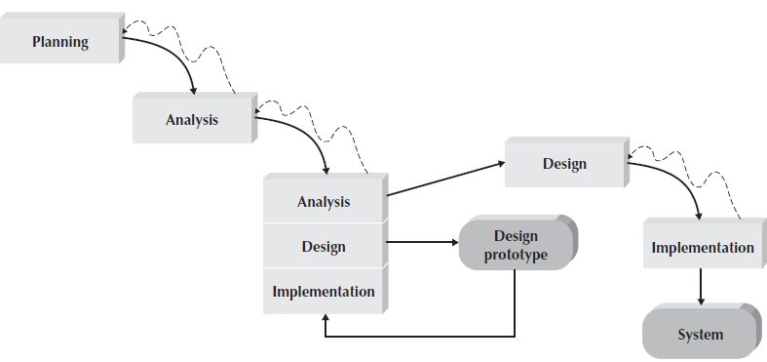
…
Throwaway prototype-development methodology:- similar to prototyping-based methodologies since it includes the development of prototypes.
However, throwaway prototypes are done at a different point in the SDLC.
In throwaway prototype-development, instead of a system prototype, a design prototype is recursively created.
Pros
Used to develop more stable system.
Cons
Managing users expectations.

Slide 16
Agile…
Agile development methodologies are based on the agile manifesto and a set of twelve principles.
early and continuously delivery to satisfy customers.
adapting requirement changes at any level.
Delivering a working software frequently to the customer.
Customers and developers work together.
individual based solutions.
face-to-face communication as an efficient and effective method of gathering requirements.
The primary measure of progress is delivering executing software.
Both customers and developers should work at a pace that is sustainable. Equal burden.
Agility is heightened through attention to both technical excellence and good design.
Simplicity, the avoidance of unnecessary work, is essential.
Self-organizing teams develop the best architectures, requirements, and designs.
Development teams regularly reflect on how to improve their development processes.

Slide 17
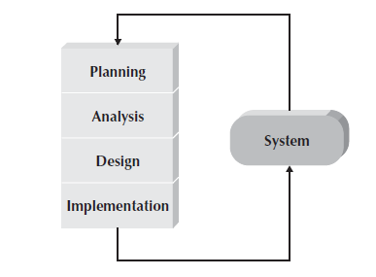
…
Agile development methodologies:- restructures the system-development process
by eliminating much of the modeling and documentation overhead and the time spent on those tasks.
Agile criticized for:
Outsourcing/ subcontracting is unrealistic in Agile.
Lack of actual documentation/ difficult for auditability
Not promising for large mission-critical systems.
The two well-known agile methodologies are:
Extreme Programming(XP)-methodology
Scrum-methodology

Slide 18
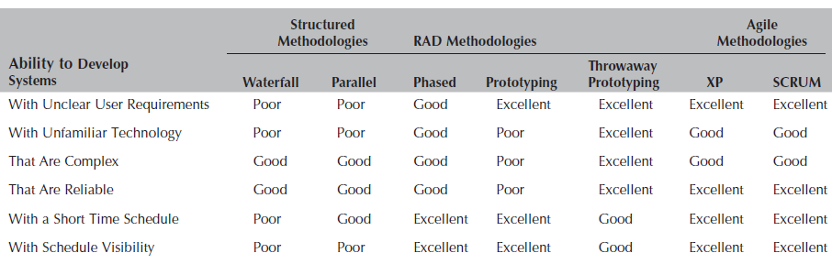
What methodology to use?
Choosing a SDLC-methodology is not simple, because no methodology is perfect in every domain.

Slide 19
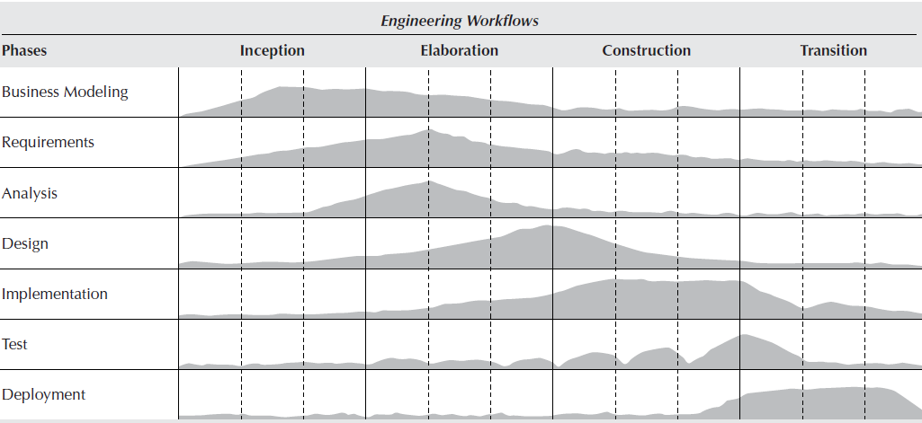
The unified process
The unified process:-
is a specific methodology that maps out when and how to use the various UML techniques in OOD.
Its a two-dimensional systems development process described by a set of phases and workflows.

Slide 20
…
The phases of the unified process are:
Inception:
mainly concerns on specifying a scope of the project, developing a business plan and feasibility analysis of the project.
Elaboration:
involves requirement analysis, system analysis and system design workflows
Construction:
focuses heavily on programming/implementing the evolving information system
and Transition:
focus is on the testing and deployment workflows.

Slide 21
…
The workflows of the unified process are:
Business Modeling Workflow:-
Planning (time and resource), requirement identification and gathering, setting scope and feasibility analysis are done.
Requirements Workflow:-
User requirement specification (as functional and non-functional)
Analysis Workflow:
UML specification of the behavior of the proposed system (use-case, sequence, activity diagrams and etc.)
Design Workflow:
UML specification of the structure and layout of the information system.
Implementation Workflow:
Testing Workflow:
Deployment Workflow

Slide 22
UML…
Unified Modeling Language: - provides:
a common vocabulary of object-oriented terms and diagramming techniques
that are rich enough to model any system development project from analysis through implementation.
UML defines a set of fifteen diagramming techniques used to model a system.
The diagrams are broken into two major groupings:
Structure diagram that depicts structure of a system.
Structure diagrams provide a way to represent the data and static relationships in an information system.
Behavioral diagram that depicts behaviors of a system.
Supports in modeling the dynamic behavior of individual objects throughout their lifetime and the functional requirements of an evolving information system.

Slide 23
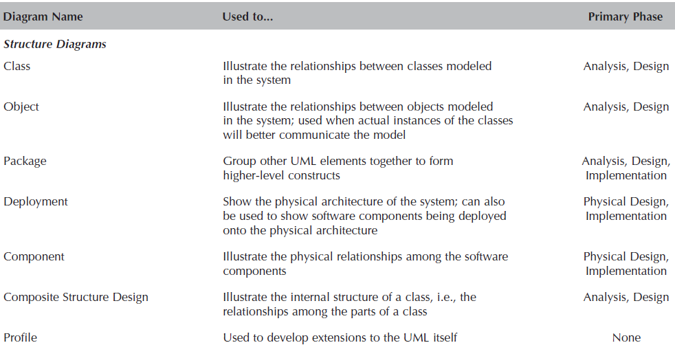
Structural diagrams

Slide 24
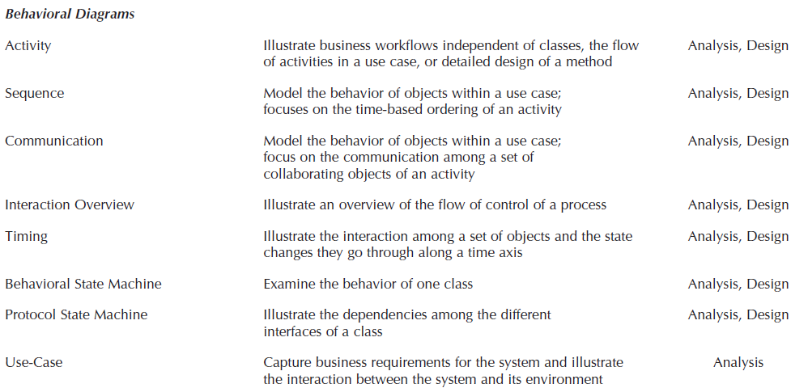
Behavioral diagrams

