Slide 1




AI Engineering
& Intelligent Systems
From foundational AI concepts to the design, training, and deployment of intelligent systems that solve real-world problems.

Slide 2



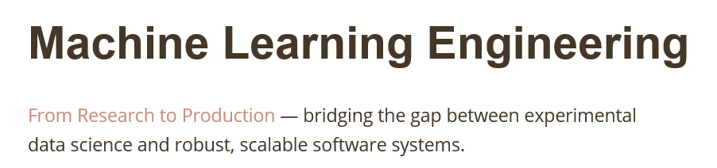

Slide 3

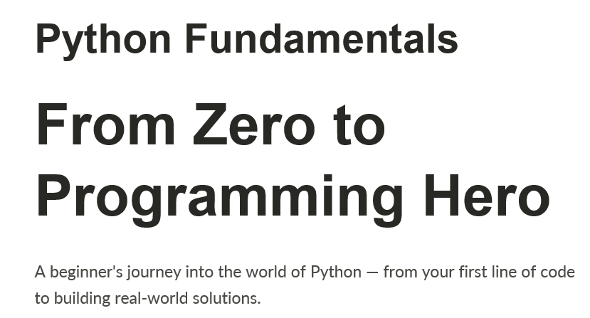

Slide 4

Python Control Flow: Mastering Logic and Loops
A step-by-step guide to conditionals, loops, and functions — the building blocks of every great Python program.
Notes:
1

Slide 5

CHAPTER 1
The Foundation of Choice
Every meaningful program makes decisions. Conditionals give your code the power to choose, branch, and respond — just like the human mind.
Notes:
2

Slide 6




How Computers Think: Control Flow
Execution Order Matters
By default, Python runs statements top to bottom, one line at a time. Control flow breaks that linearity — letting you skip, repeat, or redirect execution based on conditions.
Sequential
Conditional
Indentation
Default top-to-bottom execution
Skip blocks when conditions fail
Defines code blocks — no brackets needed
Notes:
3

Slide 7
Boolean Expressions: The True or False Switch
Every decision in Python boils down to a single question: True or False?
Comparison Operators
Truthy Values
Falsy Values
== != > < >= <=
Compare two values and return a Boolean result.
Non-zero numbers, non-empty strings and lists all evaluate as True automatically.
0, "", [], None all evaluate as False — no comparison needed.
x = 10
print(x > 5) # True
print(x == 3) # False
print(bool([])) # False
Notes:
4

Slide 8
The IF Statement: Simple Decision Making
Syntax Rules
Example: Checking a Positive Number
  Start with the keyword if
  Follow with a condition and a : colon
  Indent the code block consistently (4 spaces)
  The block only runs when the condition is True
number = 15
if number > 0:
print("The number is positive!")
print("Value:", number)
The indented lines only execute when number > 0 is True.
Notes:
5

Slide 9

Alternative Execution: The IF-ELSE Pair
How It Works
The else block acts as the default path — it runs only when the if condition evaluates to False. Exactly one branch always executes; never both.
False → Run Block B
Execute ELSE branch
True → Run Block A
Execute IF branch
age = 16
if age >= 18:
print("Access granted.")
else:
print("Too young to enter.")
Evaluate Condition
Check boolean expression
Notes:
6

Slide 10

Chained Conditionals: IF-ELIF-ELSE
When you need to check more than two possibilities, chain conditions with elif. Python evaluates each one in order — the first True match wins.
score = 78
if score >= 90:
print("Grade: A")
elif score >= 80:
print("Grade: B")
elif score >= 70:
print("Grade: C")
else:
print("Grade: F")
1
2
3
IF checks first
ELIF checks next
ELSE is the fallback
Evaluated at the top
Only if prior ones are False
Runs when nothing else matches
Notes:
7

Slide 11

Nested Conditionals: Decisions Within Decisions
When to Nest
username = "admin"
password = "secure123"
if username == "admin":
if password == "secure123":
print("Welcome, Admin!")
else:
print("Wrong password.")
else:
print("Unknown user.")
Place an if block inside another if block when a second check only makes sense after the first passes. Track scope carefully with consistent indentation.
Deep nesting (3+ levels) makes code hard to read. Refactor with functions when possible.
Notes:
8

Slide 12

CHAPTER 2
The Power of Repetition
Loops free you from writing the same code over and over. Let the machine do the repetitive work — that's what it's built for.
Notes:
9

Slide 13



Why Use Loops?
Eliminate Repetition
Iterate Over Data
Unknown Step Count
Instead of writing print() 100 times, a loop handles it in 2 lines of code.
Traverse lists, strings, dictionaries — process every item automatically without manual indexing.
Some tasks run until a condition is met — like waiting for user input or reading a file until its end.
Notes:
10

Slide 14

The WHILE Loop: Running Until Finished
Core Concept
count = 1
while count <= 5:
print("Count:", count)
count += 1 # crucial update!
print("Loop complete.")
A while loop keeps executing its block as long as its condition remains True. When the condition becomes False, execution moves past the loop.
Always update the loop variable inside the body — forgetting to do so causes an infinite loop that freezes your program.
Output: Count 1 through 5, then "Loop complete."
Notes:
11

Slide 15
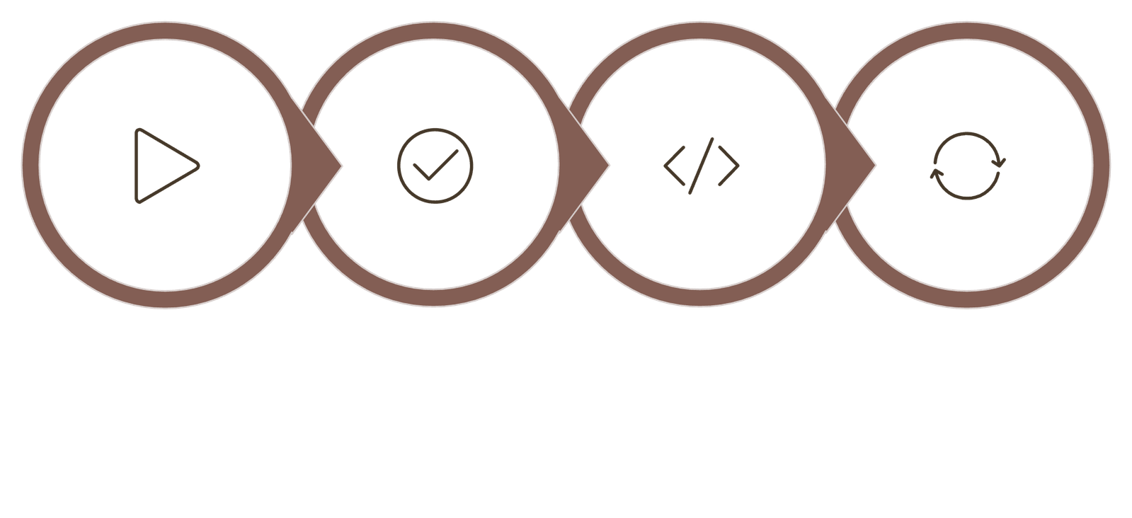
WHILE Loop Mechanics: Step-by-Step
Initialize
Check
Execute
Update
This cycle repeats continuously. Skip the Update step and the condition never changes — your loop runs forever. Always initialize before the loop and update inside the body.
Notes:
12

Slide 16

CHAPTER 3
Mastering Iteration
The for loop is Python's most elegant tool — precise, readable, and perfectly suited for working through sequences of data.
Notes:
13

Slide 17
The FOR Loop: Iterating Over Sequences
Syntax & Behavior
fruits = ["apple", "banana", "cherry"]
for fruit in fruits:
print("I like", fruit)
# Output:
# I like apple
# I like banana
# I like cherry
name = "Python"
for letter in name:
print(letter)
for target in sequence:
# body executes once
# per item in sequence
Python automatically advances through each item — no manual counter or index management required.
Works With:
  Lists: ["apple","banana","cherry"]
  Strings: "Python"
  Tuples, dictionaries, and more
Notes:
14

Slide 18
The Range Function: Controlling Loop Counts
range() generates a sequence of numbers on demand — perfect for running a loop a specific number of times.
range(stop)
range(start, stop)
range(start, stop, step)
for i in range(5):
print(i)
# 0, 1, 2, 3, 4
for i in range(2, 6):
print(i)
# 2, 3, 4, 5
for i in range(0, 10, 2):
print(i)
# 0, 2, 4, 6, 8
Notes:
15

Slide 19

Nested Loops: Loops Within Loops
How It Works
Visualizing the Output
For every single iteration of the outer loop, the inner loop runs completely from start to finish. This is ideal for processing grids, tables, or multi-dimensional data.
1 x 1 = 1
1 x 2 = 2
1 x 3 = 3
2 x 1 = 2
2 x 2 = 4
2 x 3 = 6
3 x 1 = 3
3 x 2 = 6
3 x 3 = 9
for row in range(1, 4):
for col in range(1, 4):
print(row, "x", col,
"=", row * col)
Outer loop ran 3 times. Inner loop ran 9 times total.
Notes:
16

Slide 20
Loop Control: Break and Continue
Break — Exit Immediately
Continue — Skip This Round
Stops the loop entirely and jumps past it, regardless of the condition.
Skips the rest of the current iteration and moves to the next one.
for i in range(10):
if i == 5:
break
print(i)
# Prints 0 to 4, then stops
for i in range(6):
if i == 3:
continue
print(i)
# Prints 0,1,2,4,5 — skips 3
Notes:
17

Slide 21

CHAPTER 4
Functions and Clean Logic
Functions are the cornerstone of professional Python. Package your logic once — reuse it everywhere.
Notes:
18

Slide 22
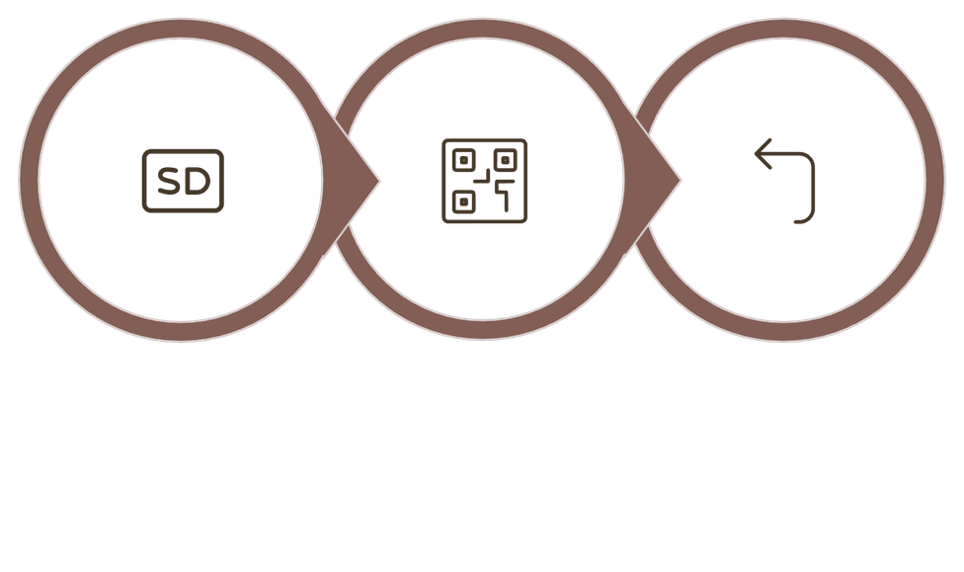
Introduction to Functions
A Complete Example
Anatomy of a Function
def greet(name):
"""Returns a greeting."""
message = "Hello, " + name + "!"
return message
result = greet("Alice")
print(result)
# Hello, Alice!
Define
Execute
Return
  def declares the function and names it
  Parameters receive input values
  return exits and sends back a result
Notes:
19

Slide 23




The Architect's Toolkit: Functions & Control Flow Together
The real power of Python emerges when you combine functions, conditionals, and loops into clean, reusable solutions.
Modular Design
Scope & Flow
Wrap if-elif-else logic inside a for loop inside a function — batch-process any dataset with a single function call.
A return inside a loop exits both the loop and the function instantly — a powerful early-exit pattern.
Real-World Automation
DRY Principle
Use while loops for event-driven logic: ATM simulations, LED fade controllers, interactive menus.
Don't Repeat Yourself. Clean, reusable functions transform chaotic scripts into professional, maintainable software.
Notes:
20

