Slide 1







PANDAS
LIBRARIES FOR MACHINE LEARNING

Slide 2


WHAT IS PANDAS
HISTORY
Pandas is a Python library used for working with data sets.
It has functions for analyzing, cleaning, exploring, and manipulating data.
The name "Pandas" has a reference to both "Panel Data", and "Python Data Analysis" and was created by Wes McKinney in 2008.

Slide 3

01
why pandas
  Pandas allows us to analyze big data and make conclusions based on statistical theories.
  Pandas can clean messy data sets, and make them readable and relevant.
  Relevant data is very important in data science.
Strictly Confidential, For Recipient Only

Slide 4



THANKS FOR WATCHING

Slide 5



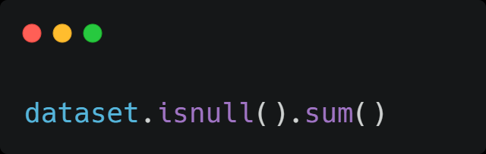
CHECK FOR NULL VALUES

Slide 6
HANDLING NULL VALUES
  Imputation
  Dropping

Slide 7
PREPROCESSING
  Data cleaning means fixing unwanted or improper data in your dataset
  This will improve the accuracy of data by removing or correcting inaccuracies, missing values, duplicates, and irrelevant data
  It can make the data more consistent, reducing the risk of errors in downstream processes

Slide 8
CORRELATION
  It calculates the relationship between each column in your data set
  The Result is a table with a lot of numbers that represents how well the relationship is between two columns.

Slide 9
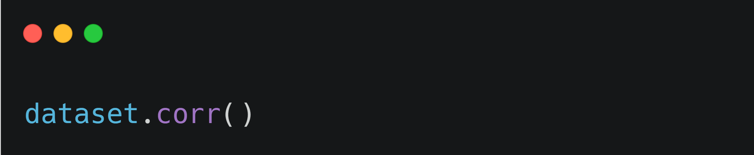
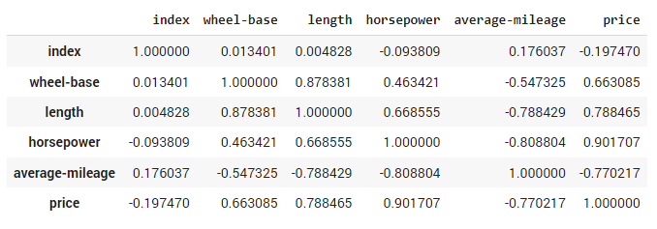
CORRELATION

