Slide 1


Python programming
fundamentals

Slide 2


Contents
  Condition and branching
  Loops
  Functions

Slide 3

Condition and Branching

Slide 4
Condition
  Conditional statements in Python are used to control the flow of a program
  They allow the program to make decisions based on certain conditions

Slide 5
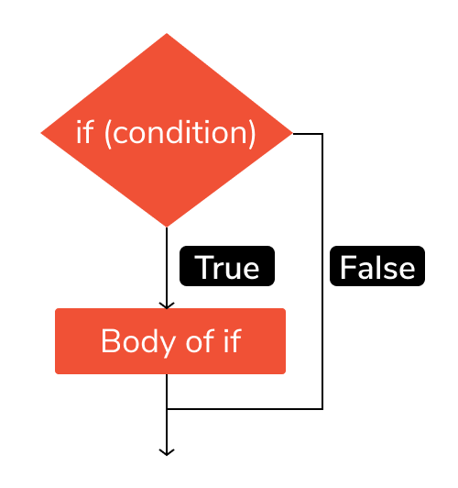
Condition

Slide 6
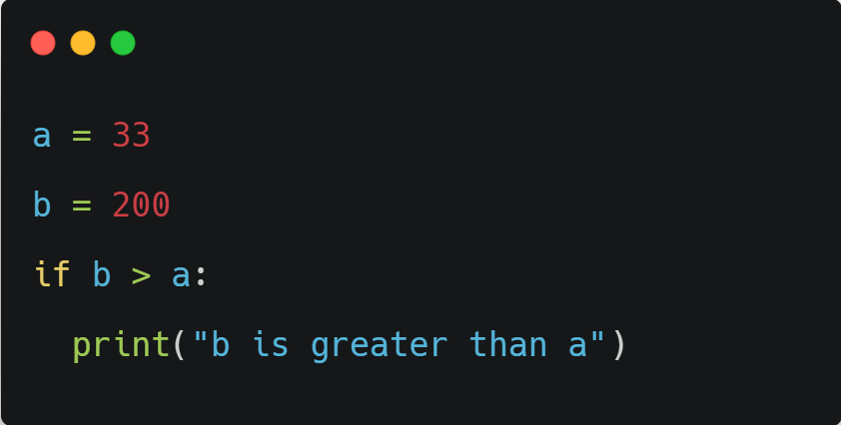
if statement

Slide 7
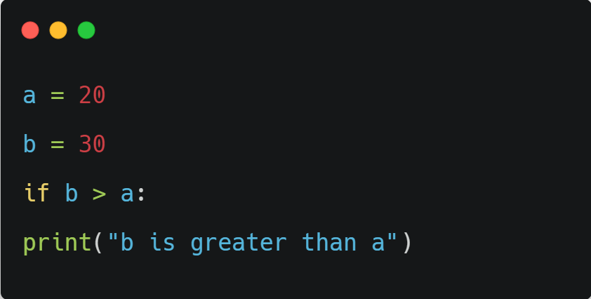

Intendation rule

Slide 8
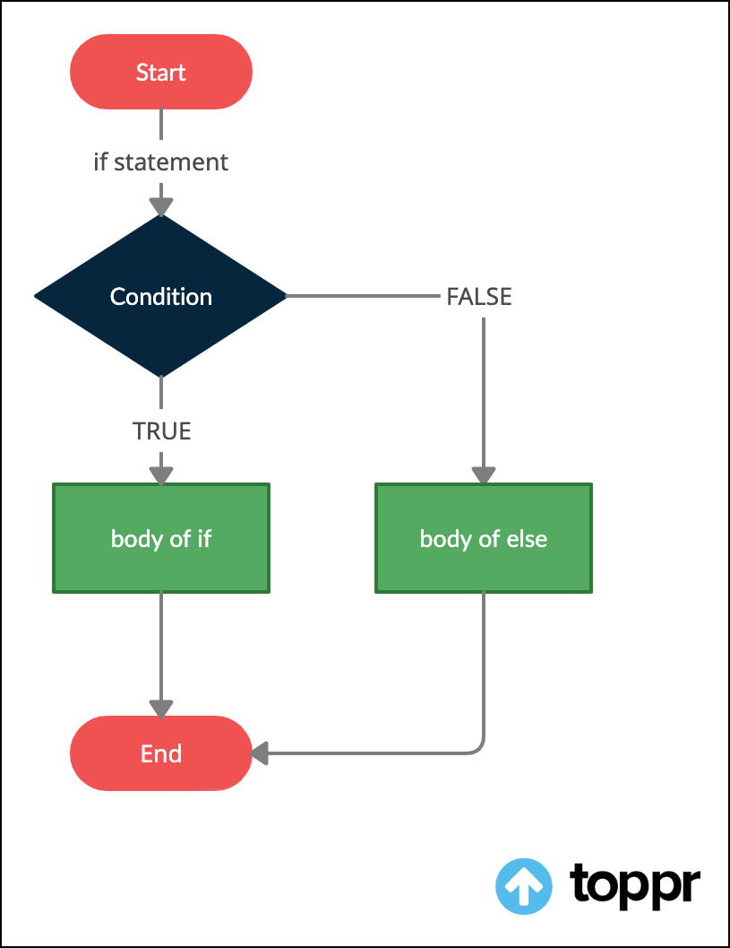
If else statements

Slide 9
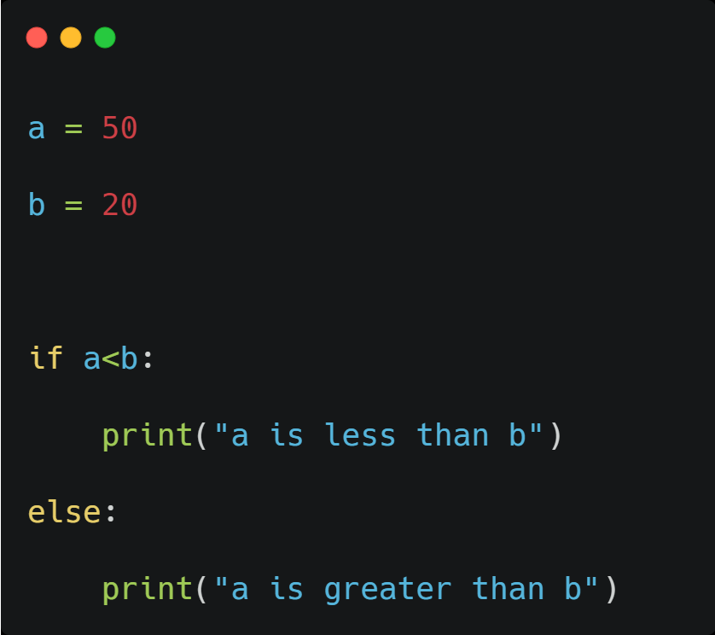
If else statements

Slide 10
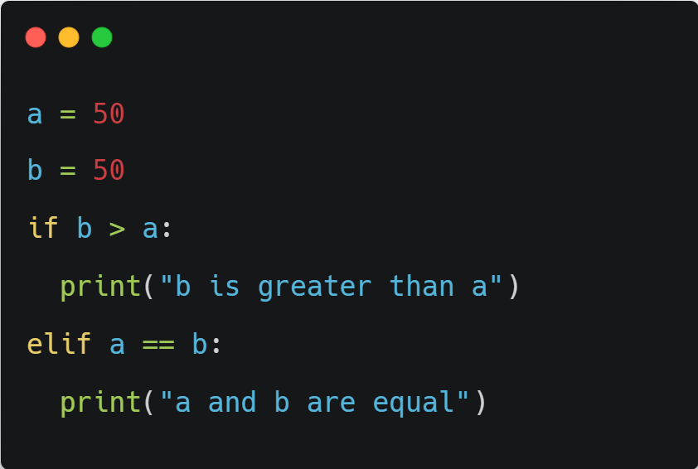
If elif statements

Slide 11
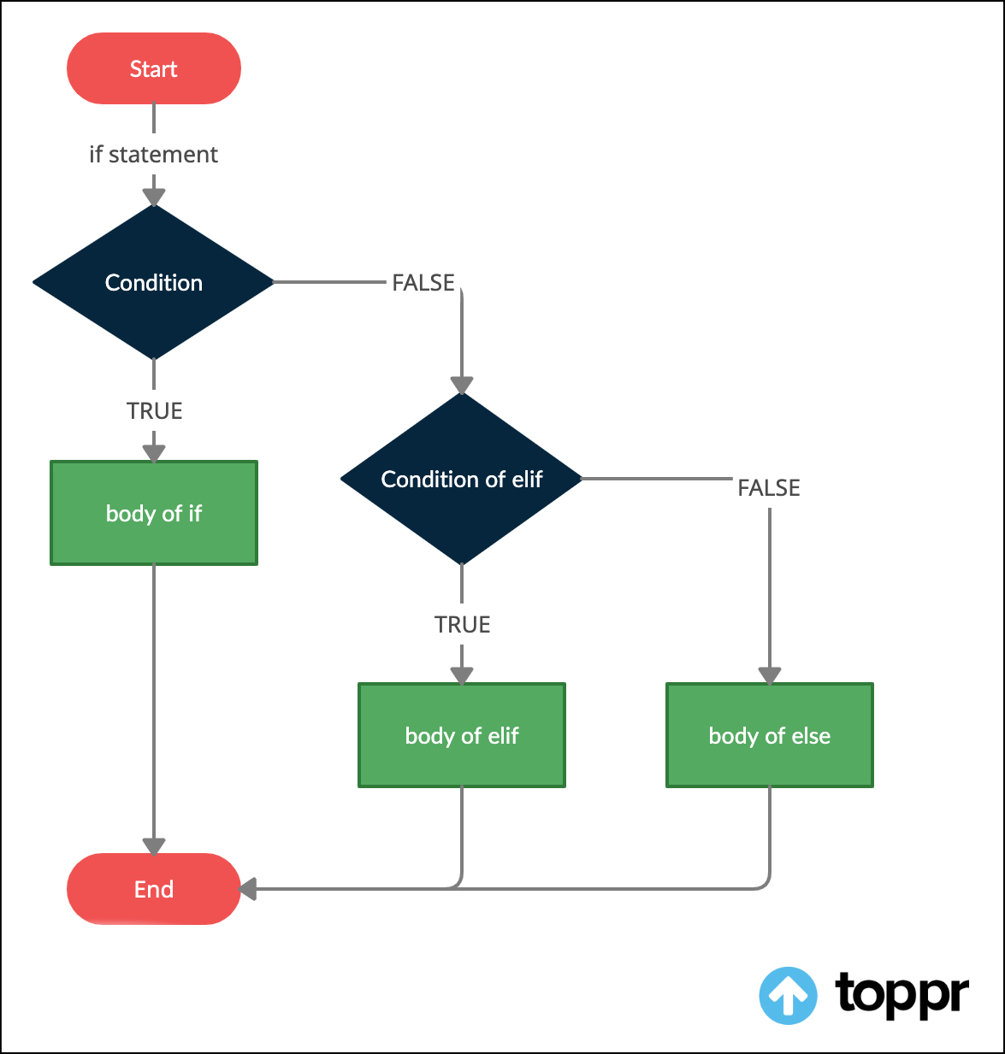
If elif else statements

Slide 12
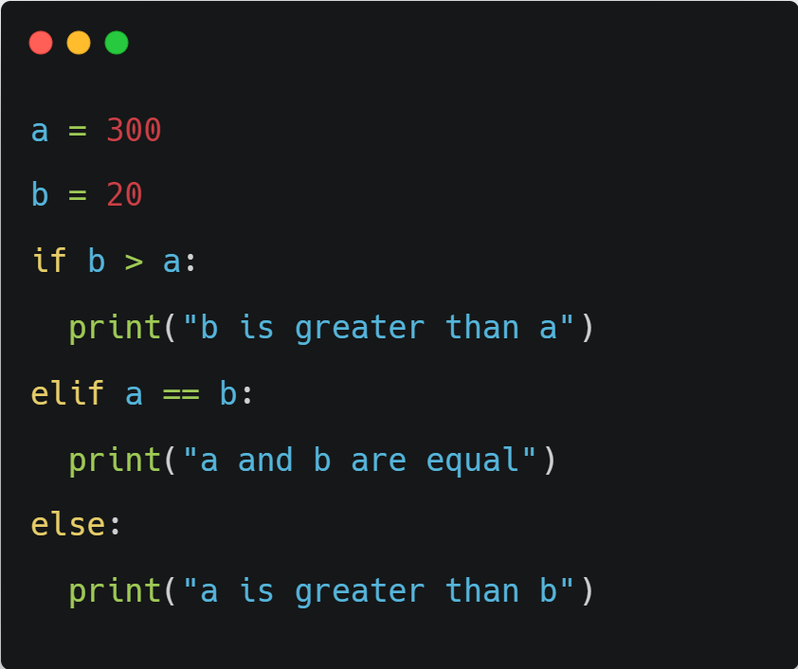
If elif else statements

Slide 13
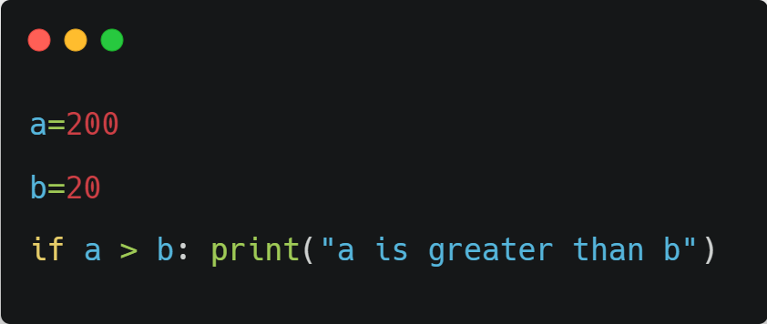
Short hand if

Slide 14
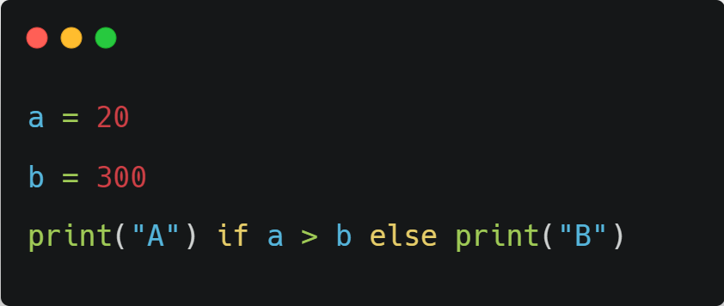
Short hand if else

Slide 15
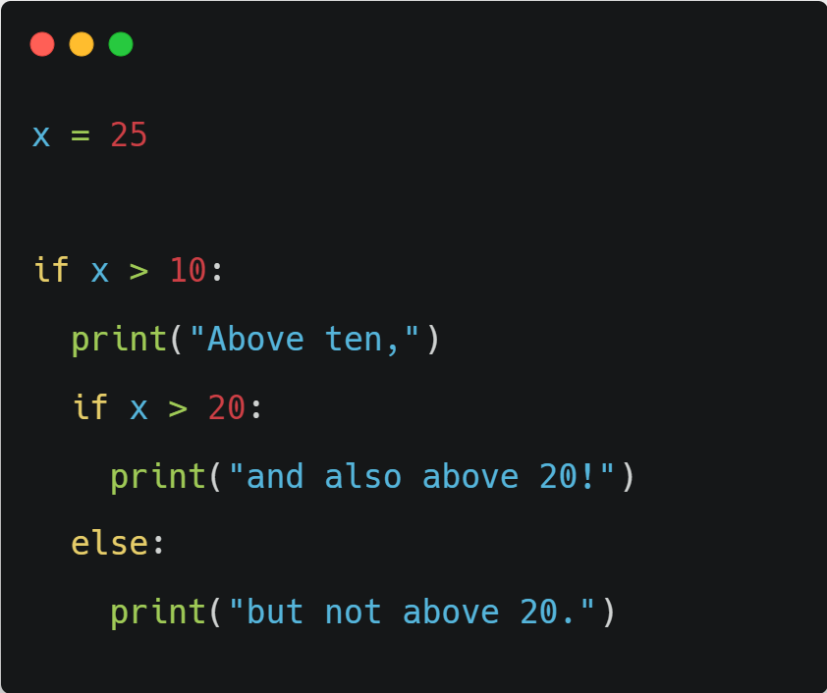
Nested if statements

Slide 16
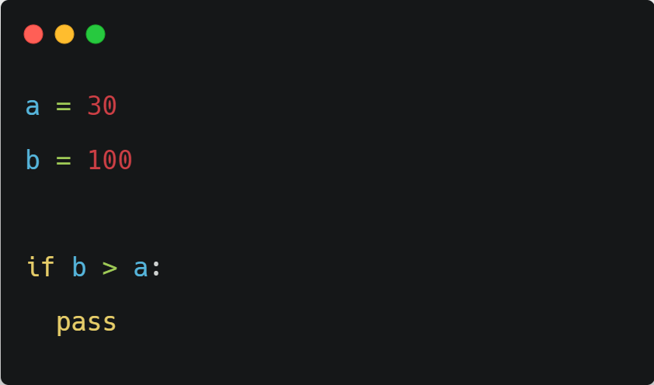
Pass statement

Slide 17


Loops

Slide 18

Loops
  For loop
  While loop

Slide 19

For Loop

Slide 20
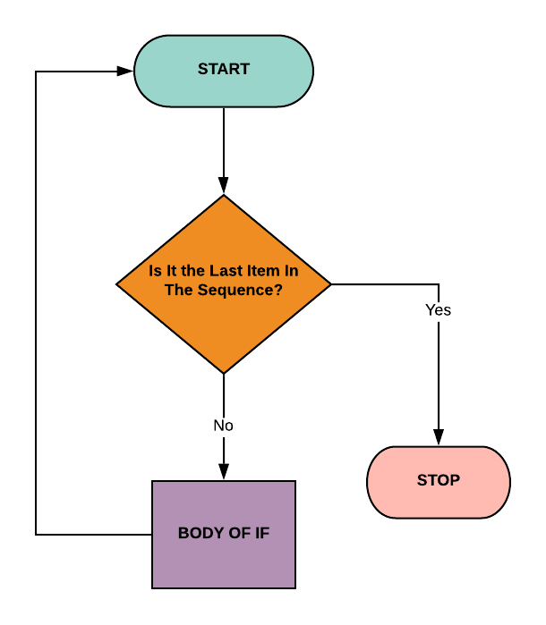
For loop
  For loops in Python are used to iterate over a sequence (list, tuple, or string) and perform a specific action for each item in the sequence
  Even strings are iterable objects, they contain a sequence of characters

Slide 21
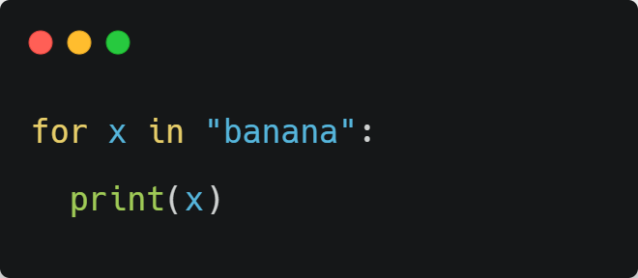
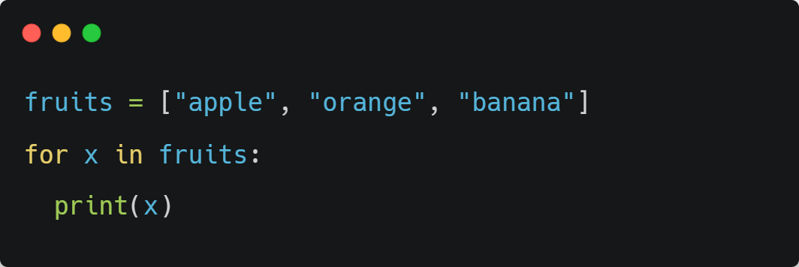
For loop

Slide 22
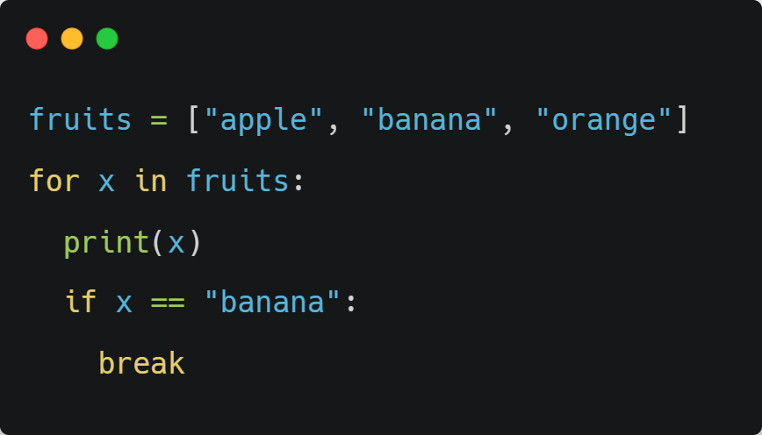
Break statement

Slide 23
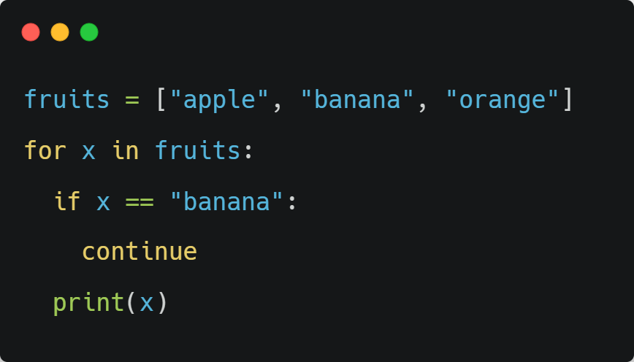
Continue statement

Slide 24
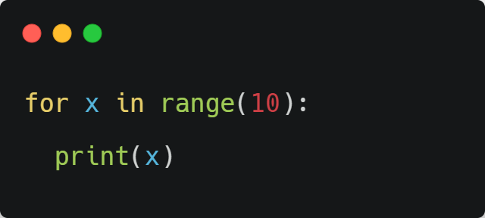
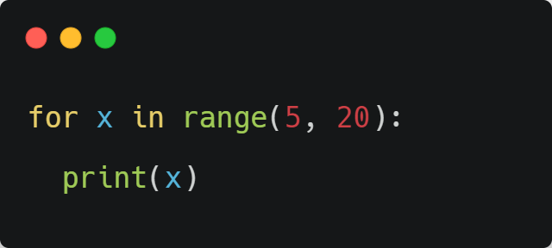
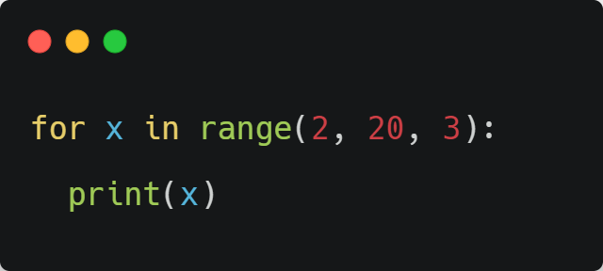
Range

Slide 25
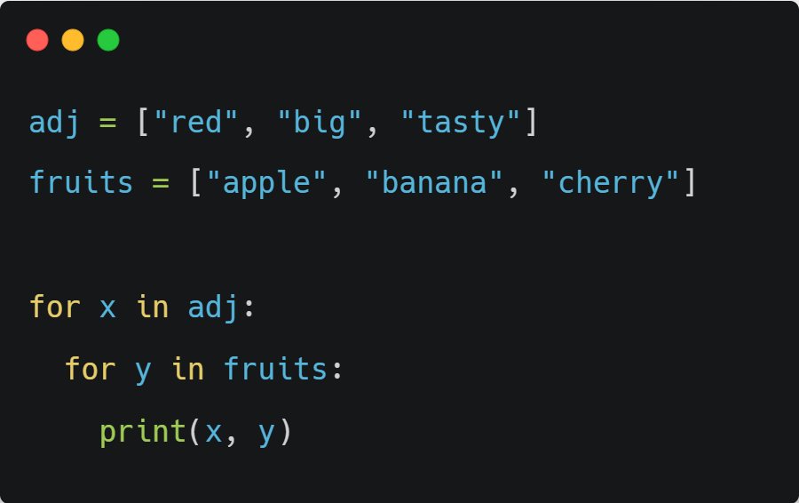
Nested for loop

Slide 26

While Loop

Slide 27
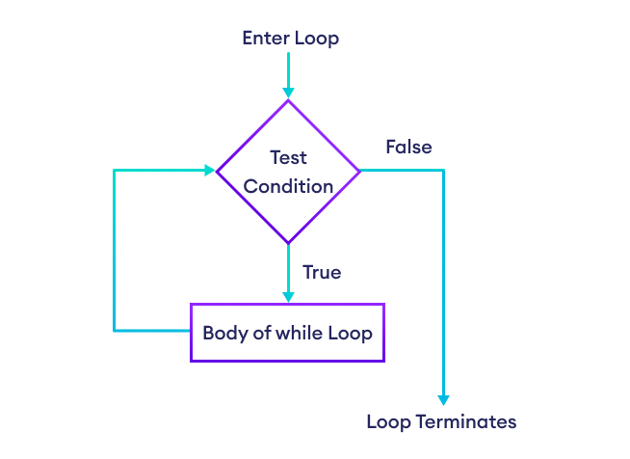
While loop
With the while loop we can execute a set of statements as long as a condition is true

Slide 28
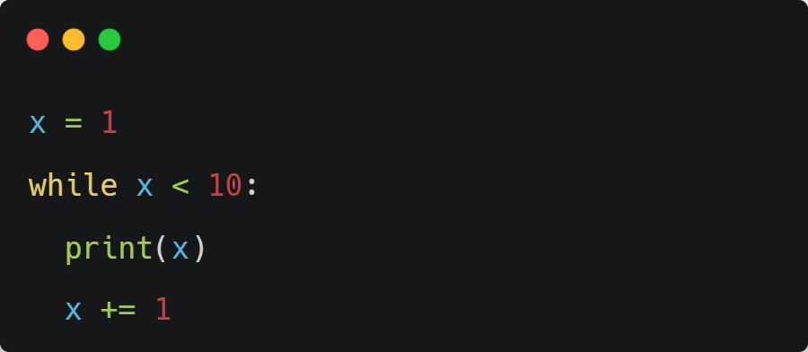
While loop

Slide 29
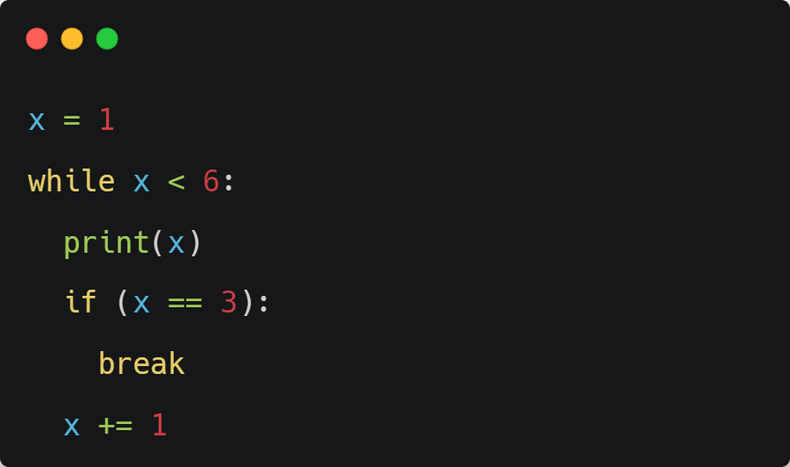
Break statement

Slide 30
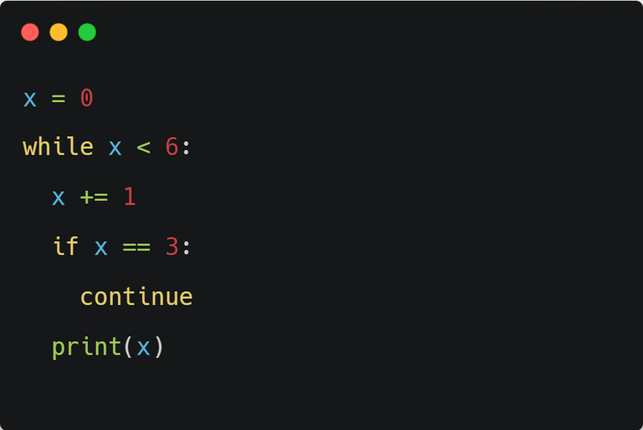
Continue statement

Slide 31
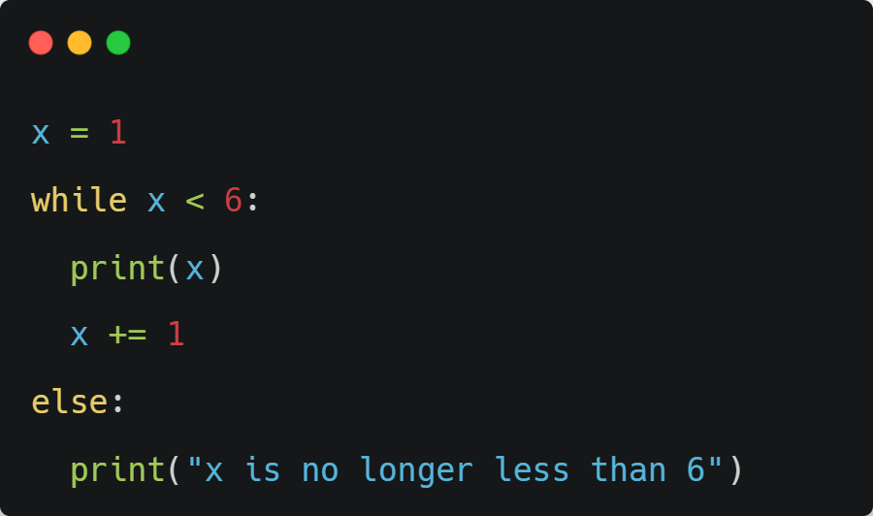
Else statement

Slide 32


Functions

Slide 33

Functions
  Functions in Python are blocks of reusable code that perform specific tasks
  A function runs only when it is called
  They are defined using the "def" keyword
  They can be called multiple times

Slide 34
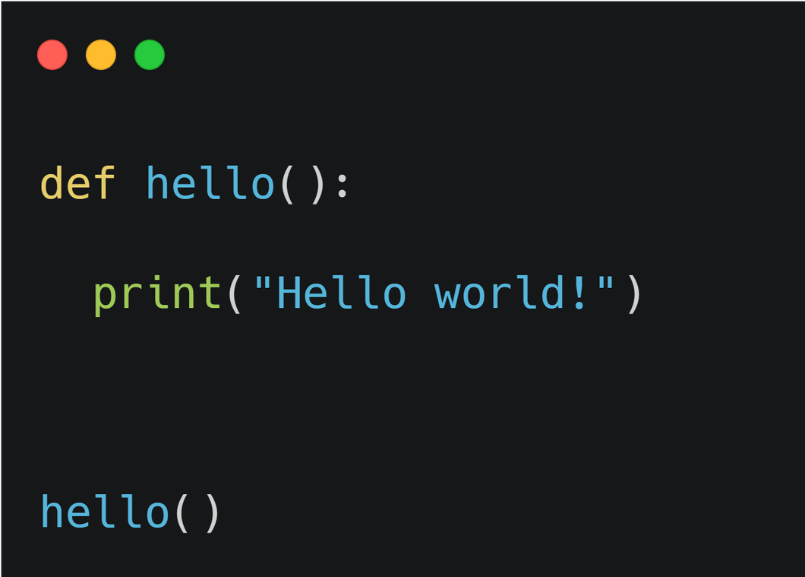
Functions

Slide 35
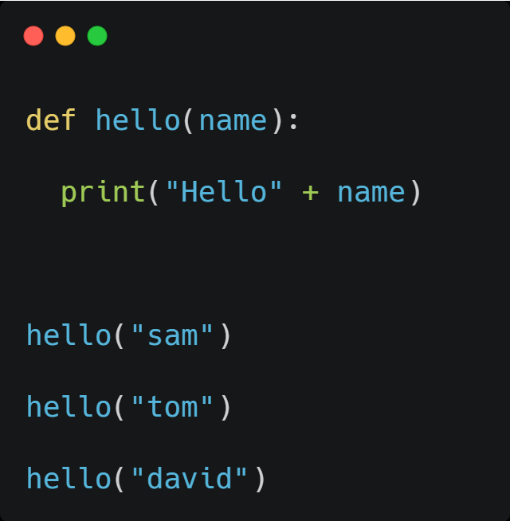
Parameters and arguments
  Information can be passed into functions as arguments
  Arguments are specified after the function name, inside the parentheses
  You can add as many arguments as you want, just separate them with a comma

Slide 36
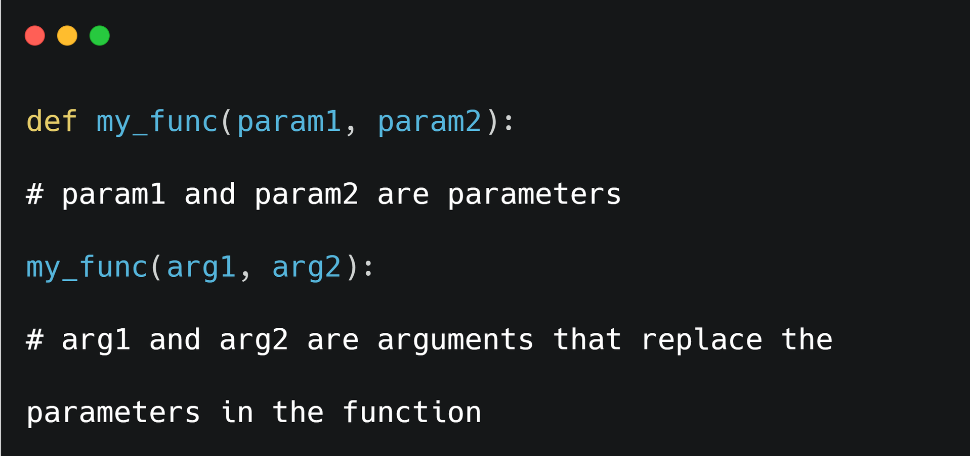
Parameters and arguments

Slide 37
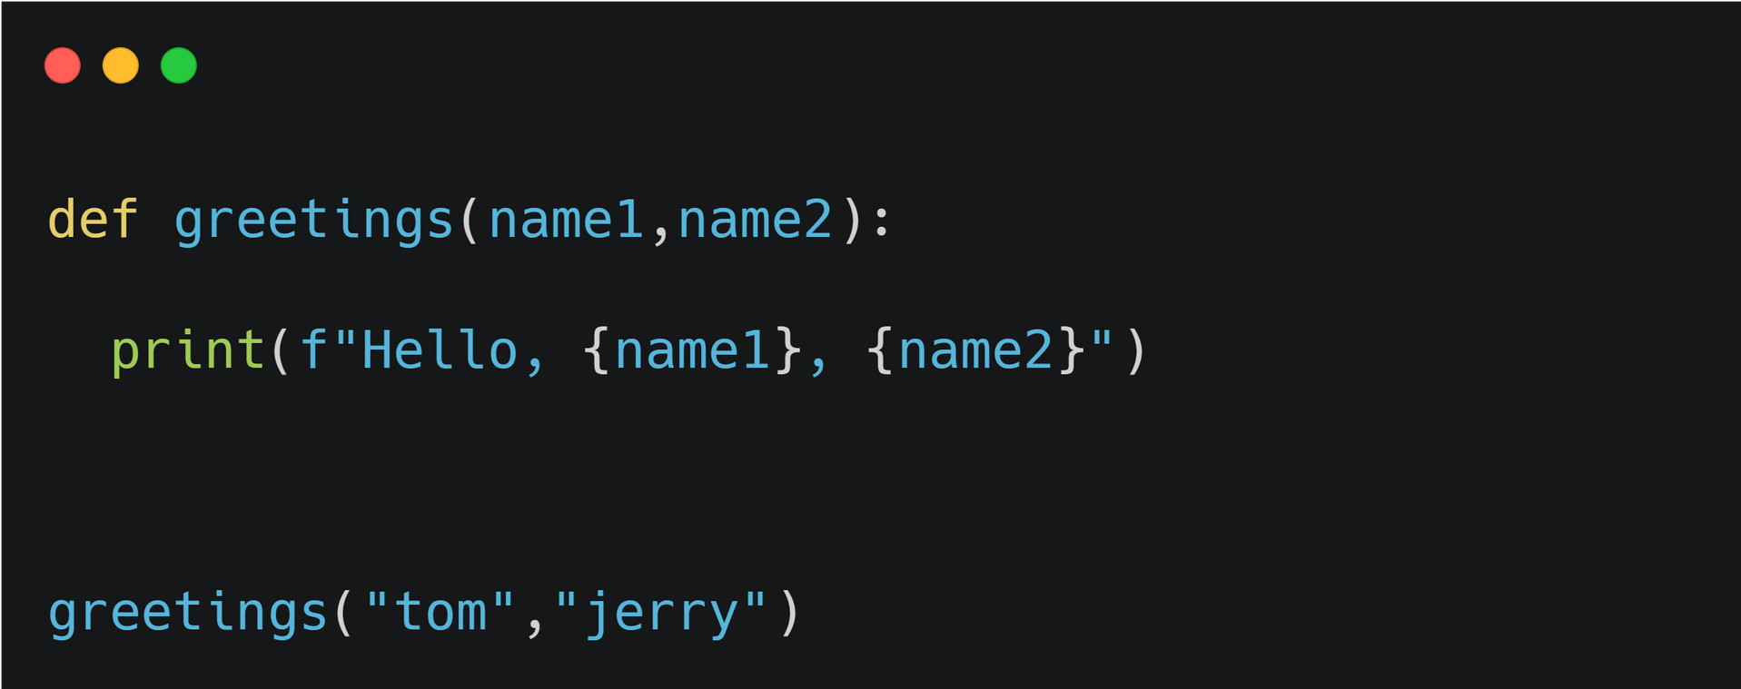
Positional Arguments

Slide 38
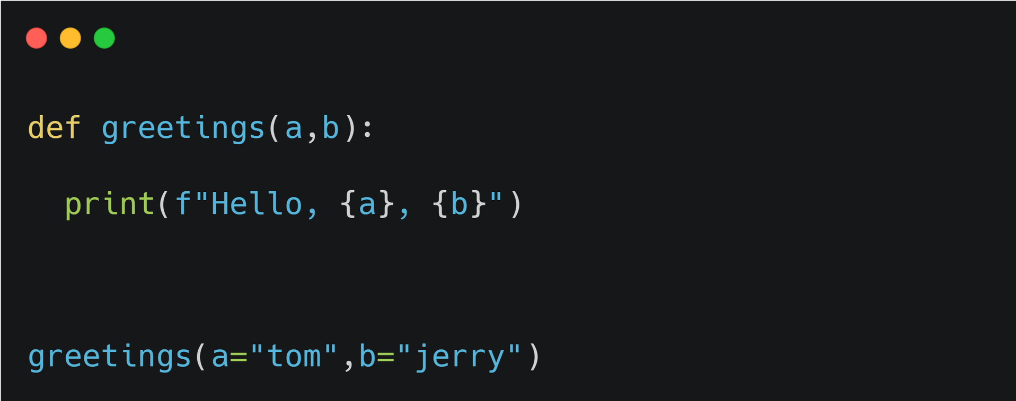
Keyword Arguments

Slide 39
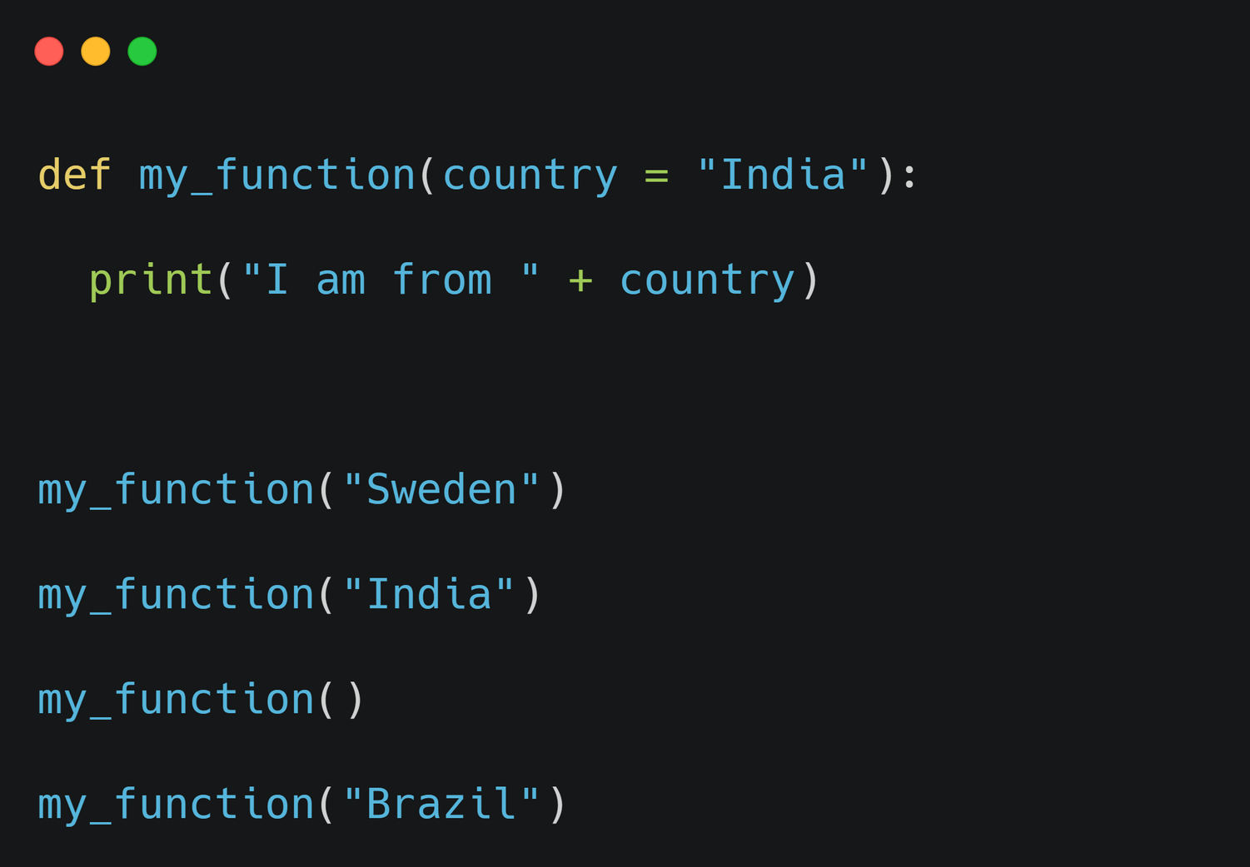
Default parameter value

Slide 40
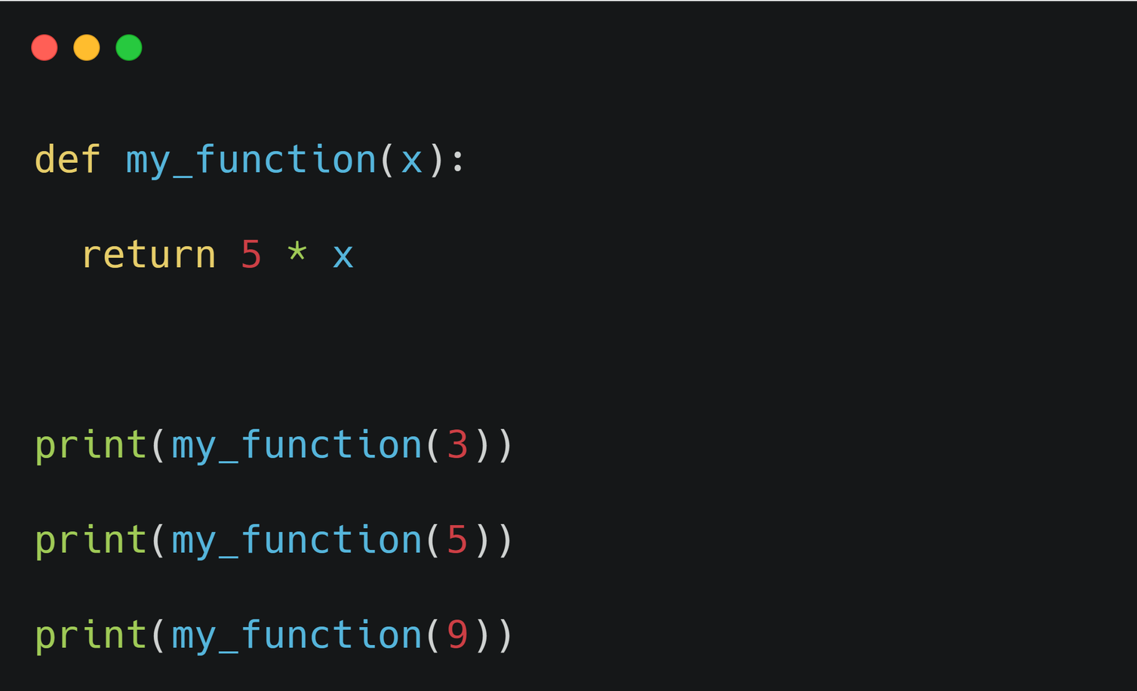
Return values

Slide 41





pantech
MY TIME
GO CONFIDENTLY IN THE DIRECTION OF YOUR DREAMS! LIVE THE LIFE YOU'VE IMAGINED."
WWW.PANTECHELEARNING.COM

Slide 42
