Slide 1
HORIZON
Sovereign Autonomous Enterprise Infrastructure Recovery Platform
Think PagerDuty plus an autopilot, built in India, with proof of every action
Presented by Falconizers - 1048

Slide 2

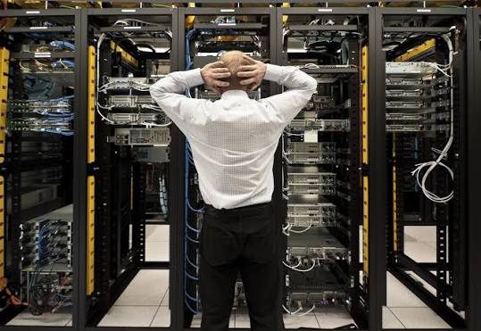
Problem: Distributed systems fail in chains, while manual recovery and incorrect restart sequences extend costly downtime.
Idea: Detect failures, map dependencies, and autonomously restore services in the mathematically correct order.
USP: Combines graph-based recovery, human approval for high-risk actions, and blockchain-backed proof of every action.
Innovation: Deterministic recovery algorithms, multilingual AI assistance, and tamper-evident audit trails in one platform.
Overview

Slide 3
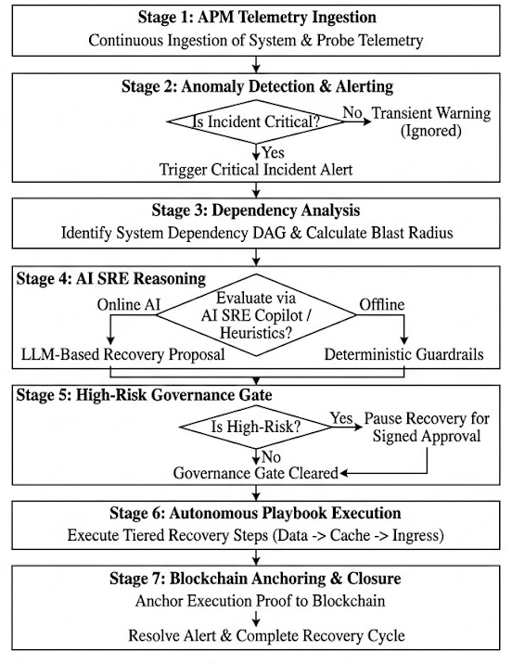
Technical Approach
Maintains live service DAGs in ClusterStateManager and confirms outages using a 3-consecutive-miss probe to eliminate flapping.
Traverses reverse dependency edges via computeBlastRadius in O(V + E) time to isolate the exact downstream cascade before acting.
Derives bottom-up recovery order via getTopologicalOrder (Databases → Caches → APIs) to eliminate thundering-herd crash loops.
Runs low-risk heals automatically while pausing hazardous mutations for signed wallet approvals via mstBlockchain.
Verifies node health in Pipeline Deployer before unlocking dependants and anchors SHA-256 Merkle proofs to HorizonAuditVault.

Slide 4
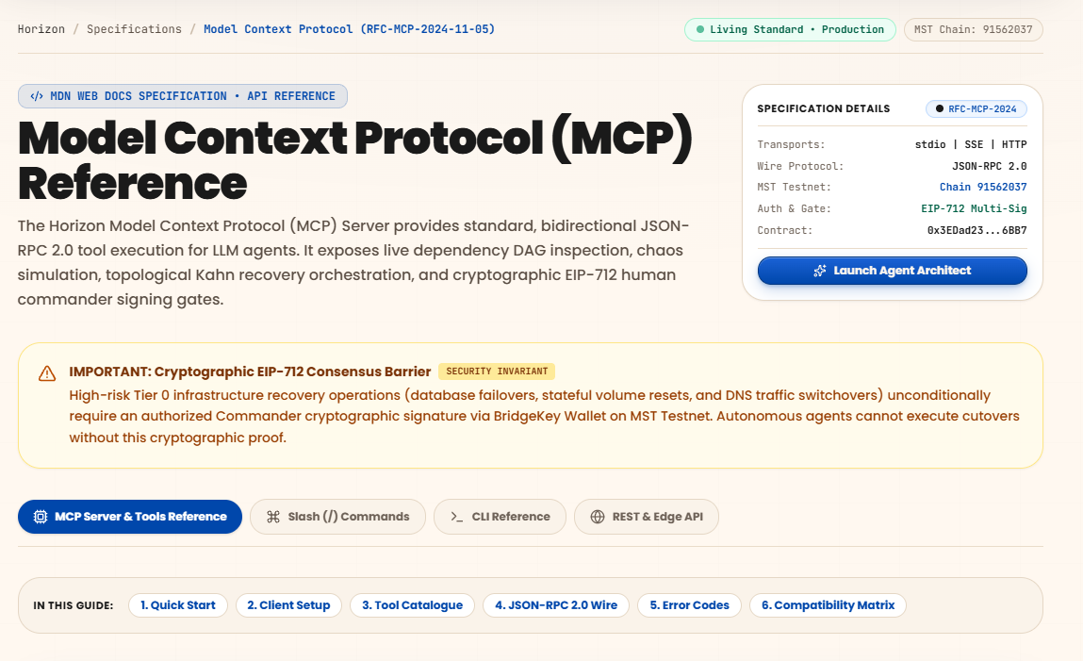
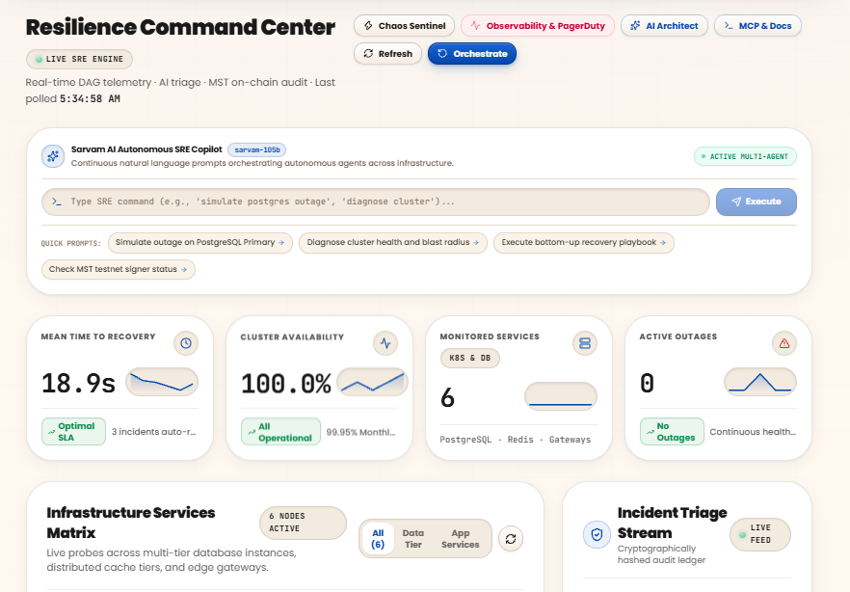
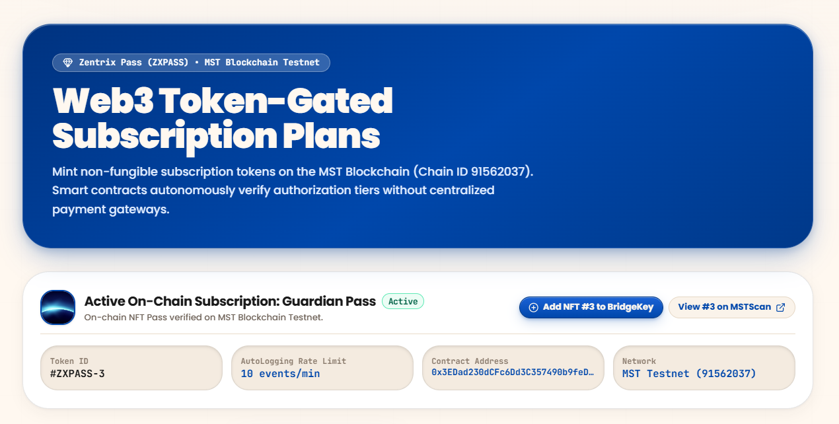
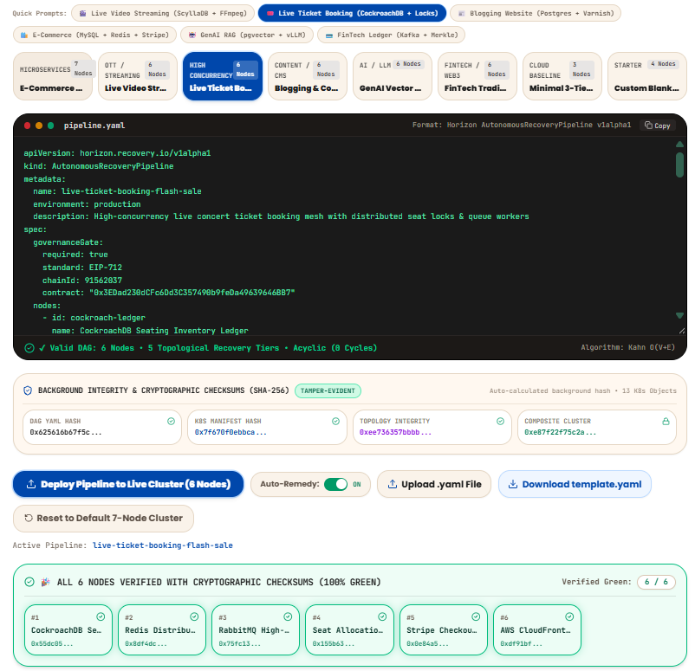
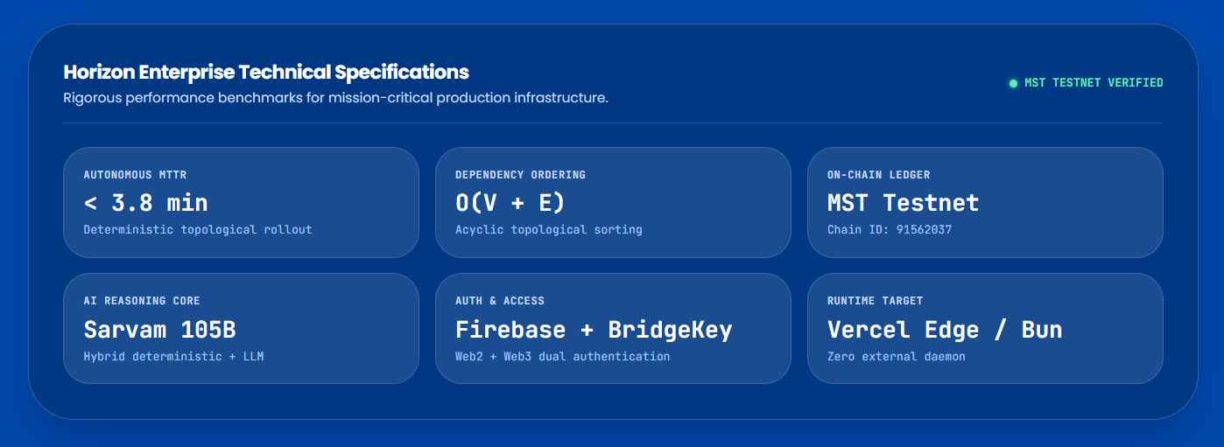
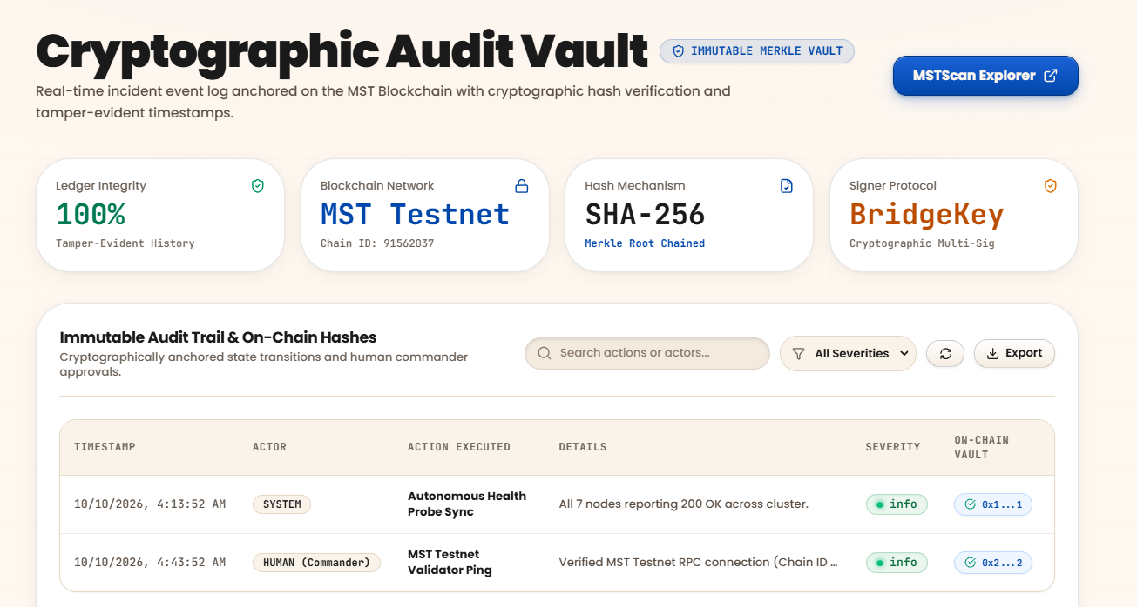
Working Deployed Prototype
Deployed Link: horizon-aiops.vercel.app
Github Repo: Horizon Repository

Slide 5
Feasibility and Viability
O(V + E) Scalability: Computes 1,000+ node recovery in < 3 ms via DependencyGraph without heavy compute.
Deterministic Core: Executes recovery via pure TypeScript in PipelineDeployer, isolated from LLM hallucinations.
Native Connectors: Plugs directly into Docker via dockerBridge, Kubernetes, and standard MCP IDE tools. Cycle & Flap Resilient: Built-in DFS cycle detection stops deadlocks, while sliding-window probes prevent flapping.
Low-Cost Web3: Hardware-backed EIP-712 wallet gates in mstBlockchain anchor on-chain for < ₹0.10 gas.
High ROI: Slashes $50k/min downtime losses by cutting MTTR from 45 mins to < 2 minutes.
Regulatory Driver: Automates India's mandatory 6-hour CERT-In reporting via on-chain HorizonAuditVault.
80%+ Gross Margins: High-margin SaaS model with < ₹12 marginal compute and gas cost per recovery.
PLG Flywheel: Developers adopt @horizon/mcp-server inside Cursor and Claude for organic bottom-up sales.
Sovereign Advantage: INR pricing removes USD forex volatility, with 100% Indian data residency for BFSI.

Slide 6
Marketing strategies
Business Model Canvas
Datadog / Dynatrace: Only alerts on issues; Horizon actuates automated recovery.
PagerDuty / Rootly: Pages on-call humans; Horizon resolves incidents autonomously.
StackStorm / Rundeck: Runs static scripts; Horizon derives dynamic DAG plans.
Generic LLM Agents: Hallucinates commands; Horizon enforces deterministic math.
Patent US12556441B1: Static mapping; Horizon re-plans on health probe failures.
Core Value: Slashes MTTR by 95%, eliminates out-of-order crash loops, and guarantees tamper-proof audit trails.
Target Market: Indian cloud scale-ups, regulated FinTech/Neobanks (CERT-In 6h compliance), and HealthTech.
Revenue Model: Predictable INR SaaS subscriptions (₹0 to ₹24,999/mo) + high-ticket Enterprise annual contracts.
Unit Economics: 82% gross margins with < ₹12 marginal serverless and blockchain cost per recovered incident.

Slide 7
Thank you
Presented by
Falconizers – 1048
Sarthak patil
Karan verma
Sneha Patidar
Sneha sharma

