Slide 1

SMART INDIA HACKATHON 2026
TITLE PAGE
Problem Statement ID :- 26173
Problem Statement Title :- iTantra - Indian Multilingual TTS & STT Aided Neural Transceiver Radio Access for low bitrate links
Theme :- Smart Automation
PS Category :- Software
Team ID :-
Team Name :- Falcons

Slide 2
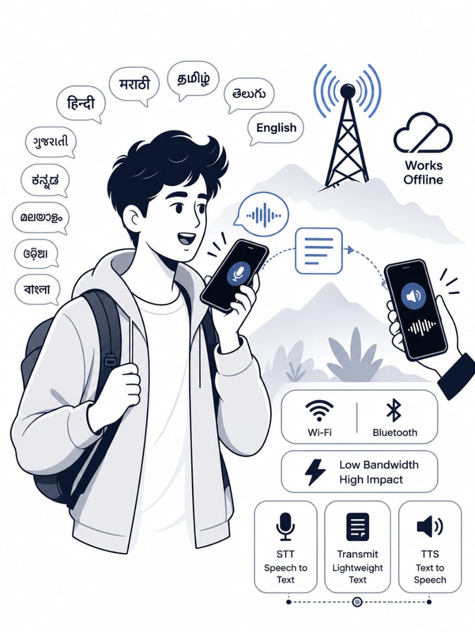
ITantra – Universal Communicator
Falcons
Problem Raw voice is highly data-intensive for low-bitrate links, while conventional STT/TTS often depends on internet or cloud infrastructure. In emergencies and remote areas, this makes fast, inclusive, multilingual voice communication difficult when connectivity is unavailable. | Our Idea iTantra converts speech into text locally, transmits only compact data over Wi-Fi/Bluetooth, and reconstructs it as speech on the receiving device. It enables low-latency, multilingual, offline voice communication between phones without relying on cellular or cloud infrastructure.
Unique Value Preposition
Transmits speech as compact text packets instead of raw audio, enabling voice communication over extremely low-bandwidth links.
Provides 10+ language on-device STT/TTS with no cloud dependency during operation, keeping communication private and functional offline.
Enables direct phone-to-phone communication through Wi-Fi Direct with Bluetooth fallback, with near-instant STT-to-TTS relay for emergency use.
Proposed Solution
Captures speech in short chunks and automatically detects pauses to finalize utterances.
Performs on-device STT and compact Protobuf packetization, minimizing the data sent between devices.
Uses Wi-Fi Direct as the primary transport and Bluetooth RFCOMM as fallback for infrastructure-independent communication.

Slide 3
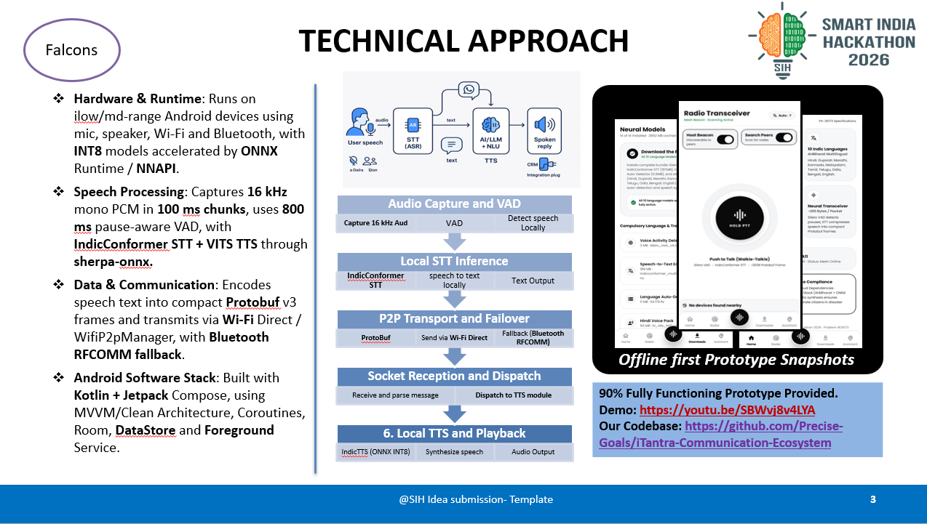
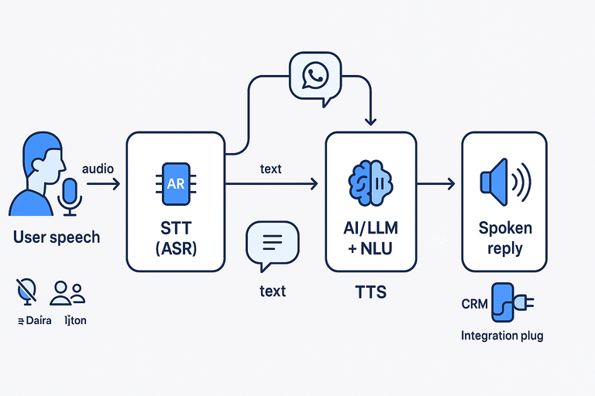
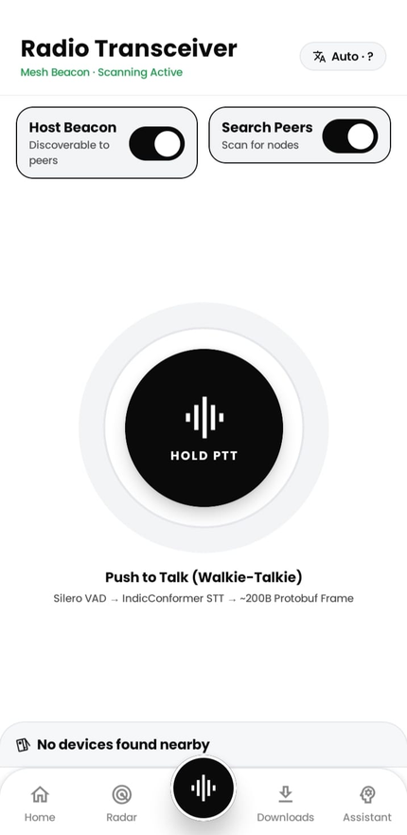
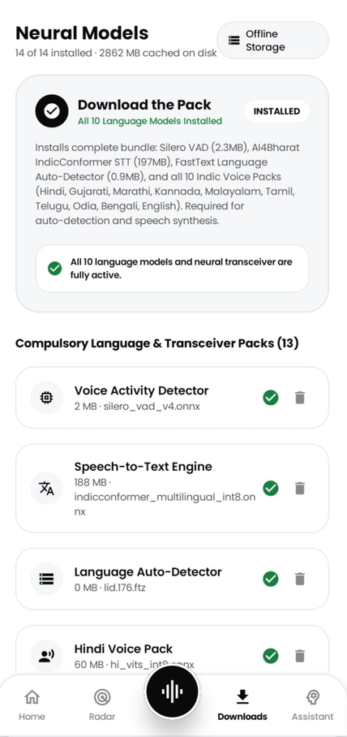
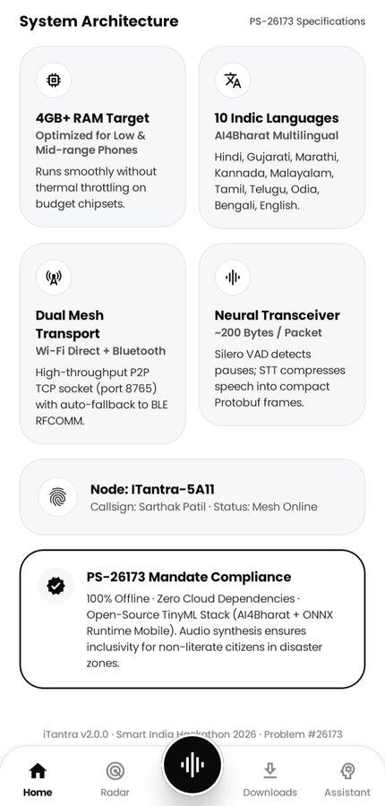
TECHNICAL APPROACH
Falcons
Hardware & Runtime: Runs on ilow/md-range Android devices using mic, speaker, Wi-Fi and Bluetooth, with INT8 models accelerated by ONNX Runtime / NNAPI.
Speech Processing: Captures 16 kHz mono PCM in 100 ms chunks, uses 800 ms pause-aware VAD, with IndicConformer STT + VITS TTS through sherpa-onnx.
Data & Communication: Encodes speech text into compact Protobuf v3 frames and transmits via Wi-Fi Direct / WifiP2pManager, with Bluetooth RFCOMM fallback.
Android Software Stack: Built with Kotlin + Jetpack Compose, using MVVM/Clean Architecture, Coroutines, Room, DataStore and Foreground Service.
Local STT Inference
IndicConformer STT
speech to text locally
Text Output
P2P Transport and Failover
ProtoBuf
Send via Wi-Fi Direct
Fallback (Bluetooth RFCOMM)
Socket Reception and Dispatch
Receive and parse message
Dispatch to TTS module
6. Local TTS and Playback
IndicTTS (ONNX INT8)
Synthesize speech
Audio Output
Audio Capture and VAD
VAD
Detect speech Locally
Capture 16 kHz Aud
Offline first Prototype Snapshots
90% Fully Functioning Prototype Provided. Demo: https://youtu.be/SBWvj8v4LYA Our Codebase: https://github.com/Precise-Goals/iTantra-Communication-Ecosystem

Slide 4
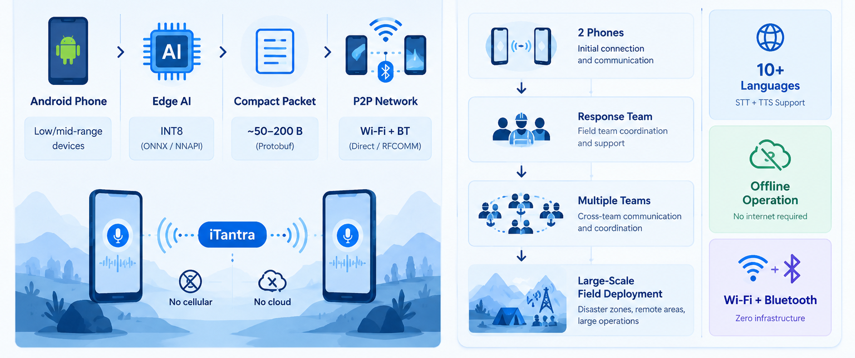
FEASIBILITY AND VIABILITY
Falcons
Feasibility
Hardware & Runtime: Runs locally on mobile chipsets using ONNX Runtime Mobile and NNAPI.
Storage & Memory: INT8 models require low storage and controlled RAM usage.
RF Connectivity: Uses built-in Wi-Fi Direct and Bluetooth RFCOMM.
Open-Source Licensing: Uses Apache 2.0 and MIT-licensed technologies.
Challenges, Risks & Mitigation
Zero Infrastructure Cost: No cloud, internet and servers subscriptions required.
Power Efficiency: VAD reduces STT/TTS processing during silence.
Secure Offline Design: Operates without internet or cloud dependency.
Inter-Agency Scalability: Protobuf supports standardized communication between teams
Practical Implementation
Resilient Ad-Hoc Networking: Automatically pairs devices via Wi-Fi Direct with a Bluetooth fallback, ensuring priority SOS messages are delivered immediately through high-volume alarm audio.
High-Speed Offline Edge AI: A Push-to-Talk interface runs all speech processing entirely on-device, delivering translated, synthesized audio in under 2.5 seconds with zero internet dependency.

Slide 5
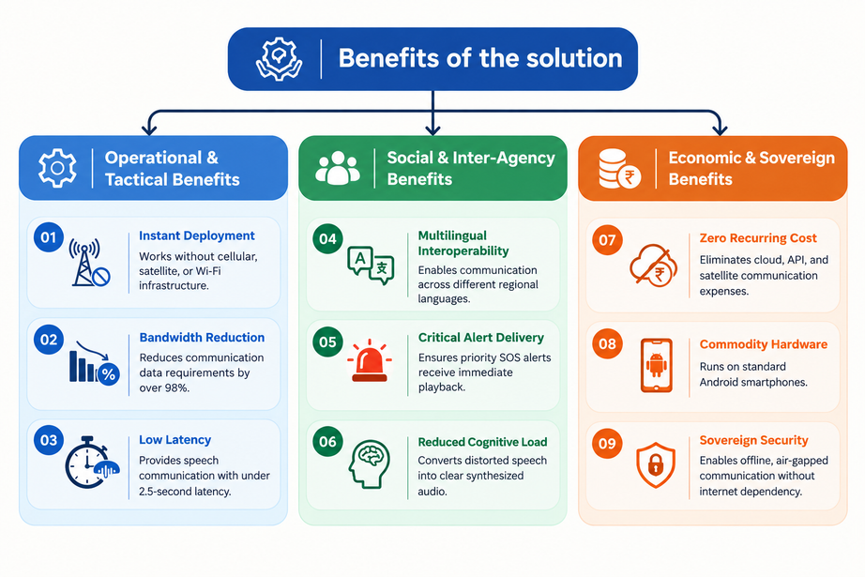
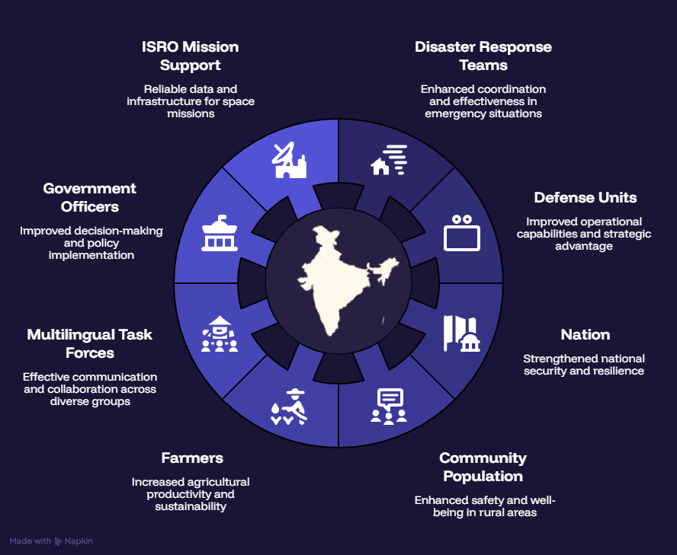
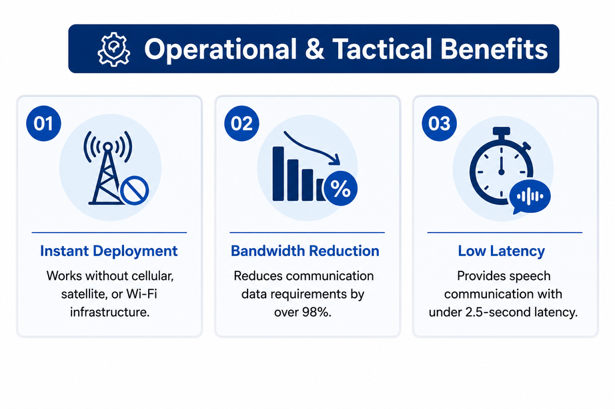
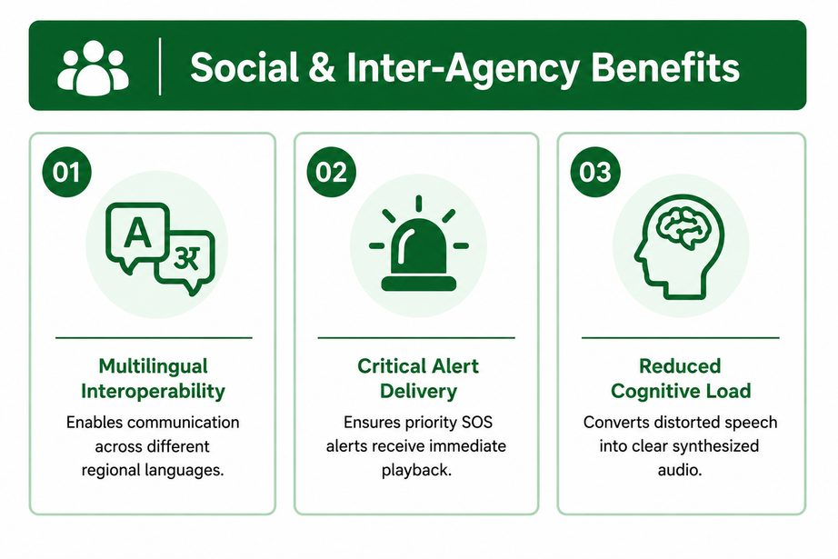
IMPACT AND BENEFITS
Falcons
Potential Impact of our Solution
ISRO: Shadow zone telemetry.
First Responders: Zero-infrastructure coordination.
Defense: Air-gapped operational security.
Nation: Reduces import dependency.
Task Forces: Eliminates language friction.
Communities: Stronger local trust.
Government: Simplified live reporting.
Future Scope
Deep-Space Telemetry & LoRa Expansion: Compressing voice into tiny 50-byte payloads positions iTantra perfectly for ISRO's satellite networks, while future LoRa hardware integration will extend our secure, offline terrestrial mesh beyond 10 kms.
Accelerating India's Rural Economy: Transforming everyday smartphones into decentralized communication hubs bypasses vulnerable cellular grids, ensuring remote farmers remain permanently connected to drive India's national growth.

Slide 6
RESEARCH AND REFERENCES
Falcons
Semantic Communication & Offline Edge AI:- Associated Academic Study: Real-Time Speech-to-Text on Edge: A Prototype System for Ultra-Low Latency and Local Processing - MDPI Article
Resilient Ad-Hoc Networking
the Framework for Satellite Communication Network – TRAI Paper
Associated Academic Study: IEEE Device-to-Device Wireless Protocols – IEEE Published Research Paper
Low Bitrate High-Quality RVQGAN-based Discrete Speech Tokenizer – IBM Research
Performance evaluation of low-bitrate voice using spread spectrum techniques for satellite-based emergency communication – Science Direct Article
Associated Academic Study: An Infrastructure-Less Communication Platform for Android Smartphones Using Wi-Fi Direct – Springer Natural Article
Associated Academic Study: Wi-Fi Direct in Android: Creating seamless device-to-device communication – ArdaScience Article
Our Patent Research draft: iTantra Universal Communicator – iTantra Article
Project Ecosystem & Repositories
Our Own Codebase: Our Github Project Repository
Deployed Application Link: Application Download URL & Application Release Page
Video Demonstration: Prototype Youtube Video Link
Live Web Portal: Landing Page for the Application

