Slide 1
Traffic lights optimization for decreasing the traffic congestion
Supervisor
Associate professor dr. Iuliana Bocicor
Author
Preda Andrei-Constantin

Slide 2
Agenda
Introduction
Objective
Existing solutions
Used approach
Application details
Experiments and results
Conclusions and further work
Demo

Slide 3
INTRODUCTION

Slide 4
The problem
1
Long queues
2
High load
3
Waiting time
4
Low traffic flow
Waiting 2-3 consecutive times at one semaphore
A lot of cars heading to a certain event
Wait even if there are no cars on the other street
A good flow of traffic can be destroyed

Slide 5
Motivation
Significant traffic growth in the past years
Fuel consumption
Air pollution
Drivers’ frustration

Slide 6
OBJECTIVE

Slide 7
Goals
Low queue length
High speed of the cars (not over the speed limit ☺)
Low waiting time
Less yellow lights
High number of cars that pass each 5 seconds
Cars pass the intersection faster
No fast change of the lights if not necessary

Slide 8
EXISTING SOLUTIONS

Slide 9
Currently used methods
1.IntelliLight
reinforcement learning method
decisions on whether to keep current traffic light or not
image representation of the intersection
2.SOTL
counter incremented every second
threshold

Slide 10
USED APPROACH

Slide 11
Reinforcement learning
1
Observation
2
Action choice
3
Action taking
4
Reward computation
We observe the current state of the intersection
Agent takes an action based on the state
Agent changes the traffic lights based on the selected action
After implementing the selected action, we need to check its impact

Slide 12
State
Four streets with 3 lanes.
12 integers for the queue length
12 integers for the number of vehicles
12 integers for total waiting times of vehicles
current phase of the semaphore
fresh change of the semaphore

Slide 13
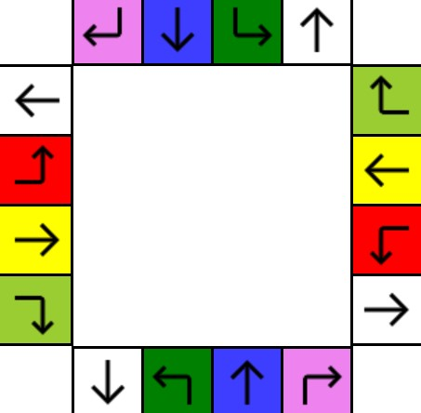


Actions/Semaphore phases
NSR1
WER2
L1R1
L2R2

Slide 14

Reward
Total queue length - Q
Total delay - D
Total waiting time – W
Semaphore change - C
Number of cars that passed – P
Total travel time - T
Fresh change of the semaphore - F

Slide 15
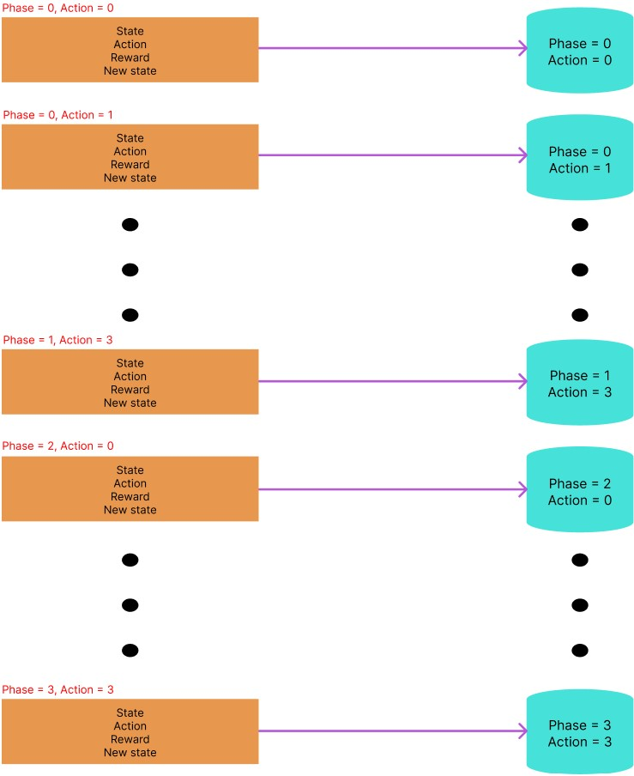
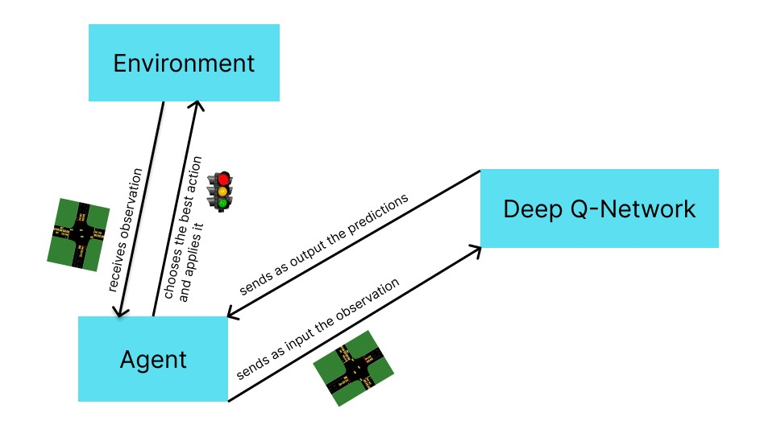
Deep Q-Network

Slide 16
APPLICATION DETAILS

Slide 17




Used technologies

Slide 18
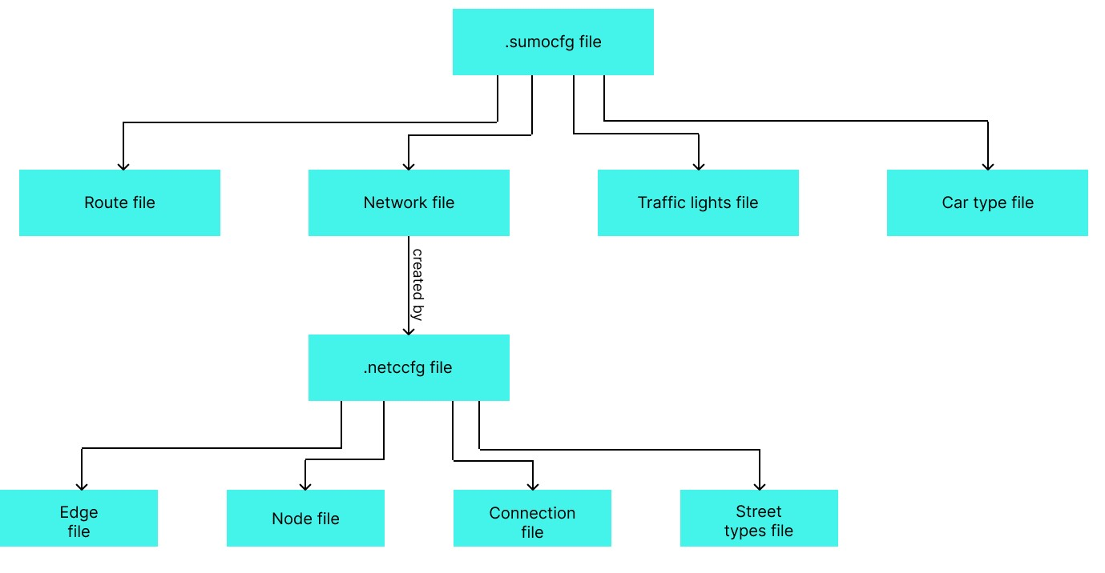
Sumo files

Slide 19
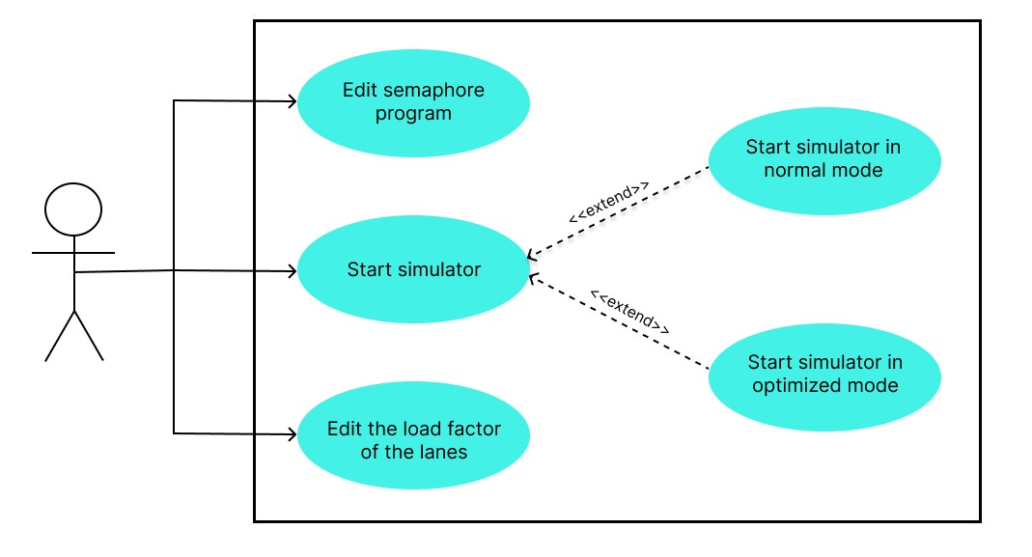
Features

Slide 20
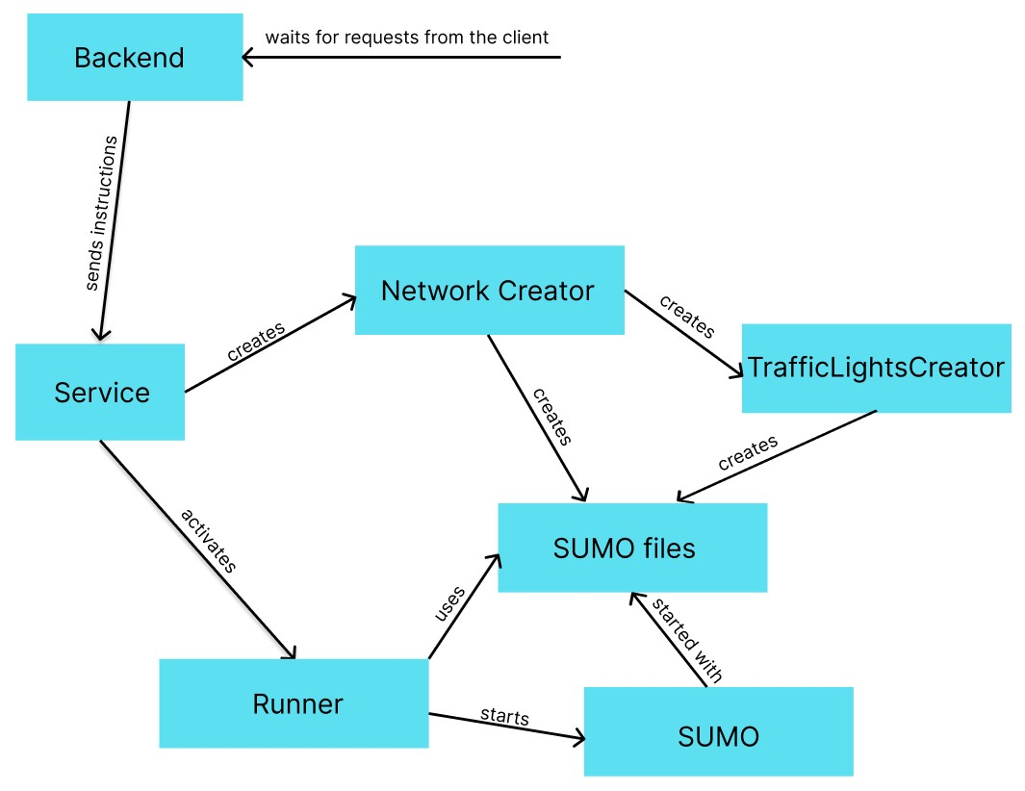
Back-End Architecture

Slide 21
EXPERIMENTS & RESULTS

Slide 22
Training
LS = Learning Step (full run of the dataset in the simulator)
1. Pre-Training
Phase durations
Order of the phases
2. Normal Training
Every 300s
Target network update – every 1500s
The model was trained on 15LS

Slide 23
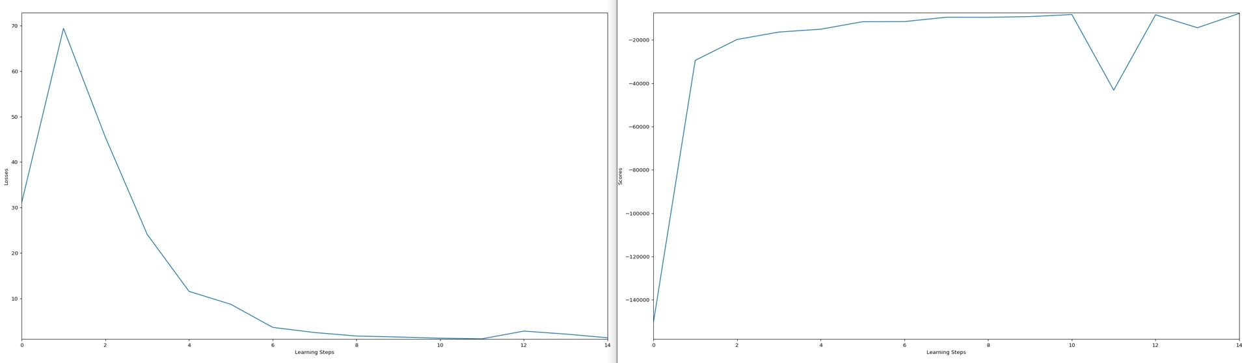
Graphs

Slide 24
CONCLUSIONS & FURTHER WORK

Slide 25

Conclusions
Deep Reinforcement Learning
Promising results

Slide 26
Further work
Longer training
More complex and varied dataset
Generalization
Use of real traffic data

Slide 27
DEMO

