Slide 1
Data Driven Job Hunting
Thanks for the organizer ECCC (爱城华人基督教福音堂) group
愛民頓是一個近半載時光在漫天飄雪的地方， 但上主仍在人生天空裡放了彩虹的生命應許，我們願意以改變生命的信息，伴結成長的關係, 樂也融融的群 體，激勵人心的真道，終身學習的教導，帶給你嶄新的生命體驗, 使冰冷孤寂的秋冬，轉成溫暖融融的春夏， 見到生命總是祝福。
Speaker : Shenyi Bao baoshenyi@gmail.com
https://ca.linkedin.com/in/shenyi-bao-3b989a5

Slide 2
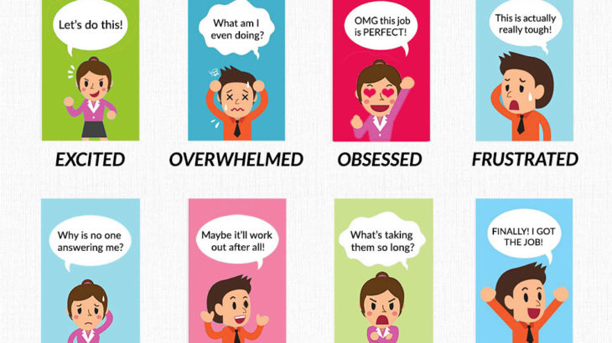
Stages
Refer to https://transparency.kununu.com/the-emotional-stages-of-the-job-search-infographic/

Slide 3
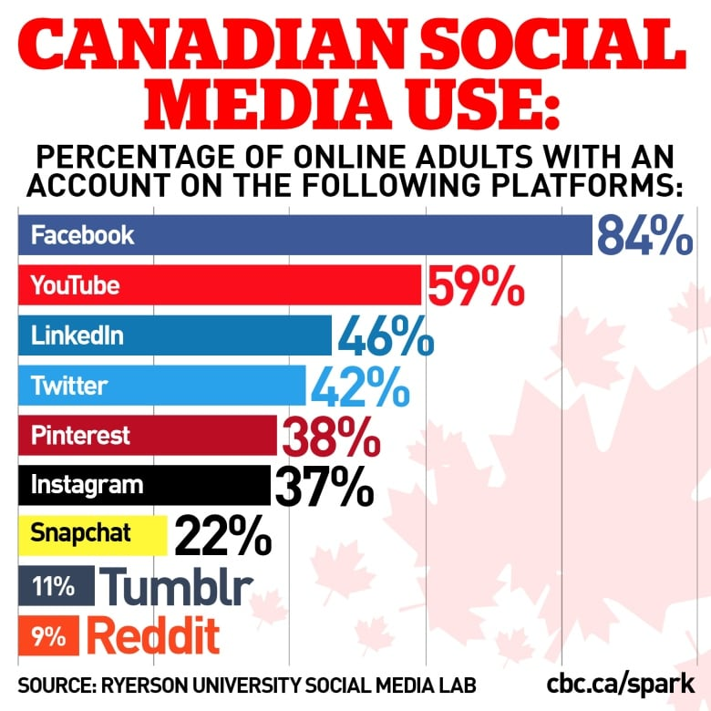
Statistics to use social media
Canadians love their social media. About 94% of online Canadians are on at least one social platform, but gender, age, and income influence what platforms we choose, according to a new report by the Social Media Lab at Ryerson University.

Slide 4
Download practice templates
https://github.com/baoshenyi/DataDrivenJobHunting
LearnWithJobPostings.xlsx
CityToGo.xlsx

Slide 5
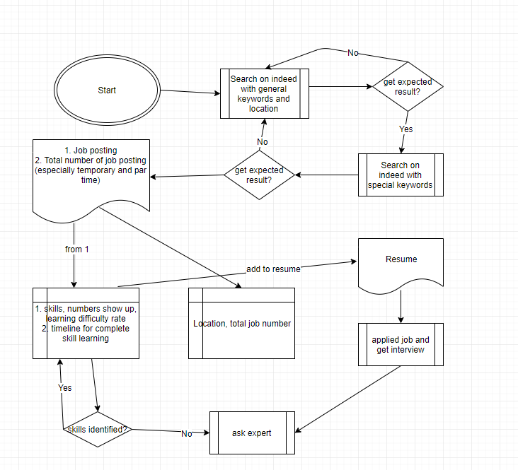

Slide 6

Thank you for coming

