Slide 1
Data Driven Job Hunting
Thanks for the organizer ECCC (爱城华人基督教福音堂); especial to Zhang Nan, Zhao Xin
愛民頓是一個近半載時光在漫天飄雪的地方， 但上主仍在人生天空裡放了彩虹的生命應許，我們願意以改變生命的信息，伴結成長的關係, 樂也融融的群 體，激勵人心的真道，終身學習的教導，帶給你嶄新的生命體驗, 使冰冷孤寂的秋冬，轉成溫暖融融的春夏， 見到生命總是祝福。
Speaker : Shenyi Bao baoshenyi@gmail.com
https://ca.linkedin.com/in/shenyi-bao-3b989a5

Slide 2
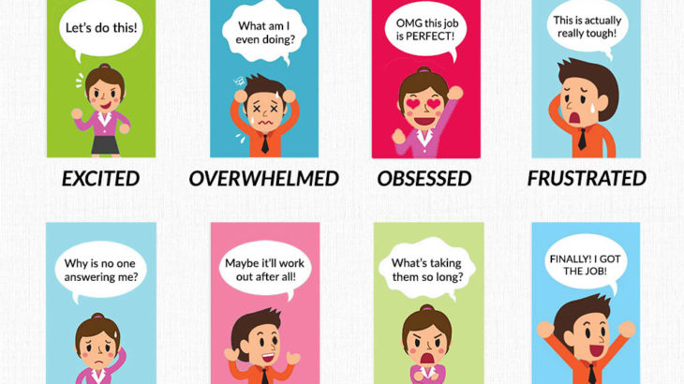
Stages
Refer to https://transparency.kununu.com/the-emotional-stages-of-the-job-search-infographic/

Slide 3
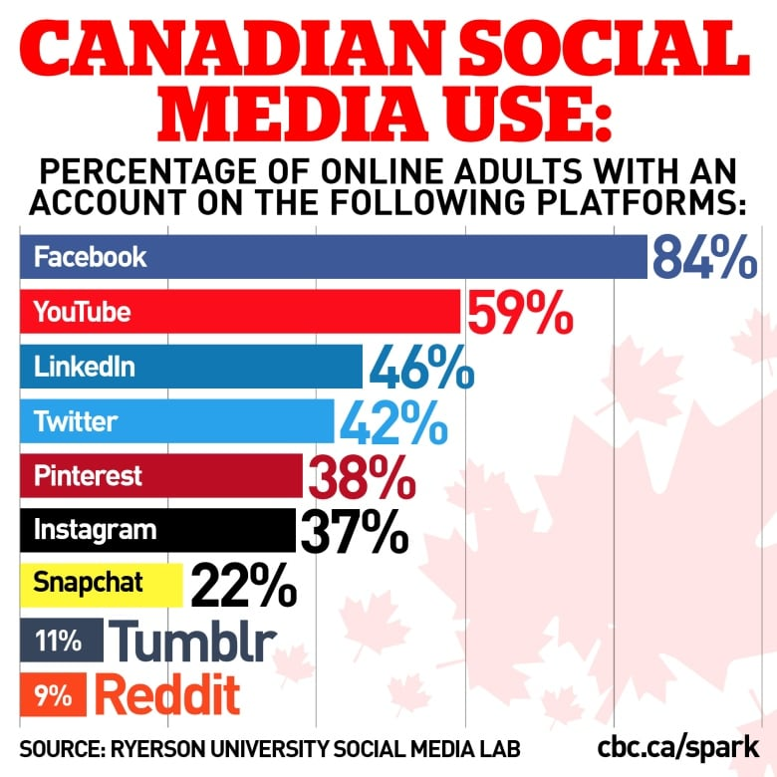
Statistics to use social media
Canadians love their social media. About 94% of online Canadians are on at least one social platform, but gender, age, and income influence what platforms we choose, according to a new report by the Social Media Lab at Ryerson University.

Slide 4
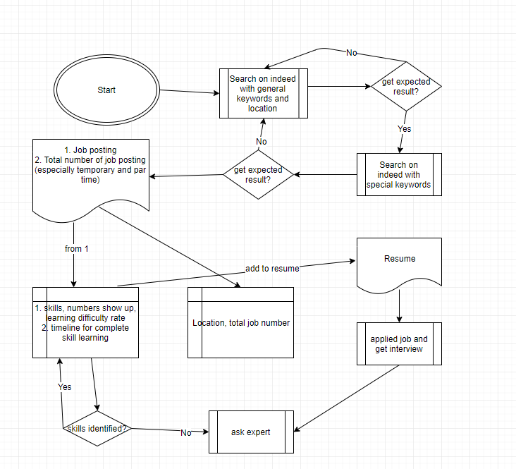

Slide 5
Download practice templates
https://github.com/baoshenyi/DataDrivenJobHunting
LearnWithJobPostings.xlsx
CityToGo.xlsx
Write your learning notes (added to resume later)

Slide 6
Online resources and interview tips
https://www.udemy.com
https://www.coursera.org from a certification of completion to a completed degree
https://www.meetup.com/Edmonton-NET-User-Group/about/
Please let interviewers leave message since you could prepare before call them back.
If you get call from interviewer on Wednesday or later, please postpone to next week
Ask export for mock up interview

Slide 7

Thank you for coming
https://www.youtube.com/watch?v=z14p9Lo7NSs

