Slide 1
Data Driven Job Hunting
Speaker : Shenyi Bao baoshenyi@gmail.com
https://ca.linkedin.com/in/shenyi-bao-3b989a5

Slide 2
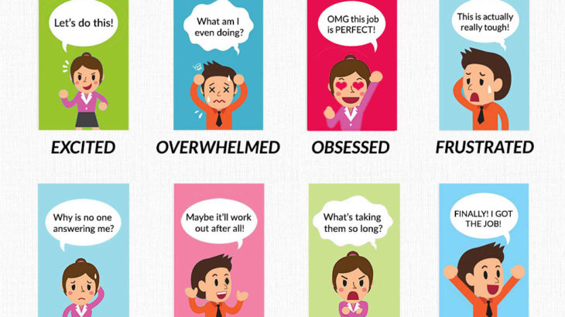
Stages
Refer to https://transparency.kununu.com/the-emotional-stages-of-the-job-search-infographic/

Slide 3
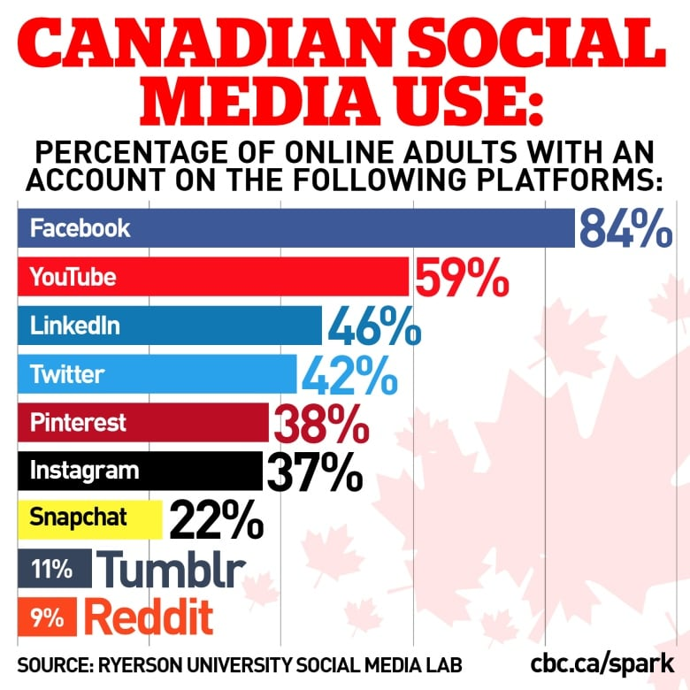
Statistics to use social media
Canadians love their social media. About 94% of online Canadians are on at least one social platform, but gender, age, and income influence what platforms we choose, according to a new report by the Social Media Lab at Ryerson University.

Slide 4
Download practice templates
https://github.com/baoshenyi/DataDrivenJobHunting
LearnWithJobPostings.xlsx
CityToGo.xlsx

Slide 5
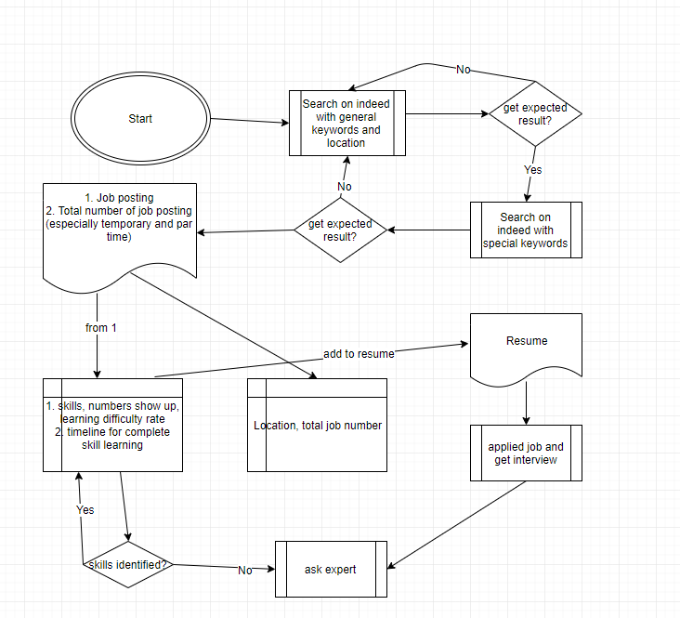

Slide 6
Online resources and interview tips
https://www.udemy.com
https://www.coursera.org from a certification of completion to a completed degree
https://www.edx.org/ more academic, get certificates, but not diploma or degree
Please let interviewers leave message since you could prepare before call them back.
If you get call from interviewer on Wednesday or later, please postpone to next week
Ask export for mock up interview

Slide 7

Thank you for coming

