Slide 1

PROGRAMMING FOUNDATIONS
WITH JS,HTML AND CSS
by Duke University
Submitted By:
AMAN PRATAP SINGH

Slide 2
CONTENT
Course Overview
Introduction to HTML
Basic tags used in HTML
Example of HTML syntax
Introduction to CSS
Few basics of CSS

Slide 3
Course Overview :
In this course, we learn the basic tools that every web page coder needs to know. We learn how to create web pages with HTML and CSS. We then learn ways to style a webpage. We will be able to code up a web page that will be attractive and very optimal . Last we go thorough the most popular and incredibly powerful language of the web: Java script.

Slide 4
Introduction to HTML5
HTML stands for Hyper Text Markup Language
HTML is the standard markup language for creating Web pages
HTML describes the structure of a Web page
HTML consists of a series of elements
HTML elements tell the browser how to display the content
HTML elements label pieces of content such as "this is a heading", "this is a paragraph", "this is a link", etc.

Slide 5
Basic tags
<!DOCTYPE> | Defines the document type
<html> | Defines an HTML document
<head> | Contains metadata/information for the document
<title> | Defines a title for the document
<body> | Defines the document's body
<h1> to <h6> | Defines HTML headings
<p> | Defines a paragraph
<br> | Inserts a single line break
<hr> | Defines a thematic change in the content
<!--...--> | Defines a comment

Slide 6
syntax
<!DOCTYPE html> <html> <head> <title>Page Title</title> </head> <body> <h1>My First Heading</h1> <p>My first paragraph.</p> </body> </html>

Slide 7
OUTPUT
My First Heading
My first paragraph.

Slide 8
INTRODUCTION TO CSS
> CSS stands for Cascading Style Sheets
>CSS describes how HTML elements are to be displayed on screen, paper or in
other media
> CSS saves a lot of work. It can control the layout of multiple web pages all at once
>External stylesheets are stored in CSS files

Slide 9
CSS can be added to HTML documents in 3 ways:
Inline - by using the style attribute inside HTML elements
Internal - by using a <style> element in the <head> section
External - by using a <link> element to link to an external CSS file
The most common way to add CSS, is to keep the styles in external CSS files. However, in this tutorial we will use inline and internal styles, because this is easier to demonstrate, and easier for you to try it yourself.

Slide 10
BASIC SYNTAX
<!DOCTYPE html> <html> <head> <style> body {background-color: powderblue;} h1 {color: blue;} p {color: red;} </style> </head> <body> <h1>This is a heading</h1> <p>This is a paragraph.</p> </body> </html>

Slide 11
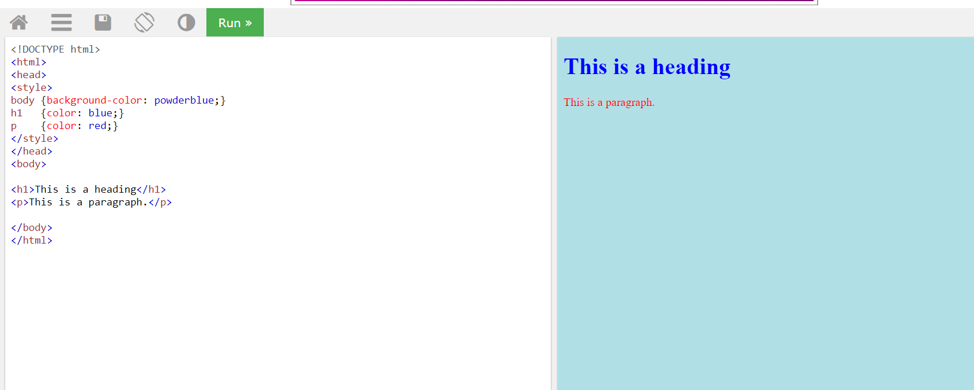

Slide 12


Project Result :

Slide 13
CERTIFICATE :

Slide 14
Link for verification of certificate:
https:/ur link

