Slide 1
SOMEONE to REMEMBER
Charles Roy Henderson
April 1, 1911 March 14, 1989
Coin, Iowa Urbana, IL
May 7, 2018 DVV

Slide 2
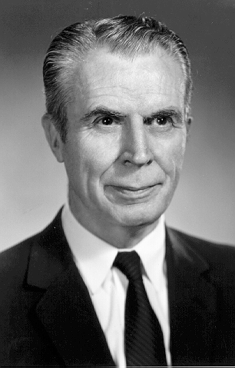

Slide 3
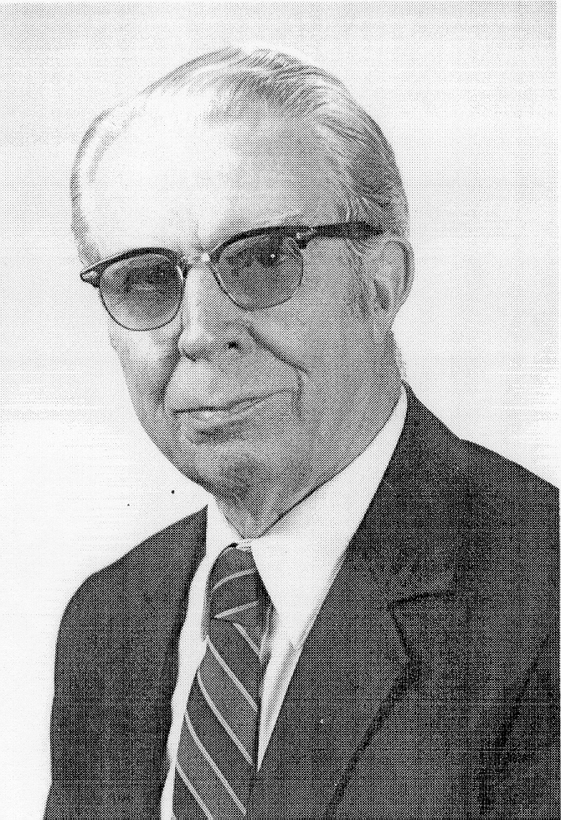

Slide 4
The
path
to his
equations
and beyond.

Slide 5
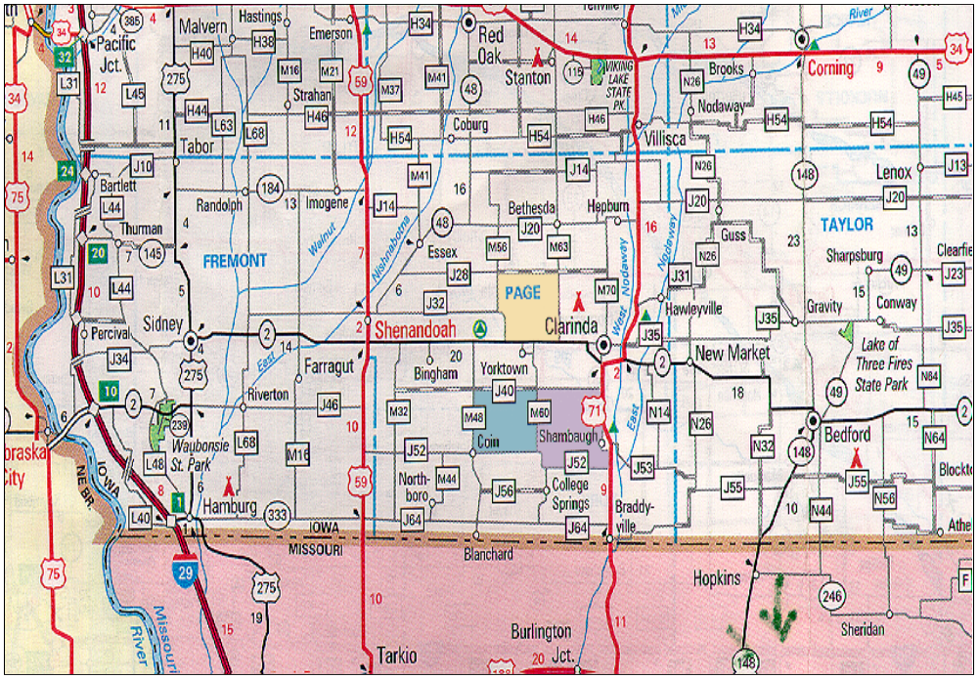
PAGE
Coin
Shambaugh

Slide 6
FARM BOY
ATHLETE
SCIENTIST

Slide 7
Page County
cows, pigs, horses
4-H
FFA
State Farmer
Championship
Judging Team

Slide 8
Page County Farm Bureau Picnic
12 - and - under
14 - and - under
16 - and - under
thereafter 10-12, 13-14, 15-16

Slide 9
IOWA STATE COLLEGE
Field House Record
440 indoor 51.7s
1933 (30 years)

Slide 10
ACADEMICS

Slide 11
“Best d….d transcript I ever saw”
K. L. Turk, 1988 (1948)
“Best student I ever had”
A. E. Brandt, 1962 (1932)
Highest Average in Agriculture
Worked through school
Track Team, indoor-outdoor
Livestock Judging Team

Slide 12
Mathematics
F-30 Math. 13, for Agr. 96
W-31 Phys. 101 98
S-31 Math. 1, Algebra 99
W-32 Math. 2, Trig. 100
S-32 Math. 3, Anal. Geo 98
SS-32 Math. 5a, Calculus 98
SS-32 Math. 5b, Calculus 98

Slide 13
Others
A.H. 210 Livestock Judging 95
A.H. 250 Animal Breeding 97
A.H. 211 Adv. Judging A
Speech 30a 85
A.E. 54 Farm Shop 87

Slide 14
M.S.
Math. 112a,b,c (Stats. ) 9 A
Math. 444, Stat Lab, Cox 1 A
A.H. 600, Research, Nutr. 17
“B”

Slide 15
Ph.D. *Fall, 1946 - Fall, 1948*
Math 541 Math. Stat 3 A
Math 542 Math. Stat 3 A
Math 543 Math. Stat 3 A
Math 548 Adv. Stat 3 A
Math 545 Design 3 A
Math 546 Design 3 A

Slide 16
Ph.D. Fall, 1946 - Fall, 1948*
Lanoy Hazel*
John Gowen
Jay Lush
Oscar Kempthorne (Mood)
George Sprague

Slide 17
Jay L. Lush (ISC)
to
K. L. Turk (CU)

Slide 18
“Charles R. Henderson is one of the ablest men we have ever had ………….. ………………….......................... . I don’t think we average getting as likely a prospect as him once in five years.”

Slide 19
“About the only criticism I could possibly offer of him in this field is that he is interested in each new thing … and may sometimes be in danger of laying a problem aside when he has it solved … but before he has quite completed preparing it for publication.

Slide 20
“…. , I do hope that whatever position he takes will give him opportunity mostly for research as it is in that direction his talents are most extraordinary.”

Slide 21
“I would rate him superior in all respects.”
John B. Youmans, M.D.
Dean
University of Illinois
College of Medicine
Chicago 12, IL

Slide 22
Serendipity

Slide 23
Simpson College Math, until a visit by
Dean of ISC 1929

Slide 24
Summer Session 1939
Economics 8 credits The extra rider
December 21, 1940 Chariton, Iowa
Marian Mae Martin

Slide 25
Nutrition M.S. 1935
U.S. Army (Sanitary Corps)
Nutrition Division 1942-46
Animal Breeding Ph.D. 1948
The “B’s”

Slide 26
Turk >>> Cornell
Salisbury >>> Illinois
Henderson >>> Cornell (1948)

Slide 27
“Right man”
“Right job”
“Right time”
* * *

Slide 28
Fulbright Award 1955
Arthur Ward - Olive Castle
New Zealand Dairy Board
S. R. Searle
Matrix Algebra

Slide 29
C. R. Henderson
to
K. L. Turk

Slide 30
Some Steps
BS ISC Animal Husbandry MS ISC Animal Nutriton
Iowa Extension (5 years)
Ohio University (2 years)
US Army Nutrition (4 years)
PhD ISC Animal Breeding (1946-48)

Slide 31
“My army experience was particularly fortunate .… as all of it involved research in nutrition and statistics. I was commissioned in the Medical Department’s Nutrition Division.”

Slide 32
“… data … were punched on I.B.M. cards, and as a result … gained valuable experience in analyzing such data. During the last half year of my army service, I was commanding officer of the Army Medical Nutrition Laboratory at Chicago.”

Slide 33
“My thesis …involves a study of the Iowa State College inbred lines of swine in crosses and estimates of … importance of general and specific combining ability of inbred lines. It requires some rather advanced statistical techniques .…”
****** pub, ISU

Slide 34
BASEBALL
“DAMN YANKEES”
Cubs - Iowa’s team
Cardinals
Little League coach
X

Slide 35
MUSIC
Grade school visit
William Tell Overture
WHCU
Music
Johannes Sebastian Bach
Beatles, Blues, Folk
X

Slide 36
SCIENCE

Slide 37
SCIENTIST
Accomplishments:
His impact,
most of anyone in Animal Science !!

Slide 38
Mixed Linear Model:
y = XB + Zu + e
V(u) = G
V(e) = R
V(y) = ZGZ’ + R = V
Pre CRH needed
V⁻¹ = (ZGZ’ + R⁾⁻¹
Xb +
Fixed effects BLUE
Random effects BLUP

Slide 39
A. S. Goldberger (1962)
named
Best Linear Unbiased Estimation (BLUE)
Best Linear Unbiased Prediction (BLUP)
Best linear unbiased prediction in the
generalized linear regression model.
American Statistical Association Journal
June 1962, pp. 369-375.
X

Slide 40
Goldberger derivation:
Needs V⁻¹ = (ZGZ’ +R)⁻¹
Started with Aitken (1935)
B^ = (X’V⁻¹X)¯X’V⁻¹y was BLUE
Then showed u^ = GZ’V⁻¹(y – XB^)
was BLUP

Slide 41
CRH: MME 1948+
y = XB + Zu + e
[X’R⁻¹X X’R⁻¹Z ][B^] = [X’R⁻¹y]
[Z’R⁻¹X Z’R⁻¹Z + G⁻¹][u^] = [Z’R⁻¹y]
Adds G⁻¹ to u^ block of LSE
Does not need V⁻¹ = (ZGZ’ + R)⁻¹
Does need G⁻¹, not always easy
Coefficient matrix often sparse

Slide 42
No. 23 Mood 1950 ** p. 164
“Suppose intelligence quotients for students in a particular age group are normally distributed about a mean of 100 with standard deviation 15. The I.Q., say x₁, of a particular student is to be estimated by a test on which he scores 130.

Slide 43
No. 23 Mood 1950 ** p. 164
It is further given that test scores are normally distributed about the true I.Q. as a mean with standard deviation 5. What is the maximum-likelihood estimate of the student’s I.Q.? (The answer is not 130.)”

Slide 44
First References to MME
Estimation of changes in herd
environment . JDS, 32: 706, 1949 (abst.)
Estimation of genetic parameters.
Ann. Math. Stat., 21:309, 1950 (abst.)
Estimation of genetic parameters.
Biometrics, June 1950, pp186-187 (abst.)

Slide 45
Proofs for MME of Henderson
The estimation of environmental
and genetic trends from records subject to culling. “BLUE”
Biometrics, 15:192, 1959. ( H, K, S, vK)
Selection index and expected
genetic advance. “BLUP”
NAS-NRC pub. 982, 1963 (1961)

Slide 46
References to Mixed Model Equations
Important for Estimating Genetic Values
A simple method for computing the inverse of a numerator relationship matrix used in prediction of breeding values. Biometrics, 32:60, 1976.
Best linear prediction of breeding values not in the model for records.
Journal Dairy Science, 60:783, 1977.

Slide 47
For genetic values, G = A(Vg)
But need G⁻¹ = A⁻¹(1/Vg)
II. A⁻¹ (A-inverse) rules 1975-76
Need only an, sire, dam trios
Includes animals w/o records
III. Augment MME 1977?
Add rows of zeroes in Z₊ for
animals w/o records

Slide 48
Animal, Sire, Dam rules for A⁻¹
includes animals w/o records
Pedigree: S - -, D - -, P S D
S - - >> 1 to s,s of A⁻¹
D - - >> 1 to d,d
P S D >> 2 to p,p:
-1 to p,s; p,d; s,p; and d,p:
1/2 to s,s; s,d; d,s; and d,d
X

Slide 49
Animal, Sire, Dam rules for A⁻¹
includes animals w/o records
Pedigree
Animal Sire Dam
1 0 0
2 0 0
3 1 0
4 1 2

Slide 50
Animal, Sire, Dam rules for A⁻¹
Pedigree
Animal Sire Dam to A⁻¹
1 0 0 1 >> (1,1)
2 0 0 1 >> (2,2)
3 1 0 4/3 >> (3,3)
-2/3 >> (1,3
and 3,1)
1/3 >> (1,1)

Slide 51
Animal, Sire, Dam rules for A⁻¹
Pedigree
Animal Sire Dam
4 1 2
2 >> (4,4)
-1 >> (1,4 and 4,1 and 2,4 and 4,2)
1/2 >> (1,1 and 2,2 and 1,2 and 2,1)

Slide 52
An, Sire, Dam rules for A⁻¹
. 1 2 3 4.
1: 1+1/2+1/3 1/2 -2/3 -1
2: 1/2 1+1/2 0 -1
3: -2/3 0 4/3 0
4: -1 -1 0 2
Over all pedigrees, will be very sparse
But includes animals w/o records

Slide 53
A-inverse to A
. 1 2 3 4 .
1: 1 0 1/2 1/2
2: 0 1 0 1/2
3: 1/2 0 1 1/4
4: 1/2 1/2 1/4 1
Over all pedigrees, may be very dense
X

Slide 54
The G⁻¹ part for genetic values
A⁻¹ (A-inverse) 1975
Augment MME 1977?
with rows of zeroes in Z₊ for
animals w/o records
Allowed use of ‘animal’ model
X Genomic G

Slide 55
Mixed Model Equations
Basis for 'ALL’
genetic evaluations
Sire models
Animal models, g^
Maternal models, g^ & m^
and many others

Slide 56
Notable Other
Variance Component
Estimation
Methods I, II, III* (1953)
RAF
X

Slide 57
Years Achievement Age
1946-48 PhD 35-37
1948-61 Mixed Model Equn 37-50
1951 Variance Comp. Est. 40
1954-75 A- inverse rules 43-64
Selection Bias 64
1984 The Book 73

Slide 58
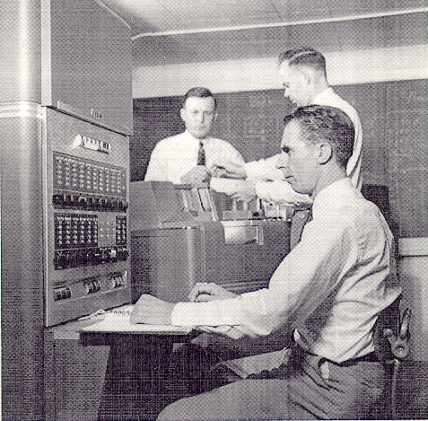

Slide 59
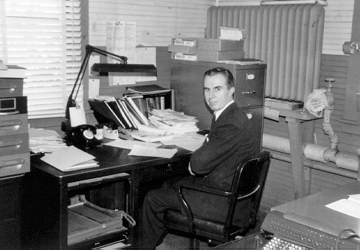

Slide 60
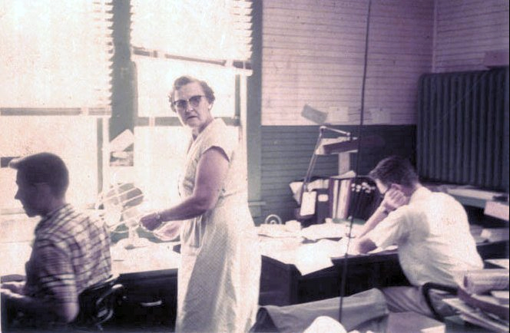

Slide 61
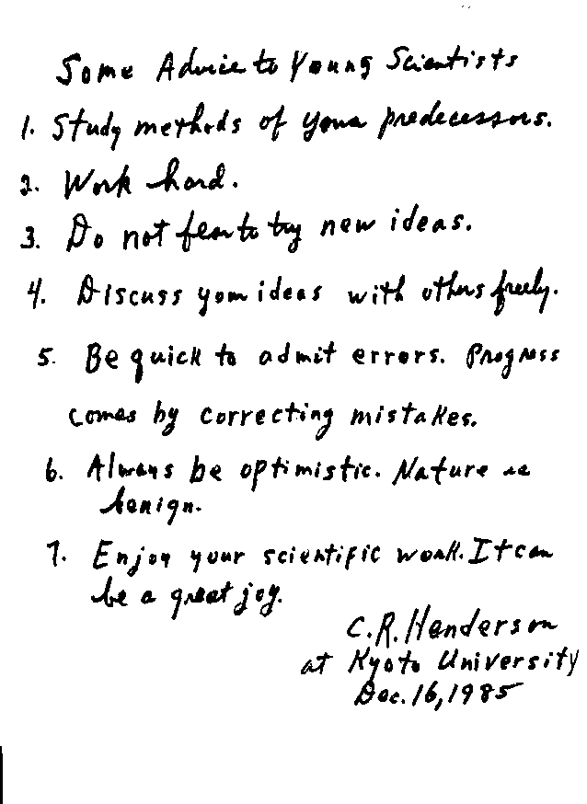

Slide 62
SOME ADVICE TO YOUNG SCIENTISTS
1. Study methods of your predecessors.
2. Work hard.
3. Do not fear to try new ideas.
4. Discuss your ideas with others freely.
5. Be quick to admit errors. Progress
comes by correcting mistakes.
Always be optimistic. Nature is benign.
Enjoy your scientific work. It can be a great joy.
C. R. Henderson
at Kyoto University
December 16, 1985

Slide 63
Wish
National meetings
Regional meetings
March 14, 1989
X

Slide 64
SOMEONE to REMEMBER
Charles Roy Henderson
April 1, 1911 March 14, 1989
Coin, Iowa Urbana, IL

