Slide 1
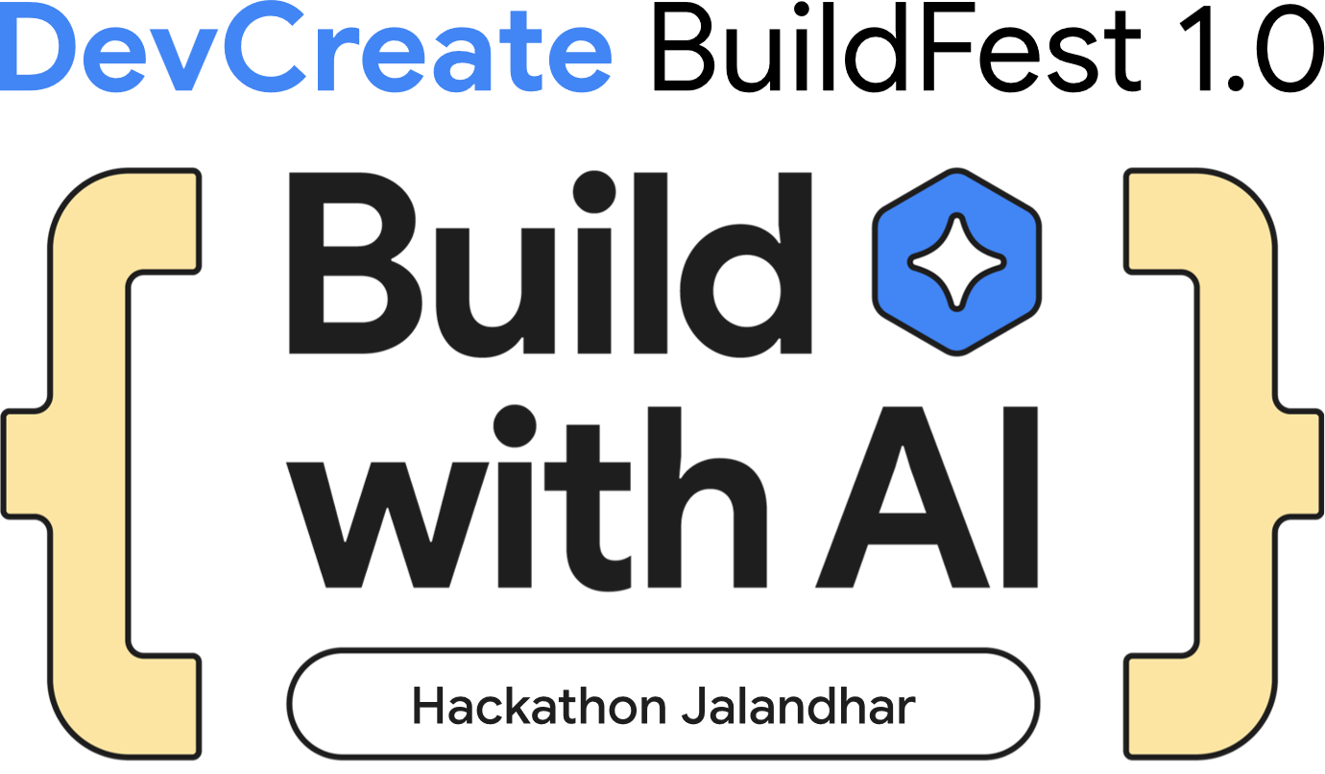
Team Name & Team ID: Aryavart & T-140
Team Members: Karuna Sharma(Frontend & UI/UX), Bhavya Kochar(Product & Strategy), Manish Tiwari(Backend & AI Integration)
Problem Statement : Swasthya Saathi: An AI-powered Health Companion
Theme: HealthTech/FoodTech/AgriTech

Slide 2


DevCreate BuildFest
🚨 INDIA'S HEALTHCARE CRISIS
⏰ 68% emergency deaths due to delayed care
• 30+ mins ambulance response in rural areas
🏥 1:1456 Doctor-Patient ratio in rural India
• 60% travel 50+ km for specialized care
💰 55M Indians pushed into poverty yearly
• Only 35% use Ayushman Bharat benefits
🗣️ 90% health apps English-only
• 40% rural population struggles with English
💊 50% chronic patients miss medications
• 70% lack proper reminder systems
THE PROBLEM: Millions suffer from delayed emergency response,
limited healthcare access, and poor medical guidance.

Slide 3


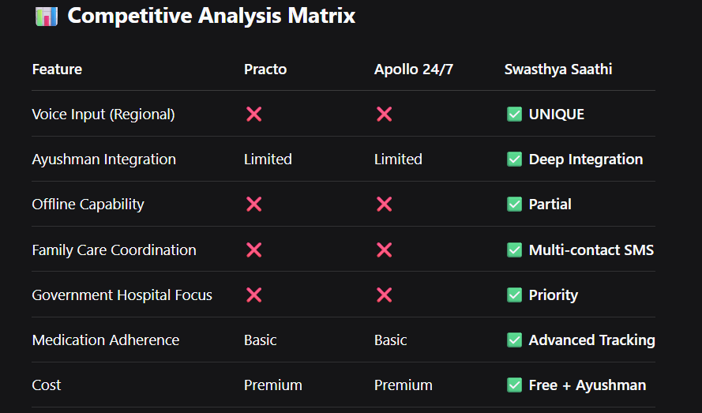
ByteVerse 1.0 Hackathon
DevCreate BuildFest
How it solves the problem?
🎯 OUR SOLUTION: SWASTHYA SAATHI
An AI-powered healthcare platform that provides:
• 🤖 Instant symptom analysis & triage
• 🎙️ Voice-first interface in regional languages
• 🏥 Smart hospital finder with Ayushman integration
• 💊 Family-connected medication management
• 📱 Zero-installation progressive web app
KEY INNOVATIONS:
✅ Voice-first for rural India - Overcomes literacy barriers
✅ Ayushman Bharat integration - Direct government scheme access
✅ Family-centric healthcare - Involves guardians in care
✅ Emergency response coordination - Multi-layer emergency handling
✅ Offline-capable architecture - Works with limited connectivity
USP: Instant voice AI triage connecting you to right healthcare instantly.

Slide 4
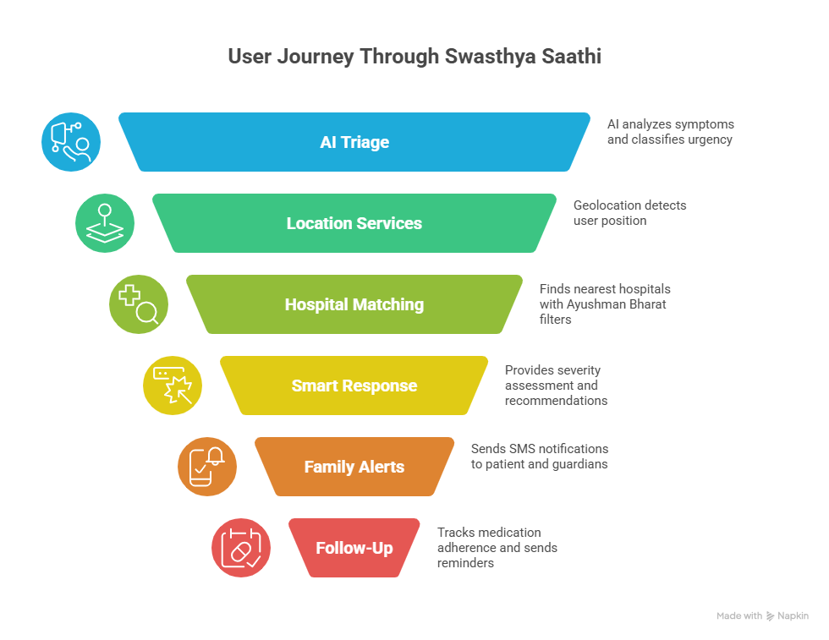
ByteVerse 1.0 Hackathon
DevCreate BuildFest
🚀 KEY FEATURES & IMPACT
🤖 AI SYMPTOM ANALYSIS
• 96.2% emergency detection accuracy
• <3 seconds response time
• Multi-lingual voice input support
🏥 SMART HOSPITAL FINDER
• Real-time distance calculation
• Ayushman Bharat empanled hospitals
• Emergency services filtering
💊 MEDICATION MANAGEMENT
• Family-connected reminder system
• SMS alerts to patients + guardians
• 40% improvement in adherence
📊 MEASURABLE IMPACT
• Faster emergency response
• 50% reduction in unnecessary hospital visits
• 500M+ Ayushman beneficiaries empowered
• 80% rural population reach through voice interface

Slide 5



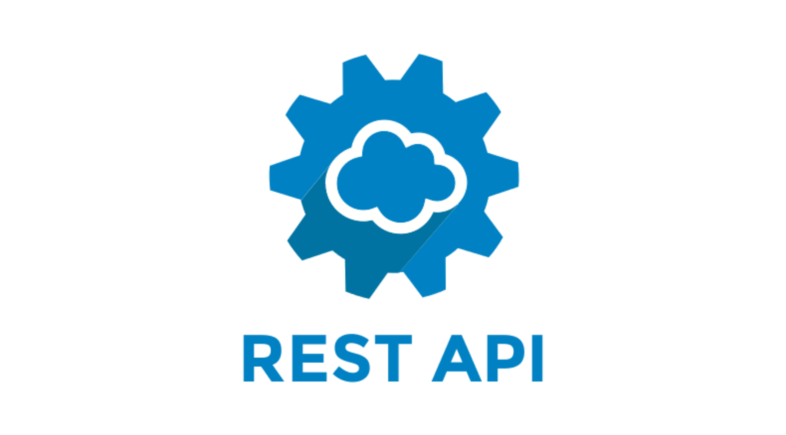



ByteVerse 1.0 Hackathon
DevCreate BuildFest
🛠️ Technologies Used
1. Frontend
HTML5 - Semantic Markup
CSS3 - Styling & Animations
JavaScript ES6+ - Core Logic
Web Speech API - Voice Recognition
2. Backend
Python - Server Environment
Flask - Web Framework
REST API - Communication
Google Gemini AI - Medical Analysis
3. Database
JSON Files - Hospital & Symptom Data
Local Storage - User Sessions & Preferences
4. External Services
Twilio API - SMS Notifications
Google Gemini API - AI Processing
5. Deployment
Local Development Server - Backend
Static File Hosting - Frontend
Key Features Built: AI Symptom Analysis, Voice Input Processing, Hospital Location Mapping, Medication Reminder System, Multi-language Support
Simple, honest product that tracks your health fully.

Slide 6
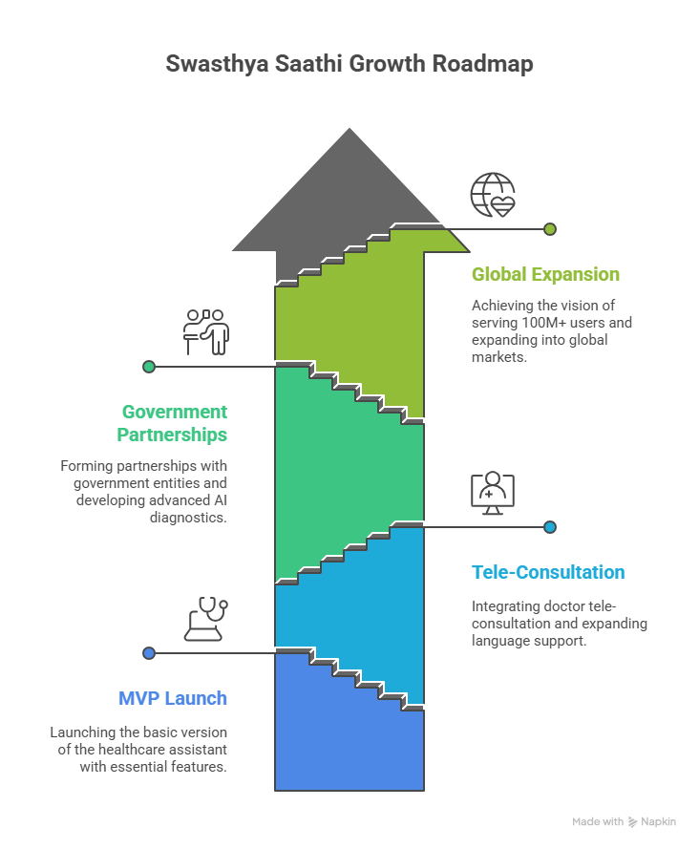
ByteVerse 1.0 Hackathon
DevCreate BuildFest
📈 Impact & Future Scaling
🎯 Immediate Impact
Reduce emergency response time by 60%
Serve 500M+ Ayushman Bharat beneficiaries
Save 55M Indians from medical poverty yearly
Enable voice healthcare for 80% rural population
🚀 Scaling Plan
Phase 1: Expand across North Indian states
Phase 2: Launch in all Indian languages
Phase 3: Government API integration & mobile app
💫 Future Vision
Create India's largest AI healthcare network
Build voice-first healthcare ecosystem
Scale to serve 100M+ users nationwide
"Voice-First Access, AI-Powered Care, National Impact"

Slide 7


