Slide 1
The Technology Value Stream
Kristopher Kuenning
10/26/2025
CSD380
DevOps

Slide 2
What is Technology Value Stream?
Lead time versus Processing Time
Lead time – Total elapsed time for when a request (bug fix, change, feature) is made until it is delivered and running in production.
Processing Time – Time when the work is actually in motion, the portion of lead time where active value-added is being done, rather than in motion or waiting.
Why does this matter?
The process may be optimized for process time, yet the lead time remains long enough for the work to sit in queues, waiting for approval, handoffs, or provisioning.

Slide 3
Most Common Scenarios
Handoffs between teams
Dev to QA to Release Engineering to Ops
Environmental provisioning
A place where work is waiting for weeks or months to get into production.
Large Batches
Changes that are grouped or merged may increase risk or rework.
Long Lead Times
Feedback loops are delayed, defects pile up, changes are more risky to deploy.

Slide 4
Our DevOps Ideal
What does this look like and why?
High-performing DevOps organizations aim to shrink deployment lead time– ideally to minutes or hours from days.
Developer commits a change, which they go through tests and pipelines, and then hand off to build, which will end up in production.
System is designed for small batch sizes, minimal hand-offs, and loosely-coupled.
“Deployment Lead Time begins when a developer checks a change into version control. Deployment Time ends when that change is successfully running in production.” – IT Revolution

Slide 5
How to apply Technology Value Stream
Map your value stream – Identify the major processes and flows of those blocks.
Measure baseline metrics – Determine deployment lead time using existing tools.
Identify bottlenecks – Look at waiting times or where rework is high.
Define target – Aim to reduce deployment lead time from months to days to hours to minutes.
Introduce improvements – Pipeline steps, reduce batch sizes, and improve feedback loops.
Record and monitor – Impactful changes that are using your lead time or processing time.

Slide 6
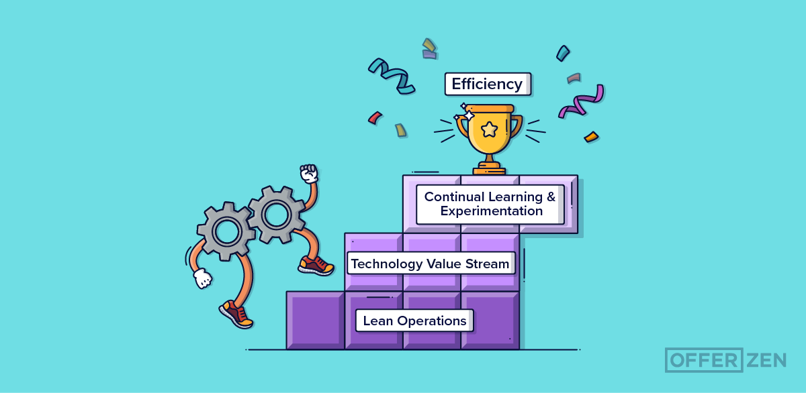

Slide 7
References
Fenton, S. (2023, February 20). Why are there so many definitions of Lead time?. Why Are There So Many Definitions Of Lead Time? | Octopus blog. https://octopus.com/blog/definitions-of-lead-time?.com
Pinheiro, G. (2023, April 28). Lessons on using devops to become more efficient and reliable. OfferZen. https://www.offerzen.com/blog/using-devops-efficient-and-reliable/
Understanding the work in our value stream and improving flow. IT Revolution. (2023, February 1). https://itrevolution.com/articles/improve-flow-devops-value-stream/?.com

