Slide 1

FlIGHT PRICE PRediction
Rishank Karkera
Nivedita Gadade
Preet Chaudhari
Atharv Mhatre

Slide 2
Problem Statement
Flight prices are extremely volatile depending on the route and market time. It’s difficult to find a great deal depending on time of the year
Predicting flight prices could help us save money, control our travel budget, compare to make the right choice thus help in making our trip better
By applying machine learning techniques, we could forecast flight prices to optimize our bookings and make the most out of our travel

Slide 3
Benefits/Motive
Cost Savings: Analyzing historical data and trends helps predict if flight prices will rise or fall, allowing travelers to make informed decisions.
Optimal Booking Time: Flight price prediction guides users to identify the best time to book flights for the lowest prices, with recommendations on immediate booking or waiting for potential price drops.
Flexible Travel Planning: Predictions assist travelers with flexible dates in finding the most cost-effective days to fly, particularly useful for those with variable travel dates.
Budget Planning: Knowing when flight prices are expected to be lowest helps in budget planning, enabling travelers to allocate their budget effectively for different times.
Comparison Shopping: Travelers could compare prices across airlines and platforms, streamlining the process of finding the best flight deals.

Slide 4
Benefits/Motive
Seasonal Travel Planning: Predictions help users understand seasonal flight price patterns that are valuable for planning trips during periods of typically lower prices.
Business Travel Optimization: Crucial for business travelers, predictions assist in optimizing travel plans for cost-effectiveness by identifying the best times to book flights.
Risk Mitigation: While not foolproof, flight price prediction provides a level of risk mitigation by making travelers aware of potential price fluctuations, reducing the risk of overpaying.
Enhanced Travel Experience: Flight price prediction contributes to a more informed and efficient travel experience, allowing travelers to approach the booking process confidently after considering factors that may affect flight prices.

Slide 5
Data Collection
We gathered a dataset containing flight routes between different cities, containing over 300k records
Flight route dataset contains airline, flight no., source/destination city, departure/arrival time, stops, cabin class, duration, days left & price
The flight routes cover the following cities for this problem: Mumbai, Delhi, Bangalore, Kolkata, Hyderabad & Chennai

Slide 6
Data processing
Clean the data by getting rid of null prices from the dataset
1
Apply label encoding to categorical attributes
2
Bring all categorical and numerical attributes to a scale using Min-Max normalization
3

Slide 7
Feature engineering & selection
Feature selection is a technique used in machine learning to identify and the top relevant features from a larger set of features in a dataset.
By reducing the number of features, we can improve machine learning model’s performance and avoid overfitting
Next, we generate heatmap to study the correlation of features and drop the unwanted columns
Finally, we optimized our feature selection using SelectKBest, we filtered the top 6 features from above step

Slide 8
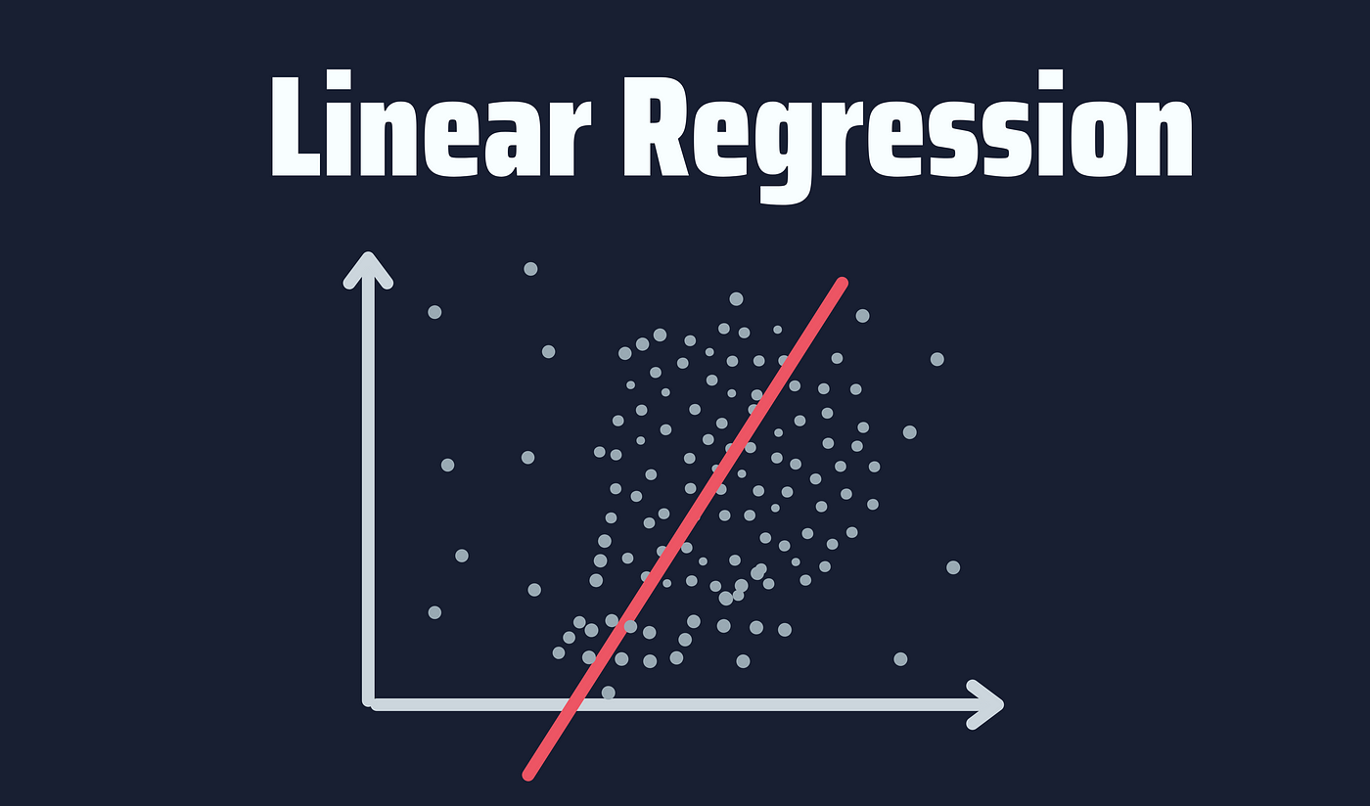
Linear Regression
Linear regression is a statistical method used to model the relationship between a dependent variable and one or more independent variables by fitting a linear equation to the observed data
Aims to find the best-fitting line (or hyperplane in the case of multiple independent variables) that minimizes the difference between the observed values and the values predicted by the model
It achieves an accuracy of 90.43%, which indicates that the model is good at identifying relation between variables of the routes

Slide 9
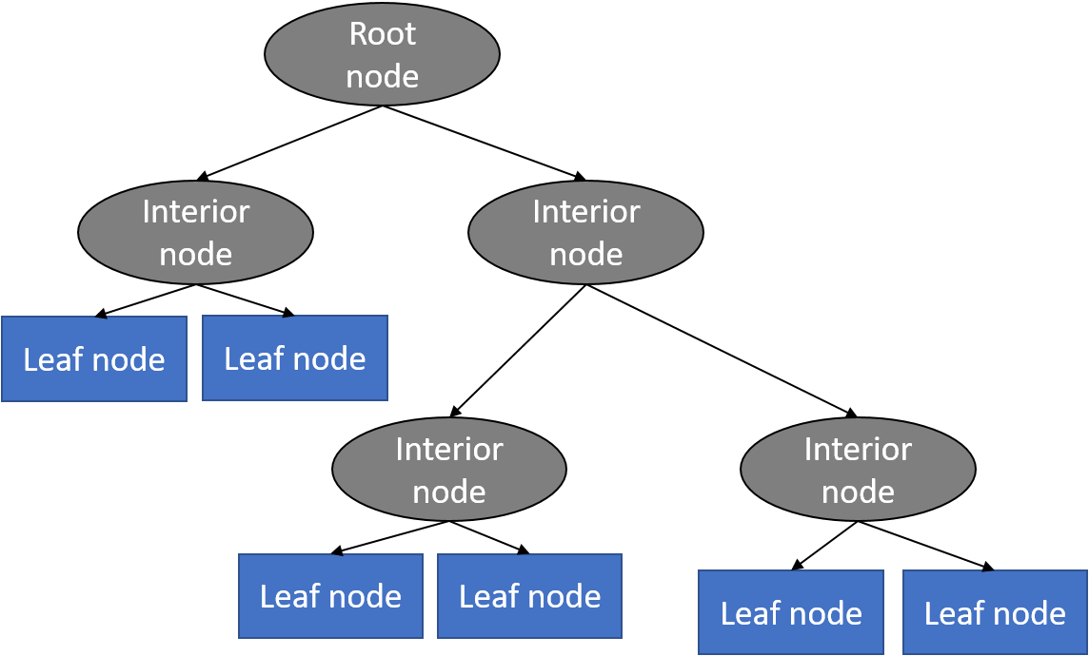
Decision Tree Regressor
Decision Tree Regressor is a machine learning algorithm used for regression tasks. It belongs to the family of decision tree algorithms, which are versatile and can be applied to both classification and regression problems
Classification involves predicting a categorical label, decision trees for regression predict a continuous numeric value
It achieves an accuracy of 93.43%, which indicates that the model is good at estimating flight price of continuous nature

Slide 10
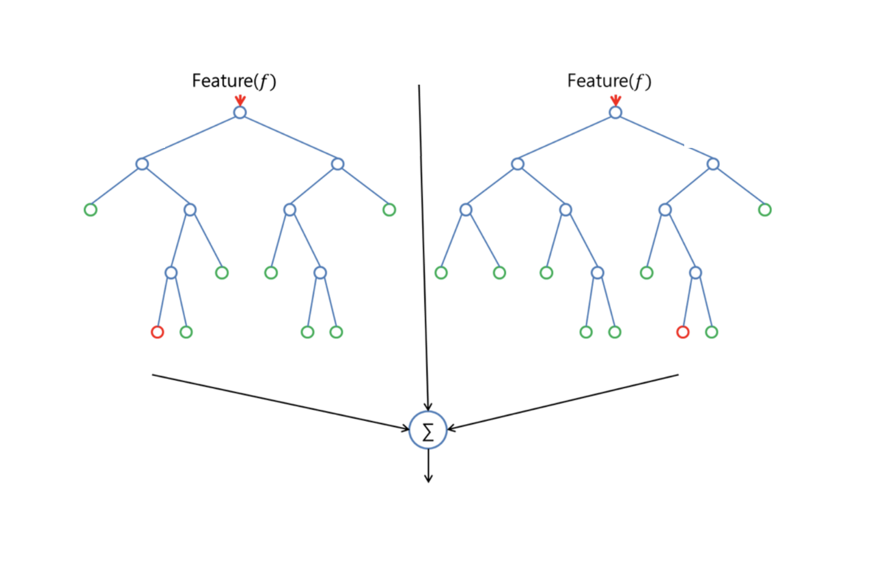
Random Forest
Random Forest is an ensemble learning algorithm that combines multiple decision trees to improve the accuracy of predictions
The Random Forest model learns to make predictions based on a combination of features in the flight routes
Random Forest achieves an accuracy of 94.94% , which indicates a strong positive correlation between the predicted and actual flight prices

Slide 11
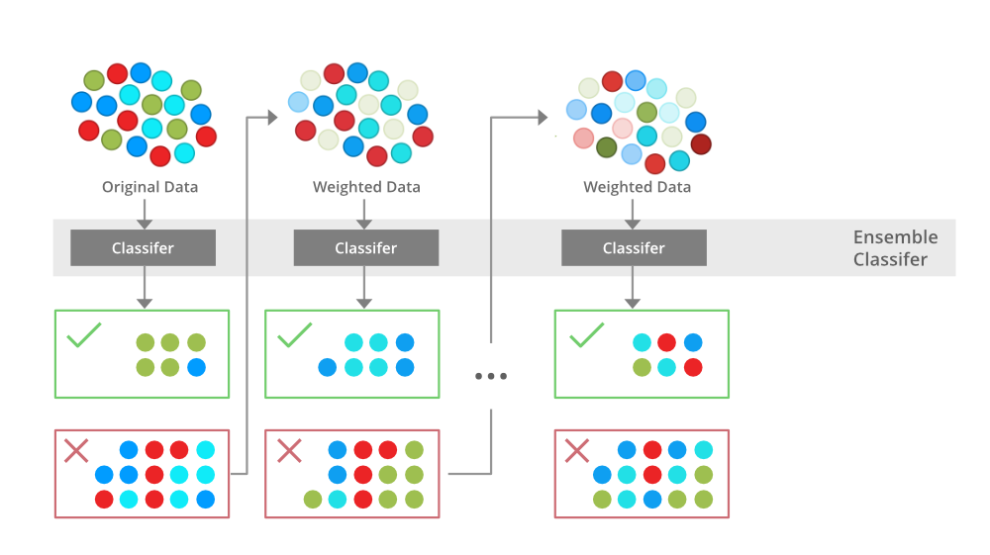
XGBoost Regressor
XGBoost is a powerful and efficient machine learning algorithm that has gained popularity for its performance in various types of predictive modeling tasks
Designed for regression tasks, employing gradient boosting techniques with tree-based models to predict continuous numeric values
It achieves the highest accuracy of 95.31%, which is better than the other three models

Slide 12
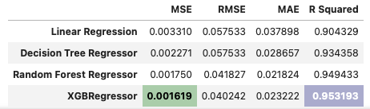
Model evaluation & comparison

Slide 13
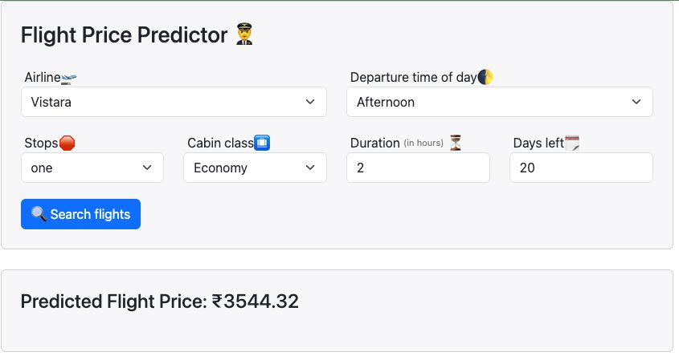
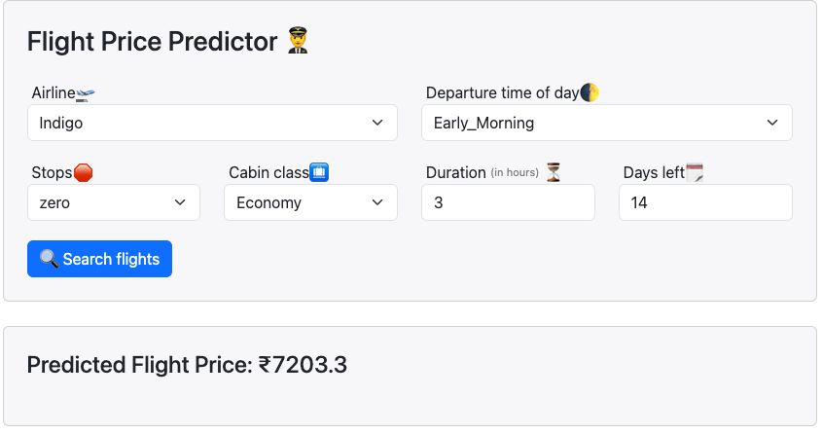
Model deployment
Deployed model to a flask application
Flask application takes input from end-users
Input is processed using the logic the training data was processed
Deployed model is loaded, and the predicted price is shown to end-users on the dashboard

Slide 14

Conclusion
We have successfully implemented and evaluated machine learning models to predict flight prices
Parameters used for predicting flight prices are airline, departure time, stops, cabin class, duration of flight and days left for flight
XGB model outperforms the other three models by accurately estimating the flight prices
Model can be used by end-users to predict flight thus helping them make an informed decision with regards to their travel booking
With incorporation of more flight routes and study of various parameters, this tool has the potential to disrupt travel booking industry.

Slide 15

THANK YOU!​

