Slide 1
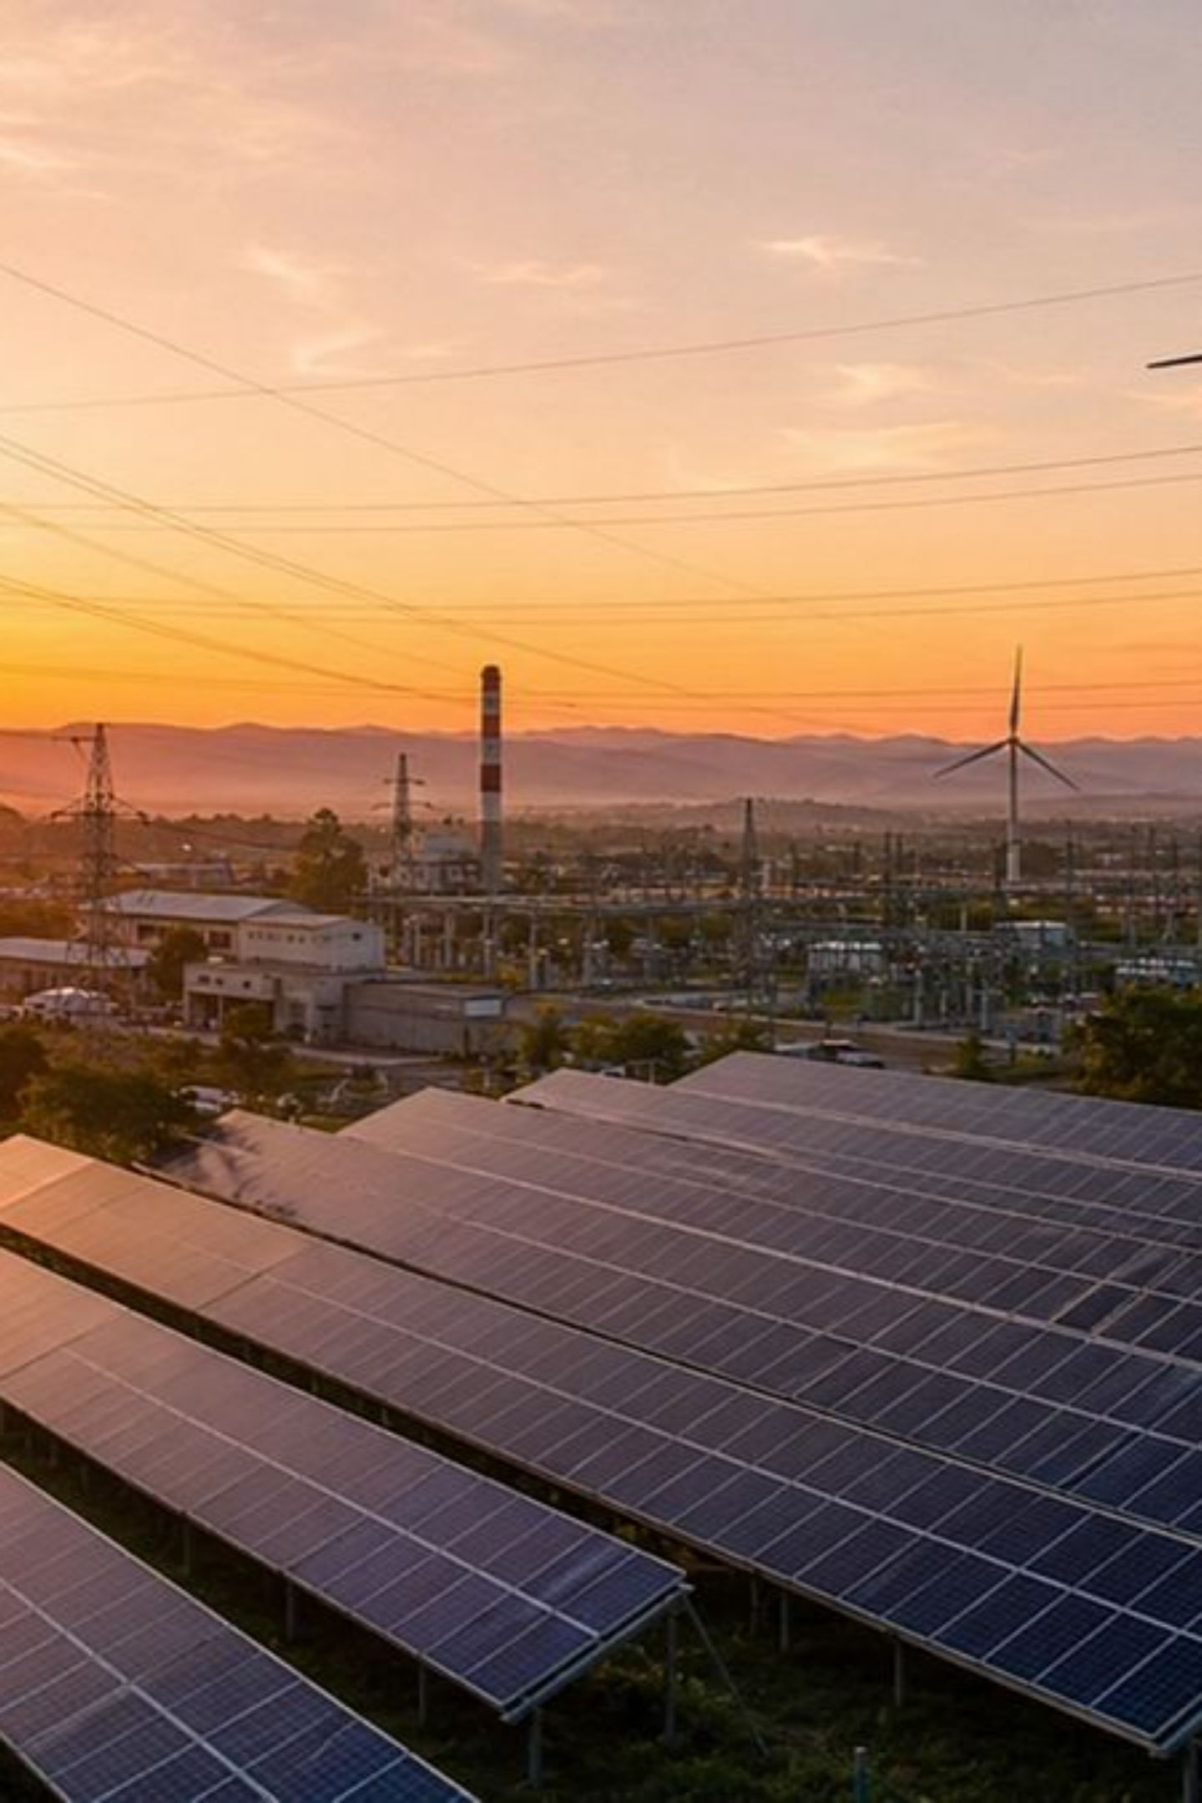
Environmental Protection & Emission-Reduction: India
Focused briefing condensed from a comparative study of Australia, USA, Japan, India, and Russia. This deck isolates India's laws, emission targets, and policy approach—framed to stand alone for policy briefings or stakeholder presentations. Sources: Indian Environment (Protection) Act, Air Act, Water Act, UNFCCC national documents; information current to August 2026.

Slide 2



Legal Framework for Environmental Protection
Primary Statutes
Project Safeguards
Waste & Conservation
India relies on the Environment (Protection) Act, Air (Prevention & Control of Pollution) Act, and Water (Prevention & Control of Pollution) Act as core national laws that regulate pollution, set standards, and enable enforcement across sectors.
Environmental Impact Assessment (EIA) procedures, waste-management rules, and forest/biodiversity safeguards are applied to projects to mitigate environmental harm and guide approvals.
Comprehensive waste-management regulations, recycling initiatives, and forest conservation laws underpin efforts to manage resources and protect ecosystems.

Slide 3

India’s Climate & Emissions Commitments (Key Targets)
India's updated climate commitments emphasize emissions intensity reduction and rapid deployment of non-fossil power: a 45% reduction in GDP emissions intensity from 2005 levels by 2030, and a target of about 50% cumulative electric-power installed capacity from non-fossil sources by 2030. These measures sit within a broader strategy of renewable expansion and energy-efficiency improvements.

Slide 4
Policy Instruments & Implementation Priorities
Renewable Energy
Accelerated deployment of solar, wind, and hybrid projects to reach the non-fossil electricity share target—includes grid upgrades and large-scale auctions.
Pollution Controls
Enforcement under Air and Water Acts, sectoral norms for industrial emissions, and EIA conditions for new projects.
Energy Efficiency
Programs to reduce energy intensity across industry, buildings, and appliances—complementing emissions-intensity goals.
Waste & Forests
Strengthening waste management, recycling schemes, and forest conservation to preserve carbon sinks and biodiversity.

Slide 5

How India’s Strategy Compares (Concise Context)
Development-focused
Renewables-first
Contrast with Others
Ambitious non-fossil capacity target (≈50% by 2030) positions renewables central to mitigation.
India pairs pollution control with development goals—targets emphasize emissions intensity rather than absolute cuts, reflecting economic growth priorities.
Unlike Australia and Japan’s legislated net-zero pathways or Russia’s forest-accounting emphasis, India emphasizes intensity reductions plus rapid renewable scale-up while maintaining development space.

Slide 6
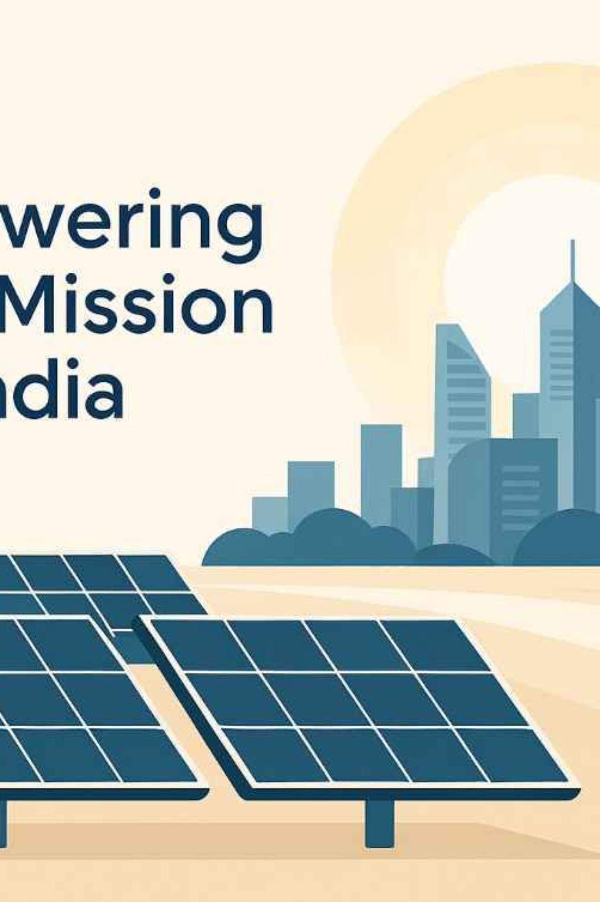

Conclusions & Near-Term Focus Areas
India combines robust pollution-control laws with a climate strategy centered on reducing emissions intensity and scaling non-fossil power. Near-term priorities: accelerate renewable auctions and storage, reinforce energy-efficiency programs, strengthen EIA and pollution enforcement, and protect forests to sustain carbon sinks. These actions support India’s 2030 and 2050 climate trajectory while balancing development needs.
Key figures: 45% reduction in GDP emissions intensity by 2030 (vs 2005); ~50% non-fossil installed power capacity by 2030. Information current to August 2026.

