Slide 1

A Markerless Augmented Reality System for Mobile Devices
Building Mobile And Web Apps
Ramanpreet Kaur & Mythri Manjunath
Master GSD
April 20 2017
Hochschule Fulda

Slide 2
Table of Contents
Paper summary
System Architecture
Implementation
Client Apps
Live Demo

Slide 3
Paper Summary
A Markerless Augmented Reality System for Mobile Devices
Research done by Alex Ufkes and Mark Fiala
Open CV and Android Platform
Experimental Results – mobile AR system recognizing a scene and drawing simple augmentation overlays (grid lines and cube).

Slide 4
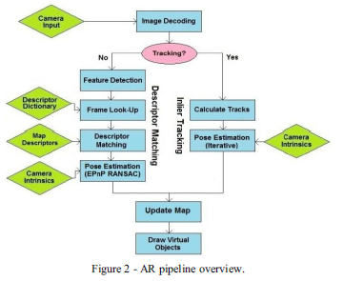
Existing System Architecture

Slide 5
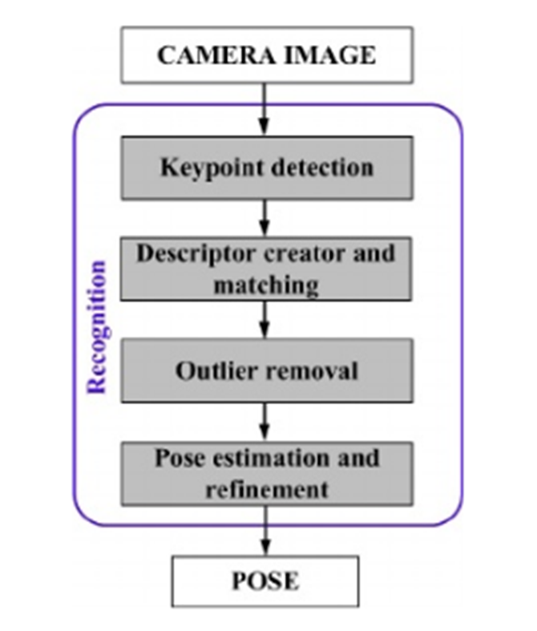
Planned System Architecture

Slide 6
Implementation
Open CV
Android Platform
Unity 3D
Android Studio

Slide 7
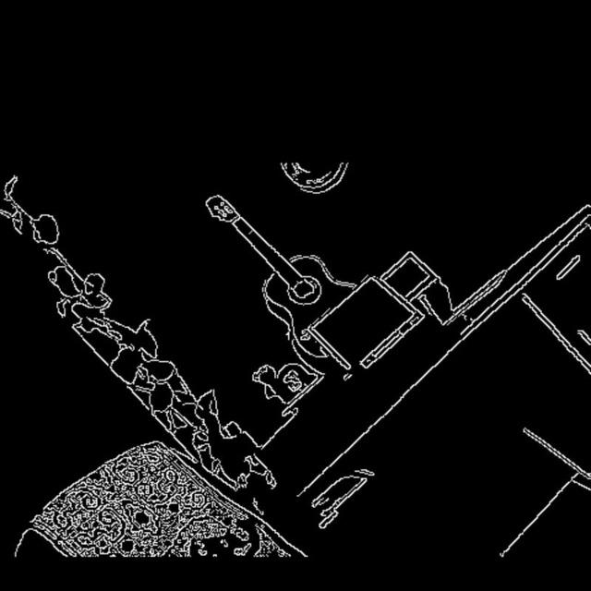
Client Apps
Output of Feature Detection

Slide 8
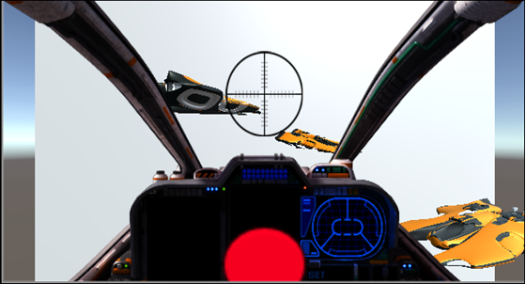
Client Apps
Output of Jet Fighter

Slide 9
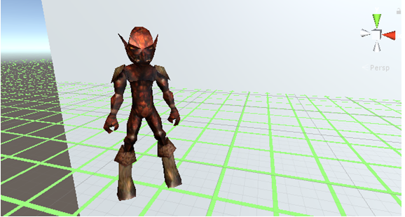
Client Apps
Output of 3D Augmentation Overlay

Slide 10
Thank You!

