Slide 1
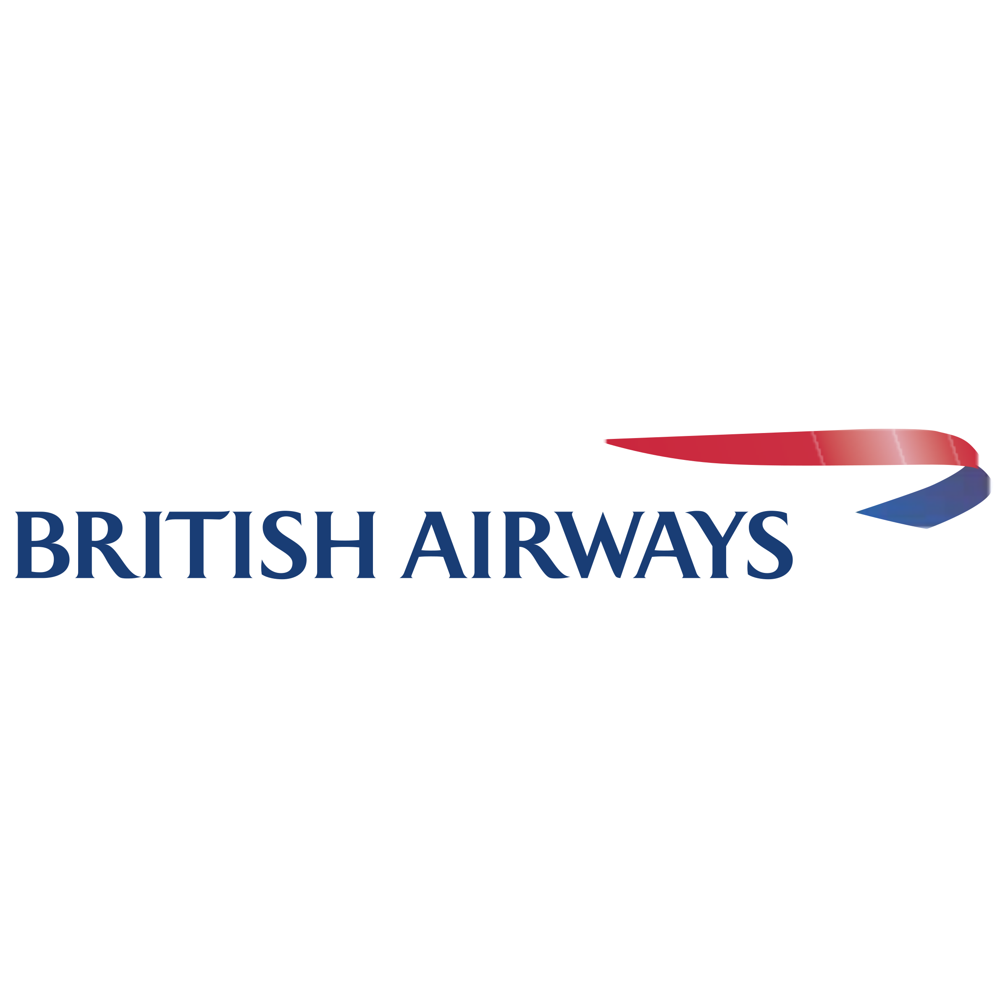
To Fly. To Serve.
An Insight and Analysis of Customer Ratings

Slide 2
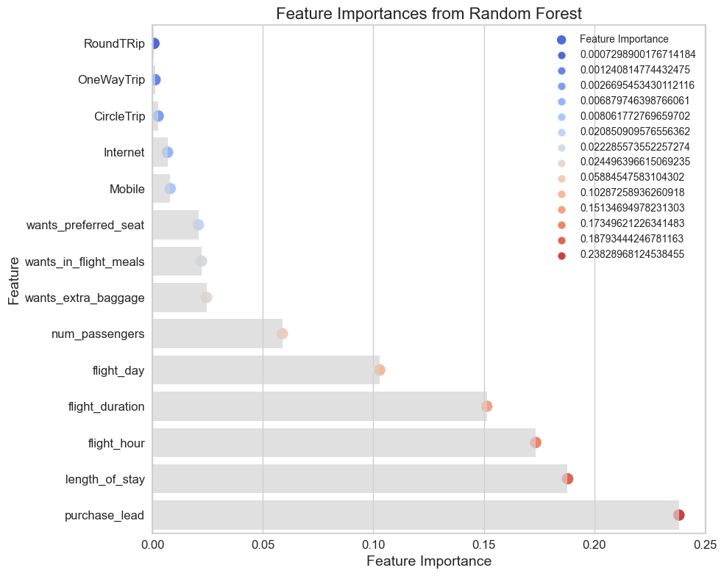
Precision Rate
60%
Trip Type
97%
Will be predicted as successful completed bookings
Will be Predicted to take to Round Trip While 3% people will take OneWayTrip.
88% People will be predicted as booking through internet and12% people will book through mobile phone
Booking
88%
Accuracy
65%
Accuracy of the model predicting successful or incomplete booking is
Accuracy can be increased if dataset provided can be balanced it can be more balanced
This Graph represents which features are more important to customers

