Slide 1

To Fly. To Serve.
An Insight and Analysis of Customer Ratings

Slide 2
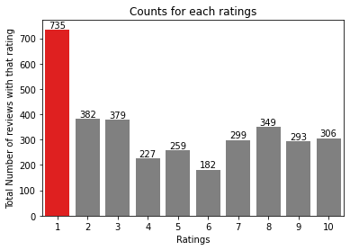
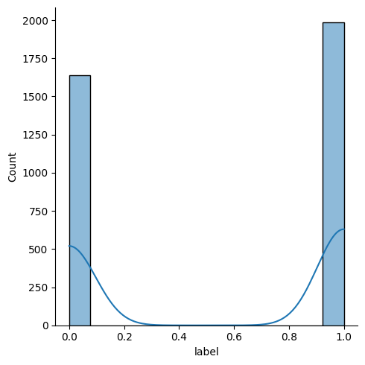
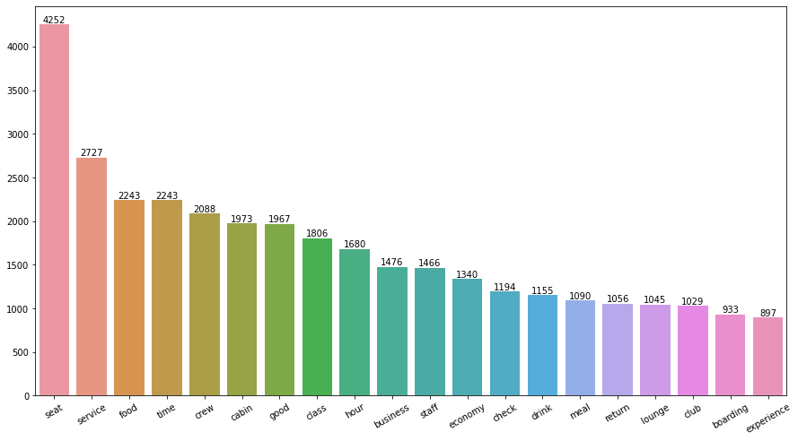
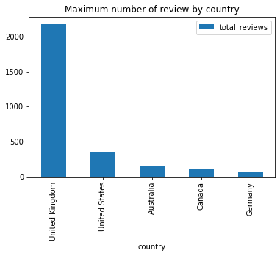

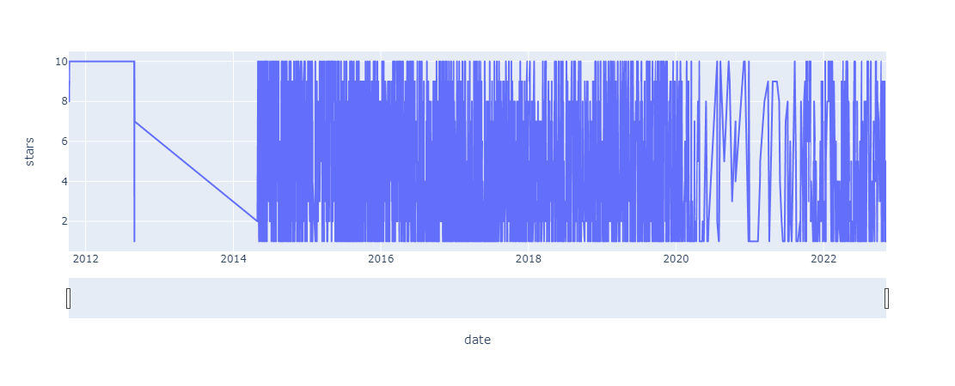
This Graph Provides Number of Reviews versus how much rating customer gave as feedback.
<- This Graph gives us idea on Positive and negative sentiments of people where 0 being negative and 1 being positive
This graph shows what customer have talked about majorly.
This Graph Provides Insights on from which country the reviews are mostly originated
This Graph shows the timeline of customer review the low density area shows the covid affected time

