Slide 1

Market Research Analysis - RFM:
Project Report
BY : Preetam Sarmah - PGPDSBA.O.JAN23.A
Proprietary content. © Great Learning. All Rights Reserved. Unauthorized use or distribution prohibited.

Slide 2
Table of Contents
Problem Statement
About Data
Business Overview
Exploratory Analysis
RFM
Inferences and Conclusion

Slide 3
Problem Statement
An automobile parts manufacturing company has collected data on transactions for 3 years. Tasked to find the underlying buying patterns of the customers, provide the company with suitable insights about their customers, and recommend customized marketing strategies for different segments of customers.

Slide 4
About Data
The Dataset has 2747 entries pertaining to different orders placed in the past 3 years
The Dataset has 20 different attributes for all the 2747 different orders placed.
There are 11 Object (String ) attributes , 1 Date attribute and 8 Numerical Attributes
The Dataset has no missing values
The Dataset has no duplicate values
The Dataset has 89 unique customers
Median Quantity Ordered is 35 and Average is around 35, so quantity ordered has negligible skew and follows a normal distribution.

Slide 5
Business Overview
Total Sales
Total Orders
Total Customers
Top Country
9.76 M
2747
89
USA
Last Ǫtr Revenue
Avg Order Recency
Top Customer
Top Product
Top City
1757 Days
Euro Shopping
Channel
Classic Cars
Madrid

Slide 6
Exploratory Analysis

Slide 7
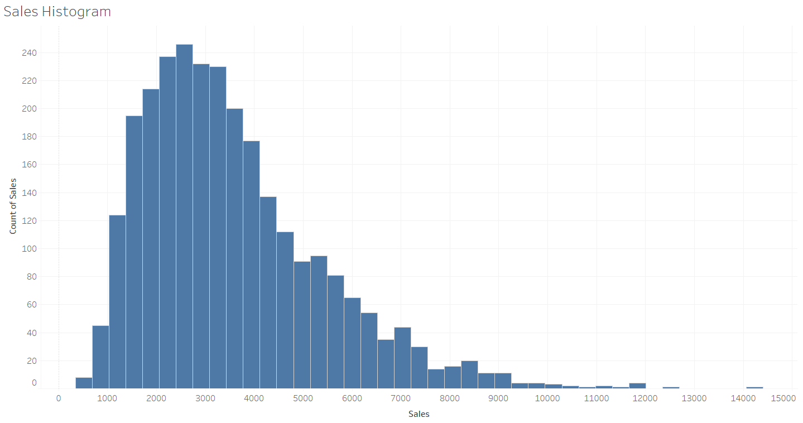
Univariate Analysis
The most sales are between 1300 and 3500 $
The lower sales account for the maximum volume of sales

Slide 8
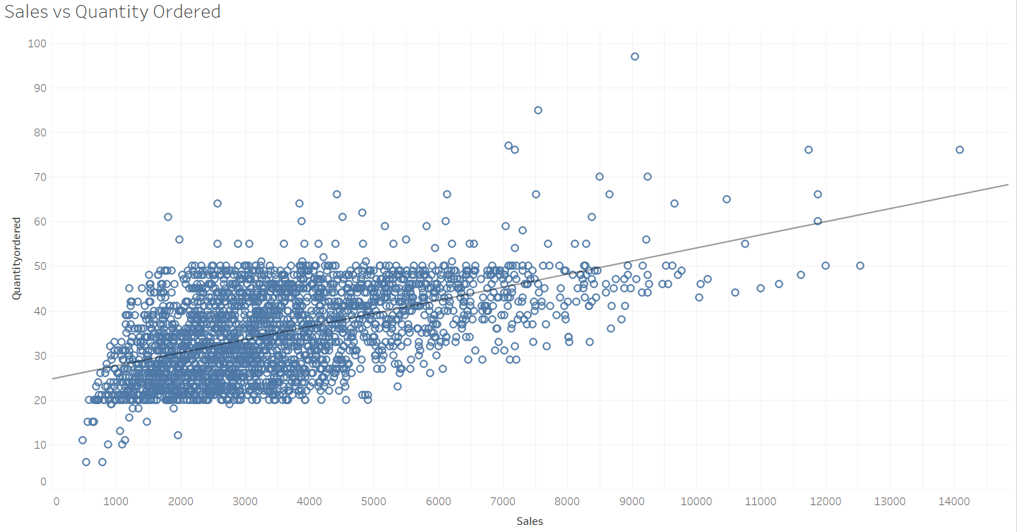
Bivariate Analysis
Quantity Ordered and the Sales show a positive relation, i.e as the quantity ordered increases , the sales also increases.

Slide 9
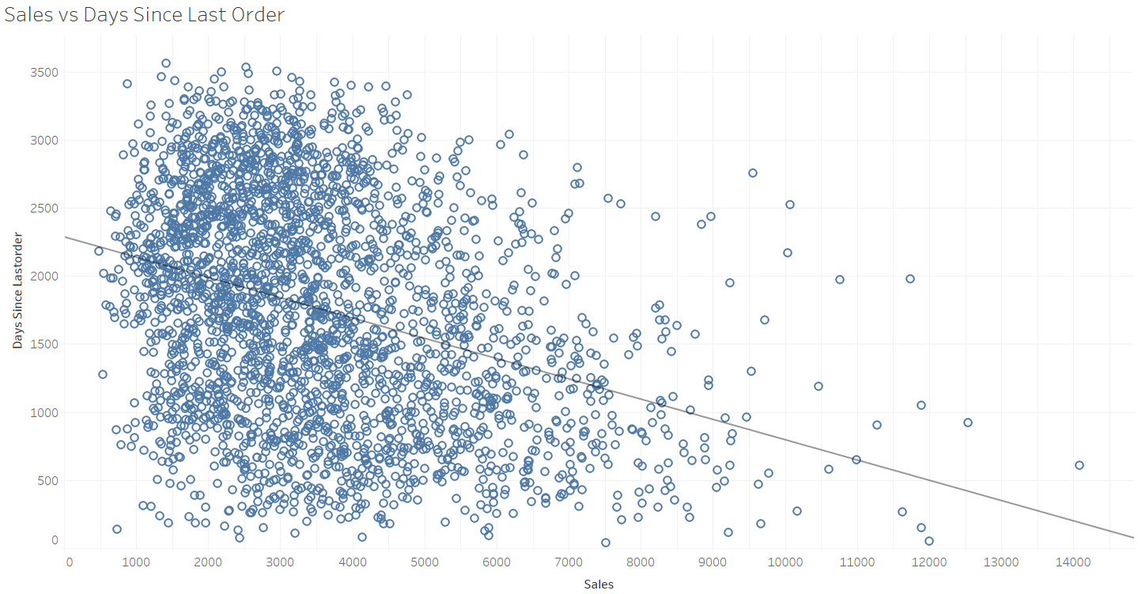
Bivariate Analysis
Days since last order and the Sales show a negative relation, i.e. as the Days since last order increases , the sales decreases.
This can be attributed to the infrequent order frequency which ultimately results in less sales.

Slide 10
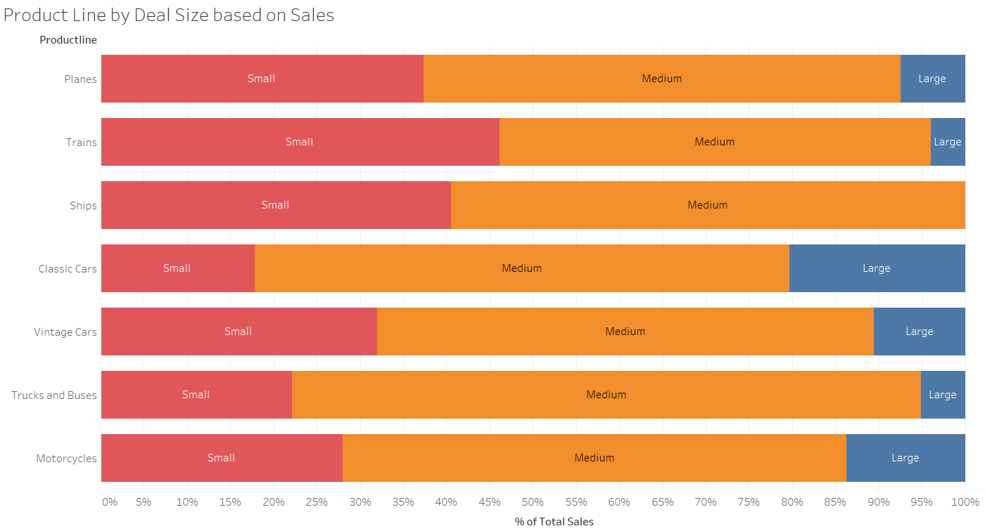
Multivariate Analysis
Classic Cars are by far their most popular product line.
Medium deal sizes account for 50% or more sales for each product line.
Ships have only small and medium deal sizes.

Slide 11
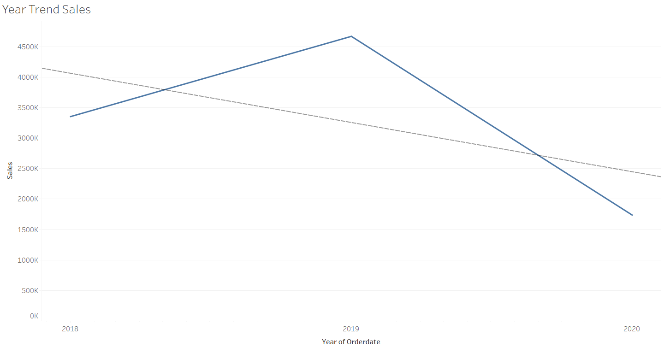
Yearly Trend in Sales
Sales shows an increase from 2018 to 2019.
Sales shows a decrease from 2019 to 2020.
The dip in sales from 2019 to 2020, might be likely due to us only having data for Q1,Q2

Slide 12
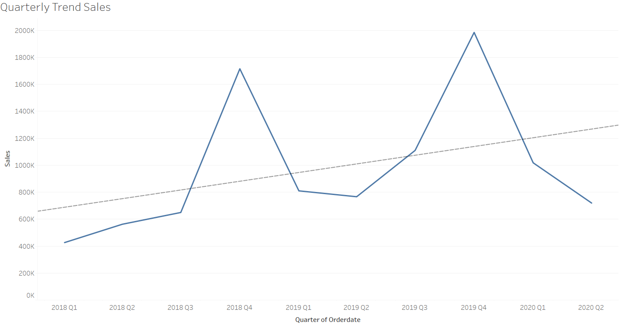
Quarterly Trend in Sales
Q1 to Q4 for each year shows a increasing trend in sales.
Q4 displays some seasonality as every year sees a spike in Q4 sales.
Q4 of previous year to Q1 of current year shows a dip in sales

Slide 13
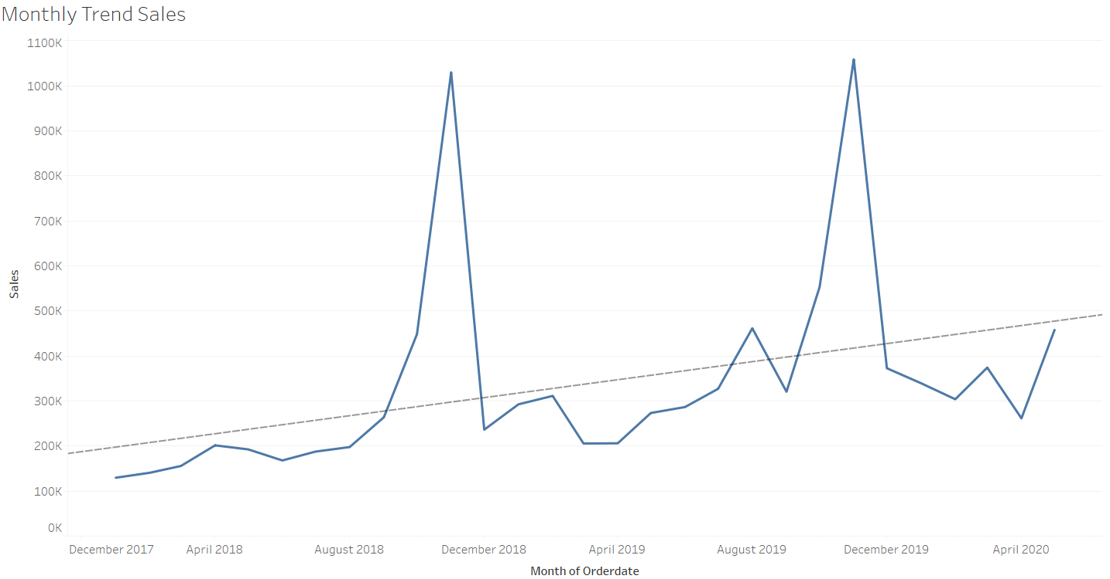
Monthly Trend in Sales
There is seasonality in data.
The sales gradually increases every month and peaks in November every year.

Slide 14
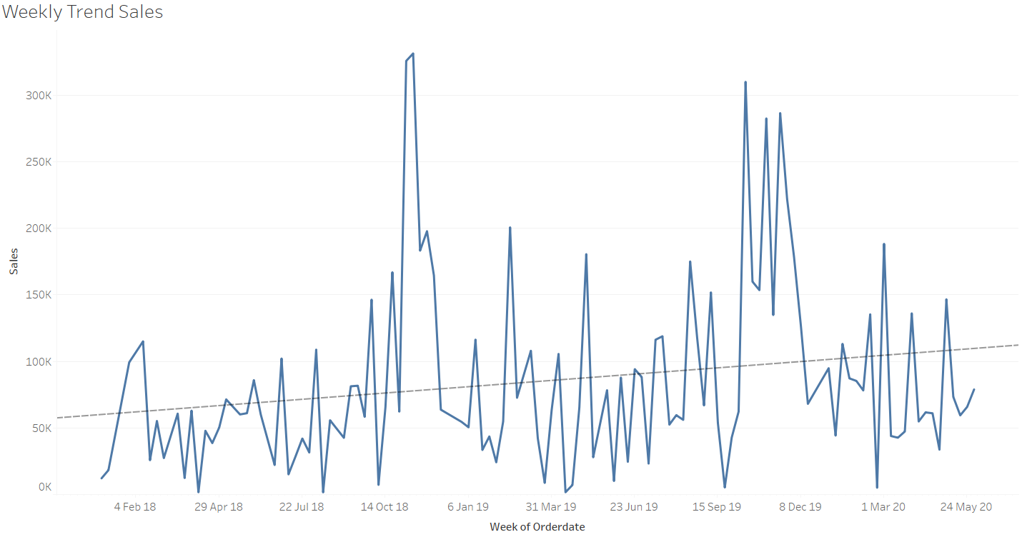
Weekly Trend in Sales
Sales in each week gradually increases from Monday to Sunday.
Weekend sales far exceed the weekday sales in most cases , likely due to people having off from work.

Slide 15
RFM

Slide 16
RFM – Recency, Frequency, Monetary
The recency, frequency, monetary (RFM) model assigns an establishment’s customer base a particular trait, which can be used to segment the customers and drive business decisions.
For each attribute (recency, frequency, and monetary value), customers are given a score from 1 (lowest) to 5 (best) based on their observed purchasing behavior.
In our model , The customers are segmented into 4 Tiers – Tier 1, Tier 2, Tier 3, Tier 4; based on the quantile their respective R,F,M values lie. Tier 1 being the Best and Tier 4 being the lowest.
Assumptions
The RFM model is based on the assumption that customers who has purchased more recently, have placed more orders, and that customers who spend more money with the business are likely to be more valuable and are more likely to shop again than those that have not.

Slide 17
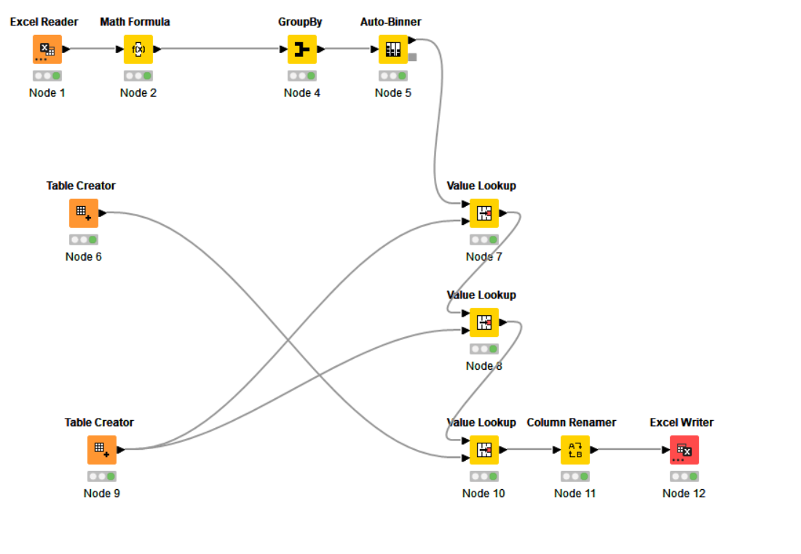
KNIME Workflow

Slide 18
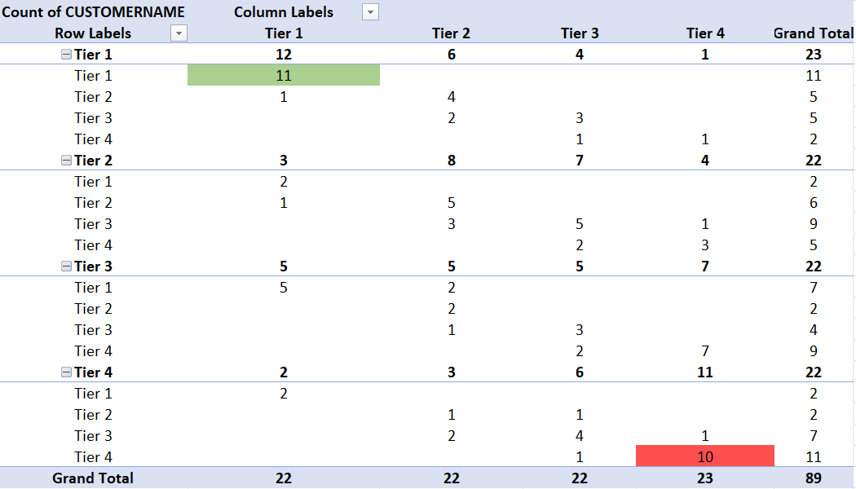
Segmentation
All the 89 customers have been segmented based on R,F ( rows) and M (columns) values into Tier 1, Tier 2 , Tier 3, Tier 4.
We have 11 best customers and 10 customers are almost lost

Slide 19
Inferences and Conclusion

Slide 20
Best Customers
Criteria : Tier 1 – Recency , Tier 1 – Frequency and Tier 1 - Monetary
We have a total of 11 customers that can be classified as Best Customers
Anna's Decorations, Ltd
Australian Collectors, Co.
Euro Shopping Channel
La Rochelle Gifts
Land of Toys Inc.
Mini Gifts Distributors Ltd.
Online Diecast Creations Co.
Salzburg Collectables
Souveniers And Things Co.
Technics Stores Inc.
The Sharp Gifts Warehouse

Slide 21
Lost Customers
Criteria : Tier 4 – Recency , Tier 4 – Frequency and Tier 4 - Monetary
We have a total of 10 customers that can be classified as Lost Customers
Alpha Cognac
Auto-Moto Classics Inc.
Bavarian Collectables Imports, Co.
Clover Collections, Co.
Double Decker Gift Stores, Ltd
Gift Ideas Corp.
Iberia Gift Imports, Corp.
Mini Auto Werke
Royale Belge
Signal Collectibles Ltd.

Slide 22
Loyal Customers
Criteria : Tier 1 – Recency , Tier 2 or 3 – Frequency and Tier 2 or 3 - Monetary
We have a total of 9 customers that can be classified as Loyal Customers
Auto Canal Petit
Baane Mini Imports
Collectables For Less Inc.
FunGiftIdeas.com
Gift Depot Inc.
Gifts4AllAges.com
Oulu Toy Supplies, Inc.
Quebec Home Shopping Network
UK Collectables, Ltd.

Slide 23
Almost Churned Customers
Criteria : Tier 4 – Recency , Tier 2 or 3 – Frequency and Tier 3 or 4 - Monetary
We have a total of 6 customers that are on the verge of churning.
Australian Collectables, Ltd
Blauer See Auto, Co.
Enaco Distributors
Marseille Mini Autos
Norway Gifts By Mail, Co.
Signal Gift Stores

Slide 24
Thank You

