Slide 1

Market Research Analysis – MBA:
Project Report
BY : Preetam Sarmah - PGPDSBA.O.JAN23.A
Proprietary content. © Great Learning. All Rights Reserved. Unauthorized use or distribution prohibited.

Slide 2
Table of Contents
Problem Statement
About Data
Exploratory Analysis
Market Basket Analysis
Associations Identified
Inferences and Conclusion

Slide 3
Problem Statement
A grocery store shared the transactional data with you. Tasked to conduct a thorough analysis of Point of Sale (POS) data, identify the most commonly occurring sets of items in the customer orders, and provide recommendations through which a grocery store can increase its revenue by popular combo offers & discounts for customers.

Slide 4
About Data
The Dataset has 20641 entries in the dataset.
The Dataset has 3 different attributes for all the 20641 different orders placed.
There is 1 Object (String ) attributes , 1 Date attribute and 1 Numerical Attribute.
The Dataset has no missing values.
There are 37 unique products.
The Top 3 products being poultry, soda, cereals respectively.

Slide 5
Exploratory Analysis

Slide 6
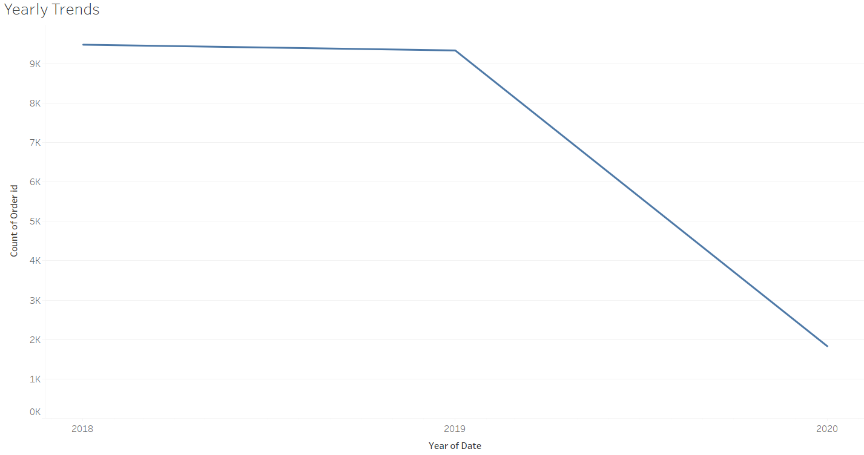
Yearly Trend in Sales
No of Orders shows an slight decrease from 2018 to 2019.
The decrease in No of Orders ,shows a sharp decline from 2019 to 2020.

Slide 7
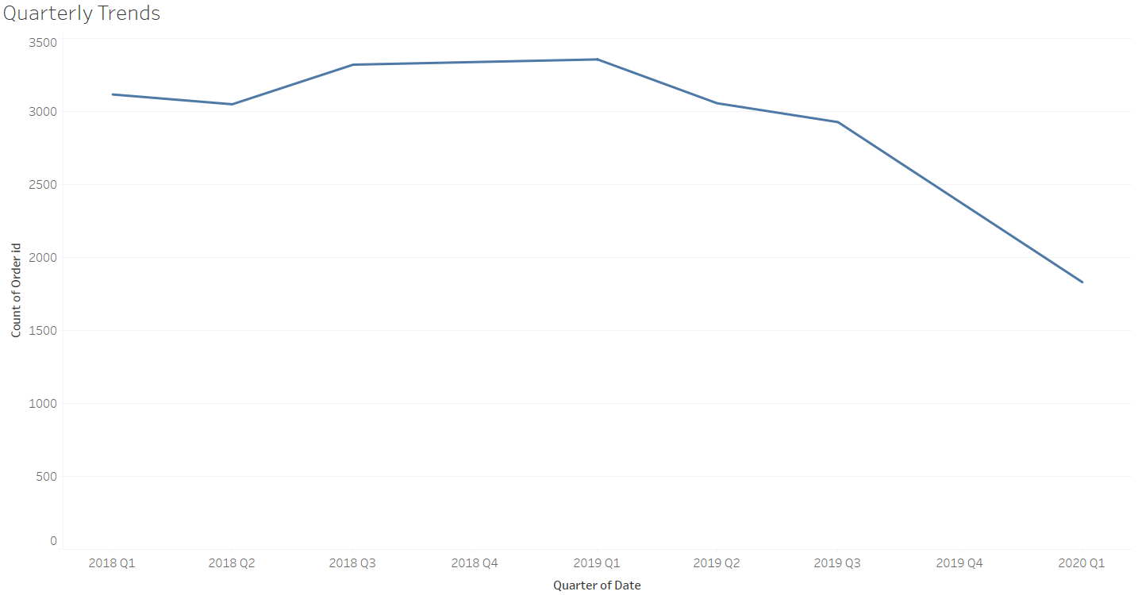
Quarterly Trend in Sales
Q1 of 2019 , saw the highest number of orders.
Q1 of 2020, saw the lowest number of orders.

Slide 8
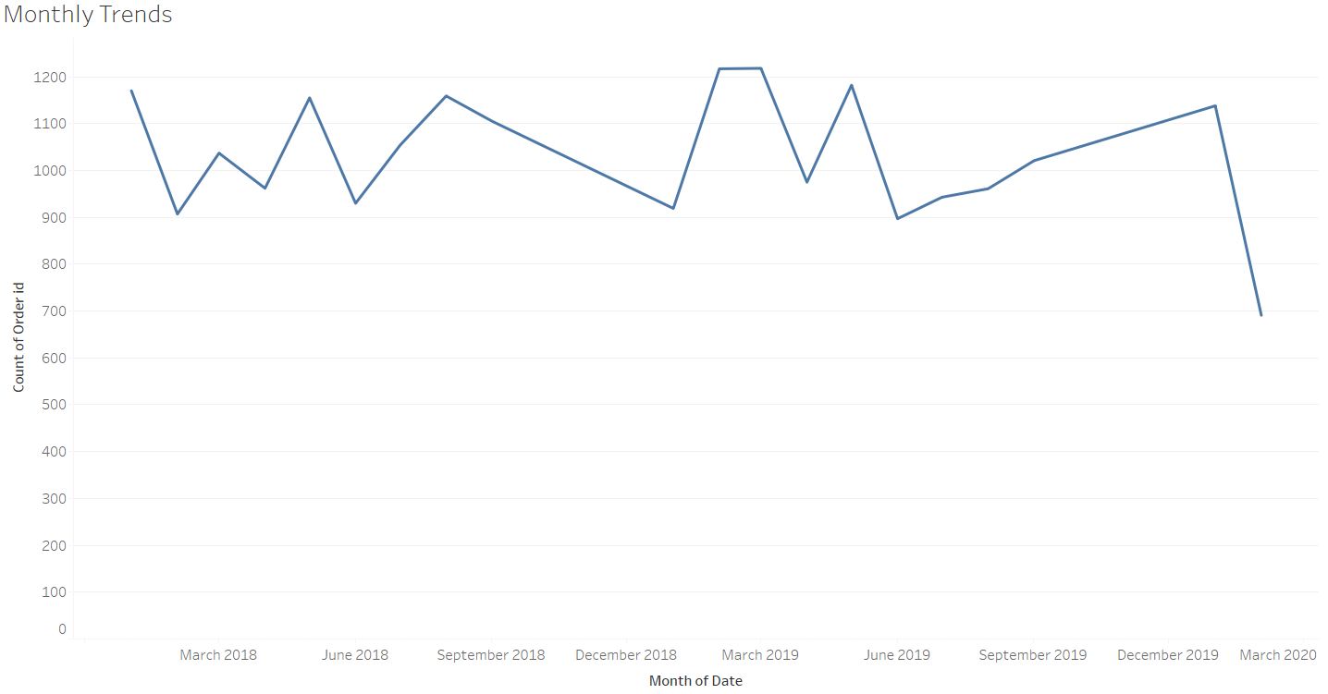
Monthly Trend in Sales
The Months are not continuous, there are missing details between September 2018 and January 2019.

Slide 9
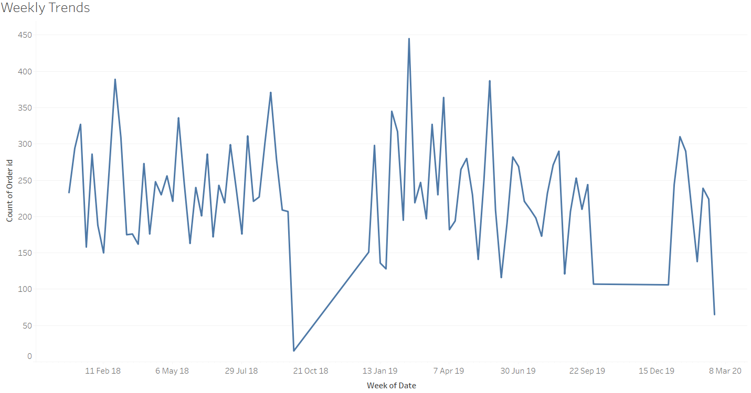
Weekly Trend in Sales
Sales in each week gradually increases from Monday to Sunday.
Weekend sales far exceed the weekday sales in most cases , likely due to people having off from work.

Slide 10
Market Basket Analysis

Slide 11
Market Basket Analysis – Association Rules
Market basket analysis is a data mining technique used by retailers to increase sales by better understanding customer purchasing patterns.
The output is that a certain product groupings go well together and suggestion of products based on the current products selected i.e. a market basket
Association rules are "if-then" statements, that help to show the probability of relationships between data items, within large data sets.
E.g. If a customer buys a Mobile Phone, the act of suggesting a screen protector

Slide 12
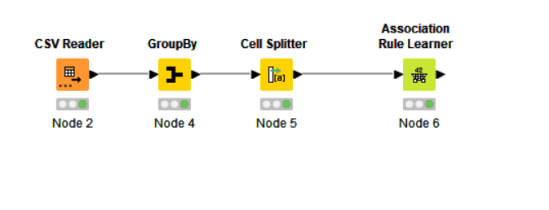
KNIME Workflow
The Association Rule Learner of the workflow uses the support at 0.05 and confidence at 0.6, which returns 24 rules.
This is about right in terms of quantity of Association Rules as well as confidence.

Slide 13
Associations Identified

Slide 14
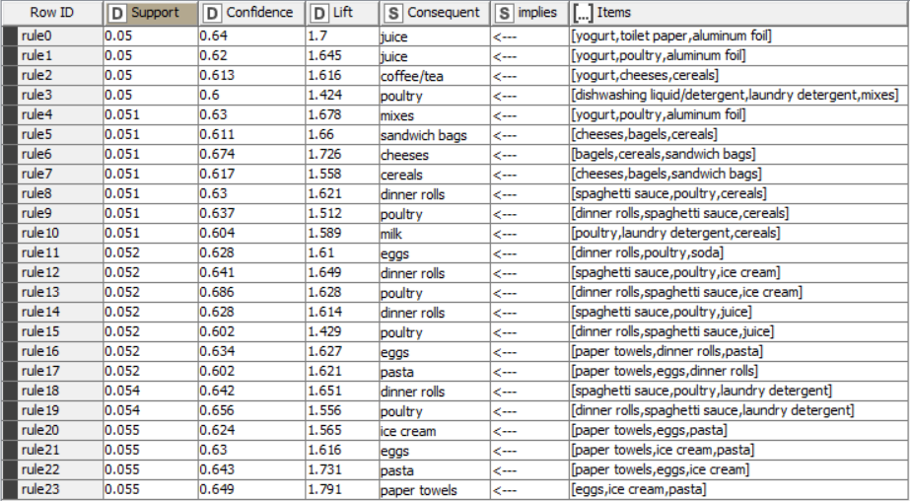
Rules

Slide 15
Support: Support is the evidence of how many times an item appears in the data. The workflow the Support threshold is set to minimum of 0.05 Confidence: Confidence is defined by how many times the if-then statements are found true. The workflow the confidence threshold is set to minimum of 0.6 Lift: Lift measures the performance of a targeting model at predicting a specific outcome compared with a random choice. Therefore, Lift is the ratio between target and average response. Lift > 1 – increases chance of the outcome Lift = 1 – No affect on outcome Lift < 1 - decreases chance of the outcome

Slide 16
Inferences and Conclusion

Slide 17
Recommendations:
Note : When a basket of products implies a recommended product and another basket of different products also implies the same recommended product.
Then the Rule which has a higher lift will hold strong.
A basket of yogurt, toilet paper, aluminum foil will recommend Juice
A basket of dinner rolls, spaghetti sauce, ice cream will recommend poultry.
A basket of paper towels, dinner rolls, pasta will recommend eggs.
A basket of yogurt, cheeses, cereals will recommend tea/coffee.
A basket of eggs, ice cream, pasta will recommend paper towels.
A basket of yogurt, poultry, aluminum foil will recommend mixes.
A basket of bagels, cereals, sandwich bags will recommend cheeses.
A basket of cheeses, bagels, cereals will recommend sandwich bags.

Slide 18
Marketing Strategies
Buy Bagels , Cereal, cheese and sandwich bag for 25% off on bundle.
Buy Eggs, Ice Cream , Pasta and Paper Towels for 25 % off on the bundle.
Buy Spaghetti sauce, Poultry, Cereal, Dinner rolls and get ice cream absolutely free.
Get upto 50% off on Laundry Detergents and Liquid Dishwashes on every purchase on Groceries .

Slide 19
Thank You

