Slide 1
WEEK — 01
🌐 IoT
IoT, Embedded
Systems &
Robotics
⚙️ Embedded
Systems &
🤖 Robotics
🔧 CNC
💡 Sensors
📡 Actuators
CNC · Microcontrollers · Sensors · Actuators · Projects

Slide 2
Table of Contents
Topics covered in this presentation
01
IoT, Embedded Systems & Robotics
Definitions, differences, applications
02
CNC Machines & G-code
What is CNC, PCB fabrication, G-code commands
03
Microcontrollers
Definition, uses, Bangladesh availability & price
04
Sensors & Actuators
Types, functionalities, applications
05
Real-Life System Examples
Traffic light system & smart farm automation

Slide 3
IoT(Internet of Things)
Section 1.1.1 — Definition & Overview
What is IoT?
The Internet of Things (IoT) refers to a network of physical objects — "things" — embedded with sensors, software, and connectivity that enable them to collect and exchange data over the internet, without requiring human-to-human or human-to-computer interaction.
Key Areas of IoT:
Smart Home
Industrial IoT (IIoT)
Healthcare & Wearables
Smart Agriculture
Smart Cities
Retail & Supply Chain

Slide 4
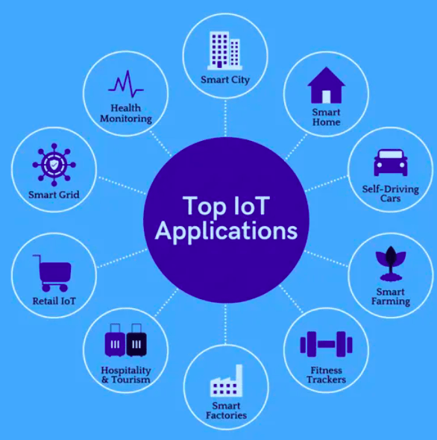
1.1.2 Applications:
Internet of Things — Real-World Use Cases
🏠 Smart Home
🌾 Smart Agri
Automated lighting, security cameras, thermostats, voice assistants
Soil monitoring, drone irrigation, smart greenhouses
🏭 Industrial IoT
🏙️ Smart Cities
Predictive maintenance, asset tracking, process automation
Traffic management, waste management, smart grids
🏥 Healthcare
🛒 Retail & Supply
Patient monitoring, smart hospitals, wearable health trackers
Inventory tracking, automated checkouts, cold chain

Slide 5
Embedded System
Section 1.2.1 — Definition & Overview
What is Embedded System?
An embedded system is a small computer system designed to perform a specific task inside a larger system. It consists of a processor, memory, and input/output units. Embedded systems are used in devices with size, cost, power, or weight limitations.

Slide 6
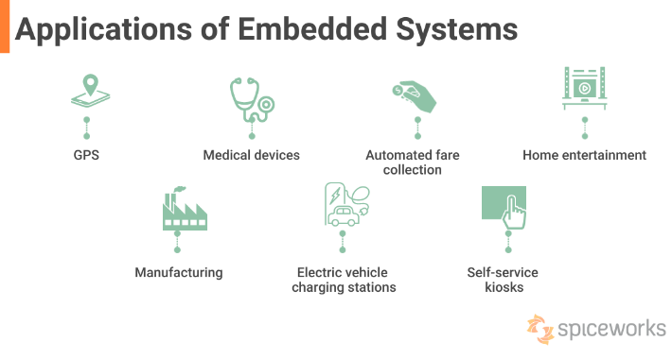
1.2.2 Applications:
Embedded Systems — Use Cases
GPS Systems — Navigation devices with real-time positioning
Medical Devices — Pacemakers, insulin pumps, diagnostic tools
Automotive Systems — ABS, ECU, ADAS, infotainment
Automated Fare Collection — Smart card ticketing systems
Home Entertainment — Smart TVs, set-top boxes, gaming consoles
ATM Machines — Cash dispensing and secure transactions
Manufacturing & Robotics — Industrial automation and control
EV Charging Stations — Battery management and billing
Self-Service Kiosks — Check-in, ordering, and ticketing

Slide 7
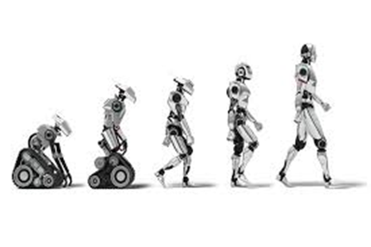
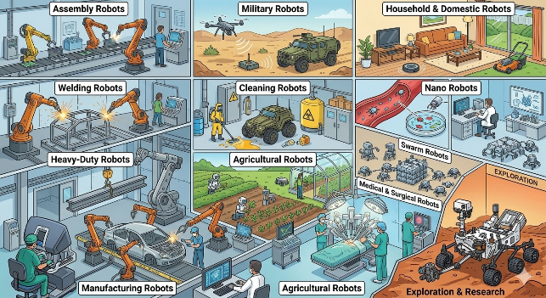
Robotics
Section 1.3.1 — Definition & Overview
What is Robotics?
Robotics is the branch of engineering that involves the design, construction, operation, and use of robots. These are machines capable of carrying out complex tasks automatically. Robots sense their environment, process information, and perform physical actions.
Types of Robots:
Assembly Robots
Welding Robots
Manufacturing Robots
Military Robots
Cleaning Robots
Agricultural Robots
Household & Domestic Robots
Nano Robots
Swarm Robots

Slide 8
1.3.2 Applications:
Robotics — Use Cases Across Industries
Assembly Robots Used in industries for assembling products automatically.
Welding Robots Used for seam welding and other industrial welding tasks.
Heavy-Duty Robots Used for lifting heavy materials and industrial operations.
Manufacturing Robots Used in factories and automobile industries for fast and accurate production.
Military Robots Used for bomb detection, surveillance, and dangerous military operations.
Cleaning Robots Used for cleaning toxic waste and hazardous industrial areas.
Agricultural Robots Used for farming, planting, harvesting, and monitoring crops.
Household & Domestic Robots Used for home cleaning and daily household tasks.
Nano Robots Tiny robots used in medical and scientific applications.
Swarm Robots Groups of robots working together to complete tasks efficiently.

Slide 9
Difference between IoT, Embedded System, and Robotics
1.4 Comparative Overview
Feature | IoT | Embedded System | Robotics
Definition | Network of connected objects | Dedicated computer in a product | Machines that perform tasks automatically
Main Focus | Connectivity & data exchange | Specific task execution | Physical action & motion
Internet | Essential ✅ | Not required ❌ | Optional ⚡
Physical Action | Indirect | Often limited | Core requirement ✅
Human Interact. | Minimal | Minimal | Can be autonomous
Examples | Smart thermostat, GPS tracker | Washing machine, ABS | Surgical robot, drone, arm
Uses Embedded? | Yes — as backbone | Is the core | Yes — embedded inside

Slide 10
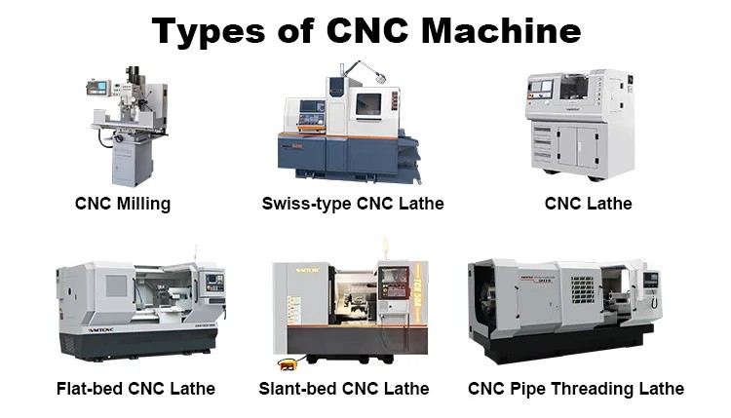
What is CNC?
Computer Numerical Control — Section 2
CNC (Computer Numerical Control) is the automated control of machining tools — such as drills, mills, lathes, routers, and laser cutters — using pre-programmed software and numerical codes. Rather than manual operation, a computer reads instructions and precisely moves cutting tools across multiple axes (X, Y, Z) to shape raw material into finished parts.
Key Advantages:
Precision — sub-millimeter accuracy
Repeatability — identical parts every run
Speed — faster than manual machining
Complexity — intricate shapes impossible by hand
Safety — reduces operator exposure to danger

Slide 11
Role of CNC Machines in PCB Fabrication
How CNC is used in circuit board manufacturing
Drilling Via Holes
Copper Trace Milling
🔩
CNC drill machines bore hundreds of tiny holes (vias, through-holes) into PCB blanks with ±0.05mm or better positional accuracy — impossible to achieve by hand.
🗂️
CNC milling machines remove copper layers to create isolation channels and traces, making chemical-free single-layer circuit boards (ideal for prototyping).
Board Routing & Depaneling
Speed & Quality Control
✂️
CNC routers cut individual PCBs from large panels along exact outlines defined in Gerber/CAM files, producing clean edges and consistent board dimensions.
🎯
CNC automation dramatically increases throughput, reduces human error, ensures batch-to-batch consistency, and enables rapid design iteration.

Slide 12
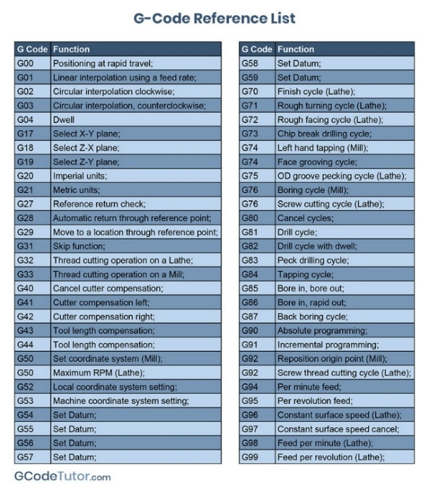
Basic Idea of G-code
The language of CNC machines
G-code (Geometric Code) is the most widely used numerical control (NC) programming language. It tells a CNC machine what to do — where to move, how fast to move, and along what path — using simple alphanumeric commands.
G-code Building Blocks:
G words
Preparatory commands that set motion modes (e.g., G00 rapid move, G01 linear cut, G02 arc CW)
M words
Miscellaneous machine functions — spindle on/off, coolant, program stop/end
F word
Feed rate — controls how fast the tool moves during cutting operations
T word
Tool selection — specifies which tool from the magazine to use
S word
Spindle speed — sets RPM of the cutting spindle

Slide 13
What do (G00, G01, G02, G03, G90, G91, G92, F, M03, M04, M05, T, M06, M08, M09, M00, M30) these mean in G-code?)
G-code Command Reference
Code | Name | Meaning
G00 | Rapid Positioning | Moves tool at max speed — no cutting
G01 | Linear Interpolation | Straight-line cut at controlled feed rate (F)
G02 | Circular Interp. (CW) | Clockwise circular arc at feed rate
G03 | Circular Interp. (CCW) | Counter-clockwise arc at feed rate
G90 | Absolute Positioning | Coordinates measured from fixed origin
G91 | Incremental Posit. | Coordinates relative to current position
G92 | Set Coordinate System | Redefines current position as new origin
F | Feed Rate | Speed of tool movement during cutting (mm/min)
M03 | Spindle ON (CW) | Starts spindle motor clockwise at set RPM
Code | Name | Meaning
M04 | Spindle ON (CCW) | Starts spindle motor counter-clockwise
M05 | Spindle OFF | Stops the spindle motor
T | Tool Select | Selects tool from magazine (e.g. T01 = tool #1)
M06 | Tool Change | Executes the physical tool swap in spindle
M08 | Coolant ON | Activates coolant pump/spray
M09 | Coolant OFF | Deactivates coolant system
M00 | Program Stop | Pauses program; waits for operator input
M30 | End & Reset | Ends program, rewinds to beginning

Slide 14
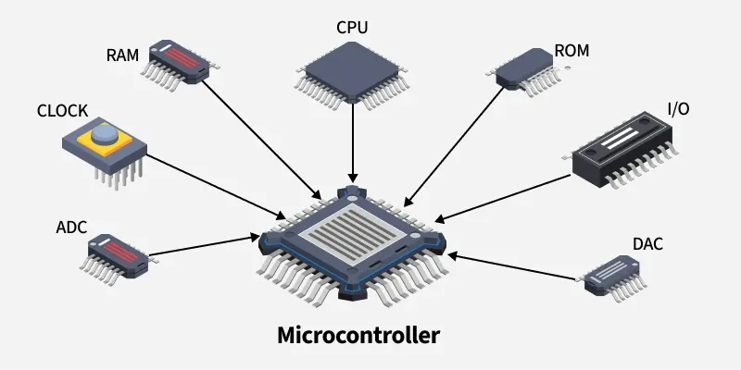
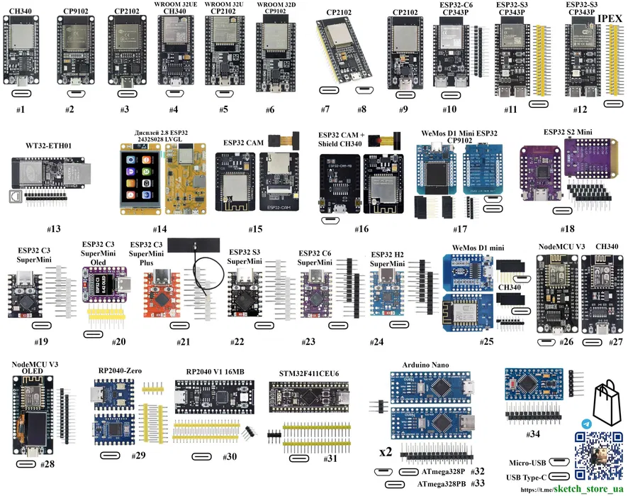
What is a Microcontroller?
Section 3 — Definition & Components
A microcontroller (MCU) is a compact integrated circuit (IC) that houses a processor (CPU), memory (RAM + Flash/ROM), and programmable input/output peripherals — all on a single chip. It is designed to run one specific embedded application with limited resources.
On-chip Components:
CPU — Central Processing Unit for instruction execution
Flash / ROM — Program memory (stores firmware)
RAM — Data memory for runtime variables
ADC / DAC — Analog-to-digital & digital-to-analog converters
GPIO — General Purpose Input/Output pins
Timers/PWM — Timing and PWM signal generation
UART / SPI / I2C — Serial communication protocols

Slide 15
Why microcontrollers are used?
Applications & Motivation
💰
Low Cost
⚡
Low Power Consumption
🎯
Task-Specific Efficiency
MCUs are extremely affordable (pennies to a few dollars), integrating CPU, memory, and I/O on one chip, removing the need for multiple discrete components.
Designed for efficient operation, MCUs can run for years on a battery in sleep modes — ideal for IoT sensors, wearables, and remote devices.
No OS overhead, no unused processing power. Real-time deterministic response is predictable and fast for the dedicated task.
📦
Compact & Integrated
🔧
Ease of Programming
🏭
Broad Application Fields
Entire control systems fit on a fingernail-sized chip, reducing PCB area, weight, and assembly complexity.
Supported by C/C++, MicroPython, Arduino IDE, and visual tools, lowering the barrier for rapid prototyping and development.
Consumer Electronics · Automotive Industry · Medical Devices · Industrial Automation · Communication Systems

Slide 16
A list of available microcontrollers in Bangladesh
With approximate prices (BDT) — 2025
Microcontroller / Development Board | Approximate Price (BDT)
Arduino Boards
Arduino Uno R3 | 949
Arduino Nano (ATmega328) | 363
Arduino Pro Mini 328 (5V/16MHz) | 430
Arduino UNO R4 Minima 32bit 48MHz | 1,650
Arduino Pro Micro Atmega32U4 5V/16MHz | 680
ESP & Wireless Microcontrollers
ESP32 NodeMCU Development Board Wireless Wifi | 427
ESP8266 NodeMCU Lua V3 | 350
ESP32-CAM (with Camera Module) | 940
ESP32-S3 Microcontroller 2.4 GHz Wi-Fi Development Board | 1,590
ESP32 C6 DevKit-C N16R8 | 950
Wemos D1 Mini ESP8266 | 320
📍 Available at: Robotics BD · TechShop BD · BDTronics · Robotech BD

Slide 17
A list of available microcontrollers in Bangladesh
With approximate prices (BDT) — 2025
STM32 & Advanced ARM Boards
STM32F103C8T6 "Blue Pill" Board | 480
STM32G431CBU6 Mini Core Development Board | 1,550
STM32F401RCT6 MicroPython Compatible | 974
STM32F411CEU6 Black Pill Development Board | 874
STM8S103F3P6 STM8 Blue Core | 350
Raspberry Pi & Teensy
Raspberry Pi Pico 2 (RP2350) | 1,250
Raspberry RP2040 Core Board 16MB | 1,450
Teensy 4.1 Development Board | 8,945
Bare AVR, PIC & RISC-V Chips
ATmega32A | 430
ATtiny15L | 270
PIC18F4550 | 762
PIC16F877A | 2,250
PIC16F628 | 135
CH32V003 Development Board 48Mhz RISC-V | 390
📍 Available at: Robotics BD · TechShop BD · BDTronics · Robotech BD

Slide 18
What are sensors and actuators?
Section 4 — Input & Output Devices
👁️ SENSORS
✊ ACTUATORS
Sensors are input devices that detect physical or chemical changes in the environment (temperature, light, motion, gas, sound, distance) and convert them into electrical signals a microcontroller can read and process.
Actuators are output devices that convert electrical control signals from a microcontroller into physical action — movement, heat, light, or sound. They are the 'muscles' of an embedded system.
Signal Flow:
Signal Flow:
Environment → Physical Quantity → Electrical Signal → MCU → Decision
MCU Decision → Electrical Signal → Actuator → Physical Motion/Action
Used for:
Used for:
Data acquisition
Automation & control
Safety & protection
Decision-making systems
Motion & movement control
Switching high-power devices
Valve & flow control
Sound & light output

Slide 19
Functionalities of common sensors and their applications
Temperature, Gas, Light, Motion, Sound, Ultrasonic, IR & more
 | Sensor | Type | How It Works | Applications
🌡️ | DHT11 / DHT22 | Temp & Humidity | Measures ambient temperature and humidity via capacitive/resistive sensing | Smart home, HVAC, weather stations
📡 | HC-SR04 | Ultrasonic | Emits 40kHz sound pulses; measures echo return time to calculate distance | Obstacle avoidance, tank level, parking
💨 | MQ Series Gas | Gas / Air Quality | Resistance changes with target gas contact on heated metal oxide surface | Fire detection, CO alarm, air quality IoT
💡 | LDR | Light | LDR changes resistance with light; BH1750 gives digital lux via I2C | Auto lighting, solar trackers, displays
🏃 | PIR | Motion | Detects IR radiation difference from warm bodies across two pyroelectric zones | Security alarm, auto-lighting, occupancy
🎤 | Sound KY-037 | Sound | Microphone converts pressure waves to voltage; comparator outputs digital HIGH | Clap detection, noise monitoring, voice
🔴 | IR FC-51 | Infrared | IR LED emits light; phototransistor detects reflection for proximity/line following | Line following robots, remote control decode
💧 | Soil Moisture | Soil Water | Capacitive/resistive sensor measures soil water content as analog voltage | Smart irrigation, plant monitoring, agri-IoT
📊 | Potentiometer | Rotary Input | Variable resistor; analog voltage proportional to rotational position | Volume control, angle sensing, user input
⌨️ | 4×4 Keypad | User Input | Matrix of 16 buttons; MCU scans rows/columns to detect key press | PIN entry, menu navigation, password systems

Slide 20
Different Types of Sensors
Visual overview of sensor modules

Slide 21
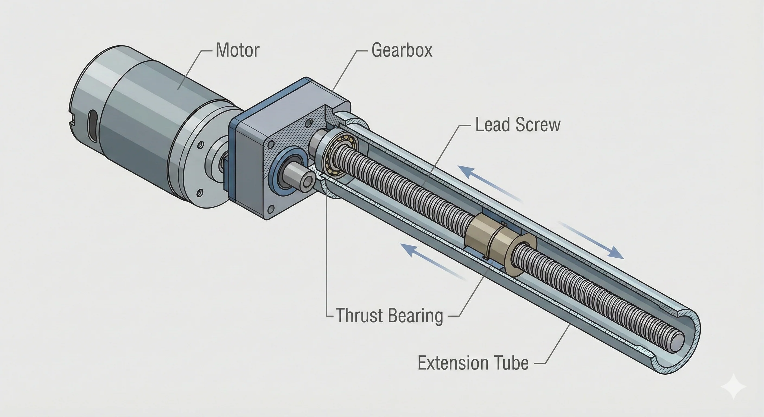
Actuator Structure
Motor · Gearbox · Lead Screw · Thrust Bearing · Extension Tube
Motor | Gearbox | Lead Screw | Thrust Bearing | Extension Tube
Converts electrical energy to rotational motion | Reduces speed, increases torque | Converts rotation to linear motion | Absorbs axial loads during extension | Translates along axis as output stroke

Slide 22
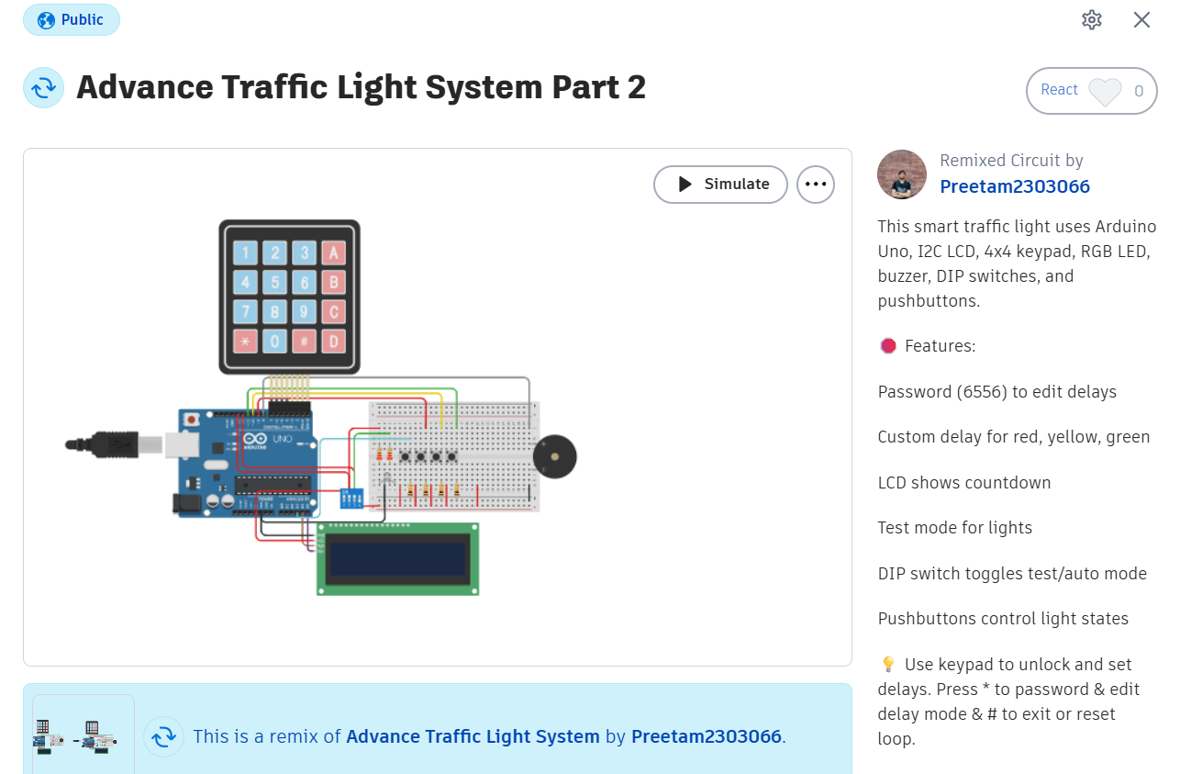
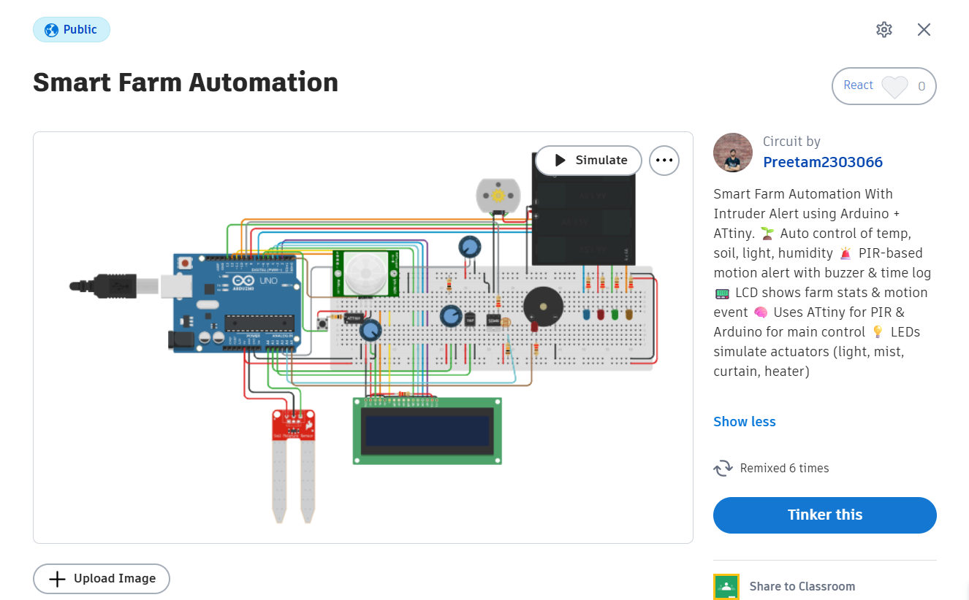
Real-Life System Example
Two integrated projects demonstrating microcontrollers, sensors, actuators,
user input, control logic, data logging, and real-world problem solving.
🚦 Advance Traffic Light System
🌾 Smart Farm Automation

Slide 23
Advance Traffic Light System and Smart Farm Automation
Project Summaries & Repository Links
🚦 Advance Traffic Light System
🌾 Smart Farm Automation
Arduino Uno as central controller
4×4 Keypad for password-protected config
16×2 LCD for status display
RGB LED array for traffic signals
Buzzer for pedestrian alert tones
DIP switch for manual test mode
Automatic traffic cycle with timers
Password-protected configuration mode
Arduino Uno as central controller
Soil moisture sensor for irrigation control
DHT11 for temperature & humidity monitoring
LDR for light intensity sensing
PIR sensor for security & intruder detection
Speaker for audio alerts on events
LCD display for live readings
Data logging and recovery features
GitHub Repository:
View on GitHub →
GitHub Repository:
View on GitHub →

Slide 24
Advance Traffic Light System
TinkerCAD circuit simulation screenshot
Technical Challenges & Future Scope
A notable challenge in this advanced loop is handling blocking delays. Currently, exiting the automated cycle requires specific timing to interrupt the loop. Future iterations of this system could implement hardware interrupts or non-blocking timers (millis()) to allow instantaneous mode switching. Additionally, writing the administrator's custom delays to EEPROM would ensure the settings survive power cycles, and integrating an RTC (Real-Time Clock) could allow the system to switch to "night mode" automatically.
Components: Arduino Uno · 4×4 Keypad · 16×2 LCD · RGB LED · Buzzer · DIP Switch
View Repository →

Slide 25
Advance Traffic Light System
TinkerCAD circuit simulation screenshot
Technical Challenges & Future Scope
Developing a dual-purpose system on a constrained microcontroller presented several technical hurdles. A primary challenge was managing timing conflicts; the system had to balance standard farming automation delays with the need for instantaneous, interrupt-like responsiveness for intruder logging. Furthermore, managing numerous analog and digital sensors alongside multiple actuators quickly exhausted the available I/O pins on the Arduino Uno, and continuous loop updates caused noticeable LCD flicker.
Components: Arduino Uno · Soil Moisture · DHT11 · LDR · PIR Sensor · Speaker · LCD Display
View Repository →

Slide 26
References
All source links — click to open
IBM — IoT
GFG — Actuators IoT
https://www.ibm.com/think/topics/internet-of-things
https://www.geeksforgeeks.org/machine-learning/actuators-in-iot/
Spiceworks — Embedded
Robotics BD
https://www.spiceworks.com/it-hardware/what-is-refs-2/
https://store.roboticsbd.com/
GeeksForGeeks — Robotics
https://www.geeksforgeeks.org/software-engineering/robotics-introduction/
TechShop BD
https://techshopbd.com/
Goodwin.edu — CNC
https://www.goodwin.edu/enews/what-is-cnc/
BDTronics
GCodeTutor — G-codes
https://www.bdtronics.com/
https://gcodetutor.com/cnc-machine-training/cnc-g-codes.html
Robotech BD
HowToMechatronics — G-code
https://www.robotechbd.com/
https://howtomechatronics.com/tutorials/g-code-explained-list-of-most-important-g-code-commands/
GitHub — All Projects
IBM — Microcontroller
https://github.com/Preetam21022/TinkerCAD-Projects/tree/main
https://www.ibm.com/think/topics/microcontroller
GitHub — Traffic Light
GFG — MCU Apps
https://github.com/preetam21022/tinkercad-projects/tree/main/Advance%20Traffic%20Light%20System
https://www.geeksforgeeks.org/electronics-engineering/applications-of-microcontroller/
Monolithic Power — Sensors
GitHub — Smart Farm
https://www.monolithicpower.com/en/learning/mpscholar/sensors/intro-to-sensors/what-is-a-sensor
https://github.com/Preetam21022/TinkerCAD-Projects/tree/main/Smart%20Farm%20Automation

Slide 27
Thank You!
WEEK
01
IoT · Embedded Systems · Robotics
CNC · Microcontrollers · Sensors & Actuators
Presented by: Preetam | Submission: 26 May 2026

